Slide 1

BRAINWARE UNIVERSITY • MACHINE LEARNING PBL
PERSONALIZED LEARNING
RECOMMENDATION SYSTEM
A Python-based content recommendation application
PRESENTED BY
Anish Dey
BCA (Hons) • GR-1 • BCA57205
Department of Computational Sciences | Brainware University
01

Slide 2
01 / OVERVIEW
Introduction
A small Python application that recommends learning topics using a student profile.
THE IDEA
THE OUTPUT
THE PLATFORM
Use a learner’s subject, previous marks, preferred format and completed topics to rank suitable learning topics.
Display up to three recommended topics, ranked by a combined similarity and rule-based score.
Runs locally in the Python terminal. Data is read from CSV files; no web server or database is required.
The project demonstrates data preparation, exploratory analysis, text vectorization, similarity calculation, sorting, input validation and file handling.
02

Slide 3
02 / CONTEXT
Problem Statement
A fixed learning path may not reflect differences between individual learners.
• Students can differ in prior performance, preferred learning format and topic-completion history.
• A generic list of topics may not reflect a learner’s current needs.
• Learners may need help identifying what to study next within a subject.
• The project explores a simple, data-driven way to rank learning topics.
CORE QUESTION
How can a learner profile be compared with topic information to produce a short, relevant list of next learning topics?
03

Slide 4
03 / PROJECT DIRECTION
Objectives
What the project is designed to achieve.
01
Prepare data
02
Explore patterns
Load and clean the topic catalogue and student-history CSV files.
Use Pandas, NumPy and Matplotlib for basic exploratory data analysis.
03
Recommend topics
04
Validate behaviour
Compare learner-profile text with topic metadata using similarity.
Check inputs, handle edge cases and run functional tests.
04

Slide 5
04 / BOUNDARIES
Project Scope
The implementation is intentionally kept moderate and syllabus-oriented.
IN SCOPE
OUT OF SCOPE
• Terminal-based Python application\n• CSV-based topic catalogue and student history\n• Profile input and completed-topic filtering\n• Content-based ranking with rule adjustments\n• EDA dashboard and functional tests
• User accounts or authentication\n• Website, mobile app or cloud deployment\n• Live external course/API integration\n• Database server or chatbot\n• Claims of measured learning improvement
05

Slide 6
05 / BACKGROUND
Existing Approach & Project Rationale
A brief comparison to explain why a personalized ranking approach is useful.
FIXED RESOURCE LIST
MANUAL SELECTION
PROPOSED APPROACH
Same topics are shown to every learner, regardless of profile or completed work.
Learners choose topics themselves; this can be difficult when the catalogue is large.
Rank catalogue topics using profile-to-topic text similarity plus transparent rule adjustments.
06

Slide 7
06 / DATA
Dataset & Inputs
The supplied project files contain a topic catalogue and historical student records.
25
topic records
50
student-history records
8
topic catalogue fields
TOPIC CATALOGUE
STUDENT PROFILE INPUT
Subject, topic name, difficulty, preferred format, estimated hours, prerequisite and tags.
Name, subject, previous marks, weekly study hours, preferred format and completed topics.
07

Slide 8
07 / METHODOLOGY
Data Preparation & Recommendation Method
From CSV files and learner input to a ranked recommendation list.
1
2
3
4
5
Load
Clean
Build text
Compare
Adjust & rank
Read CSV files using Pandas.
Normalize text and convert numeric fields.
Combine topic metadata into a text representation.
Use CountVectorizer and cosine similarity.
Apply difficulty, format and prerequisite rules; sort scores.
08

Slide 9
08 / RECOMMENDATION LOGIC
How the Ranking Works
The score combines text similarity with simple, interpretable rule adjustments.
BASE SIMILARITY
RULE ADJUSTMENTS
CountVectorizer converts text to count vectors; cosine similarity compares the profile query with topic metadata.
Difficulty match: +0.15 | Format match: +0.10 | Uncompleted prerequisite: −0.20
Final ranking score = cosine similarity + applicable rule adjustments
09

Slide 10
09 / SYSTEM DESIGN
Internal Structure & Architecture
The application is organized into small Python modules.
main.py
data_processor.py
student_model.py
recommender_engine.py
eda_visualizer.py
Terminal interface\ncollects learner input
Loads and cleans\nCSV datasets
Builds learner\nprofile/query
Similarity, rule\nadjustments, ranking
Creates EDA\nvisualizations
INPUT FILES
OUTPUT FILES
data/topics_catalog.csv • data/student_history.csv
Terminal recommendations • data/user_logs.csv • plots/eda_dashboard.png
10

Slide 11
10 / IMPLEMENTATION
Application Workflow
What happens when a student runs the project.
• Run the program with: python main.py
• Enter learner details and select a subject.
• Provide previous marks, weekly study hours and preferred format.
• Identify topics already completed.
• The system filters completed topics, ranks the remaining catalogue and displays up to three recommendations.
• The interaction is recorded in the user log.
TERMINAL RUN COMMAND
$ python main.py
Input profile\n ↓\nProfile + topic comparison\n ↓\nRanked recommendations
11

Slide 12
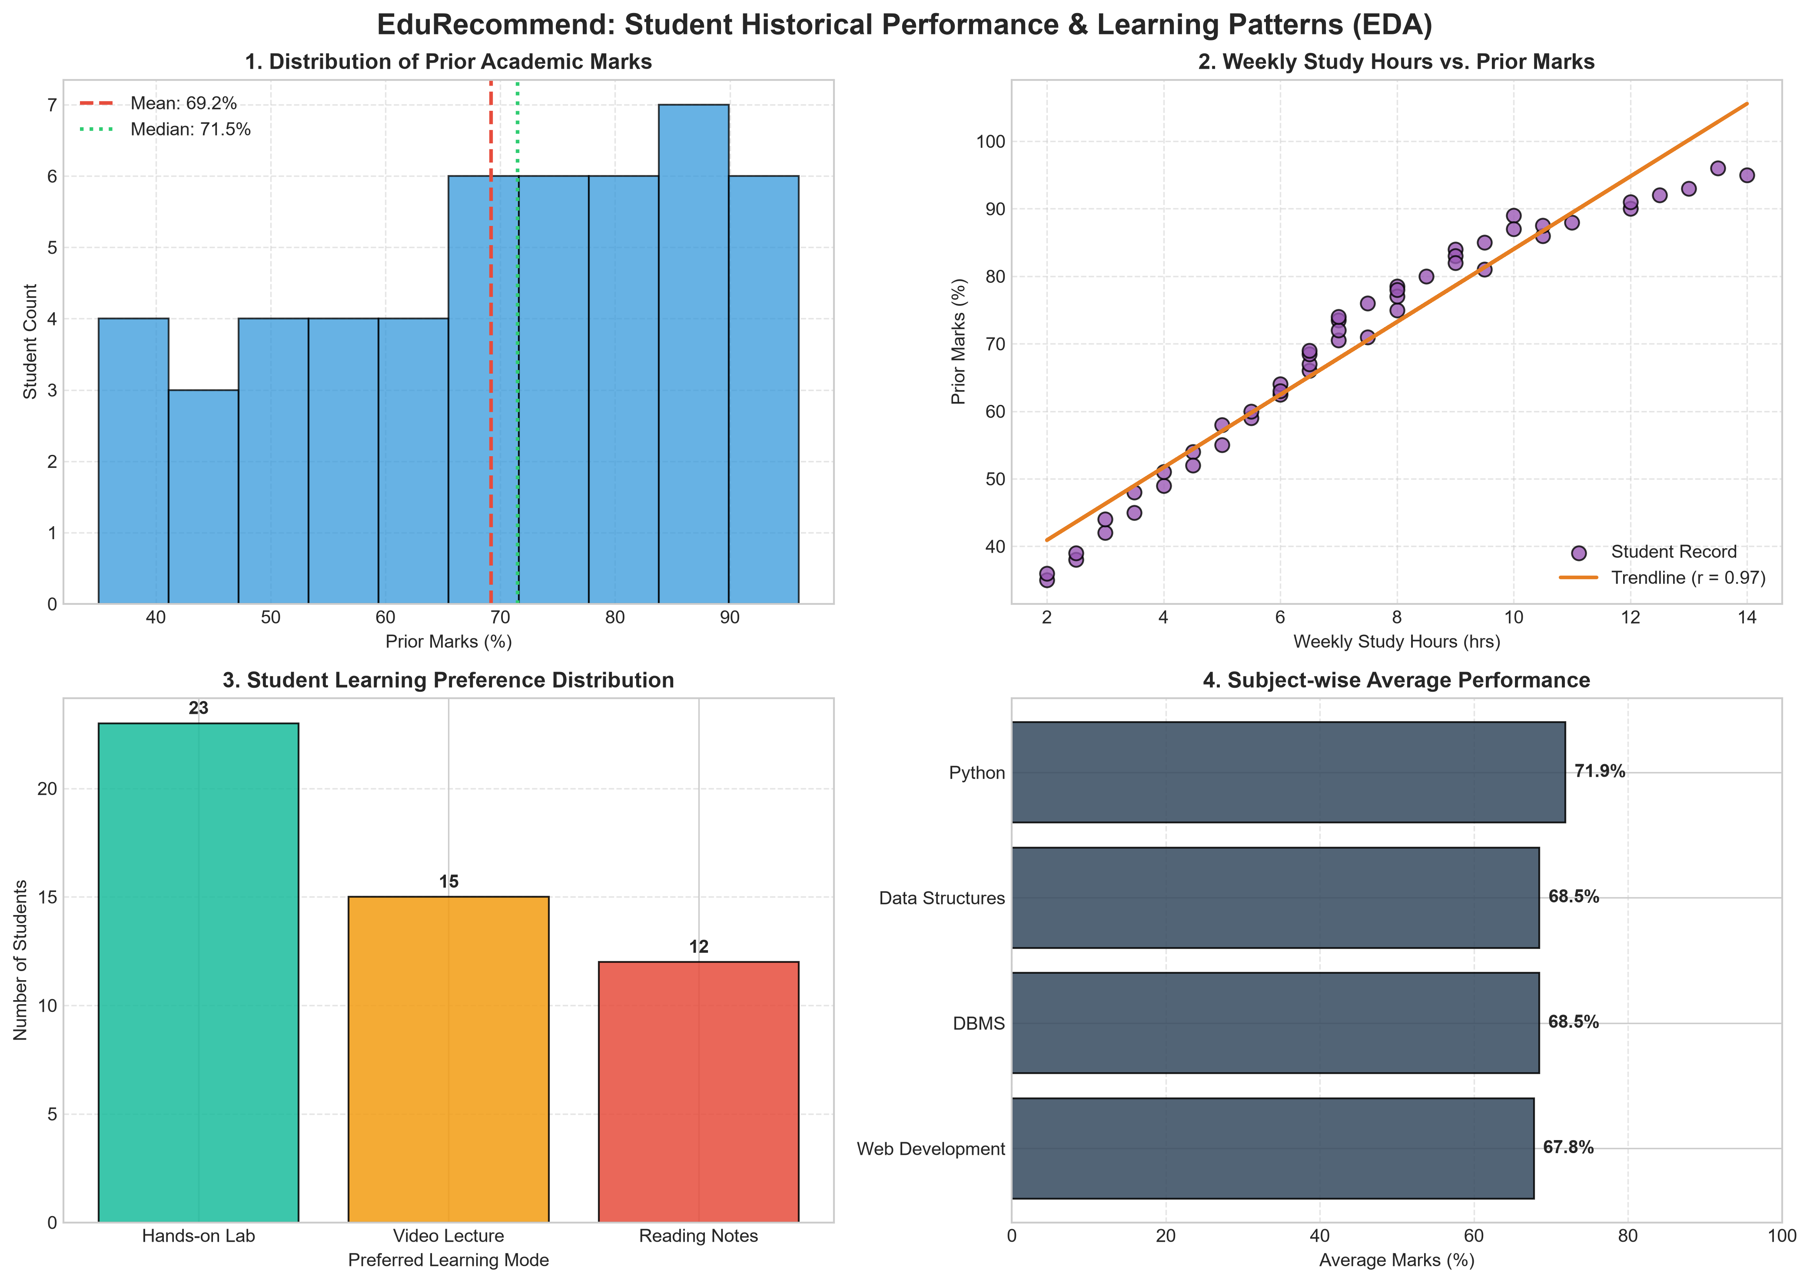
11 / ANALYSIS
Exploratory Data Analysis
The dashboard summarizes patterns in the 50-row student-history dataset.
MARKS
Distribution of prior marks.
STUDY TIME
Weekly study hours compared with marks.
PREFERENCES
Format and subject-level summaries.
12

Slide 13
12 / VERIFICATION
Testing & Results
Seven functional and edge-case tests passed in the supplied test suite.
TEST CASE
EXPECTED / OBSERVED BEHAVIOUR
Valid profile
Top recommendations returned
Marks above 100
Invalid input rejected
Negative study hours
Invalid input rejected
Empty name
Invalid input rejected
Unsupported subject
Invalid subject rejected
All topics completed
No further recommendations
Zero-vector similarity
Returns 0.0 safely
13

Slide 14
13 / OUTCOME
Conclusion, Limitations & Future Scope
A working prototype demonstrates a complete recommendation workflow.
CONCLUSION
LIMITATIONS
FUTURE SCOPE
The project reads learner and topic data, compares text features and returns a ranked shortlist.
Weekly study hours are collected but not used in scoring. No labelled relevance data is available to calculate recommendation accuracy.
Evaluate with learner feedback, improve prerequisite handling and include study behaviour in a validated scoring method.
14

Slide 15
14 / SOURCES
References
Documentation and project materials consulted.
• Python Documentation — https://docs.python.org/3/
• Pandas Documentation — https://pandas.pydata.org/docs/
• NumPy Documentation — https://numpy.org/doc/
• Matplotlib Documentation — https://matplotlib.org/stable/
• Scikit-learn: CountVectorizer — https://scikit-learn.org/stable/modules/generated/sklearn.feature_extraction.text.CountVectorizer.html
• Scikit-learn: cosine similarity — https://scikit-learn.org/stable/modules/generated/sklearn.metrics.pairwise.cosine_similarity.html
• Machine Learning PBL project brief and GR-1 project description supplied by the course instructor.
• EduRecommend project source code, CSV datasets and README supplied for this project.
15

