Slide 1


HERO VIRED
RETENTION ANALYSIS

Slide 2
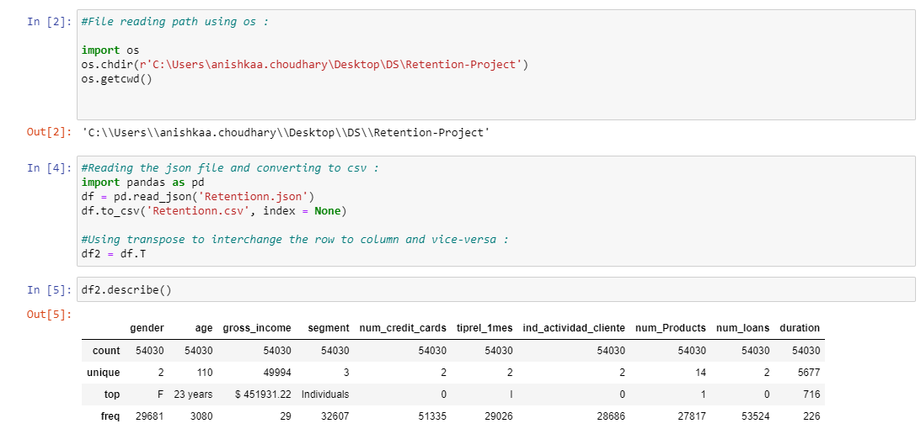
Task 1. Data Quality Check
Question 2 : Convert the given json data to a csv file :
Answer : Given Below
Question 1 : Do you have all the relevant fields in the raw data file given to you? :
Answer : Yes

Slide 3
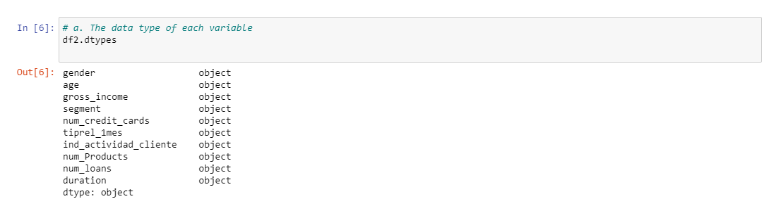
Create a data quality report :
A) The data type of each variable :

Slide 4
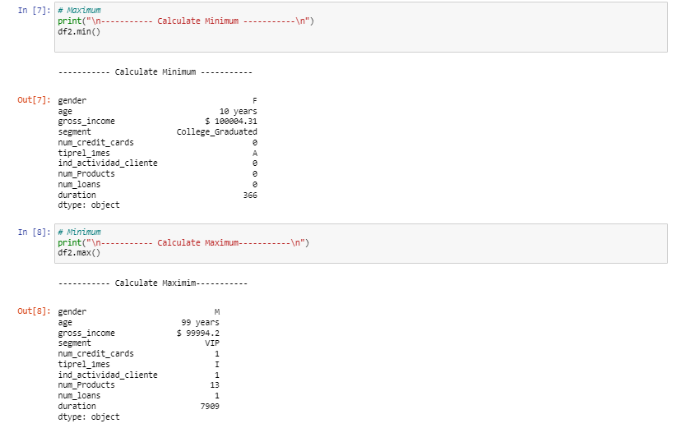
B) If a variable is numeric in nature, then, the numeric summary (Min, Max, Mean,25th percentile, Median, 75th percentile, 90th percentile, 95th percentile, number of zeros and number of unique values, number of missing values, percentage of missing values) must be computed :

Slide 5
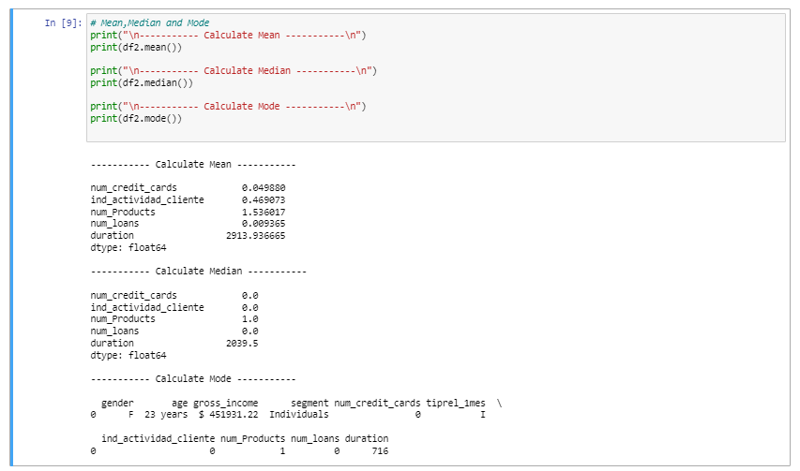
Mean, Median and Mode :

Slide 6
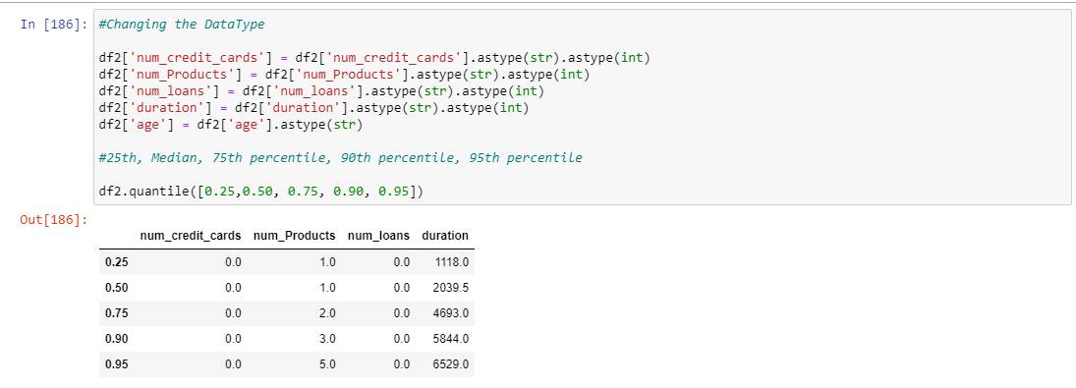
25th percentile, Median, 75th percentile, 90th percentile, 95th percentile

Slide 7
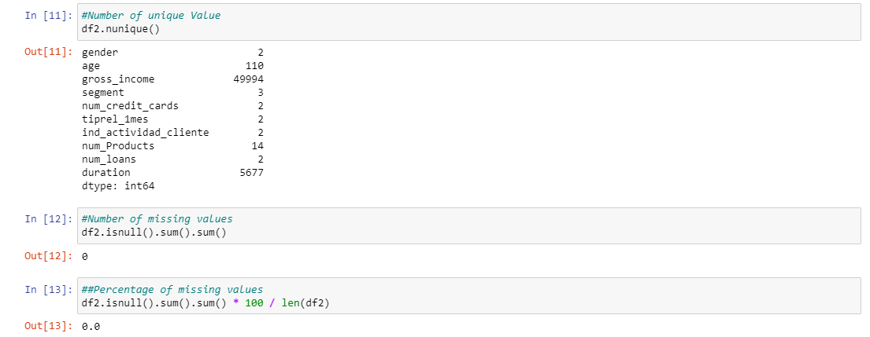
Number of unique values
Number of missing values
Percentage of missing values

Slide 8
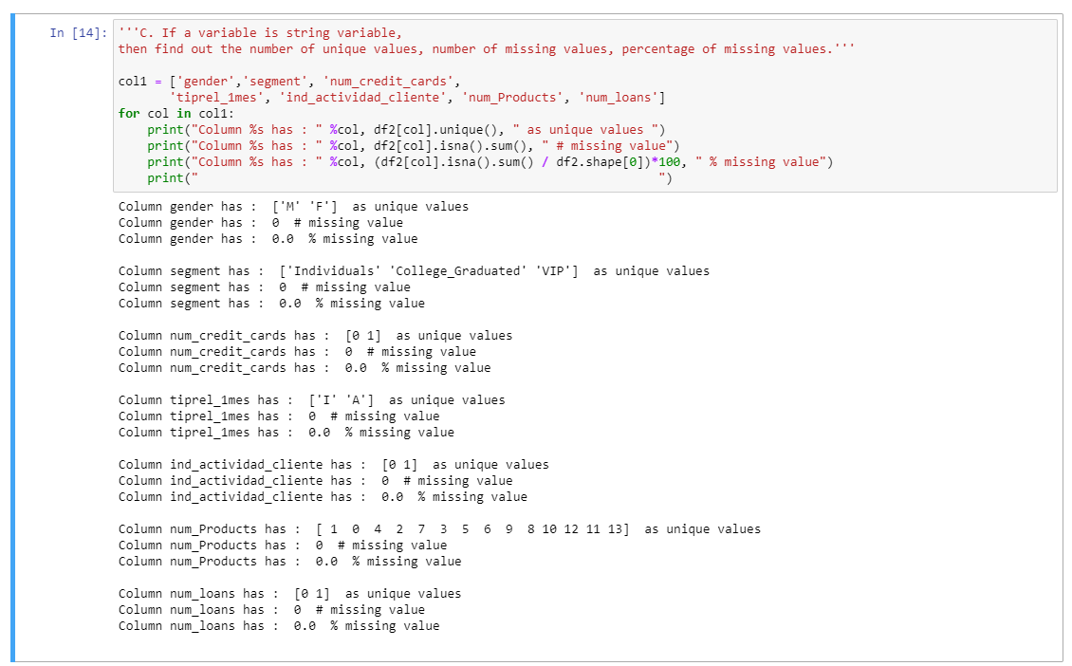
C) If a variable is string variable, then find out the number of unique values, number of missing values, percentage of missing values.

Slide 9
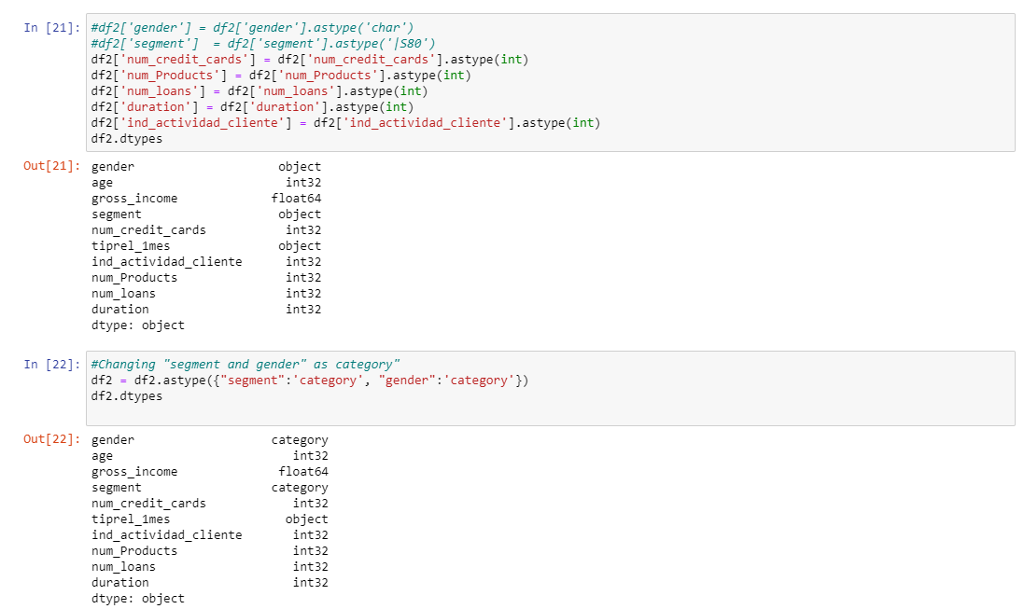
After the data quality report is created you need to :
A) Check if there is any variable whose data-type needs to be changed :

Slide 10
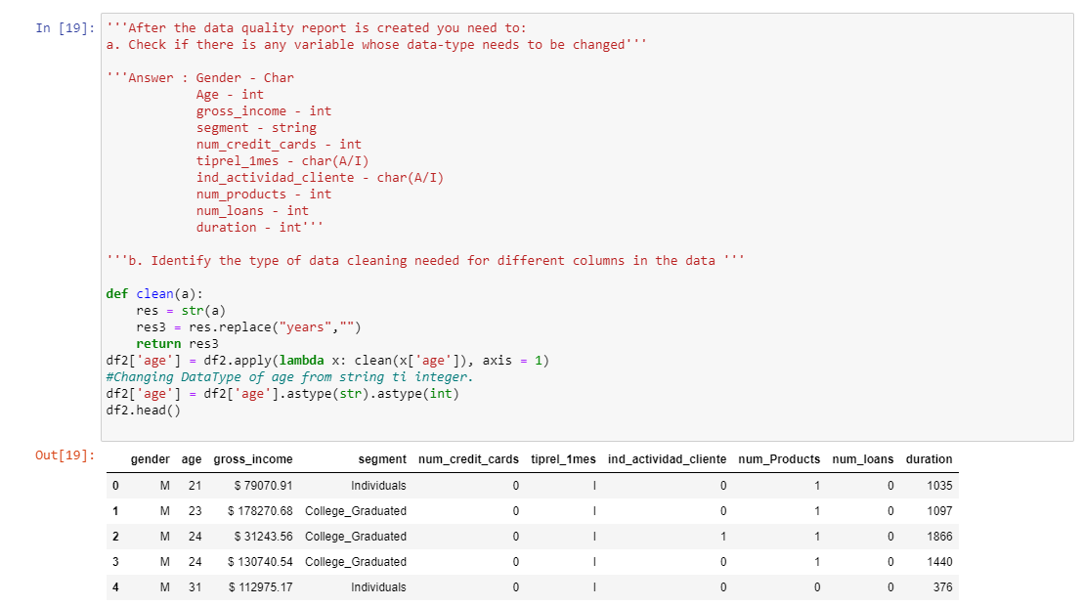
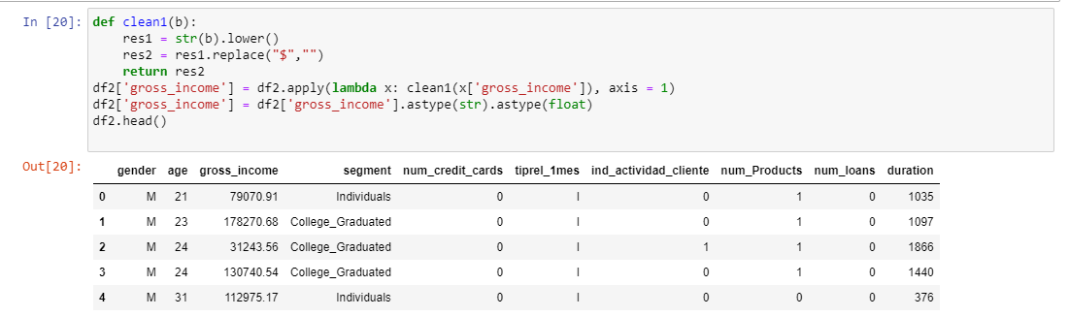
B) Identify the type of data cleaning needed for different columns in the data :
‘Years’ should be removed from ‘Age’ :
‘$’ should be removed from ‘gross_income’ :

Slide 11
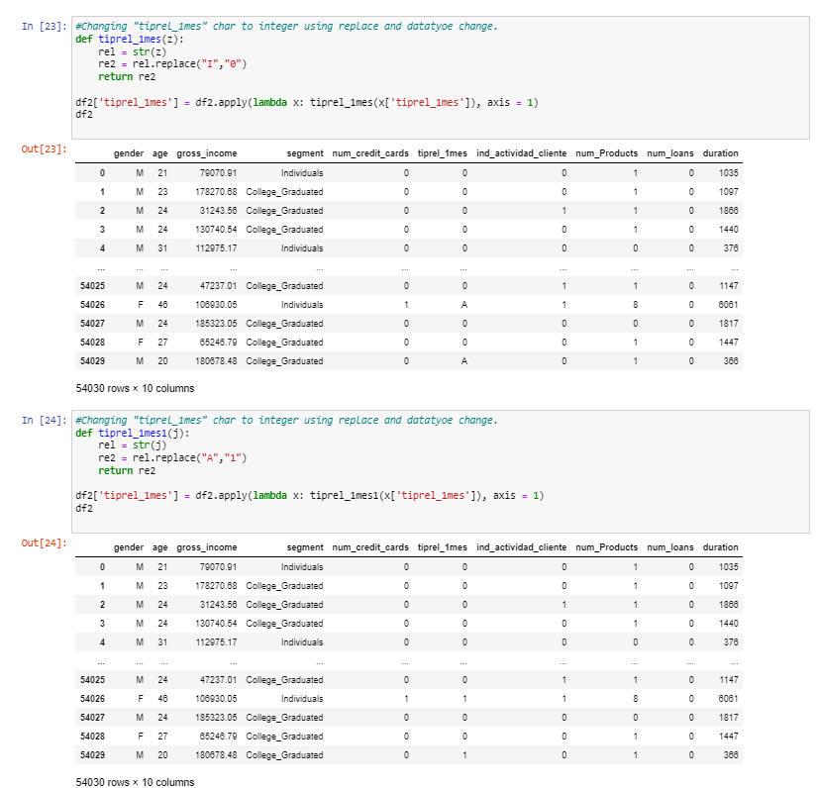
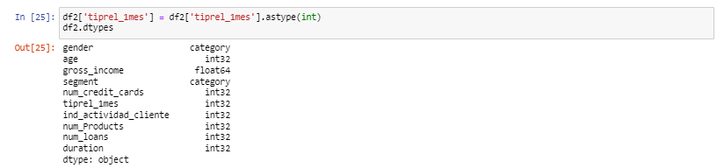
“Tiprel_1mes” : Replacing I and A to 0 and 1 :

Slide 12
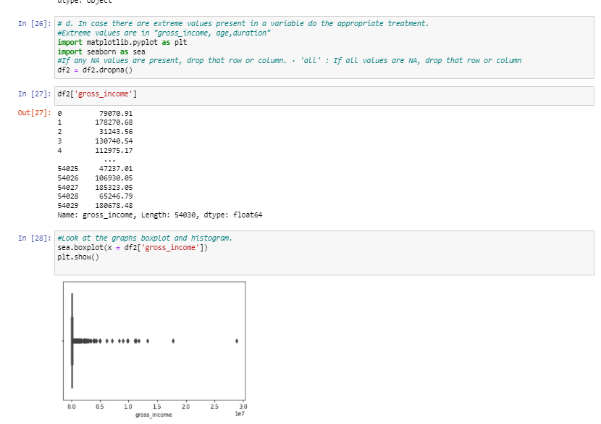
C) Handle missing data appropriately :
Answer : There are no missing data.
D) In case there are extreme values present in a variable do the appropriate treatment :

Slide 13
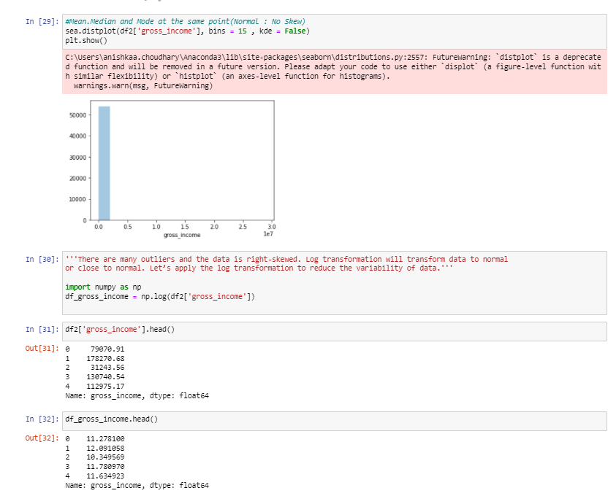
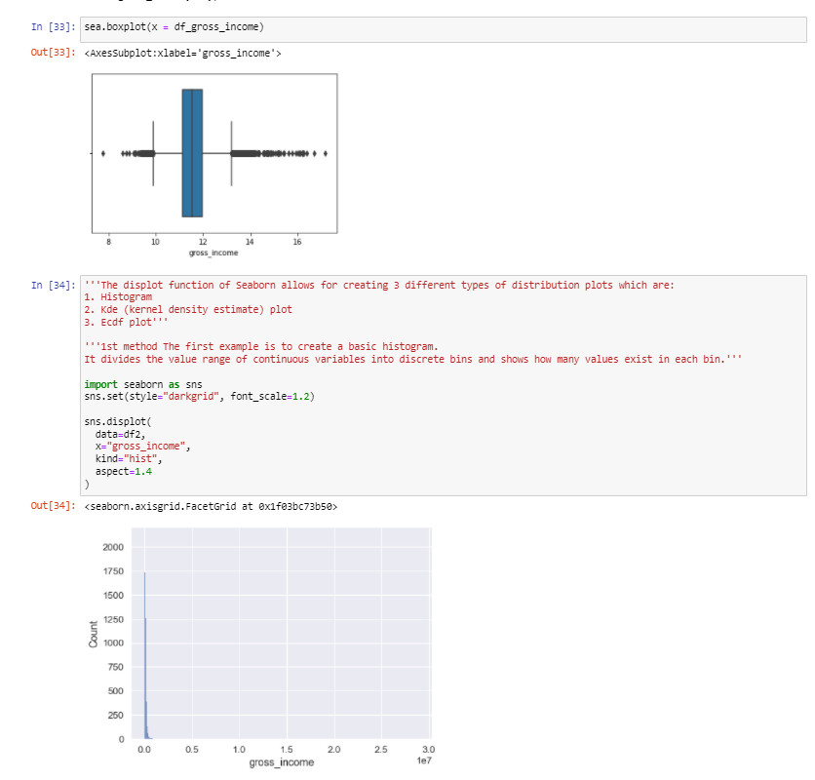
Using Distribution plot :

Slide 14
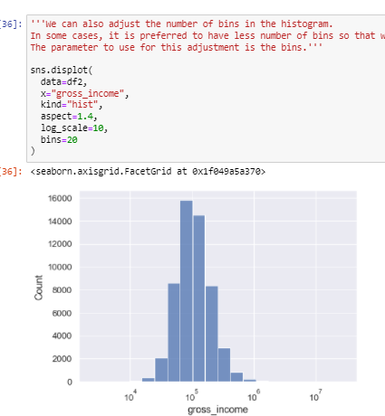
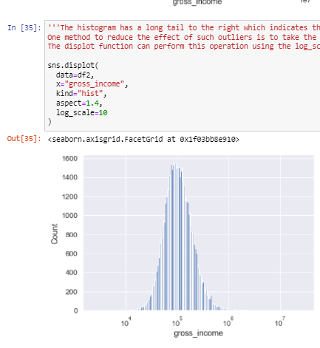

Slide 15
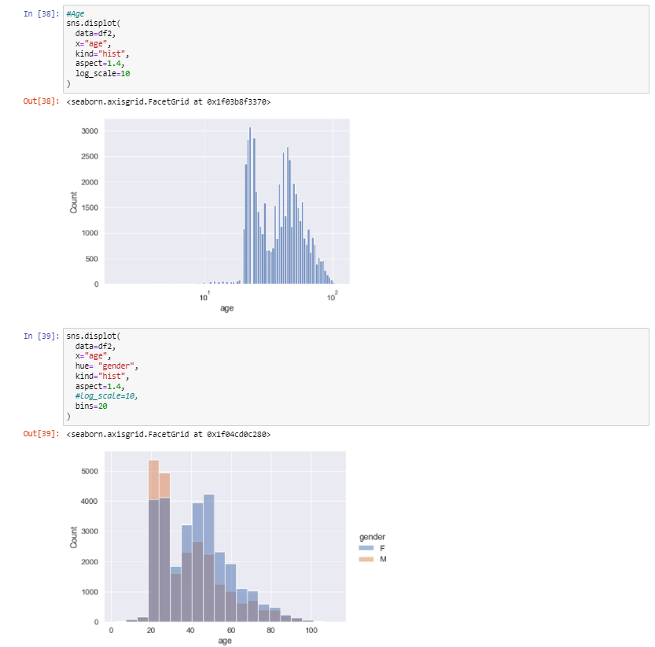
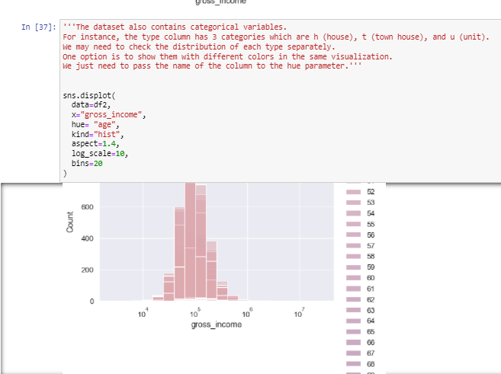

Slide 16
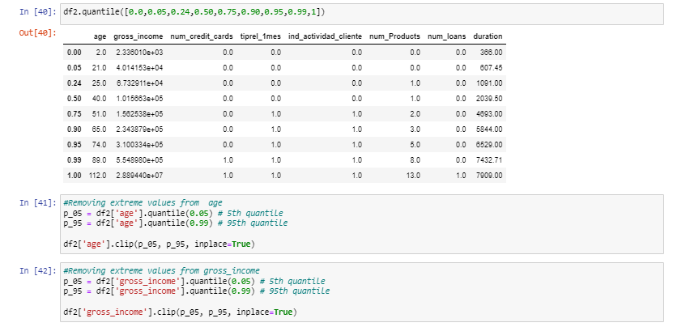
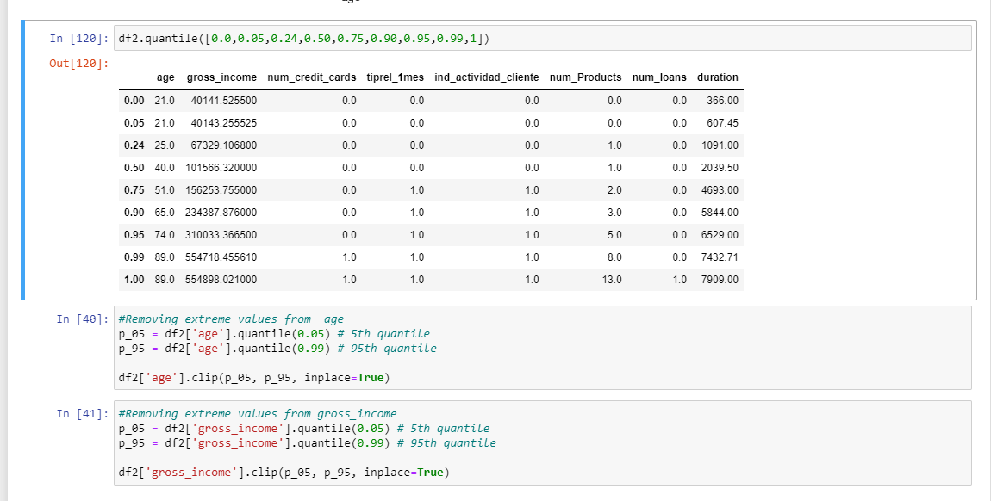
Before any Changes :
Removing extreme values from ‘age’ and ‘gross_income’ :
After replacing :

Slide 17
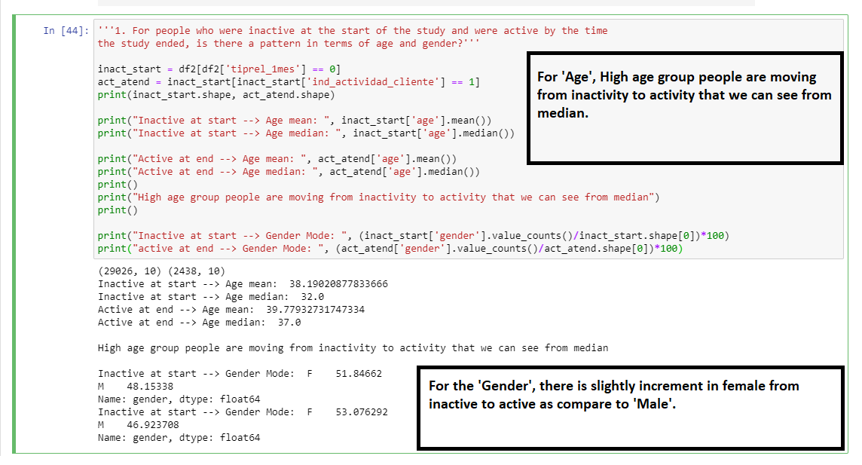
TASK 2. Data Exploration and business hypothesis testing
1. For people who were inactive at the start of the study and were active by the time the study ended, is there a pattern in terms of age and gender ?

Slide 18
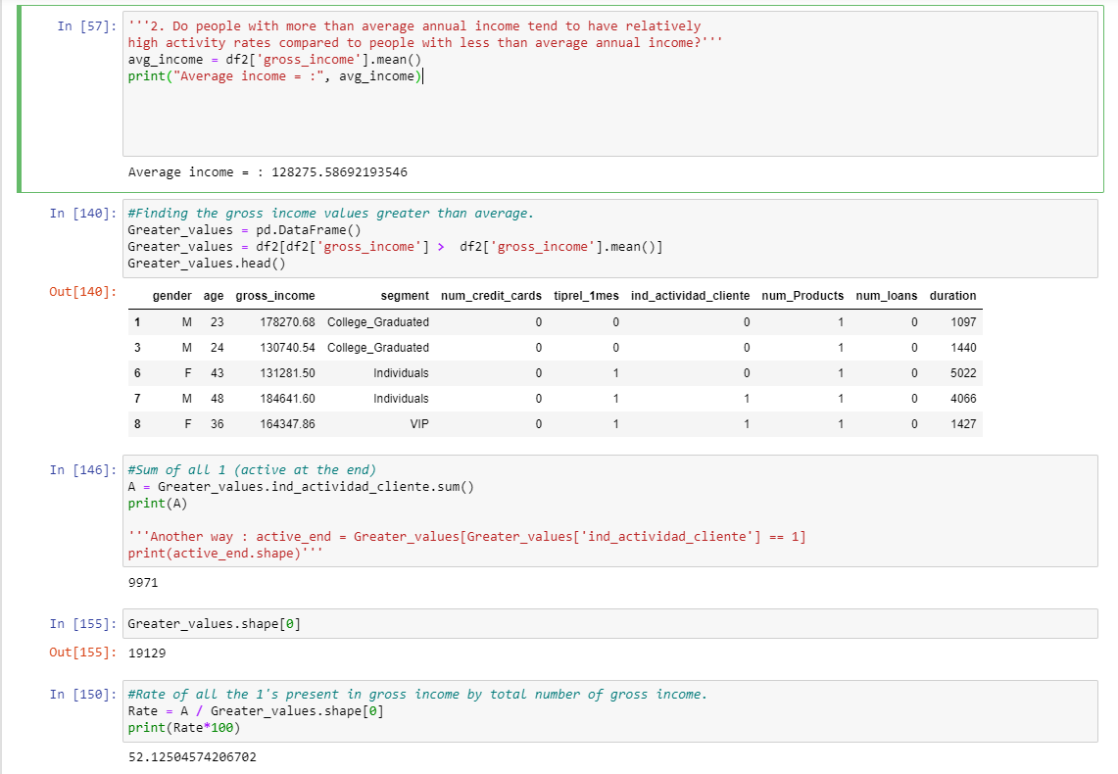
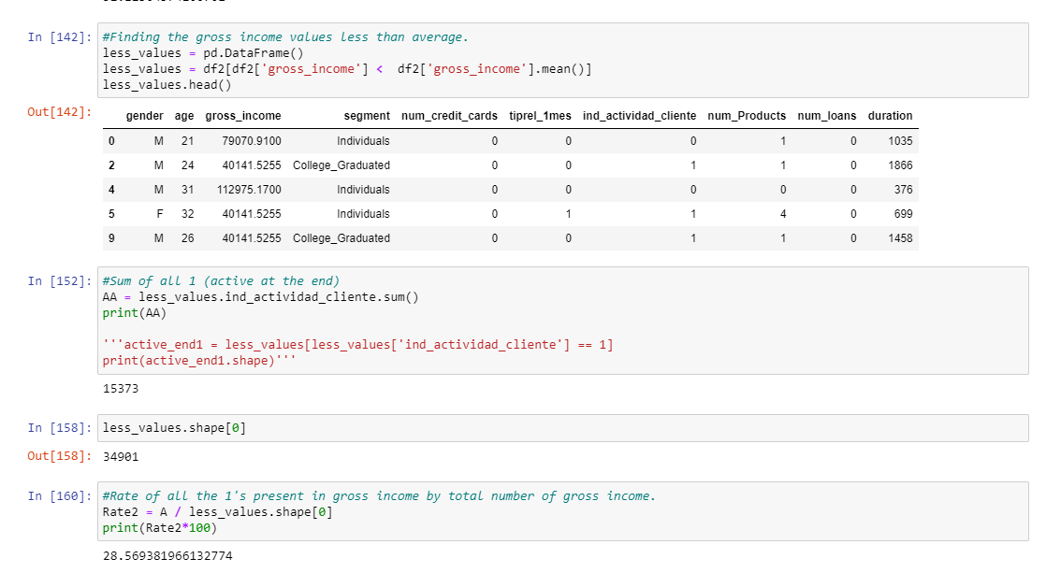

2. Do people with more than average annual income tend to have relatively high activity rates compared to people with less than average annual income ?
Answer : Yes

Slide 19
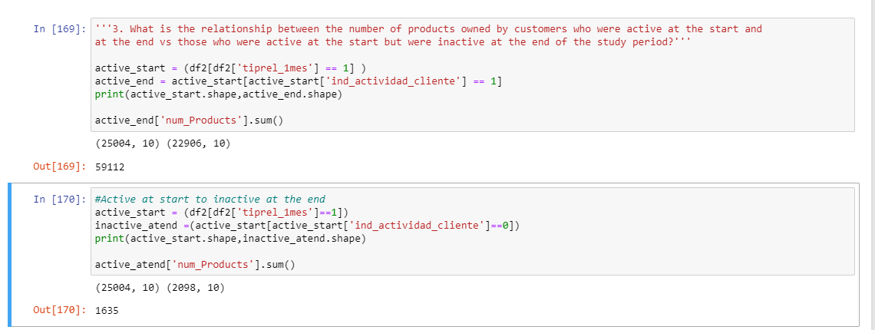
3. What is the relationship between the number of products owned by customers who were active at the start and at the end vs those who were active at the start but were inactive at the end of the study period?
Answer : Number of ‘Products’ were more when customers were active at the start till end as compared to customer who were active at the start but were inactive at the end.

Slide 20
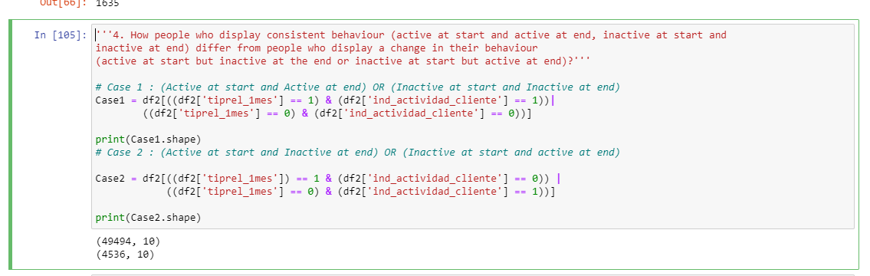
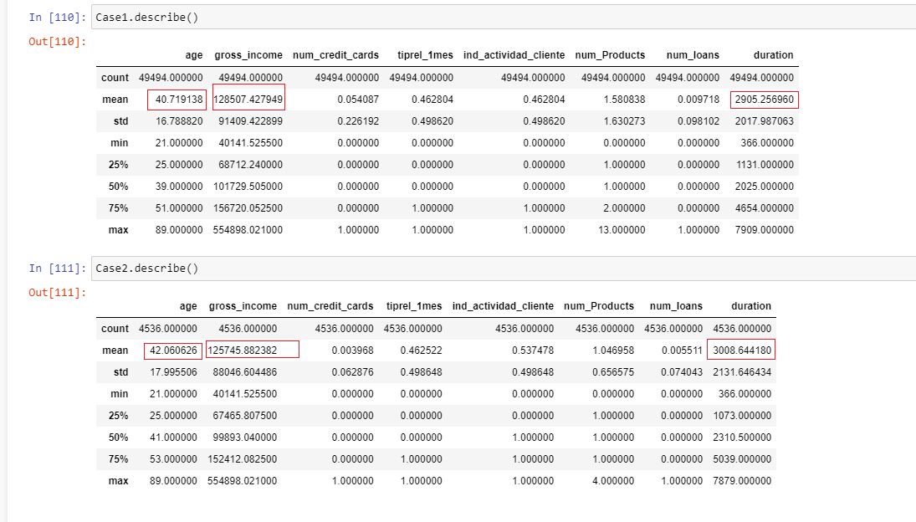
4. How people who display consistent behaviour (active at start and active at end, inactive at start and inactive at end) differ from people who display a change in their behavior (active at start but inactive at the end or inactive at start but active at end)?
Answer : In the Case 1, “Age” of the people are less with more “Gross Income” and less “Duration” as compared to Case 2.

Slide 21
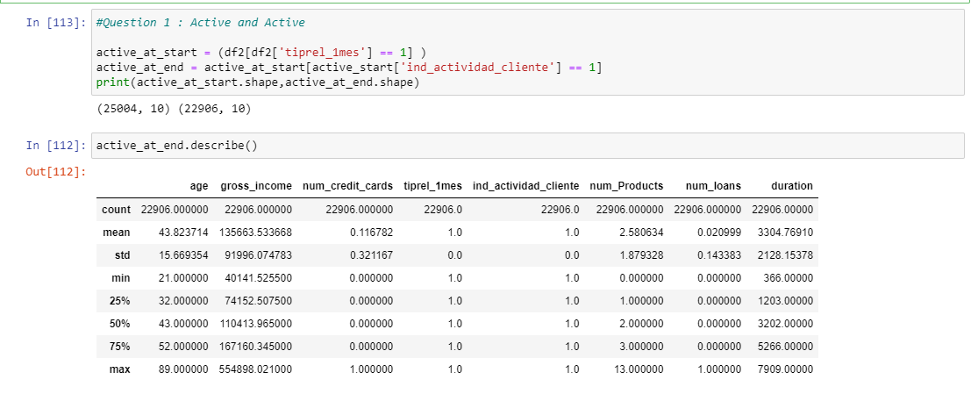
5. Generate elaborate profiles for the following four groups:
a) Active at the start but inactive at the end :

Slide 22
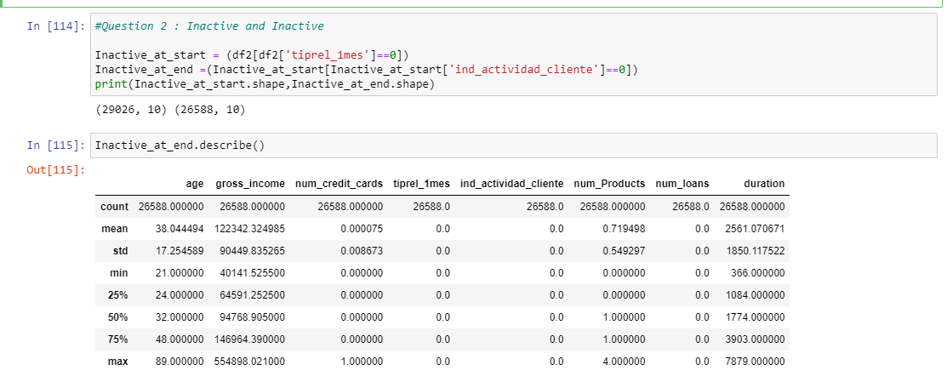
b) Active at the start and active by the end :

Slide 23
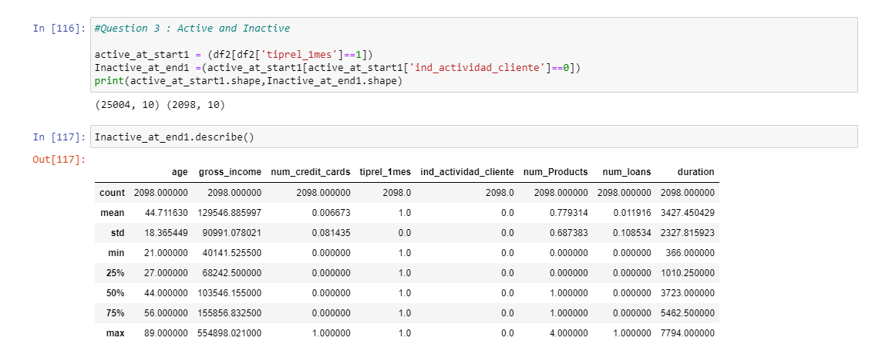
c) Inactive at the start but active at the end :

Slide 24
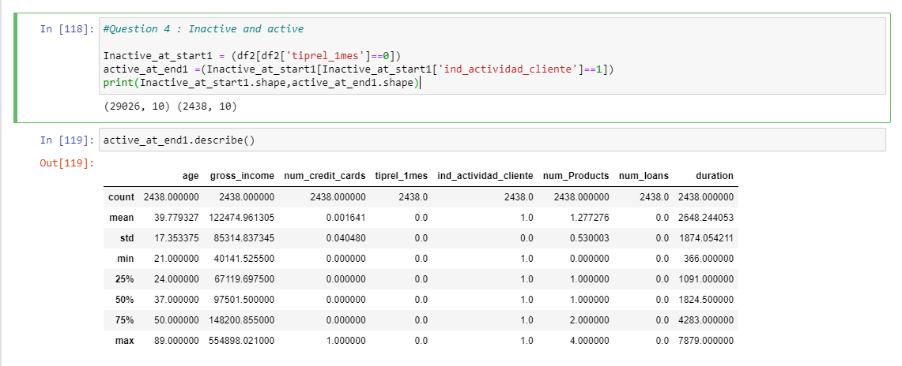
d) Inactive at the start and inactive at the end :

