Slide 1
Music Recommendation – Using Facial Recognition
ANISH KUMAR
SRN-R21EH065
CSE-AI&DS

Slide 2
ABSTRACT
The current music streaming landscape, while offering vast music libraries, often struggles to provide a truly personalized and engaging user experience. Existing recommendation algorithms primarily rely on factors like listening history and user preferences, which might not always capture the user's current emotional state or specific needs. This project aims to address this gap by developing a novel music recommendation system that incorporates the user's emotions, detected through facial recognition, into the recommendation process.
INTRODUCTION
Today, whenever a person wants to listen to music, he has unlimited access everywhere. Be it music apps like Spotify, wynk or looking up for a music video on YouTube or any other platform. Music is a big part of our life, as it seems to give life to even the lifeless things. Even though with the music platforms today we can choose any music that we want to , but this is not always the best scenario because we don’t always want to search the particular song that we want to listen to, sometimes we just want to hear a song depending on our mood. This is where we come with our idea.

Slide 3
OBJECTIVE
Develop a sentiment analysis model to accurately detect moods from user's facial expressions.
Create a comprehensive mapping between moods and musical genres.
Use the Spotify API to find a playlist based on the identified genre and user's language preference.
Design a user-friendly interface for interacting with the recommendation system.

Slide 4
LITERATURE SURVEY
Wafaa Mellouk, Wahida Handouzi : This paper discusses recent advances in facial emotion recognition (FER) using deep learning techniques from 2016 to 2019. It presents several popular databases used in FER research and reviews state-of-the-art methods that employ deep convolutional neural networks (CNNs) and recurrent neural networks (RNNs). Different deep learning architectures proposed by researchers for FER are described, including CNNs, CNNLSTM combinations, and 3D CNNs. The paper compares the performance of these methods on different databases and finds recognition rates generally over 90%. Pre-processing steps like data augmentation are discussed as important for training deep models
Amjad Rehman Khan : The paper provides a review of facial emotion recognition techniques using both traditional machine learning and deep learning methods. It discusses conventional ML approaches that use facial detection, feature extraction and classification. Deep learning approaches like CNNs that enable end-to-end learning are also covered. Popular facial emotion datasets and evaluation metrics used to compare different approaches are described. While deep learning methods provide high accuracy, they require more resources. Remaining challenges in the field are also discussed.
Francesca M.M. Citron, Marcus A. Gray , Hugo D. Critchley, Brendan S. Weekes, Evelyn C. Ferstl : This study investigated how emotional valence (positive versus negative) and arousal (intensity) dimensions interact during implicit processing of emotional words. Sixteen participants underwent fMRI scanning while performing a lexical decision task with words varying on valence (positive, negative) and arousal (high, low) dimensions. The results showed greater activation in the right insular cortex for words eliciting conflicting approach-withdrawal tendencies (positive high-arousal and negative low-arousal words) compared to words eliciting congruent tendencies. Increased activation was also found in the left extrastriata cortex for emotional versus neutral words, suggesting enhanced perceptual processing of emotionally salient stimuli.
Mimoun Ben Henia Wiem and Zied Lachiri : This paper presents research on recognizing human emotions using physiological signals collected from the MAHNOB-HCI database. Peripheral signals measured include ECG, GSR, skin temperature, and respiration volume. Emotional states are classified into two areas of the valence-arousal model. preprocessing, feature extraction and a support vector machine (SVM) classifier are used. Classifying individual signals and fused features are evaluated. The ECG and respiration volume were found to be most effective for emotion recognition. Classification accuracies were calculated and compared to other works, showing improvements over previous studies using this database.

Slide 5
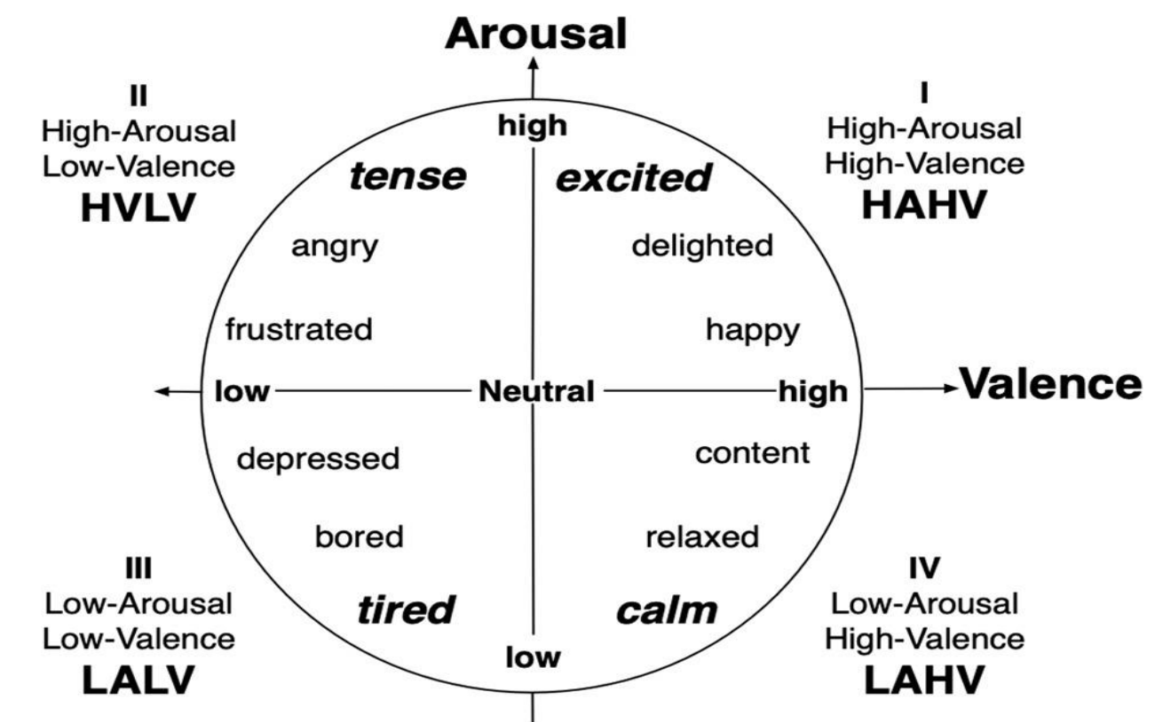
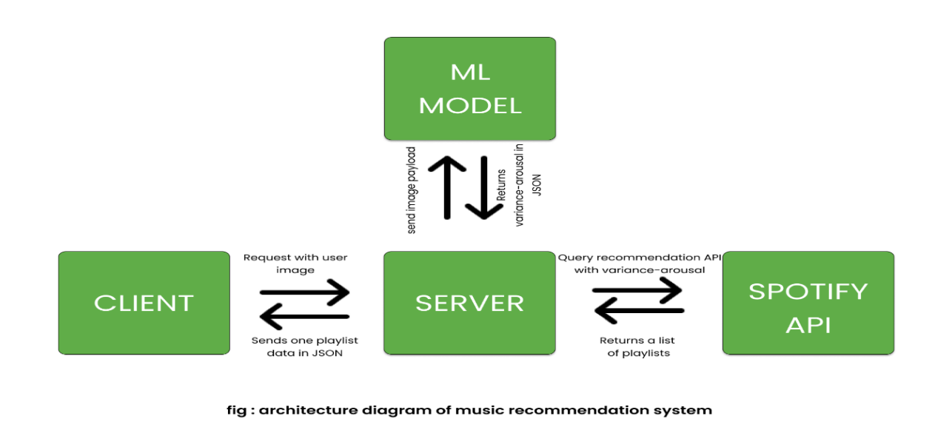
METHODOLOGY
.
Employs facial expression recognition with a CNN model (trained on FER-2013) to analyze user-uploaded images and detect moods.
Utilizes a MuSe dataset to map detected moods into a list of songs.
Uses the spotify and lastfm applications to refer the songs.
Features a user interface for video capture, mood detection, and accessing recommended songs.
Fig(1) : block diagram

Slide 6
PACKAGES USED
Frontend :
React (Version: ^18.2.0)
Tailwind CSS (Version: ^3.2.4)
Typescript (Version: ^4.9.4)
Backend :
Flask (Version: ^2.3.0)
TensorFlow (Version: ^2.12.0)
Keras (Version: ^2.13.1)
OpenCV (Version: ^4.6.0)

Slide 7
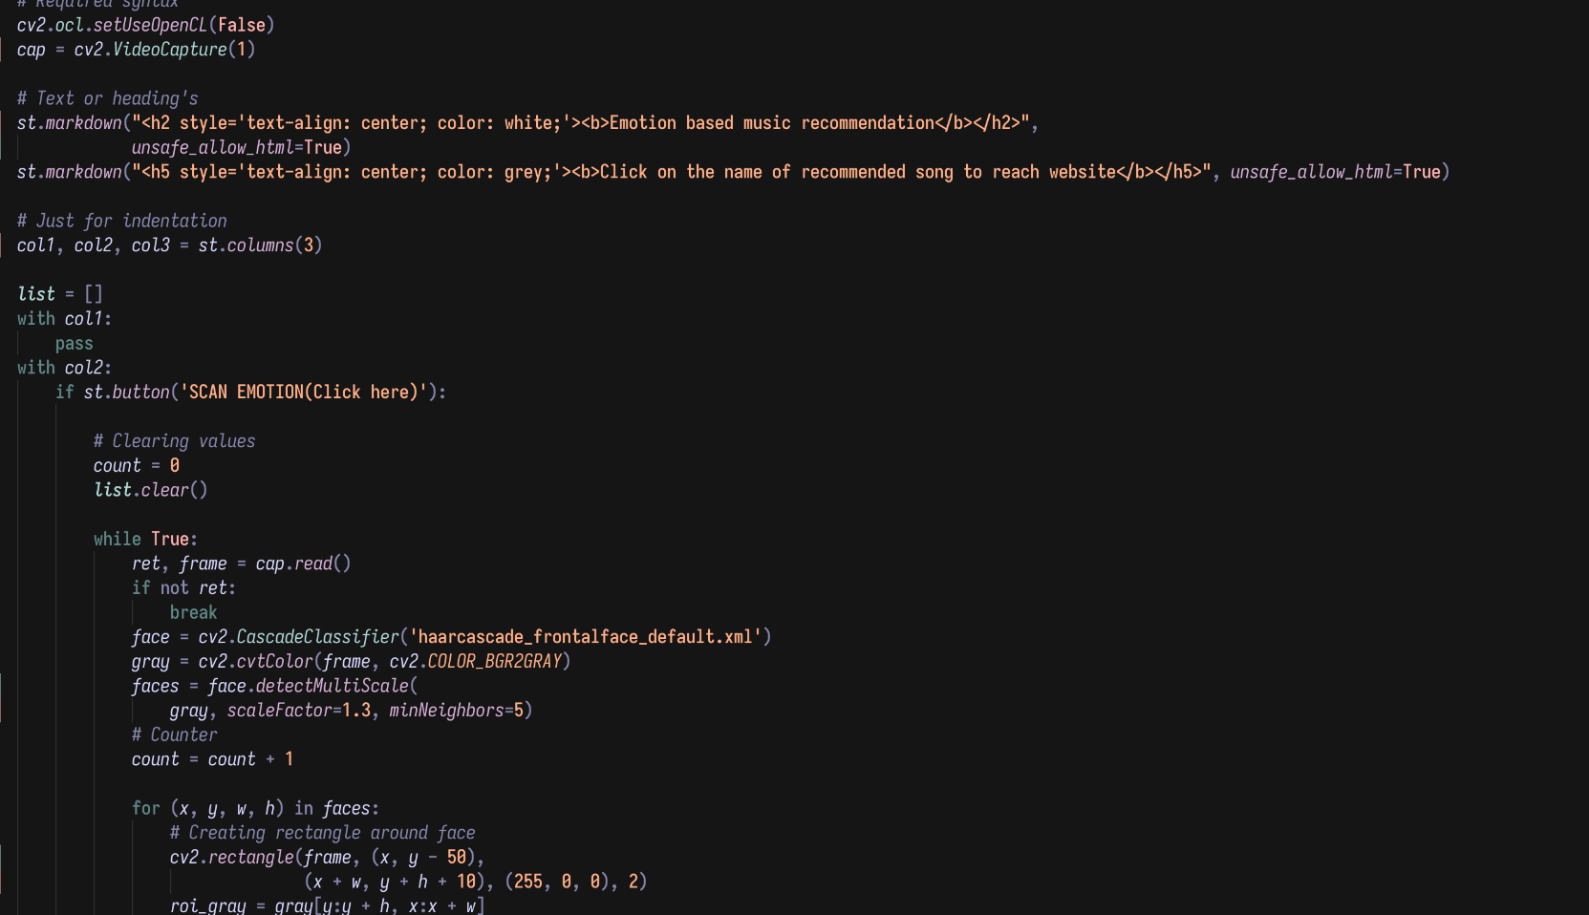
SAMPLE CODE

Slide 8
CONCLUSION
This project explores a mood-based music recommendation system utilizing facial expression analysis. By employing CNN, the system accurately detects moods from user images. A rule-based mapping was established to translate these moods into valence and arousal values, facilitating targeted music recommendations via the Spotify API. This approach demonstrates the potential for personalizing music discovery based on emotional state. Future directions include expanding the mood detection capabilities, refining the valence-arousal mapping through user studies, and exploring additional recommendation techniques to offer even greater diversity and personalization within the system.

Slide 9
REFERENCES
[1] Wafa Mellouk,Wahida Handouzi, “Facial emotion recoginition using deep learning: review and insights,”August-2020,Leuven,Belgium.
[2] Mimoun Ben Henia Wiem1 , Zied Lachiri, “Emotion assessing using valence-arousal evaluation based on peripheral physiological signals and support vector machine”,December-2016,Tunisia, Hammamet
[3] Francesca M.M. Citron , Marcus A. Gray , Hugo D. Critchley , Brendan S. Weekes , Evelyn C. Ferstl, “Emotional valence and arousal affect reading in an interactive way: Neuroimaging evidence for an approach-withdrawal framework,” June-2013, Queensland, Australia
[4] Amjad Rehman Khan, “Facial Emotion Recognition Using Conventional Machine Learning and Deep Learning Methods: Current Achievements, Analysis and Remaining Challenges,” CCIS Prince Sultan University, Riyadh 11586, Saudi Arabia.
[5] Jaladi Sam Joel, B. Ernest Thompson ,“ Emotion based Music Recommendation System using Deep Learning Model,” Proceedings of the International Conference on Inventive Computation Technologies (ICICT 2023) IEEE Xplore Part Number: CFP23F70-ART; ISBN: 979-8-3503-9849-6.
[6] Madhuri Athavle , Deepali Mudale , Upasana Shrivastav , Megha Gupta “Music Recommendation Based on Face Emotion Recognition,” Vol. 02, Iss. 02, S. No. 018, pp. 1-11 ISSN (Online): 2582- 7006

Slide 10
THANK YOU

