Slide 1

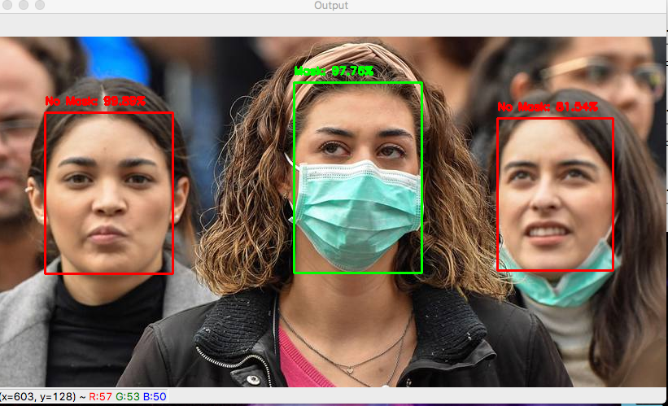
MASK DETECTION USING CNN
By :
ANISH KUMAR – R21EH065

Slide 2
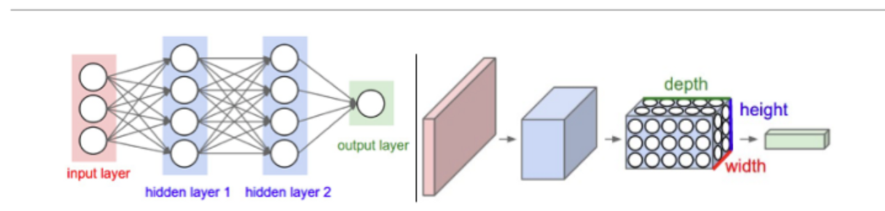
WHAT IS CNN ?

Slide 3
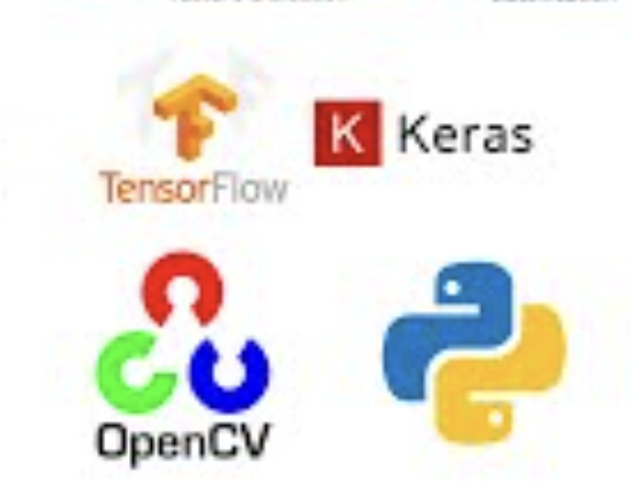
MODULES USED :
Python – Pandas , Numpy
Tensorflow
OpenCV
Keras
CNN (Convolutional Neural Network)
Imutils

Slide 4
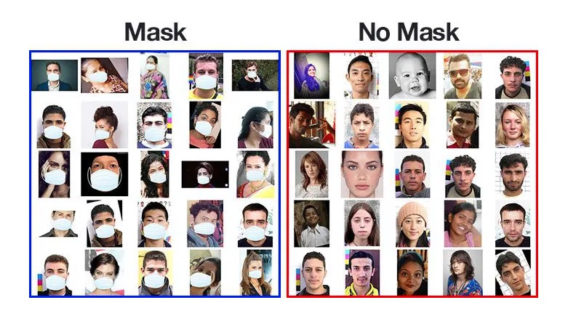
DATASET USED : Keras.models

Slide 5
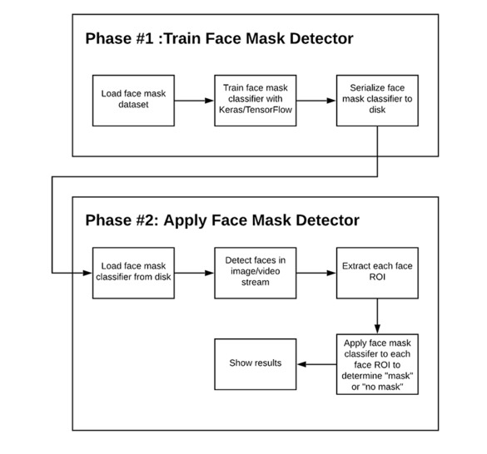
PROJECT ARCHITECTURE

Slide 6
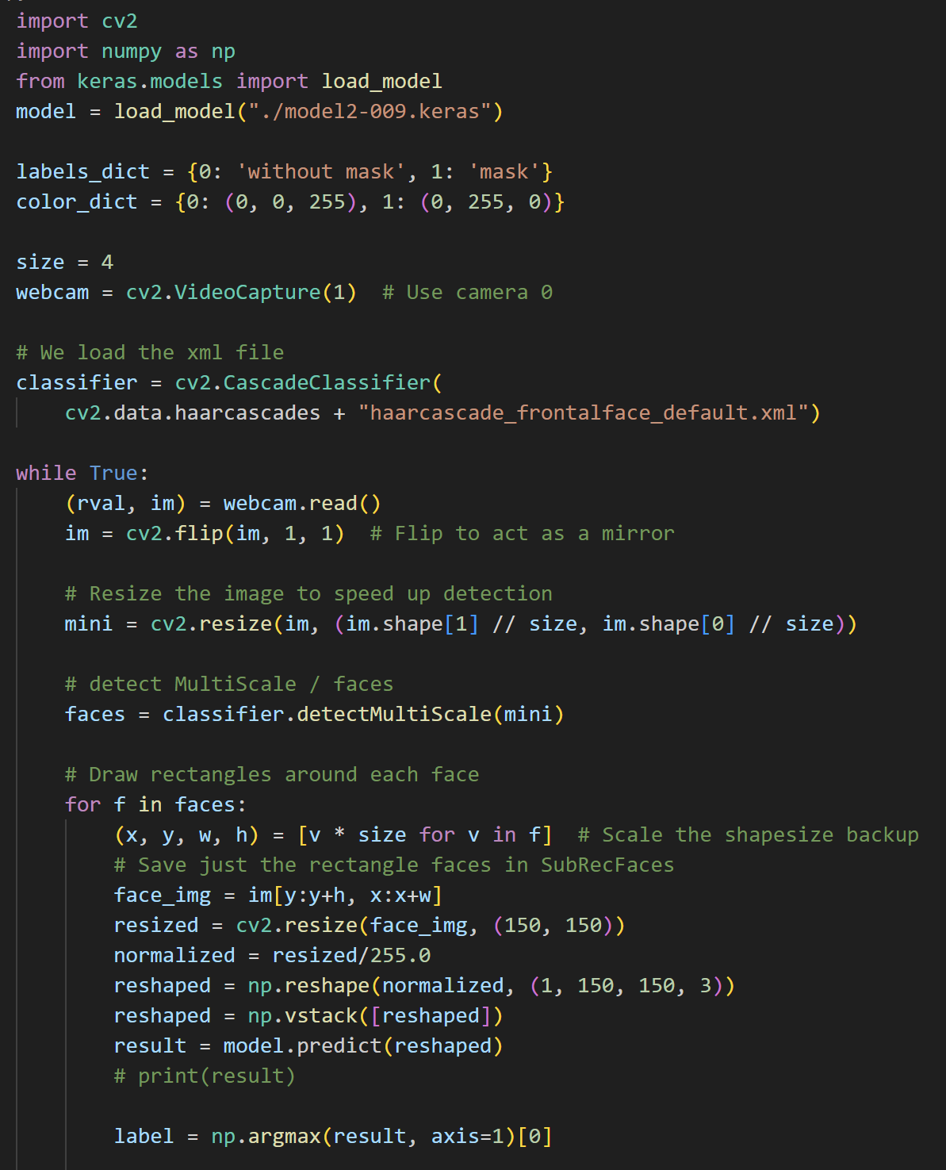
PROJECT CODE :
UI INTERFACE

Slide 7
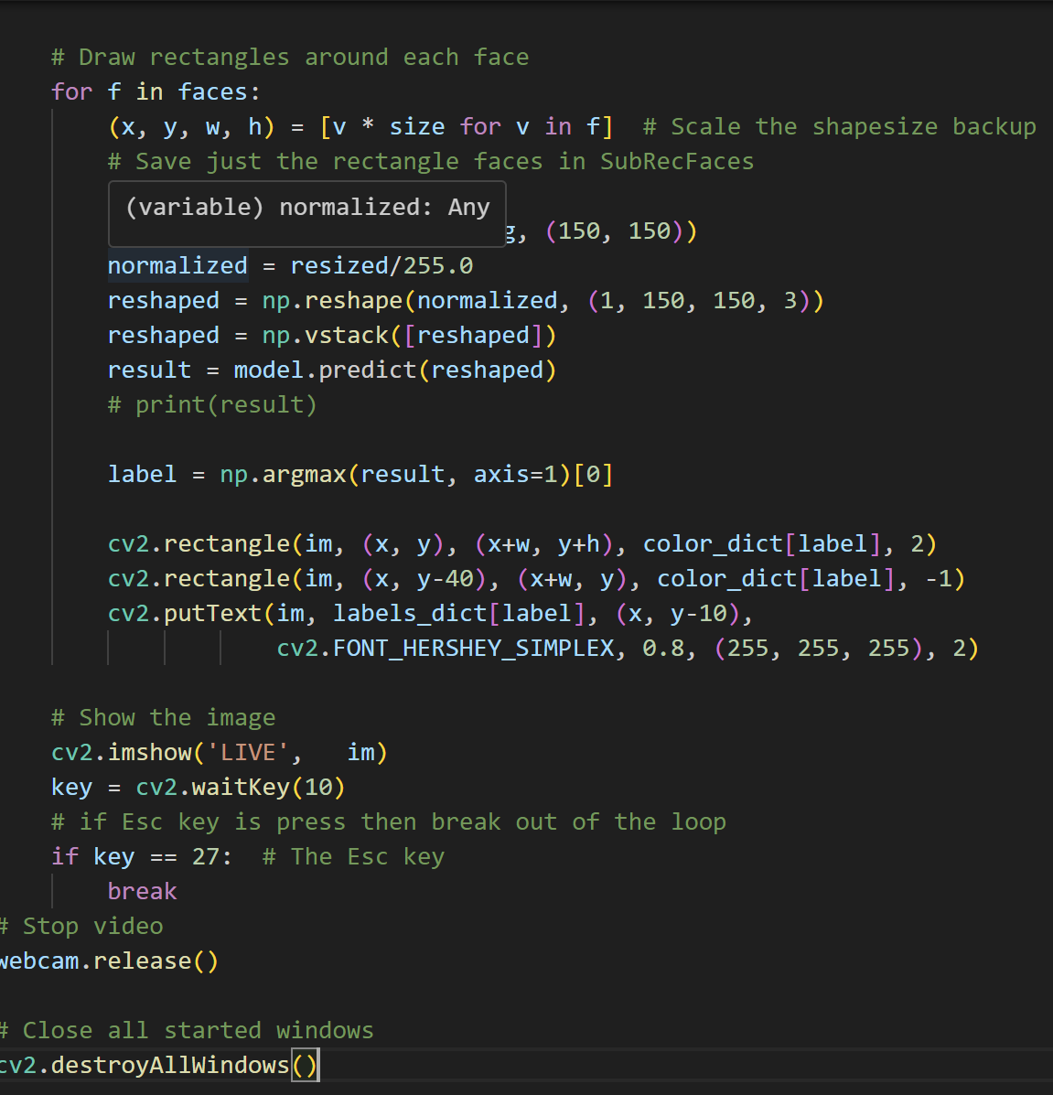
PROJECT CODE :
UI INTERFACE

Slide 8
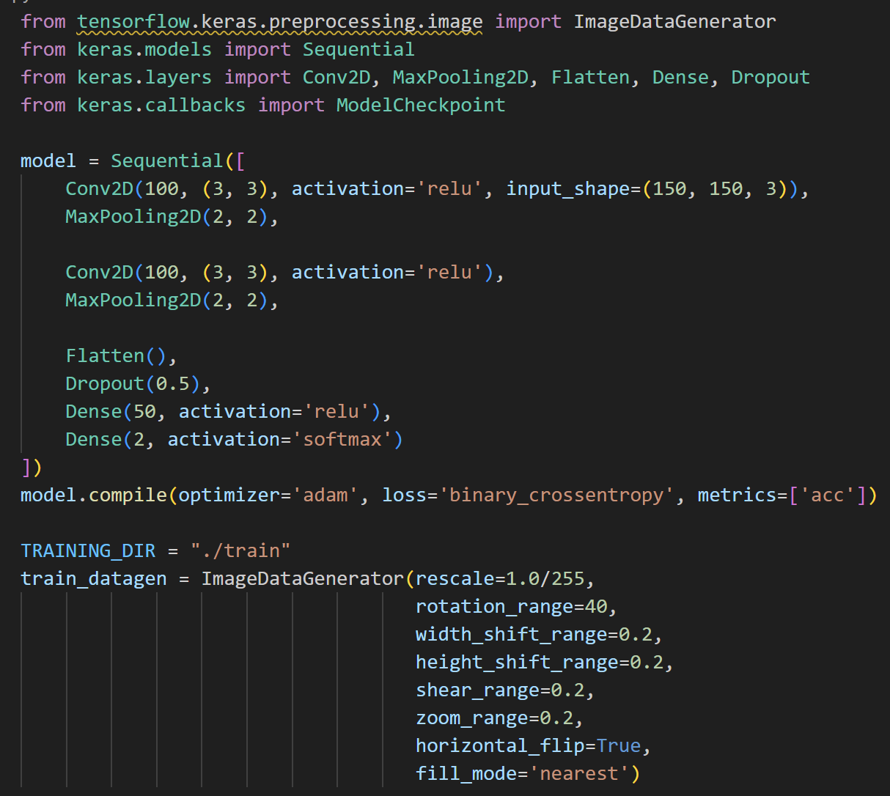
PROJECT CODE :
OUR MODEL

Slide 9
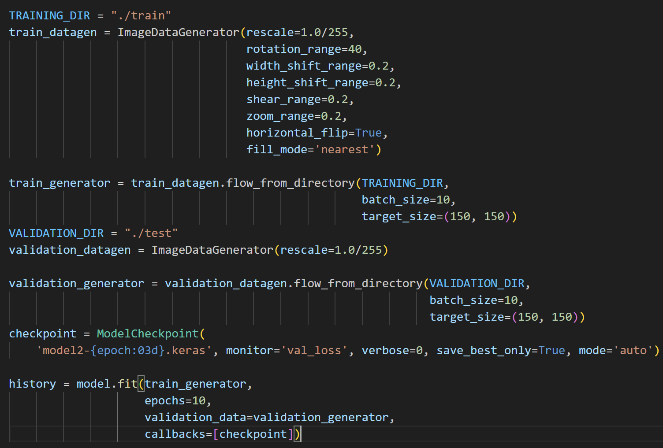
PROJECT CODE :
OUR MODEL

Slide 10

LIVE DEMO ▶️

