Slide 1
Naming Convention for variables

Slide 2
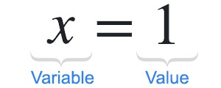
Declaring Variables
Python variables do not need explicit declaration to reserve memory space.
The declaration happens automatically when you assign a value to a variable.
The equal sign (=) is used to assign values to variables.

Slide 3
Rules for Naming Variables
A variable name must start with a letter or underscore.
data=3 (Correct)
_data=3 (Correct)
A variable name cannot start with a number.
4data = 3 (Incorrect)

Slide 4
More Rules for Naming Variables
A variable name can only contain alphanumeric characters and underscores.
@data = 3 (Incorrect)
Variable names are case-sensitive.
DATA = 3 and data=3, Here both DATA and data are different variables.

