Slide 1
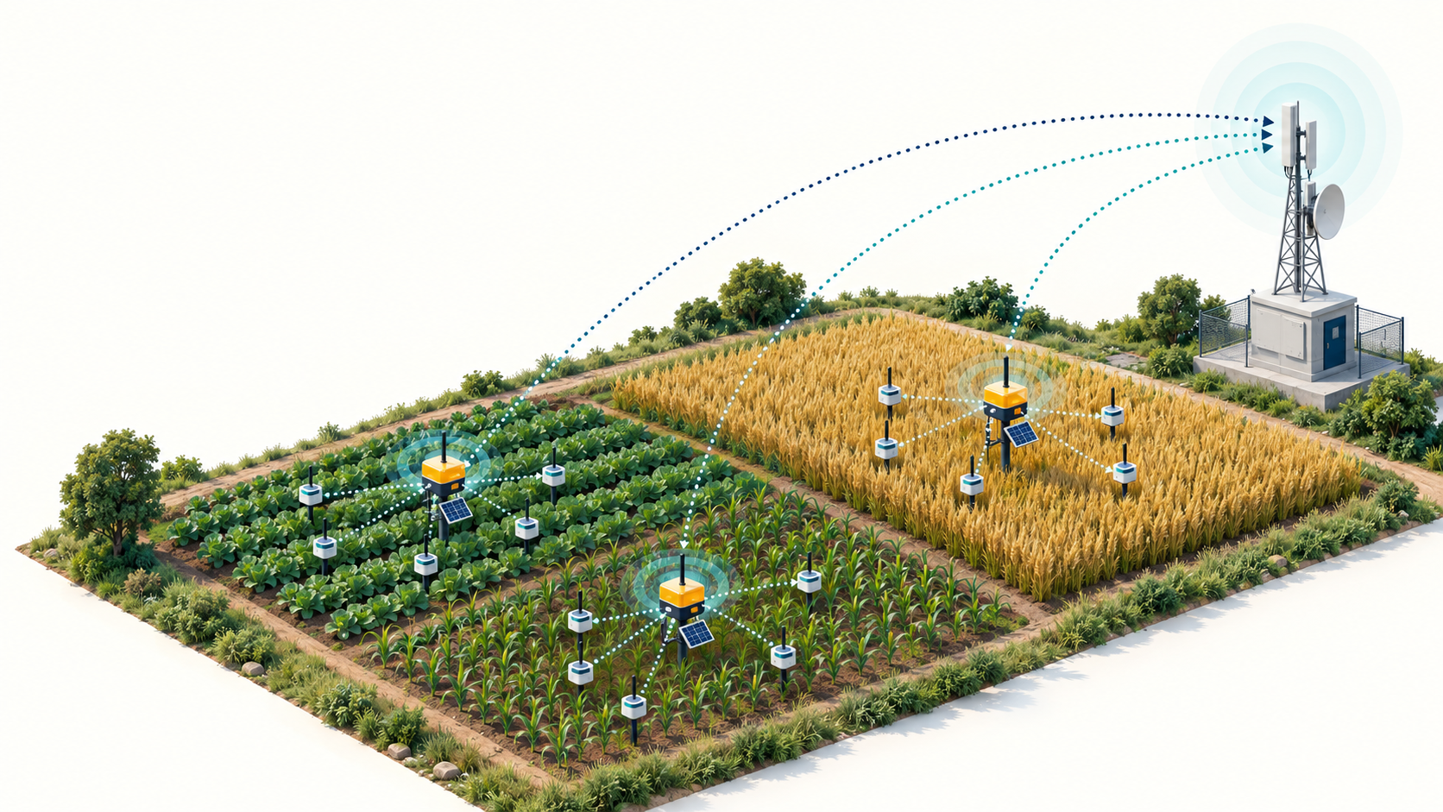
COA-APSO-LEACH
Control-overhead-aware adaptive clustering
Research idea and working network demonstration • 14 October 2026
Conceptual illustration
Conceptual illustration
Notes:
Introduce the full name: Control-Overhead-Aware Adaptive Particle Swarm Optimization with Low-Energy Adaptive Clustering Hierarchy. The project contains a Python energy model and a Contiki-NG application demonstration. The cover is an AI-generated conceptual illustration. It depicts a possible application, not the tested hardware or deployment. No energy harvesting is implemented.
Project source: simulator/engine.py, run_demo.py, export_cooja_policy.py, cooja/root.c, cooja/node.c, cooja/message.h.

Slide 2
The project at a glance
Research question: when is changing cluster heads worth the energy cost?
Python compares five algorithms on the same starting network.
Contiki-NG firmware exchanges packets in a nine-mote Cooja network.
Evidence includes a completed model run and a passing networking smoke test.
2
Notes:
Explain the two experiments before discussing performance. The Python experiment has 60 sensors and 450 rounds. Cooja has one root and eight sensors. They differ in geometry, timing, traffic and energy accounting, so their values cannot be combined.
Project source: simulator/engine.py, run_demo.py, export_cooja_policy.py, cooja/root.c, cooja/node.c, cooja/message.h.
Project evidence: results/config.json, results/summary.csv and per-protocol round CSV files. Seed 42, 60 sensors, 450 rounds.
Validated Cooja run: results/cooja-run.txt, results/cooja-validation.log, results/cooja_report.json. Duration 600 simulated seconds. TEST OK.

Slide 3
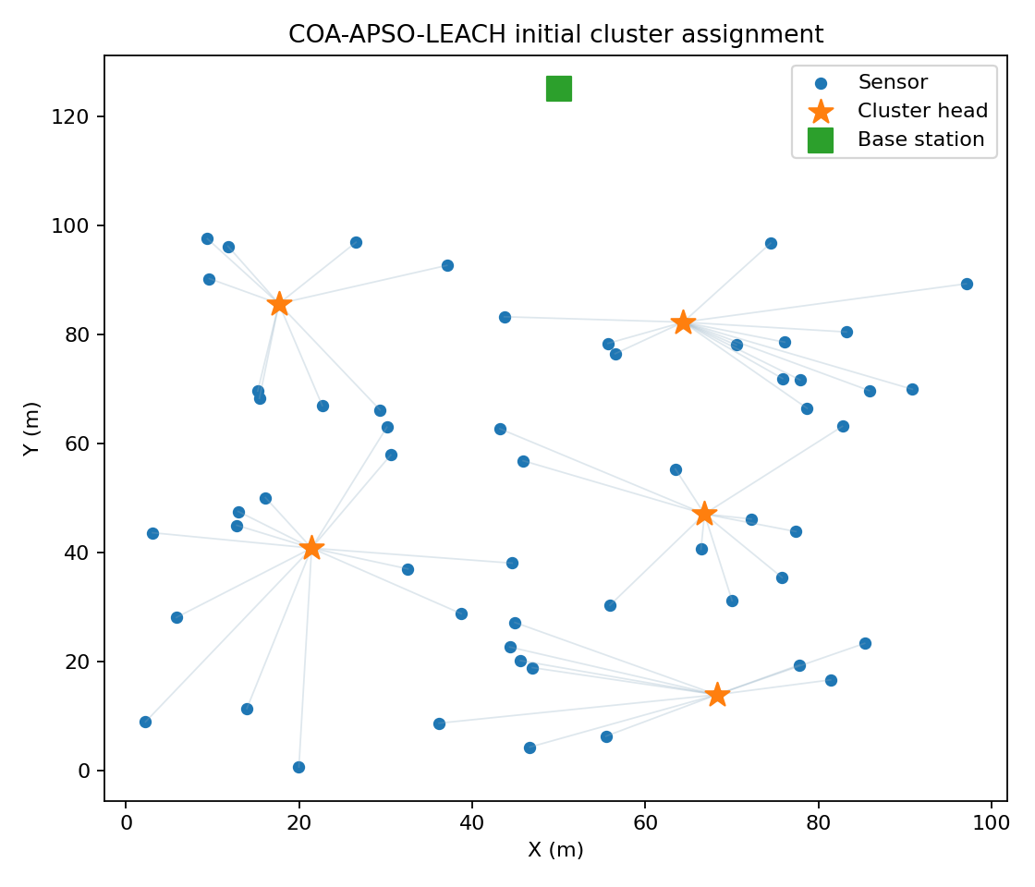
Wireless sensor networks
Battery-powered sensors collect readings across a physical area.
A cluster head receives nearby readings and sends a summary to a base station.
Long radio links and repeated control messages consume energy.
An uneven workload can drain some nodes earlier than others.
3
Notes:
Use the topology image to identify ordinary sensors, cluster heads and the base station. This is the initial Python clustering snapshot, not a Cooja screenshot or a map of surviving nodes at round 450. Applications could include soil monitoring or building instrumentation. The current readings are simulated.
Project source: simulator/engine.py, run_demo.py, export_cooja_policy.py, cooja/root.c, cooja/node.c, cooja/message.h.
Project evidence: results/config.json, results/summary.csv and per-protocol round CSV files. Seed 42, 60 sensors, 450 rounds.

Slide 4
Why reconfiguration matters
A new clustering may reduce future data-transmission cost.
Changing clusters also needs advertisements, joining and scheduling.
A small per-round improvement may never repay the setup cost.
The proposed decision explicitly compares those two quantities.
4
Notes:
Distinguish optimization from adoption. A candidate can score well in PSO and still be rejected because its predicted energy saving does not exceed the modeled switching cost. The baseline and proposed controllers also pay status-reporting costs.
Project source: simulator/engine.py, run_demo.py, export_cooja_policy.py, cooja/root.c, cooja/node.c, cooja/message.h.

Slide 5
Research question and hypotheses
Question: can a cost-benefit gate reduce control energy while preserving useful service?
H1: the gate reduces cluster changes relative to periodic APSO.
H2: savings remain useful after accounting for total energy and delivery quality.
H3: results persist across seeds, network sizes and traffic conditions.
5
Notes:
These are research hypotheses, not established universal results. The current single-seed run supports an example of H1. H2 and H3 require repeated experiments and packet-level measurements. The contribution under investigation is the adoption decision, not invention of PSO or clustering.
Project source: simulator/engine.py, run_demo.py, export_cooja_policy.py, cooja/root.c, cooja/node.c, cooja/message.h.

Slide 6
Related research and the proposed focus
Research | Relevant idea | This project
Haris & Nam, 2025 | Adaptive PSO head selection | Simplified custom PSO baseline
Zhang et al., 2025 | Heterogeneity and hybrid routing | Optional modeled relay choice
Proposed evaluation | Reconfiguration cost test | Retain or replace existing heads
6
Notes:
Haris and Nam describe adaptive inertia and energy-aware clustering. Zhang and colleagues study adaptive PSO and hybrid routing. These papers motivate the project but the implementation is not an exact reproduction. A focused review of overhead-aware and event-triggered reclustering is still needed before claiming novelty.
M. Haris and H. Nam, Enhancing Energy Efficiency in IoT-WSNs Through Optimized PSO Cluster Head Selection, IEEE Access 13, 126496–126512, 2025. DOI: 10.1109/ACCESS.2025.3583922. Institutional record: https://erica.scholarworks.kr/item/f4334541-1e7a-49ad-b3bf-b43838f819d2
Y. Zhang, L. Yang and Y. Tan, Energy-efficient adaptive routing in heterogeneous wireless sensor networks via hybrid PSO and dynamic clustering, Journal of Cloud Computing 14, 46, 2025. https://doi.org/10.1186/s13677-025-00768-3
Project source: simulator/engine.py, run_demo.py, export_cooja_policy.py, cooja/root.c, cooja/node.c, cooja/message.h.

Slide 7
Python, Contiki-NG and Cooja
Component | Role | Output
Python | Algorithm and energy model | CSV files, graphs, policy.h
Contiki-NG | Embedded OS and network stack | Root and sensor firmware
Cooja | Virtual wireless network | Packet logs and activity counters
7
Notes:
Contiki-NG runs on simulated devices. Cooja hosts the virtual network. Python optimizes and generates policy.h before compilation. There is no live Python-to-Cooja control loop. Cooja native motes run quickly but do not reproduce a particular hardware platform precisely.
Project source: simulator/engine.py, run_demo.py, export_cooja_policy.py, cooja/root.c, cooja/node.c, cooja/message.h.
Contiki-NG, Running Contiki-NG in Cooja. https://docs.contiki-ng.org/en/master/doc/tutorials/Running-Contiki-NG-in-Cooja.html (accessed 14 October 2026).

Slide 8
Implementation workflow
1 Run the Python comparison and inspect the dashboard.
2 Export the eight-sensor cluster assignment schedule.
3 Compile root.c and node.c with policy.h in Contiki-NG.
4 Run demo.csc in Cooja and inspect packet exchanges.
5 Parse the saved logs separately from Python energy results.
8
Notes:
The installed Linux repository is /home/anish/coa-demo/contiki-ng. The project remains on the Windows D drive and the install script copies firmware to the example directory. Recompile after changing policy.h. The simulator does not automatically load changes from Python while running.
Project source: simulator/engine.py, run_demo.py, export_cooja_policy.py, cooja/root.c, cooja/node.c, cooja/message.h.

Slide 9
Implemented protocol comparison
Protocol | Head selection | Reconsideration
LEACH | Random election approximation | Every round
E-LEACH | Highest residual energy | Every 15 rounds or emergency
PSO-LEACH | Fixed-inertia PSO | Every 15 rounds or emergency
APSO-LEACH | Cosine-inertia PSO | Every 15 rounds or emergency
COA-APSO-LEACH | APSO with cost-benefit gate | 15-round checks or emergency
9
Notes:
A scheduled evaluation does not always change the head set. Setup energy and the reconfiguration counter increase only when the set changes. E-LEACH is a local energy-first baseline, not a verbatim published algorithm. Its implementation does not charge the status reports charged to the PSO variants, which complicates control-energy comparisons. All methods use the same optional hybrid-routing setting in this run.
Project source: simulator/engine.py, run_demo.py, export_cooja_policy.py, cooja/root.c, cooja/node.c, cooja/message.h.

Slide 10
Radio energy model
Transmit: Etx(b,d) = b × [Eelec + amplifier(d)]
Amplifier: εfs d² below d0, otherwise εmp d⁴
Receive: Erx(b) = b × Eelec
Aggregation: EDA per processed bit
Control energy includes setup and modeled status reports.
10
Notes:
Constants in engine.py: Eelec=50 nJ/bit, EDA=5 nJ/bit, epsilon_fs=10 pJ/bit/m², epsilon_mp=0.0013 pJ/bit/m⁴. d0=sqrt(epsilon_fs/epsilon_mp), about 87.71 m. Data packets contain 4000 modeled bits and control packets 128 bits. These assumptions do not include idle listening, retransmissions, interference or measured CPU energy.
Project source: simulator/engine.py, run_demo.py, export_cooja_policy.py, cooja/root.c, cooja/node.c, cooja/message.h.

Slide 11
Adaptive particle swarm optimization
A particle contains candidate cluster-head coordinates.
Each position maps to distinct, existing, alive sensors.
Fitness balances data energy, load imbalance and head energy.
Inertia decreases smoothly from 0.90 to 0.45.
The current head set seeds one particle when feasible.
11
Notes:
Velocity update: v = wv + 1.6r1(pbest−x) + 1.6r2(gbest−x). Position x is updated and clipped to the sensing area. Standard PSO uses inertia 0.70. Adaptive inertia is 0.45 + 0.225[1+cos(pi*t/(T−1))]. Fitness is 0.65 normalized data energy + 0.16 load imbalance + 0.14 mean relative-energy scarcity + 0.05 relative-energy dispersion. These weights are design choices requiring sensitivity analysis.
Project source: simulator/engine.py, run_demo.py, export_cooja_policy.py, cooja/root.c, cooja/node.c, cooja/message.h.

Slide 12
The reconfiguration decision
Predicted saving = H × (current round cost − candidate round cost)
Required saving = safety margin × new setup energy
Accept a different head set when predicted saving exceeds required saving.
Override the gate when a head is missing, dead or below the safety threshold.
12
Notes:
The saved Python run uses H=15 rounds, safety margin=1.15 and head minimum fraction=0.22 of initial energy. The saving estimate repeats the current estimated per-round cost over H; it is not a forecast incorporating future depletion or packet loss. Status-report cost is paid when checking, including rejected proposals. The code also checks that a candidate changes the head set.
Project source: simulator/engine.py, run_demo.py, export_cooja_policy.py, cooja/root.c, cooja/node.c, cooja/message.h.

Slide 13
A worked break-even example
Illustrative saving: 0.20 mJ per round × 15 rounds = 3.00 mJ
Illustrative setup: 2.00 mJ × 1.15 = 2.30 mJ
Decision: accept the change because 3.00 > 2.30 mJ.
If saving falls to 0.10 mJ per round, retain the existing heads.
13
Notes:
These are teaching numbers, not measured or simulated project results. In the second example predicted benefit is 1.50 mJ, below 2.30 mJ. The emergency rule can still override rejection. Explain the rule as paying a one-time moving cost only when the expected future saving can repay it.
Project source: simulator/engine.py, run_demo.py, export_cooja_policy.py, cooja/root.c, cooja/node.c, cooja/message.h.

Slide 14
Configuration of the saved Python run
Parameter | Value | Interpretation
Sensors / horizon / seed | 60 / 450 / 42 | One illustrative experiment
Area / base station | 100 × 100 m / (50,125) | Sink outside sensing area
Initial energy levels | 0.5, 1.0, 2.0 J | Sampling probabilities 70%, 23%, 7%
Target heads / swarm | 5 / 9 particles | 10 PSO iterations
Check / lookahead / margin | 15 / 15 / 1.15 | 22% head safety threshold
14
Notes:
Use results/config.json rather than Config defaults. run_demo.py uses 9 particles and 10 iterations for this saved run, whereas the dataclass defaults and run_research.py use 10 and 12. Cluster count is a target for LEACH, whose randomized election can yield a different number. The sampled energy-class proportions need not equal their probabilities exactly.
Project evidence: results/config.json, results/summary.csv and per-protocol round CSV files. Seed 42, 60 sensors, 450 rounds.
Project source: simulator/engine.py, run_demo.py, export_cooja_policy.py, cooja/root.c, cooja/node.c, cooja/message.h.

Slide 15
Alive sensors after 450 rounds
LEACH: 52 sensors remain alive.
Other methods: all 60 remain alive.
Lifetime ordering among those four remains unresolved.
Seed 42 · 60 sensors · 450 rounds · modeled results
15
Notes:
FND is 322 for LEACH. No first-node-death event is observed for the other methods during this horizon. Half-node and last-node death are unobserved. A censored event is not zero, infinity or a demonstrated lifetime extension.
Project evidence: results/config.json, results/summary.csv and per-protocol round CSV files. Seed 42, 60 sensors, 450 rounds.

Slide 16
Residual energy comparison
Proposed: 31.0656 J remaining.
APSO: 31.0212 J remaining.
The difference is only 0.0444 J in this run.
Seed 42 · 60 sensors · 450 rounds · modeled results
16
Notes:
The proposed method has about 0.143% more residual energy than APSO at the end. This is not a 32.6% reduction in total energy. The much larger percentage on the next slide applies only to control energy. Standard PSO finishes at 31.0638 J, extremely close to the proposed result.
Project evidence: results/config.json, results/summary.csv and per-protocol round CSV files. Seed 42, 60 sensors, 450 rounds.

Slide 17
Modeled control energy
APSO: 0.0690 J. Proposed: 0.0465 J.
32.6% lower control energy than APSO.
E-LEACH is lower still at 0.0249 J.
Seed 42 · 60 sensors · 450 rounds · modeled results
17
Notes:
Calculation: (0.06904520340655584−0.046515989693528506)/0.06904520340655584 ×100. E-LEACH has different telemetry accounting in this implementation, so do not infer a fair deployment-level ranking from this graph. Status cost means retaining heads does not eliminate control overhead.
Project evidence: results/config.json, results/summary.csv and per-protocol round CSV files. Seed 42, 60 sensors, 450 rounds.
Project source: simulator/engine.py, run_demo.py, export_cooja_policy.py, cooja/root.c, cooja/node.c, cooja/message.h.

Slide 18
Cluster changes and rejected proposals
APSO: 24 changes. Proposed: 7.
70.8% fewer reconfigurations than APSO.
The proposed controller rejects 26 candidate updates.
Seed 42 · 60 sensors · 450 rounds · modeled results
18
Notes:
Counters include initial cluster formation. E-LEACH changes 16 times and PSO changes 27 times. Same-set selections do not count as reconfigurations. Rejection does not avoid the cost of obtaining state or running the optimizer.
Project evidence: results/config.json, results/summary.csv and per-protocol round CSV files. Seed 42, 60 sensors, 450 rounds.
Project source: simulator/engine.py, run_demo.py, export_cooja_policy.py, cooja/root.c, cooja/node.c, cooja/message.h.

Slide 19
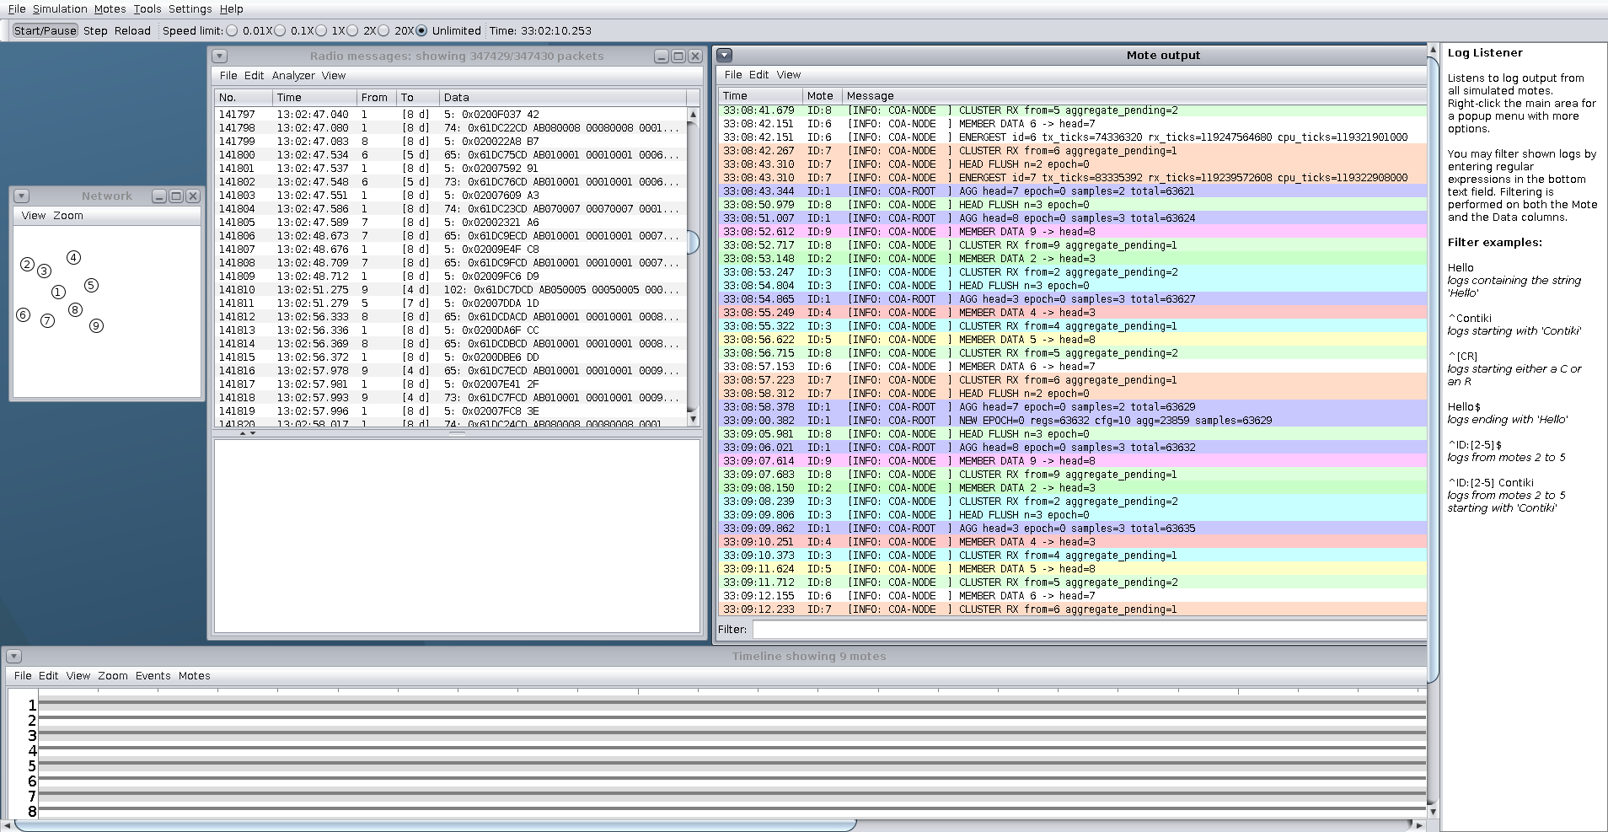
Cooja demonstration on this PC
Actual running application: topology, radio messages, mote output and timeline.
19
Notes:
This image was captured from the live Cooja window while preparing the presentation. It shows a later continuously running GUI session, not the separate 600-second validation run. Its cumulative counters must not be substituted for the validation report. The user-supplied screenshot shows the same demonstration at an earlier time. The application roles appear in log messages, not automatically as colored cluster groups.
Contiki-NG, Running Contiki-NG in Cooja. https://docs.contiki-ng.org/en/master/doc/tutorials/Running-Contiki-NG-in-Cooja.html (accessed 14 October 2026).
Validated Cooja run: results/cooja-run.txt, results/cooja-validation.log, results/cooja_report.json. Duration 600 simulated seconds. TEST OK.

Slide 20
Nine-mote application roles
Role | Node IDs | Traffic
Base station | 1 | Receives registration and summaries
Head 3 | 3, members 2 and 4 | Collects local readings
Head 7 | 7, member 6 | Collects local readings
Head 8 | 8, members 5 and 9 | Collects local readings
20
Notes:
All six generated epochs retain heads 3, 7 and 8. Root epochs last 90 simulated seconds. Sensors communicate approximately every 15 seconds after startup and report Energest every fourth reachable reporting cycle. Cooja uses center root coordinates (50,50), unlike Python sink (50,125).
Project source: simulator/engine.py, run_demo.py, export_cooja_policy.py, cooja/root.c, cooja/node.c, cooja/message.h.

Slide 21
Packet exchange and log messages
REG: a sensor registers its IPv6 address with the root.
CONFIG: the root replies with a cluster-head ID and address.
MEMBER DATA / CLUSTER RX: a member sends and a head receives.
AGG: a head sends its accumulated sample count to the root.
DIRECT: a sensor uses a fallback when configuration is incomplete.
21
Notes:
The packed application payload is 24 bytes, comprising eight one-byte fields and a 16-byte IPv6 address. It is not the Python model’s 4000-bit packet. Aggregation sums observation counts, not sensor-value compression. RPL can route a member-to-head packet through the root. There is no custom LEACH MAC or TDMA implementation.
Project source: simulator/engine.py, run_demo.py, export_cooja_policy.py, cooja/root.c, cooja/node.c, cooja/message.h.

Slide 22
Verified Cooja results
Check or count | Observed result
Simulation duration | 600 simulated seconds
Configured sensors | 8 of 8
Sensors reporting Energest | 8 of 8
Aggregate packets received | 114
Samples in aggregate packets | 299
Automated outcome | TEST OK
22
Notes:
This networking smoke test requires configuration and Energest evidence for all eight sensors, and at least one member send, cluster receive and aggregate receipt. It does not prove zero loss or validate all failure conditions. The root final total includes direct fallback samples and therefore can differ from the 299 aggregated samples. The parser does not compute delivery ratio.
Validated Cooja run: results/cooja-run.txt, results/cooja-validation.log, results/cooja_report.json. Duration 600 simulated seconds. TEST OK.

Slide 23
Energest interpretation
Energest tracks time in CPU and radio activity states.
The firmware logs cumulative transmit, listen and CPU ticks.
Energy estimation needs ticks per second, current draw and voltage.
Use interval differences and a consistent hardware profile for comparisons.
23
Notes:
Conceptual conversion: E = V × sum(I_state × delta_ticks_state / ENERGEST_SECOND). Use a consistent decomposition because CPU and radio operate concurrently. The current output lacks a calibrated device profile and does not estimate Joules. The parser stores the latest report per node; report times are staggered. Current logs call listen time rx_ticks, which is not simply successful packet reception time.
Contiki-NG, Energest. https://docs.contiki-ng.org/en/master/doc/programming/Energest.html (accessed 14 October 2026).
Project source: simulator/engine.py, run_demo.py, export_cooja_policy.py, cooja/root.c, cooja/node.c, cooja/message.h.
Validated Cooja run: results/cooja-run.txt, results/cooja-validation.log, results/cooja_report.json. Duration 600 simulated seconds. TEST OK.

Slide 24
Limitations affecting interpretation
Python omits collisions, idle listening and MAC retransmissions.
Cooja replays an offline policy and has no battery-death controller.
The two experiments use different packet sizes and configurations.
A single seed cannot establish statistical significance or novelty.
Reliable configuration delivery and transition handling need further testing.
24
Notes:
Root caches an assignment when it sends it, with no application acknowledgment. A lost configuration may not be resent while its cached state is unchanged. A head role change can leave pending aggregation data to handle. These are engineering follow-ups rather than demonstrated failures of the current fixed-policy smoke test. PSO CPU cost at the assumed powered base station is excluded.
Project source: simulator/engine.py, run_demo.py, export_cooja_policy.py, cooja/root.c, cooja/node.c, cooja/message.h.

Slide 25
Research plan for a stronger evaluation
Repeat paired seeds and report uncertainty, not only mean values.
Match traffic, topology, telemetry and duration across Cooja baselines.
Ablate the cost gate, adaptive inertia and hybrid relay option.
Measure delivery ratio, delay, control bytes and calibrated energy.
Compare with recent overhead-aware reclustering methods.
25
Notes:
Suggested starting design: at least 20 paired seeds, 30/60/100 sensors, multiple sink positions and traffic intervals. Set a justified replication count based on variance or power analysis. Report confidence intervals of paired differences. Handle censored lifetimes with survival methods or a common restricted horizon. run_research.py supplies descriptive summaries only, not significance tests or unbiased lifetime estimates.
Project source: simulator/engine.py, run_demo.py, export_cooja_policy.py, cooja/root.c, cooja/node.c, cooja/message.h.

Slide 26
Live demonstration sequence
1 Open results/dashboard.html and explain the model comparison.
2 Run .\Launch-Cooja.ps1 and set a readable simulation speed.
3 Identify node 1 and cluster heads 3, 7 and 8.
4 Follow MEMBER DATA, CLUSTER RX and AGG messages.
5 Explain Energest units and the offline-policy limitation.
26
Notes:
Suggested 5-minute demonstration: 45 seconds problem, 60 seconds algorithm, 90 seconds graphs, 90 seconds Cooja, 15 seconds conclusion. If the window is already open, do not launch a second instance. At unlimited speed hours of simulated time pass quickly. Pause the simulation when explaining messages. The documentation contains the exact rerun and validation commands.
Project source: simulator/engine.py, run_demo.py, export_cooja_policy.py, cooja/root.c, cooja/node.c, cooja/message.h.
Contiki-NG, Running Contiki-NG in Cooja. https://docs.contiki-ng.org/en/master/doc/tutorials/Running-Contiki-NG-in-Cooja.html (accessed 14 October 2026).

Slide 27
Main conclusion and viva answers
Implemented: cost-aware selection logic and working UDP aggregation.
Observed: lower control cost than APSO in one modeled experiment.
Unresolved: robust lifetime gains, calibrated energy and novelty.
Next milestone: matched repeated experiments and reliable policy transitions.
27
Notes:
Why Contiki? It provides an embedded network stack. Why Cooja? It lets us execute that stack on virtual motes and inspect communication. Why not PSO on every sensor? The chosen architecture places optimization at a powered controller. Are the graphs real device measurements? No, they are mathematical-model results. Is this publication-ready? The prototype works, but research validation is incomplete.
Project evidence: results/config.json, results/summary.csv and per-protocol round CSV files. Seed 42, 60 sensors, 450 rounds.
Validated Cooja run: results/cooja-run.txt, results/cooja-validation.log, results/cooja_report.json. Duration 600 simulated seconds. TEST OK.
Project source: simulator/engine.py, run_demo.py, export_cooja_policy.py, cooja/root.c, cooja/node.c, cooja/message.h.

Slide 28
References and reproducibility
Haris & Nam (2025), IEEE Access. DOI: 10.1109/ACCESS.2025.3583922
Zhang, Yang & Tan (2025), Journal of Cloud Computing. DOI: 10.1186/s13677-025-00768-3
Contiki-NG documentation: Cooja tutorial and Energest API.
Local evidence: source code, config.json, summary.csv and cooja-run.txt.
28
Notes:
Full references and source URLs appear in the report. Contiki-NG commit: 7a4df8a941d552b10c730db70e934a9be10937af. Cooja commit: fabff3ee41eeeb6f3de7bd11f7c9cdf0a7d7dfc4. The README also lists Abose et al. 2024, DOI 10.1109/ACCESS.2024.3429645, as a reading lead; it is not used here as evidence for a specific algorithm claim because the primary text was not retrieved.
M. Haris and H. Nam, Enhancing Energy Efficiency in IoT-WSNs Through Optimized PSO Cluster Head Selection, IEEE Access 13, 126496–126512, 2025. DOI: 10.1109/ACCESS.2025.3583922. Institutional record: https://erica.scholarworks.kr/item/f4334541-1e7a-49ad-b3bf-b43838f819d2
Y. Zhang, L. Yang and Y. Tan, Energy-efficient adaptive routing in heterogeneous wireless sensor networks via hybrid PSO and dynamic clustering, Journal of Cloud Computing 14, 46, 2025. https://doi.org/10.1186/s13677-025-00768-3
Contiki-NG, Running Contiki-NG in Cooja. https://docs.contiki-ng.org/en/master/doc/tutorials/Running-Contiki-NG-in-Cooja.html (accessed 14 October 2026).
Contiki-NG, Energest. https://docs.contiki-ng.org/en/master/doc/programming/Energest.html (accessed 14 October 2026).
Project evidence: results/config.json, results/summary.csv and per-protocol round CSV files. Seed 42, 60 sensors, 450 rounds.
Validated Cooja run: results/cooja-run.txt, results/cooja-validation.log, results/cooja_report.json. Duration 600 simulated seconds. TEST OK.

