Slide 1

Presented by Anishma.K

Slide 2
INTODUCTION
Full stack project:
library management system, the parts work together to support the management of library information resources: their acquisition, representation and circulation. Each of these parts constitutes a subsystem which in turn comprises a set of interconnected parts. In other words, each of these subsystems can be broken down into yet smaller subsystems, for example, a subsystem to control the catalogue display options. It is worth noting that vendors of library management systems

Slide 3
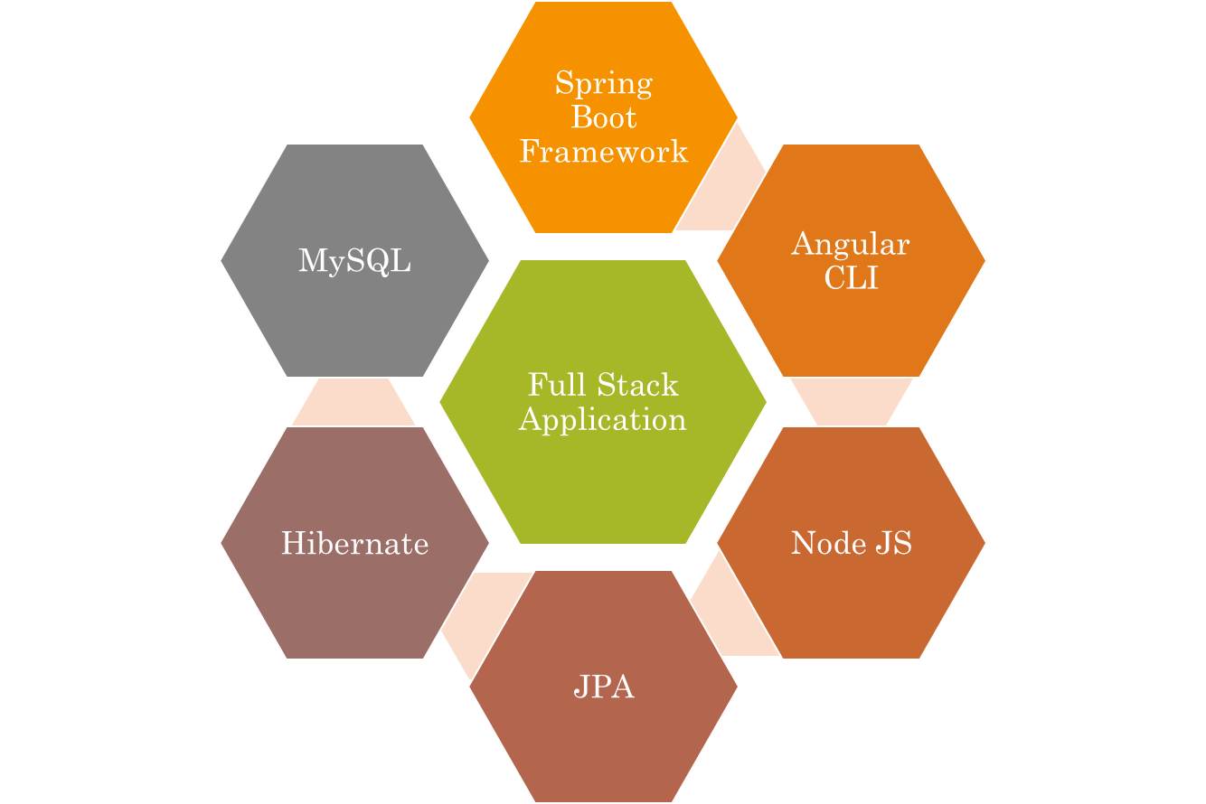

Slide 4
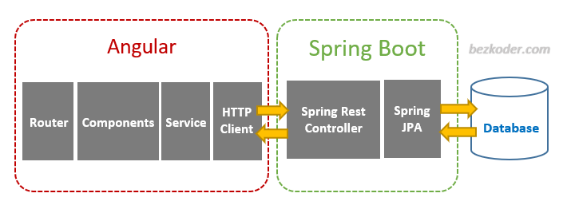
The Architecture of Angular, Spring & database(MySQL)

Slide 5
The Architecture of the Project
Spring Boot
Backend
MySQL

