Slide 1
Agentic RAG Chatbot with Groq
Multi-agent RAG chatbot system with MCP integration

Slide 2
Agent-Based Architecture with MCP Integration
• Distributed architecture with specialized agents communicating via Model Context Protocol (MCP)
• Agents: CoordinatorAgent, IngestionAgent, RetrievalAgent, LLMResponseAgent, and Streamlit UI
• Responsibilities split across parsing, embedding, retrieval, and response generation
• MCP Bus enables structured message passing between agents

Slide 3
System Flow Diagram with Message Passing
• CoordinatorAgent orchestrates workflow and manages session state
• IngestionAgent parses, chunks, and preprocesses documents
• RetrievalAgent performs FAISS-based semantic search
• LLMResponseAgent uses Groq's Llama3 model to generate responses
• Streamlit UI handles user interaction and displays responses

Slide 4
Tech Stack Used
Frontend: Streamlit (real-time UI and chat interface)
Backend: Python 3.8+, LangChain, FAISS, Sentence Transformers
Model: Groq Llama3-8B (via LangChain integration)
Vector Store: FAISS for efficient similarity search
Supported Formats: PDF, DOCX, PPTX, CSV, TXT, Markdown

Slide 5
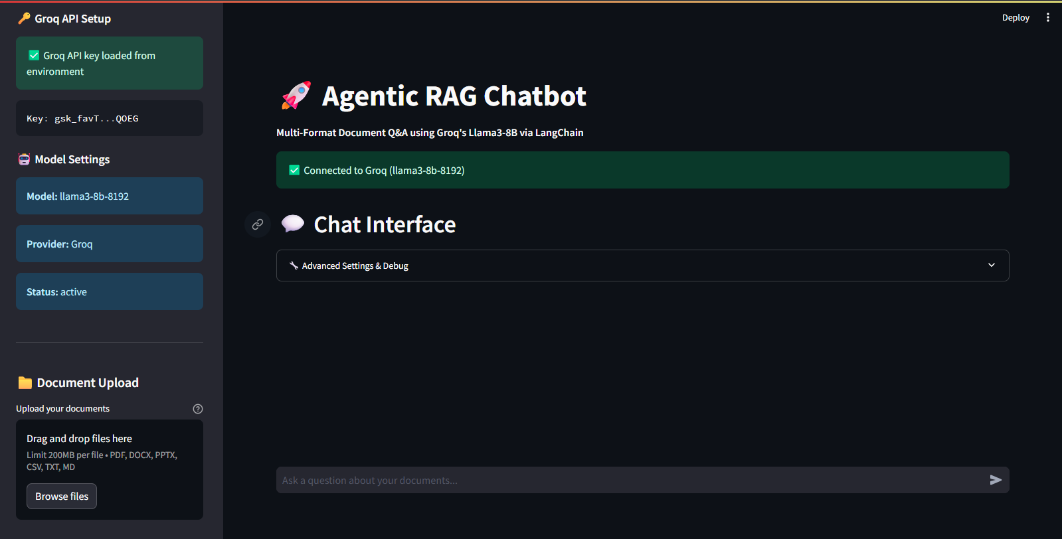
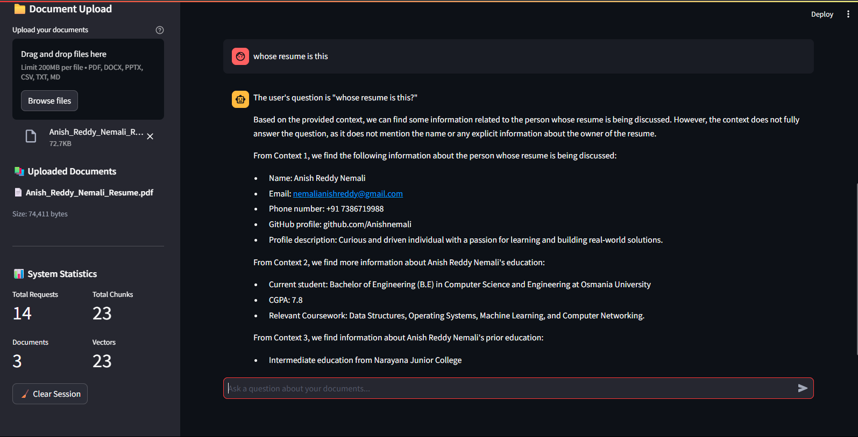
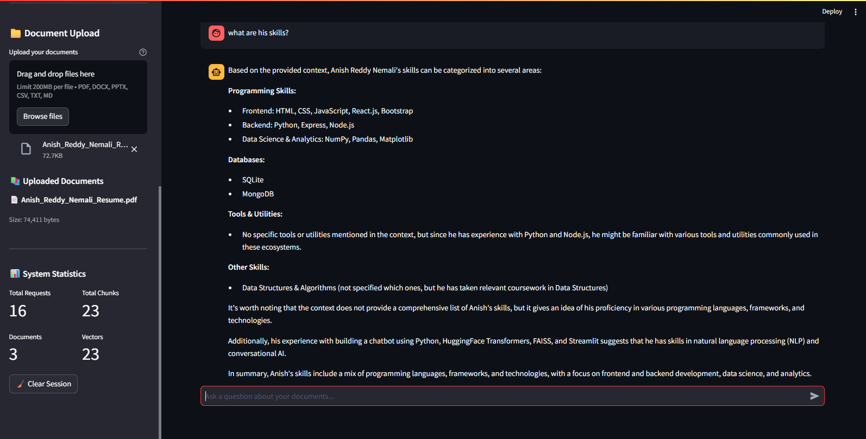
UI Screenshots of Working App

Slide 6
Challenges Faced & Future Scope
Challenges Faced:
• Integrating agents and MCP communication
• FAISS indexing with large documents
• Ensuring fallback logic without Groq API
Future Scope:
• Add streaming responses with Groq
• Expand to multimodal inputs (images, audio)
• Integrate dashboards for query analytics

