Slide 1

Smart Study
Planner
Full-Stack Web Application
Anish Pandey · June 8, 2026 · v1.0.0

Slide 2
Project Overview
A full-stack web app to help students plan study tasks, track progress, and take quizzes.
Personalised dashboard with live stats, task management, quiz engine, and admin panel.
Built with React (frontend), Express (backend), and PostgreSQL (database).
Vite dev server proxies all /api requests to Express on port 4000.
5
17
5
3
Pages
API Endpoints
DB Tables
Built-in Quizzes

Slide 3
Objectives
📋
Task Planning
🧠
Quiz Engine
📈
Progress
Centralised platform to plan and track study tasks
Knowledge self-assessment via interactive multiple-choice quizzes
Visualise academic progress with completion rates and quiz history
🔐
Security
⚙️
Admin Panel
Secure role-based access using JWT authentication
Manage quiz content and user roles dynamically

Slide 4
Technology Stack
⚛️ Frontend
🖥️ Backend
🛠️ Dev Tools
React 18.3.1
Node.js / Express 4.19.0
concurrently
React Router DOM 6.26.2
PostgreSQL (pg) 8.21.0
localtunnel
Styled Components 6.4.2
jsonwebtoken 9.0.3
Vite proxy (/api → :4000)
Vite 5.4.8
bcrypt 6.0.0
dotenv 17.4.2

Slide 5
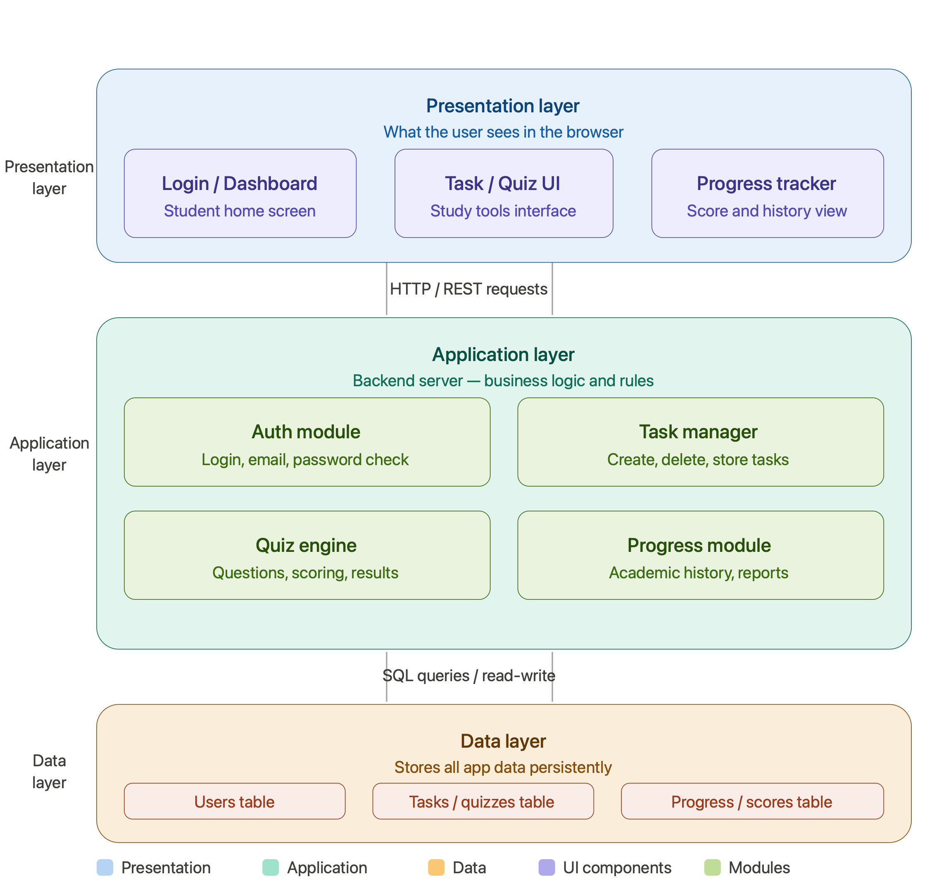
Presentation → Application → Data · HTTP/REST between layers · SQL between app and database
Three-Layer System Architecture

Slide 6
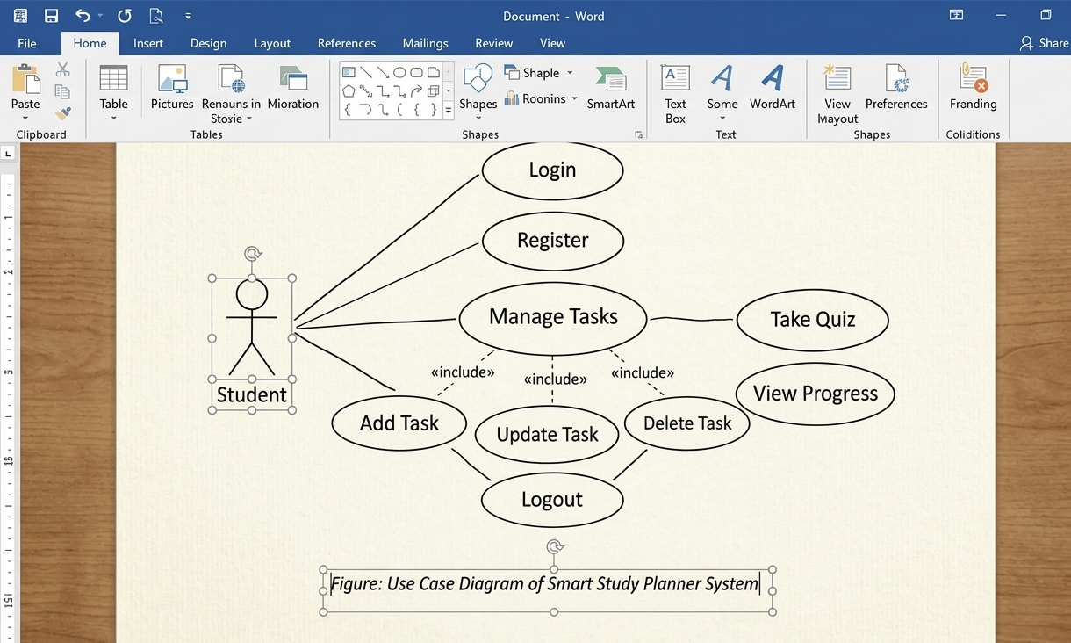
Use Case Diagram — Student
Student can Register, Login, Manage Tasks (Add/Update/Delete), Take Quiz, View Progress and Logout

Slide 7
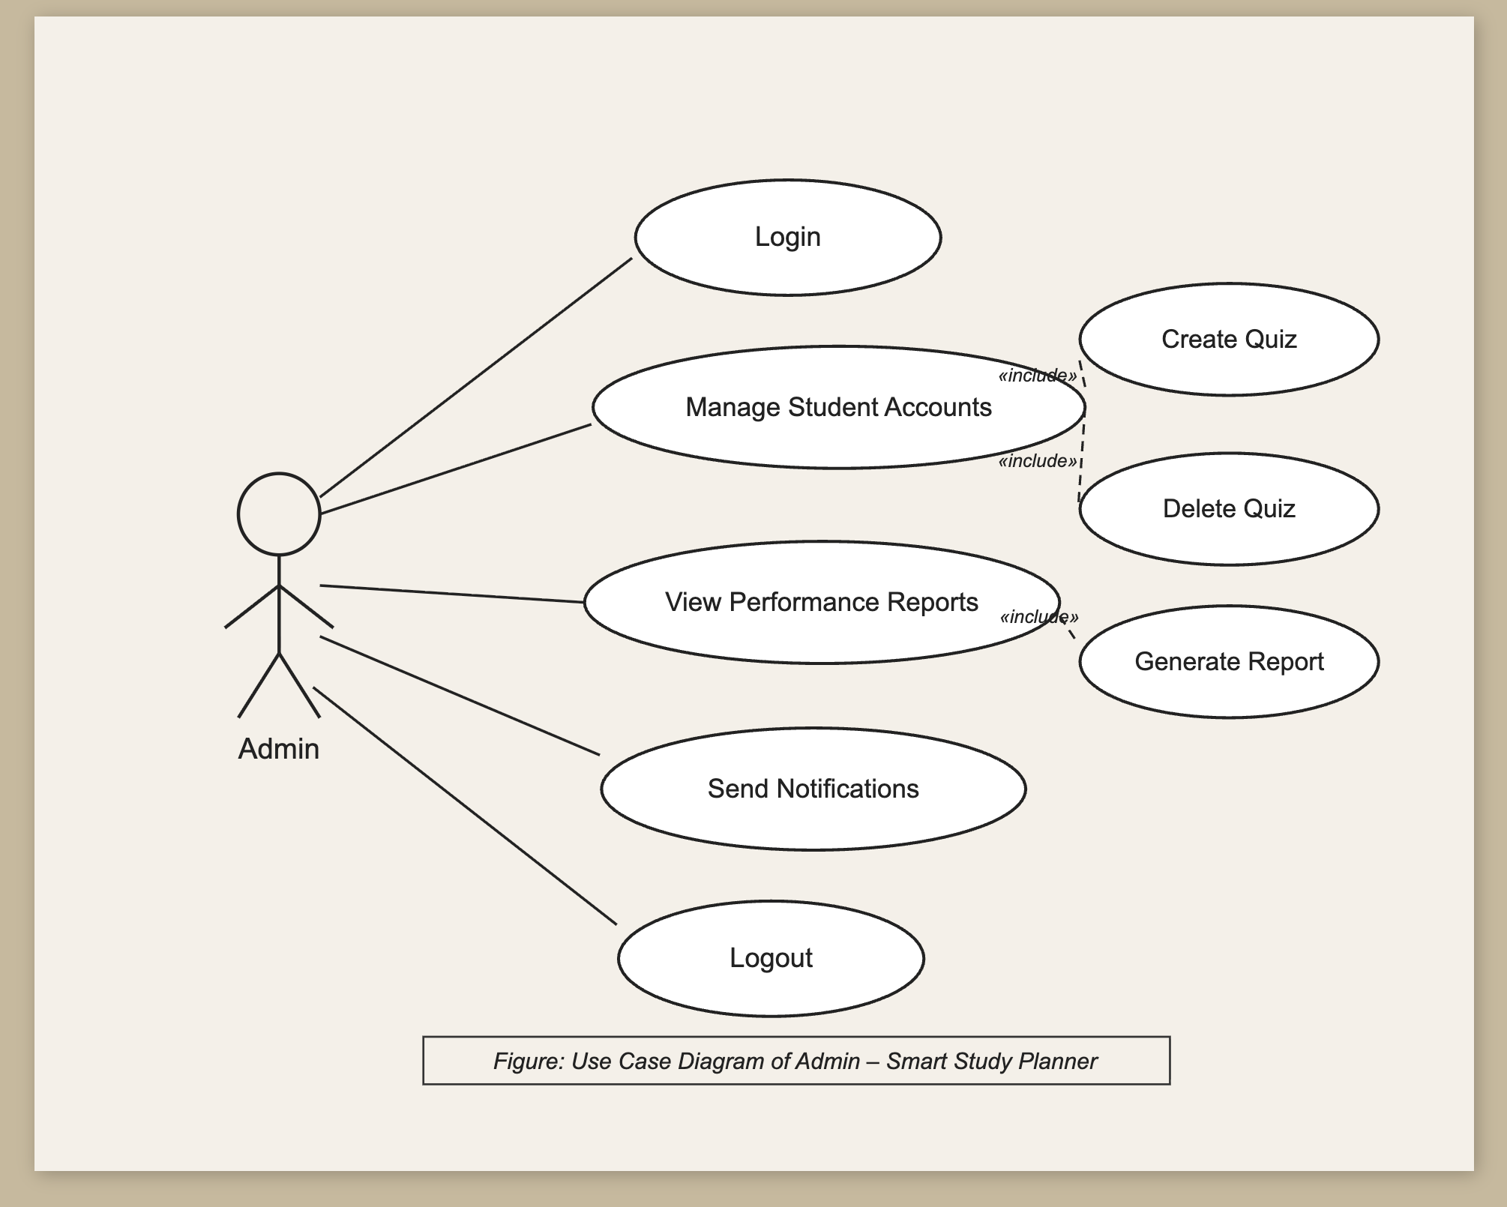
Use Case Diagram — Admin
Admin can Login, Manage Students, Create/Delete Quizzes, View Reports, Send Notifications and Logout

Slide 8
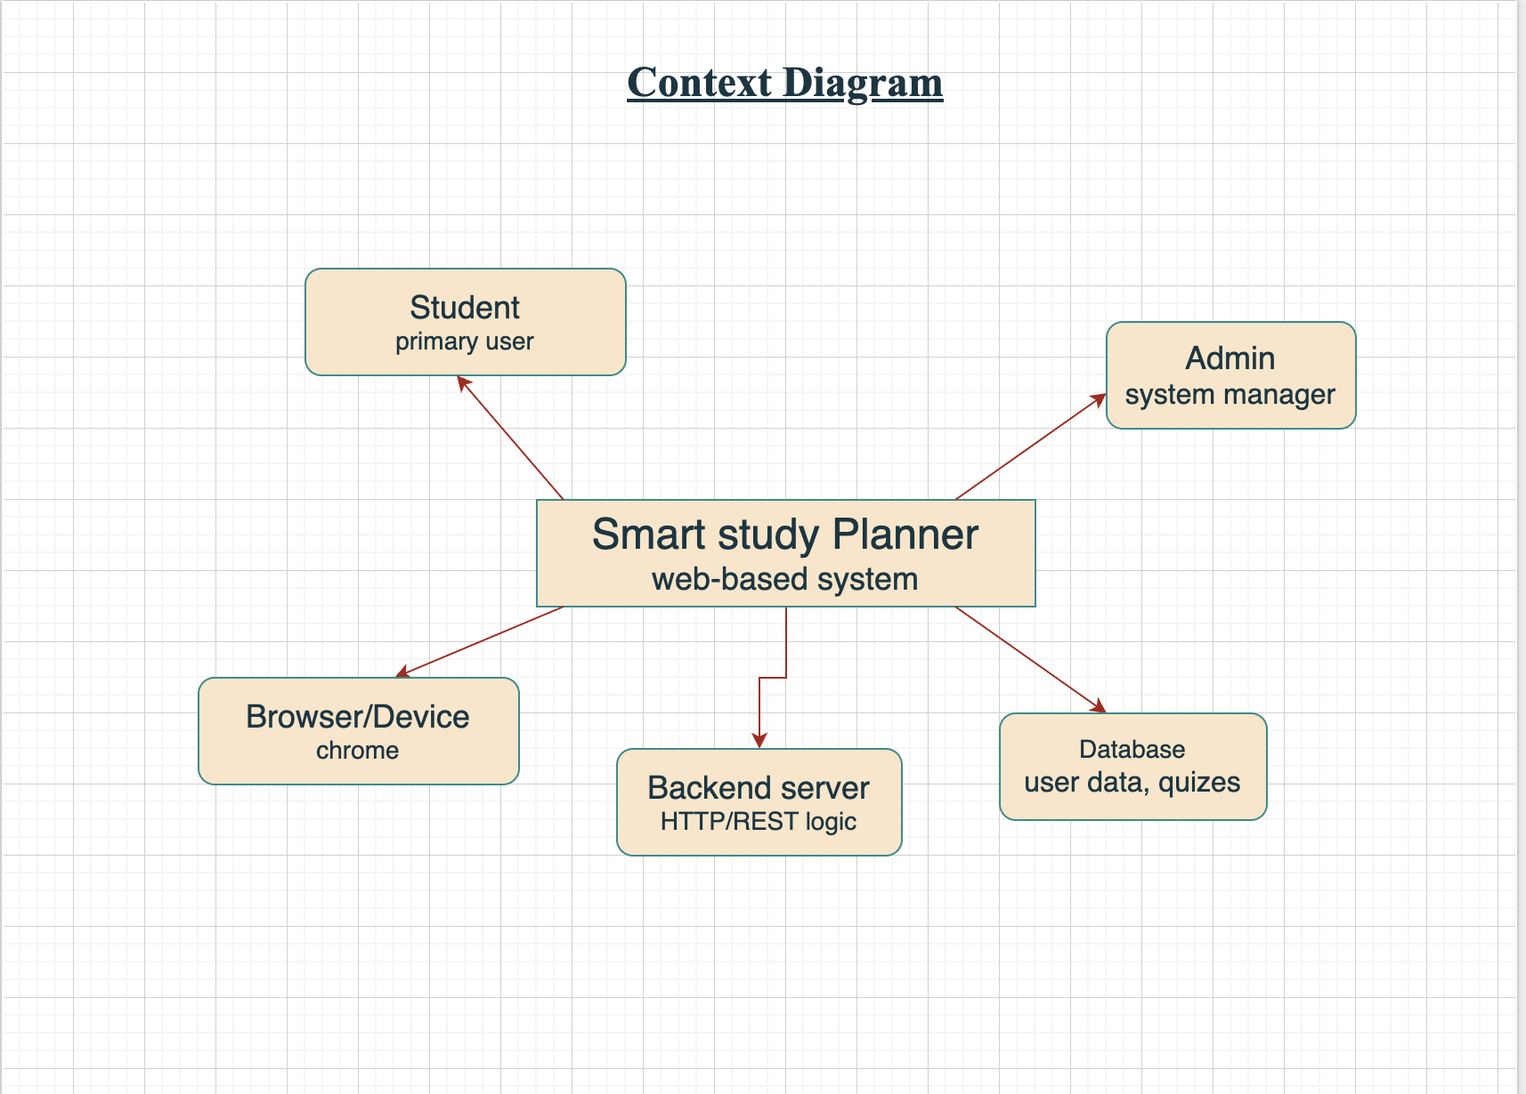
Context Diagram
Shows how the Smart Study Planner interacts with external entities: Student, Admin, Browser/Device, Backend Server, Database

Slide 9
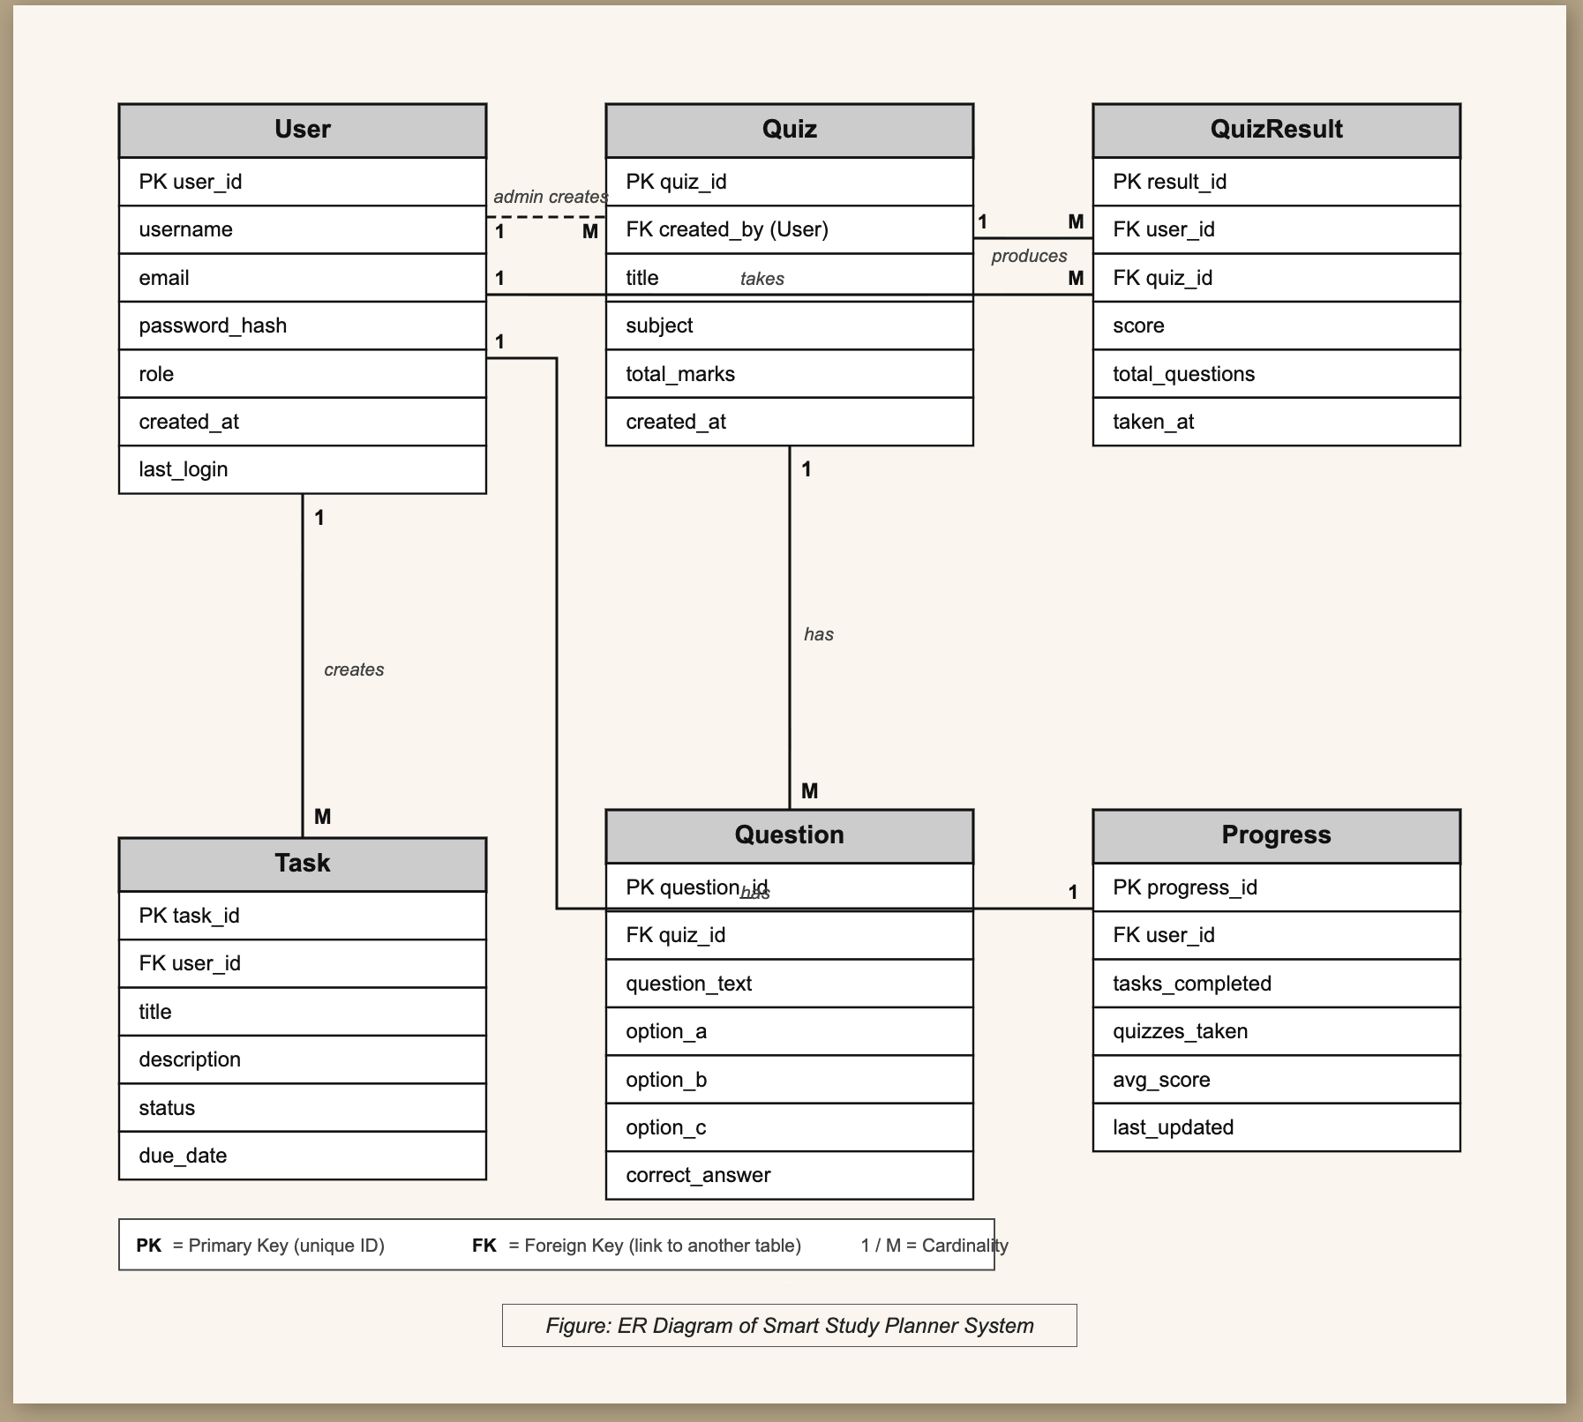
Entity-Relationship (ER) Diagram

Slide 10
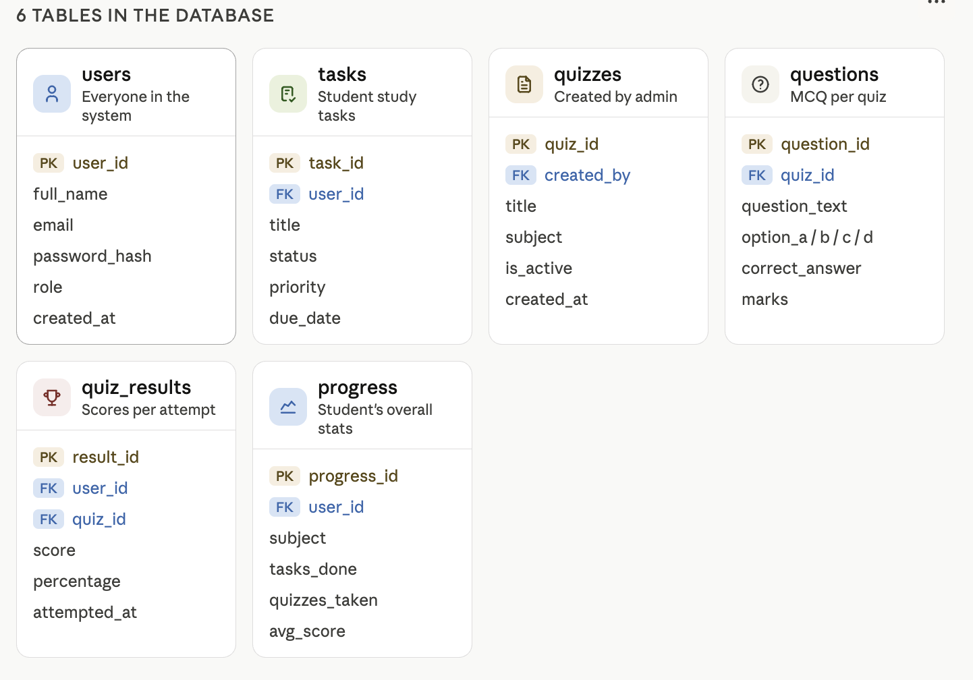
Database Design — 6 Tables
All tables in Third Normal Form (3NF). PK = Primary Key · FK = Foreign Key

Slide 11
Database Tables Detail — users, tasks, quizzes
1. users
2. tasks
3. quizzes
Column
Type
Notes
Column
Type
Notes
Column
Type
Notes
id
TEXT
PRIMARY KEY (UUID)
id
TEXT
PRIMARY KEY (UUID)
id
TEXT
PRIMARY KEY (UUID)
name
TEXT
NOT NULL
user_id
TEXT
FK → users(id)
title
TEXT
NOT NULL
email
TEXT
UNIQUE, NOT NULL
title
TEXT
NOT NULL
subject
TEXT
e.g. Web, Cloud
password
TEXT
bcrypt hashed
description
TEXT
Optional
total_marks
INT
Max available score
role
TEXT
'student' | 'admin'
status
TEXT
pending/in-progress/done
is_active
BOOL
FALSE = hidden from students
last_login
TEXT
ISO timestamp
priority
TEXT
low/medium/high
created_by
TEXT
FK → users(id)
due_date
TEXT
ISO date
📝 Stores all users. Role decides dashboard view.
📝 Study tasks created by students. Scoped per user.
📝 Quizzes by admin. is_active hides without deleting.

Slide 12
Database Tables Detail — questions, quiz_results, progress
4. questions
5. quiz_results
6. progress
Column
Type
Notes
Column
Type
Notes
Column
Type
Notes
id
TEXT
PRIMARY KEY (UUID)
id
TEXT
PRIMARY KEY (UUID)
id
TEXT
PRIMARY KEY (UUID)
quiz_id
TEXT
FK → quizzes CASCADE
user_id
TEXT
FK → users(id)
user_id
TEXT
FK → users(id)
question_text
TEXT
NOT NULL
quiz_id
TEXT
FK → quizzes(id)
subject
TEXT
e.g. Web, Cloud
option_a/b/c/d
TEXT
Four choices
score
INT
Correct answers count
tasks_completed
INT
Done tasks count
correct_answer
CHAR
A, B, C or D
total
INT
Total questions
quizzes_taken
INT
Total attempts
marks
INT
Points for correct
percentage
FLOAT
score/total × 100
avg_score
FLOAT
Average percentage
taken_at
TEXT
ISO timestamp
📝 Questions per quiz. CASCADE deletes when quiz deleted.
📝 Each attempt saved separately. Supports retakes.
📝 Overall student performance. Powers Progress Tracker.

Slide 13
API Reference — 17 Endpoints
Auth (Public)
Progress (Auth+Owner)
POST /api/registerPOST /api/login
POST /api/scores/:userIdGET /api/progress/:userId
Tasks (Auth+Owner)
GET /api/tasks/:userIdPOST /api/tasks/:userIdPATCH .../toggleDELETE .../taskId
Admin (Admin Role)
CRUD /api/admin/quizzesCRUD .../questionsGET /admin/usersPATCH toggle-admin
Quizzes (Auth)
GET /api/quizzes

Slide 14
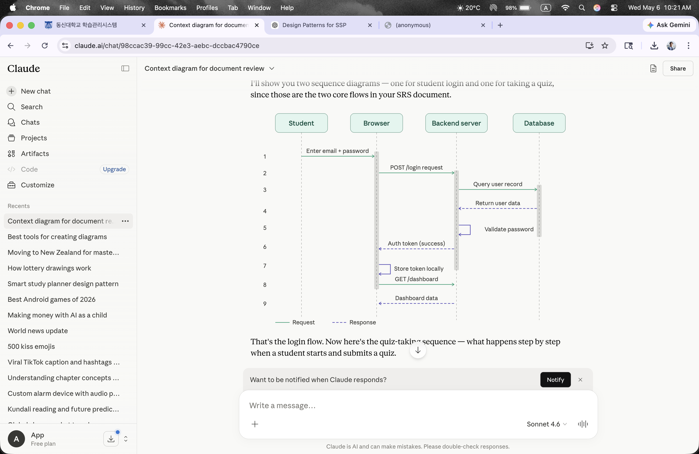
Sequence Diagram — User Login
Student enters credentials → Express validates → bcrypt.compare → JWT issued → redirect to Dashboard

Slide 15
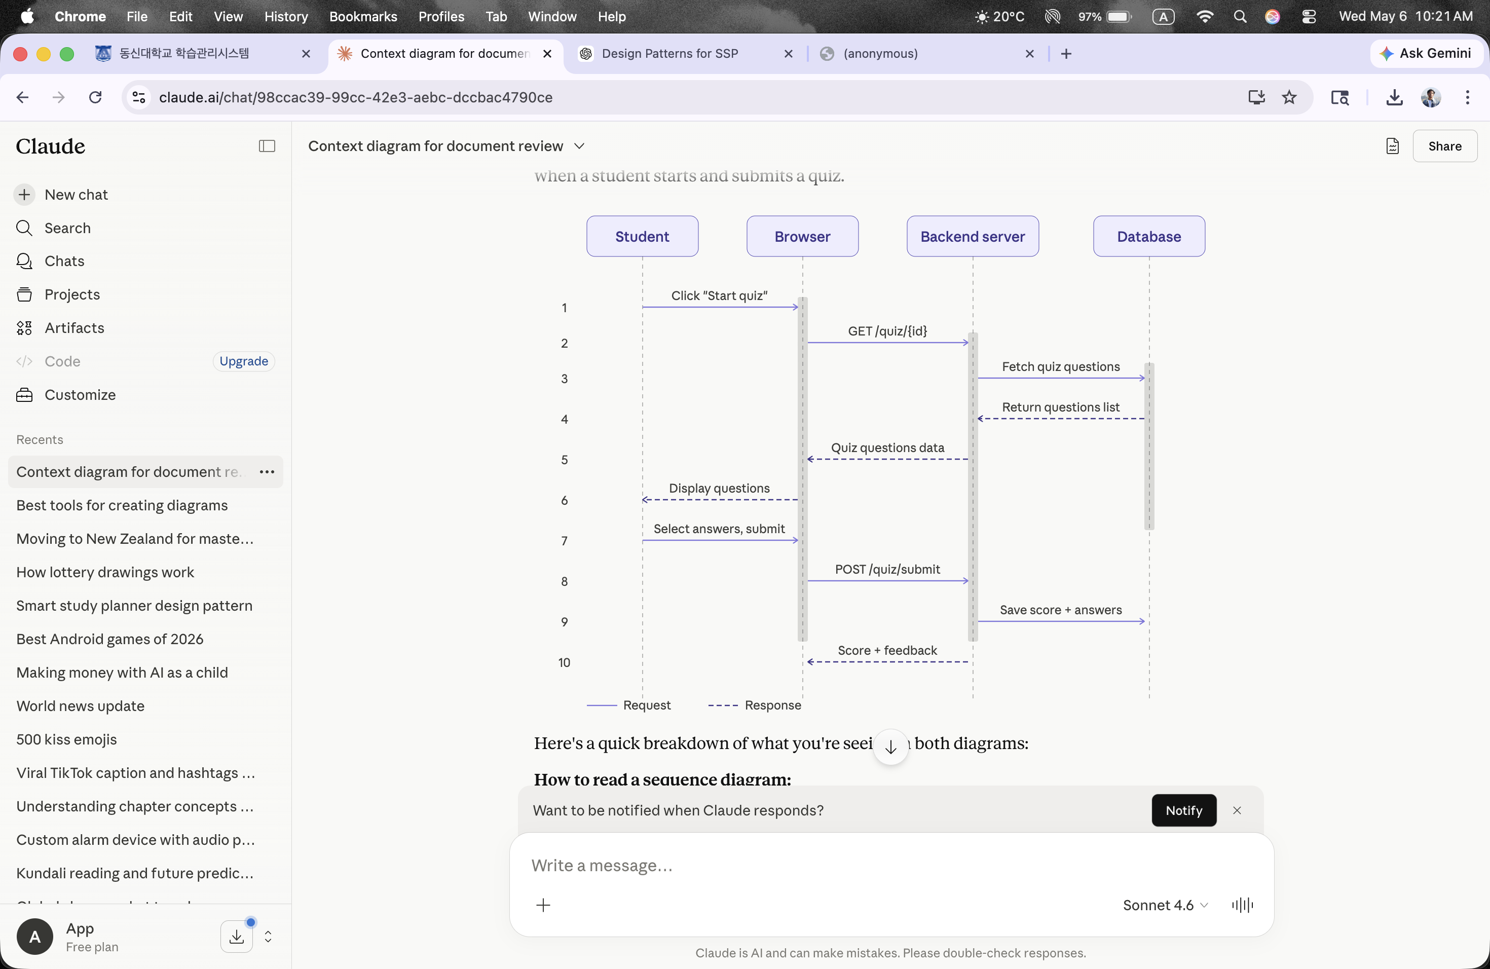
Sequence Diagram — Taking a Quiz
Student selects quiz → questions fetched → answers submitted → score calculated → saved to DB

Slide 16
Authentication & Middleware Flow
Every protected route passes through: requireAuth → requireOwner / requireAdmin
HTTP Request
Bearer token
present?
401 Unauthorized
No
Yes
jwt.verify(token)
Token valid
& not expired?
401 Invalid Token
No
Yes
req.user = decoded payload
✓ Route Handler

Slide 17
Frontend Component Architecture
React component tree · arrows show render/composition direction · Context available everywhere
App.jsx
Router + AuthProvider
AuthProvider
useAuth() — global user state
BrowserRouter + Routes
Client-side navigation
🔒 ProtectedRoute (checks auth / admin role) wraps all pages below
Welcome
Login
Signup
Dashboard
Tasks
Quiz
Progress
Admin
public
public
public
protected
protected
protected
protected
protected
Shared Components
Context & API
Styles
Navbar.jsx
ProtectedRoute.jsx
StudyIllustration.jsx
AuthContext.jsx
backend.js (API calls)
quizzes.js (seed data)
index.css
CSS custom properties
responsive design vars

Slide 18
Request Flow Diagram
Swimlane: Browser → Vite Proxy → Express API → PostgreSQL → response back to UI
Browser (React)
Vite Dev Server
Express API
PostgreSQL
1. User action (e.g. Add Task)
2. Proxy /api/* → port 4000
3. requireAuth (verify JWT)
4. requireOwner (check userId)
5. SQL parameterised query
6. JSON { ok: true, task }
7. React state updates — UI re-renders

Slide 19
Functional Requirements — FR-1 to FR-6
FR-1
User Registration
FR-2
User Login
A new student signs up with name, email and password. System validates and creates their account.
Registered students and admins log in using email and password and are redirected to their dashboard.
FR-3
User Logout
FR-4
Task Management
Any logged-in user can log out at any time. Session ends and user is sent to the login page.
Students create, update, and delete study tasks with title, description, status, priority, and due date.
FR-5
Quiz Taking
FR-6
Quiz Result
Students take admin-created quizzes. Questions appear one-by-one as multiple choice. Score shown on submit.
After submitting a quiz the system shows the score immediately and saves the result for future reference.

Slide 20
Functional Requirements — FR-7 to FR-12
FR-7
Progress Tracking
FR-8
Admin Manages Students
System automatically tracks each student's completed tasks, quizzes taken, and average score on the dashboard.
Admin can view all students, add new accounts, update their details, or remove them from the system.
FR-9
Admin Creates Quizzes
FR-10
Admin Views Reports
Admin creates quizzes with title, subject, total marks, and multiple-choice questions with correct answers.
Admin sees every student's quiz scores, tasks completed, and overall progress. Reports can be generated and saved.
FR-11
Admin Sends Notifications
FR-12
Input Validation
Admin writes and sends announcements to students. Students see notifications on their dashboard on login.
All forms are validated — email format, password length, required fields. Clear error messages guide the user.

Slide 21
Non-Functional Requirements
⚡ Performance
🔐 Security
💾 Reliability
Pages load quickly and respond smoothly even with many simultaneous users.
bcrypt password hashing + JWT auth. Only verified users can access protected data.
System operates without crashing. All tasks, scores and progress saved accurately.
🖥️ Usability
📱 Responsiveness
🔧 Maintainability
Simple, clean interface. Students with basic computer knowledge can use all features.
Works on desktops, laptops, tablets and mobiles via Chrome and Safari.
Three-layer architecture makes it easy to extend, debug, and maintain.

Slide 22
Feature: Dashboard
📊 Stats Row
⏰ Live Header
Total Tasks, Completed, Quizzes Taken, Completion Rate
Each card links to its relevant page
Time-based greeting: Good morning/afternoon/evening
Live date + clock updated every minute
✅ Task Panel
⚡ Quick Actions
Up to 6 pending tasks with inline quick-add
Toggle complete, delete with confirmation
Animated SVG ring chart for completion %
Take a Quiz → /quiz
Manage Tasks → /tasks
View Progress → /progress
Recent 3 quiz scores shown

Slide 23
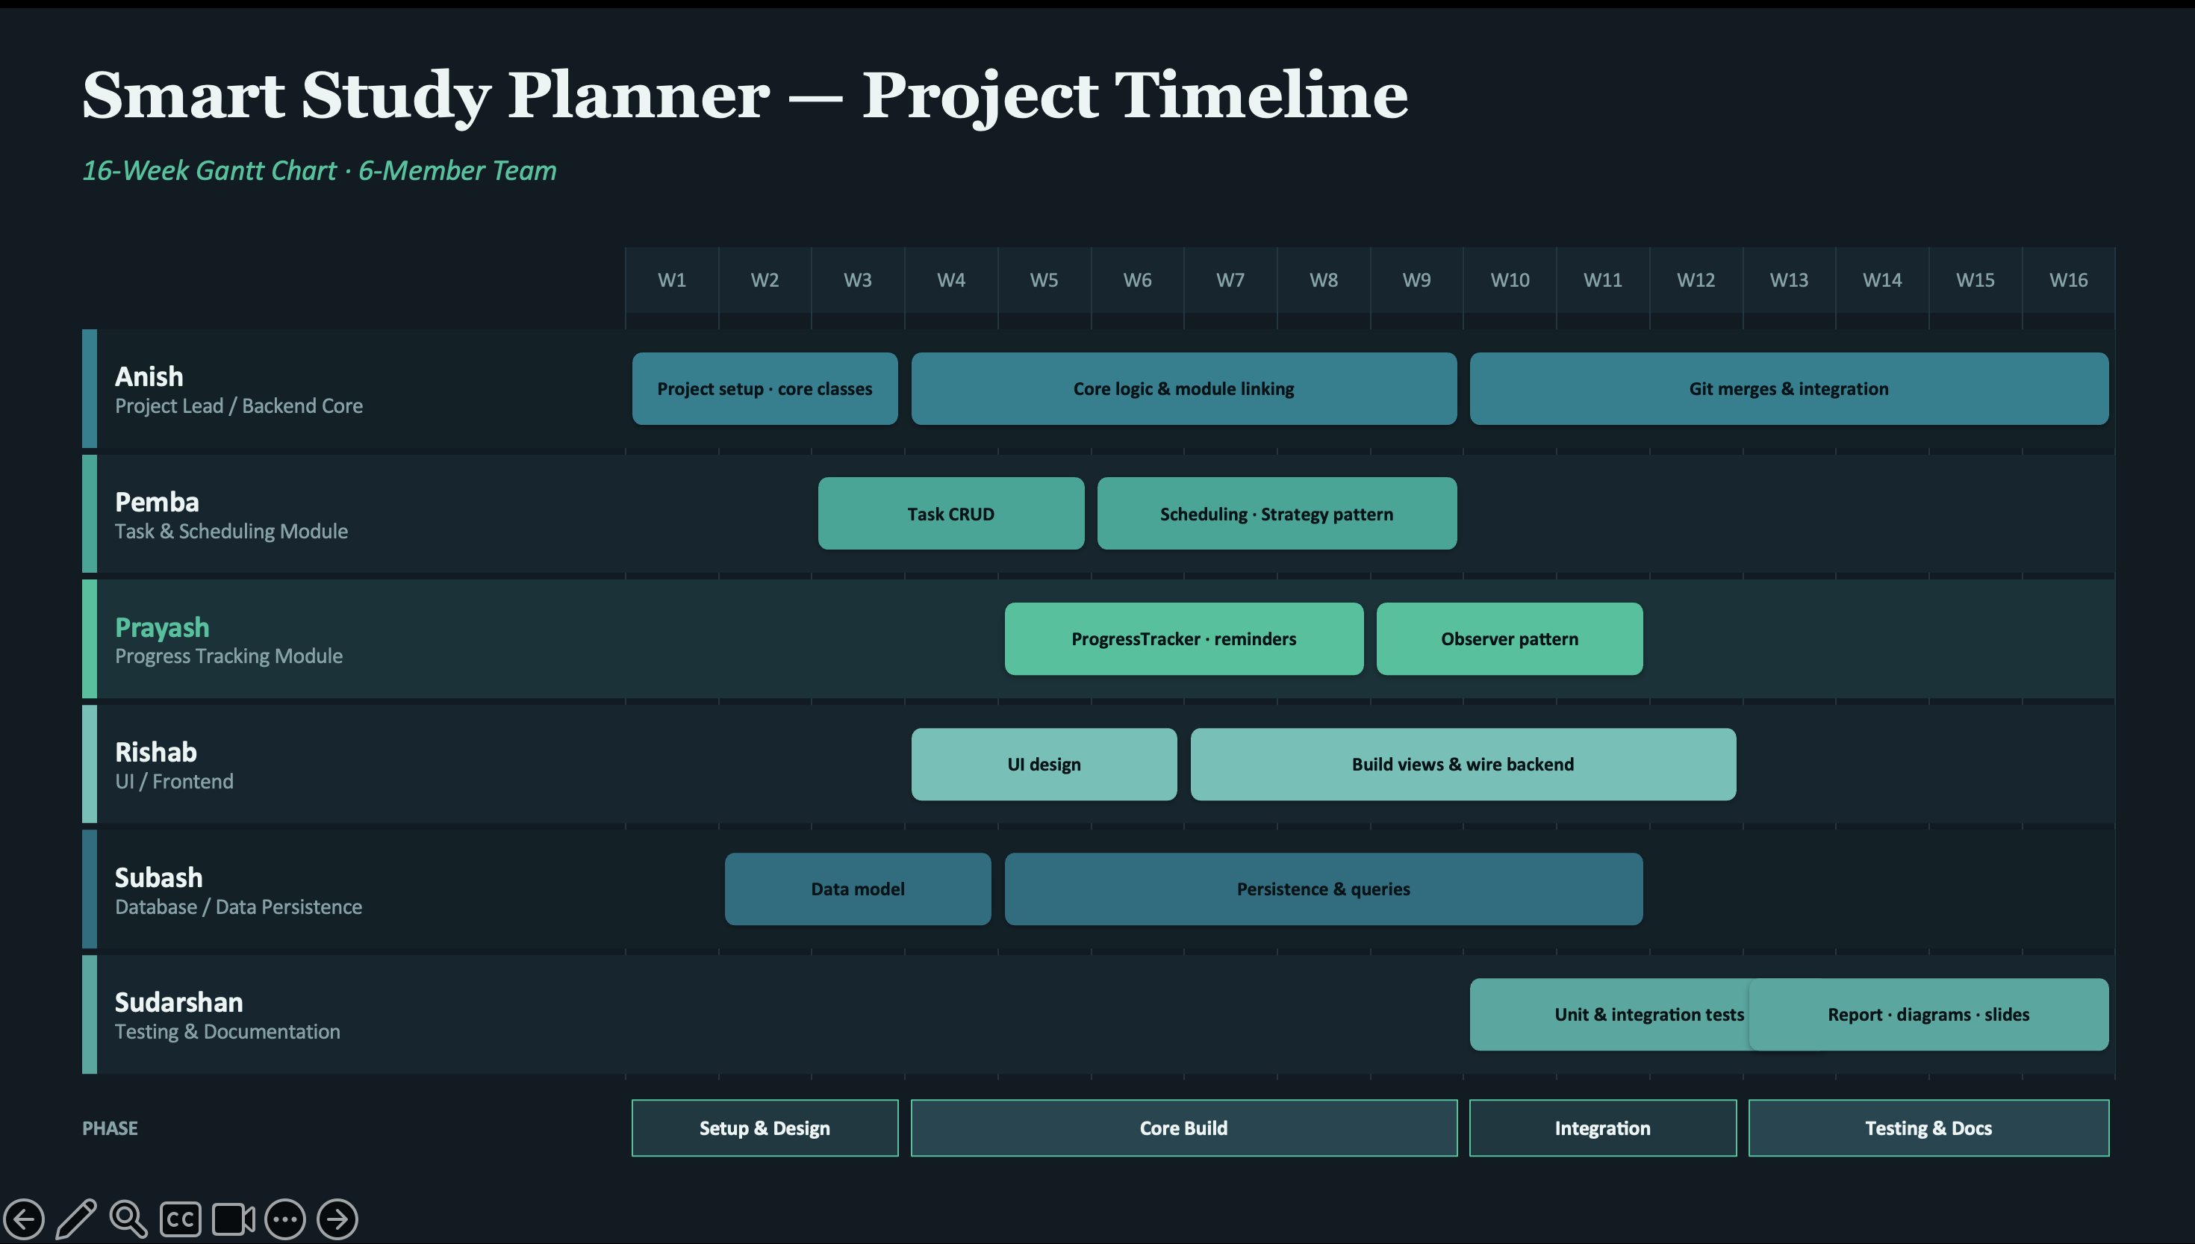

Slide 24
Feature: Task Management
➕
Create
🏷️
Priority Pills
🔍
Filter Tabs
Title, subject, due date, priority (HIGH/MEDIUM/LOW)
Colour-coded: purple HIGH · gold MEDIUM · green LOW
All · Pending · Completed
✅
Toggle
🗑️
Delete
💾
Persistent
Circular checkbox marks complete/incomplete
Confirmation dialog prevents accidents
PostgreSQL storage, scoped per user

Slide 25
Feature: Quiz System
Web Fundamentals
Cloud & Databases
Study Strategies
5 questions each
5 questions each
5 questions each
HTTP · HTML · CSS · UI · Browsers
SQL · Serverless · AWS · Responsive
Pomodoro · Active Recall · SRS
1. Pick a Quiz
2. Answer Question
3. Instant Feedback
4. See Score
5. Score Saved
Immediate feedback: correct = green highlight, wrong = red highlight
Progress bar shows current question position within the quiz
Retry the same quiz or return to quiz picker after seeing results

Slide 26
Feature: Progress Tracking & Admin Panel
📈 Progress Tracking (all users)
⚙️ Admin Panel (admin role only)
Task completion rate %
Total tasks vs. completed tasks
Total quizzes taken
Full quiz history (most recent first)
Visual progress bar
View all quizzes with question counts
Create / rename / delete quizzes
Add questions (up to 4 options + correct answer)
Delete individual questions
View all registered users
Grant or revoke admin access
Admins cannot change their own role

Slide 27
Security Implementation
🔑
Password Storage
🎫
JWT Auth
🛡️
Middleware Chain
bcrypt with 10 salt rounds — never stored in plaintext
Stateless JWT, 7-day expiry, signed with JWT_SECRET env var
requireAuth → requireOwner / requireAdmin on every route
💉
SQL Injection
✅
Input Validation
🚫
Data Exposure
Parameterised queries ($1, $2, ...) via pg library
Presence checks + max-length guards on all user inputs
Passwords excluded from all API responses

Slide 28
Limitations & Future Improvements
⚠ CORS open (*)
✓ Restrict to frontend domain in production
⚠ No task edit
✓ Add in-place edit functionality
⚠ No quiz timer
✓ Add per-question countdown timer
⚠ No email verify
✓ Add verification + password reset flow
⚠ No tests
✓ Add Jest / Vitest unit & integration tests
⚠ No deploy config
✓ Docker, nginx, PM2 for production
⚠ JWT in sessionStorage
✓ Use httpOnly cookies for XSS resistance

Slide 29
Development Timeline
3e3f53f
Initial commit: Smart Study Planner (React + Express + PostgreSQL)
7d54ad6
Remove .vite cache, tighten .gitignore
a16abdc
Add share script: concurrently + localtunnel for public sharing
5d0fe1b
Fix DB connection: load .env via dotenv, update proxy and CORS headers
cd58bcd
Full audit: JWT auth, error handling, UI polish, more quizzes (latest)

Slide 30
Future Scope
Planned enhancements for the next version
🤖
AI-Based Suggestions
📧
Email Notifications
📱
Mobile Application
AI recommends tasks and quizzes based on student weak areas and performance history.
Automated reminders for pending tasks, quiz deadlines, and system updates via email.
Dedicated iOS and Android app so students can access the planner on smartphones.
💬
Chat & Discussion
☁️
Cloud Deployment
📊
Advanced Analytics
Built-in system allowing students and admins to communicate and share study tips.
Deploy to AWS/Heroku with Docker and nginx for production-grade availability.
Detailed dashboards with charts, trends, and exportable reports per student/subject.

Slide 31
Conclusion
✅ Complete full-stack web application — React + Express + PostgreSQL
🔐 Secure JWT auth with bcrypt hashing and role-based middleware (student / admin)
📋 Full task management — priority, filtering, real-time UI updates
🧠 Quiz engine — instant feedback, score history, admin-managed content
📈 Progress dashboard — completion rate, quiz history, per-student stats
⚙️ Admin panel — full quiz & user management with notifications
🗄️ Relational DB in 3NF — 6 tables, auto-initialised, seeded on first run
🏗️ Clean three-layer architecture — Presentation → Application → Data
Pandey Anish Raj · Chand Rishab · Timalsina Sudarshan · Oli Shubhash · Thing Pemba Dorge · Thapa Prayash

