Slide 1
BioNet | Reliable Biometric Transmission
• Computer Networks: Selective Repeat ARQ over UDP
• Actual biometric ZIP transfer verified on MacBook Air M4
• Python 3.12 • real UDP sockets • CRC32 • SHA-256

Slide 2
Problem and Objective
• UDP can lose, reorder or duplicate datagrams.
• Transfer captured biometric archive without changing a single byte.
• Implement genuine networking reliability, demonstrate and evaluate.

Slide 3
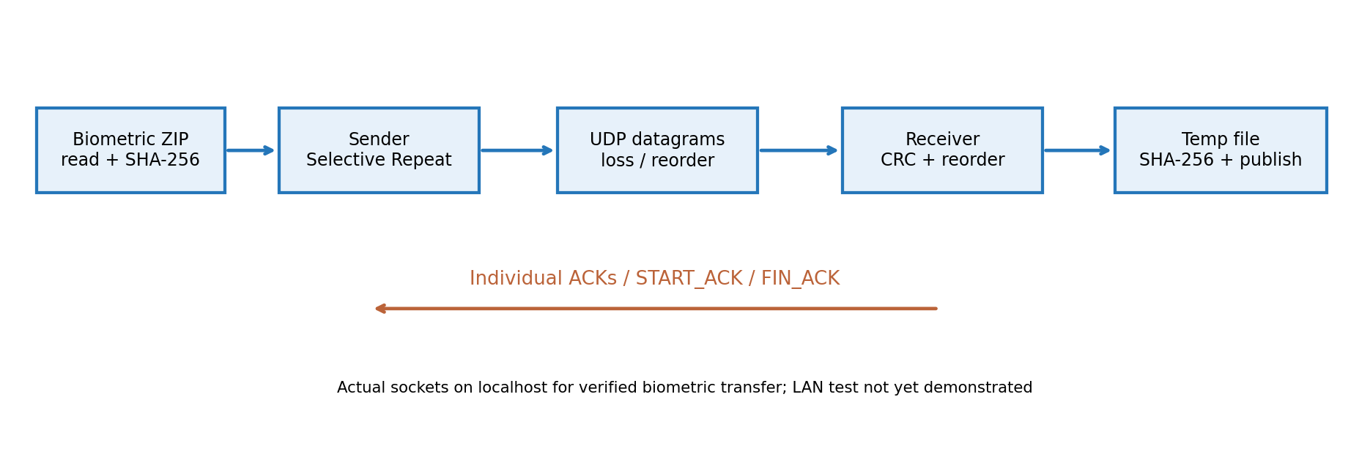
System Architecture

Slide 4
How Selective Repeat Works
• Sliding window allows multiple outstanding packets.
• Individual ACKs and independent retransmission timers.
• Receiver buffers out-of-order DATA; only missing packets are retried.
• Verified FIN_ACK only after complete SHA-256 match.

Slide 5
Real Biometric Transfer — Verified
• 2,774,235,808 bytes • 2,709,215 DATA packets ACKed
• 5% simulated sender loss • 143,000 retransmissions
• 6,453.90 s • final reported goodput 3.439 Mbps
• Sender SHA-256 PASS • receiver SHA-256 PASS • independent cmp PASS

Slide 6
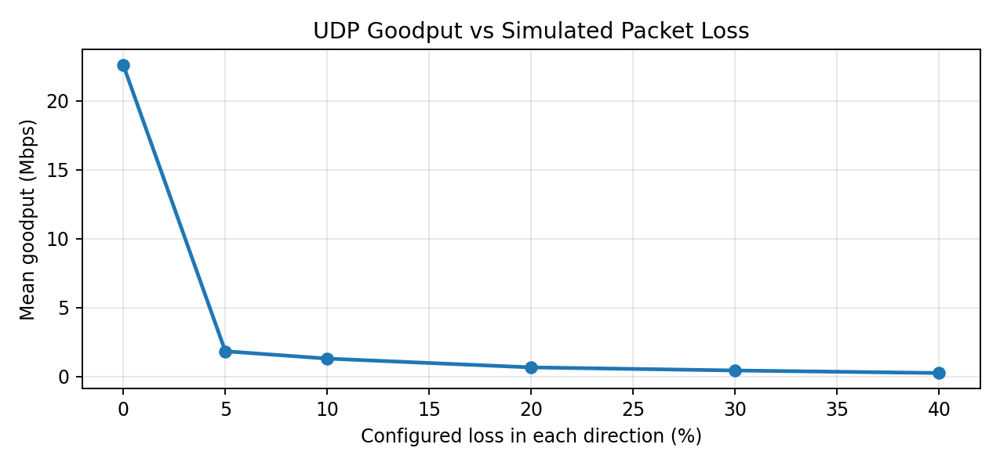
Measured Performance: Goodput vs Loss

Slide 7
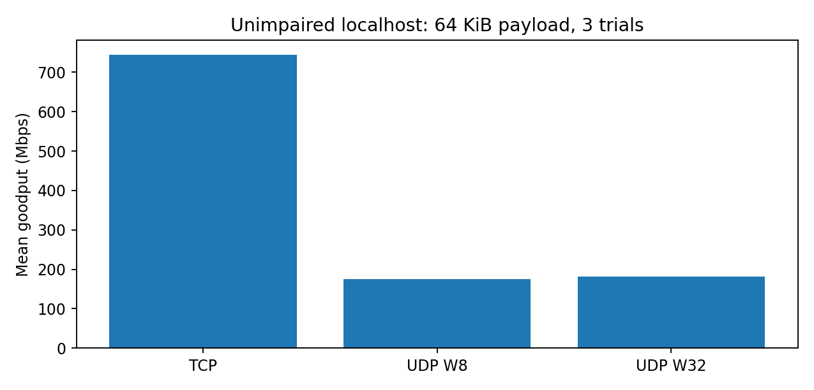
Measured Performance: TCP vs UDP

Slide 8
Testing and Limitations
• 181 / 181 automated tests passed on macOS (30.79 s).
• 90 / 90 Phase 3 synthetic benchmark transfers verified.
• Real-data transfer was localhost, not separate-device LAN.
• No encryption, authentication, congestion control or crash-resume.

Slide 9
Live Demonstration & Conclusion
• Start receiver; send synthetic ZIP with controlled loss.
• Show ACKs, retries, out-of-order buffering and SHA-256 PASS.
• Show actual transfer logs and independent byte-for-byte PASS.
• Reliable reconstruction demonstrated under simulated loss.

