Slide 1

Blinkit Sales & Outlet Analysis
SQL-driven insights for inventory, outlets, assortment, and growth

Slide 2

Project Objective
Clean Data
Measure Metrics
Segment Analysis
Standardize product attributes for reliable analysis
Total sales, avg sales, item count, avg rating
By fat content, item type, outlet attributes, year
Recommend
Inventory, outlet strategy, merchandising, growth

Slide 3

Data Preparation
Key Steps
Created blinkitdb and normalized blinkit table
Standardized ItemFatContent (Low Fat, Regular)
Ensured consistent categorical values
Result: improved reliability and aggregation accuracy

Slide 4

Key Metrics Overview
1
2
3
Total Sales
Avg Sales / Item
Total Items
Shown in million format for executives
Typical product-level revenue
Dataset size & assortment diversity
4
Avg Rating
Customer satisfaction signal

Slide 5


Fat Content Analysis
Regular
Low Fat
Higher total sales; slightly higher avg sales
Competitive ratings; strong demand
Insight: Maintain both categories—diverse consumer demand

Slide 6

Top Item Types
Top 5 Categories
Disproportionate revenue share (Pareto effect)
Performance Signals
High total sales, strong avg ratings, large item counts

Slide 7
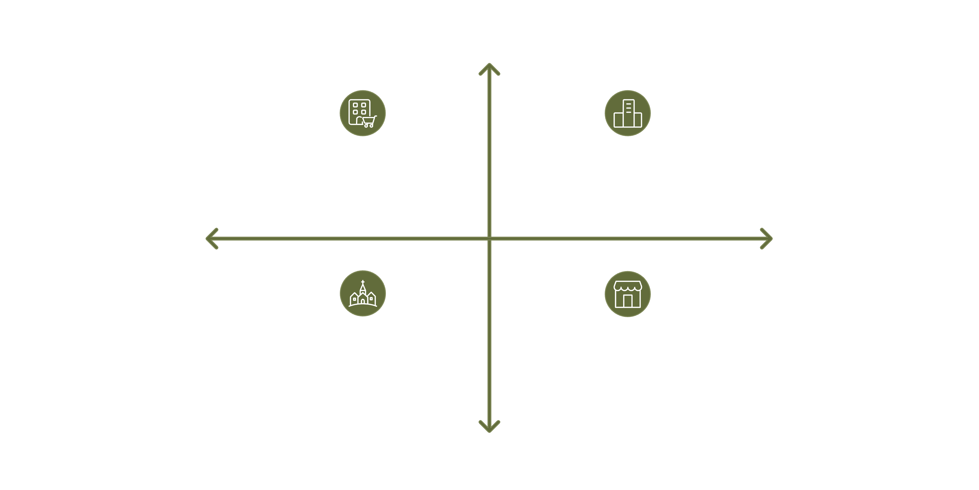

High Sales Contribution
Urban — Large outlets: Top performers
Semi-urban — Medium outlets: Strong contributors
Small Size
Large Size
Rural — Small outlets: Low sales
Semi-urban — Small outlets: Moderate performance
Low Sales Contribution
Urban & semi-urban outperform rural; medium/large outlets contribute most sales

Slide 8

Outlet Establishment & Type
Older Outlets
Higher total sales; stable ratings
New Outlets
Lower sales but growth potential; need support
Outlet Type
High item visibility → better sales

Slide 9
Recommendations
Inventory
Increase stock for top-performing types; balance Low Fat & Regular
Outlet Strategy
Expand in high-performing locations; upgrade small outlets where demand exists
Visibility
Improve shelf placement using data-driven merchandising
Support New Outlets
Promotions and benchmarking from mature outlets
Ratings
Monitor and act on ratings for high-selling but low-rated items

Slide 10

Conclusion
Impact
Opportunities
Structured SQL analysis → actionable business insights
Revenue growth, smarter expansion, inventory efficiency, customer focus
Next: prioritize top categories, optimize outlets, track ratings

