Slide 1
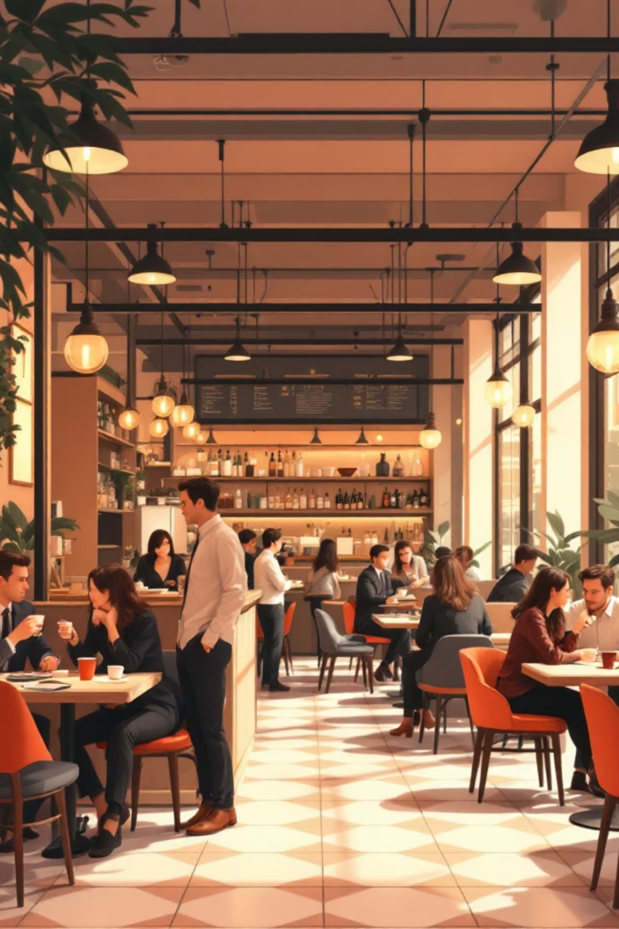
Coffee Shop Sales Analysis
Data-driven insights from 149K+ transactions across multi-location chain

Slide 2
OVERVIEW
Executive Summary
₹58.9M
149K
₹395
Total Revenue
Transactions
Avg Transaction
Across all locations
High-volume retail model
Mid-ticket purchases
Airport and high-footfall urban locations drive majority of revenue. Beverage products dominate sales with strong opportunities for optimization.

Slide 3

Business Objectives
01
Performance Measurement
Track sales and transaction metrics
02
Product Analysis
Identify top performers and categories
03
Location Comparison
Evaluate store-level performance
04
Strategic Planning
Enable data-driven growth decisions

Slide 4
Data Foundation
Key Metrics
Orders Table
Products Table
Total Sales Amount
Total Orders
Sales by Product
Sales by Store Location
Transaction date, time, store, product, quantity
Category, type, details, unit price

Slide 5
Top-Selling Products
Large-size beverages and premium drinks dominate revenue
1
Sustainably Grown Organic (Large)
₹1.78M revenue
2
Dark Chocolate (Large)
₹1.76M revenue
3
Latte (Regular)
₹1.61M revenue
4
Cappuccino (Large)
₹1.48M revenue
5
Morning Sunrise Chai (Large)
₹1.46M revenue

Slide 6

Product Performance Insights
Coffee Outperforms
Size Matters
Large Sizes Win
Large beverages drive revenue growth
Coffee Dominance
Coffee-based drinks lead sales
Premium Demand
Premium Appeal
Specialty drinks show strong demand
Customer preferences reveal clear patterns favoring premium, large-format beverages.

Slide 7
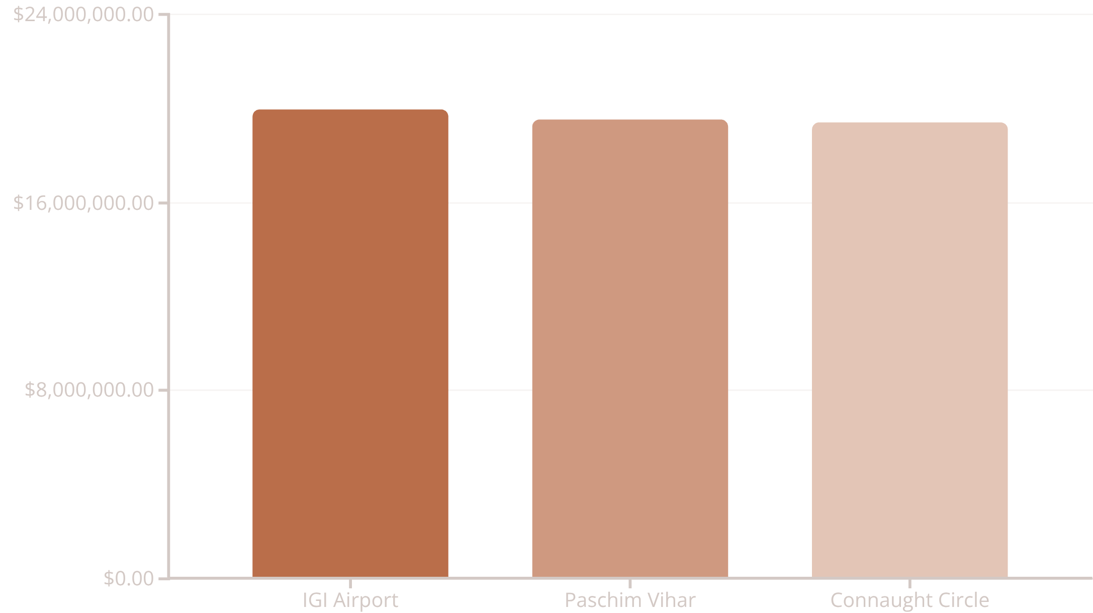
Store Location Performance
Location Insights
Airport stores generate highest sales driven by foot traffic and premium pricing tolerance.
Urban high-density locations show nearly equal contribution with balanced revenue distribution.
Optimization potential exists for each location type.

Slide 8
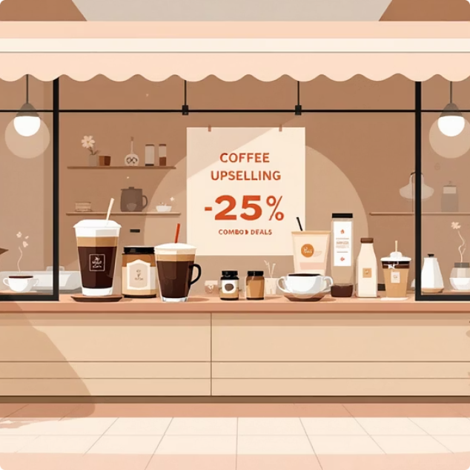


RECOMMENDATIONS
Strategic Action Plan
Product Strategy
Store Optimization
Marketing Focus
Promote large-size premium beverages
Bundle top drinks with snacks
Simplify inventory, reduce low performers
Location-specific pricing at airports
Expand seating at high-traffic stores
Use airport trends for new locations
Loyalty programs for frequent buyers
Time-based offers (morning, evening)
Highlight sustainable products

Slide 9

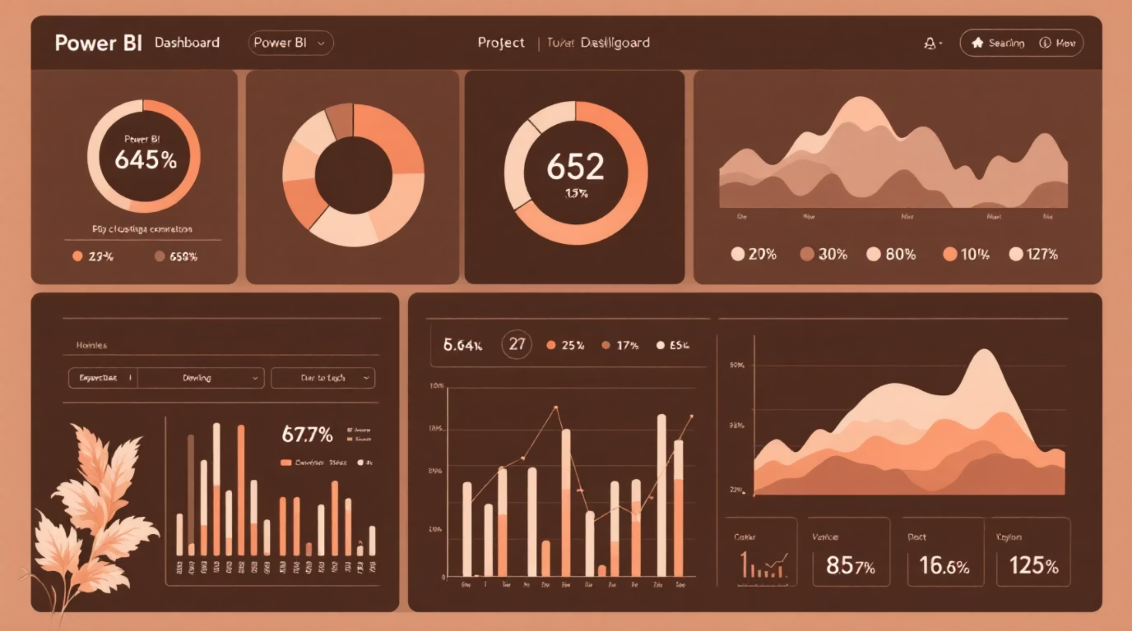
Tools & Methodology
Power BI
Data modeling, DAX measures, interactive dashboards
Data Transformation
Date handling, joins, calculated fields
KPI Tracking
Revenue, quantity sold, product and store ranking

Slide 10

Key Takeaways
High-Volume Success
Clear Winners
Location Strategy
₹58.9M revenue demonstrates strong market position
Large beverages and premium drinks drive profitability
Airport and urban stores offer optimization opportunities
Transactional data reveals actionable insights for revenue growth, customer experience improvement, and effective scaling.

