Slide 1

P4

Slide 2

https://www.uptrends.com/tools/website-speed-test

Slide 3
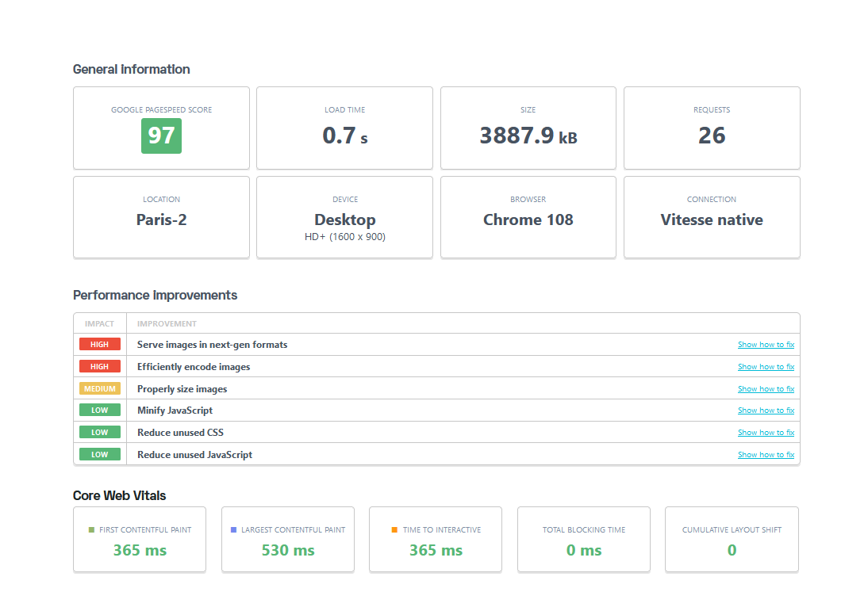

Slide 4
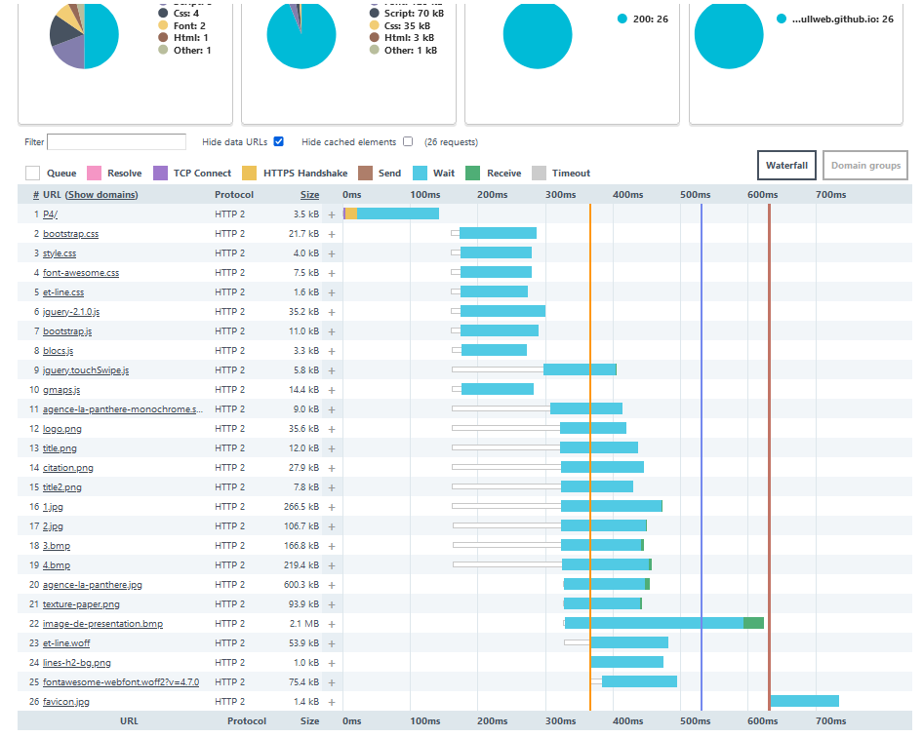

Slide 5

W3C HTML

Slide 6
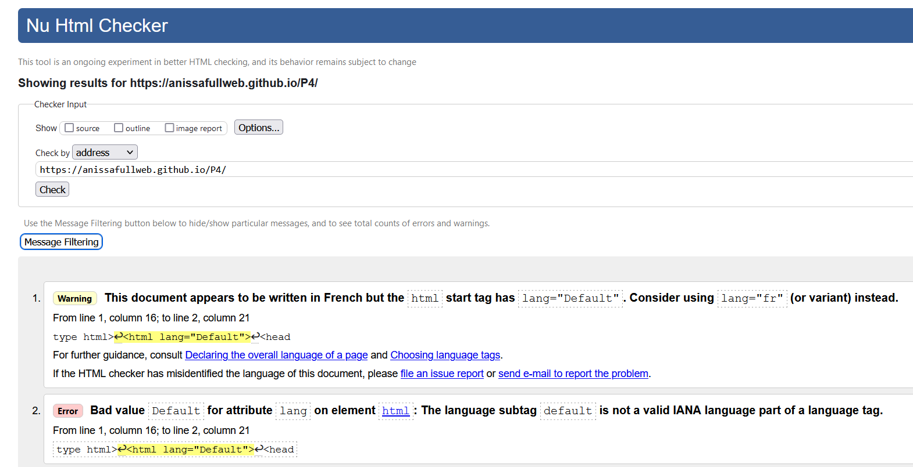

Slide 7
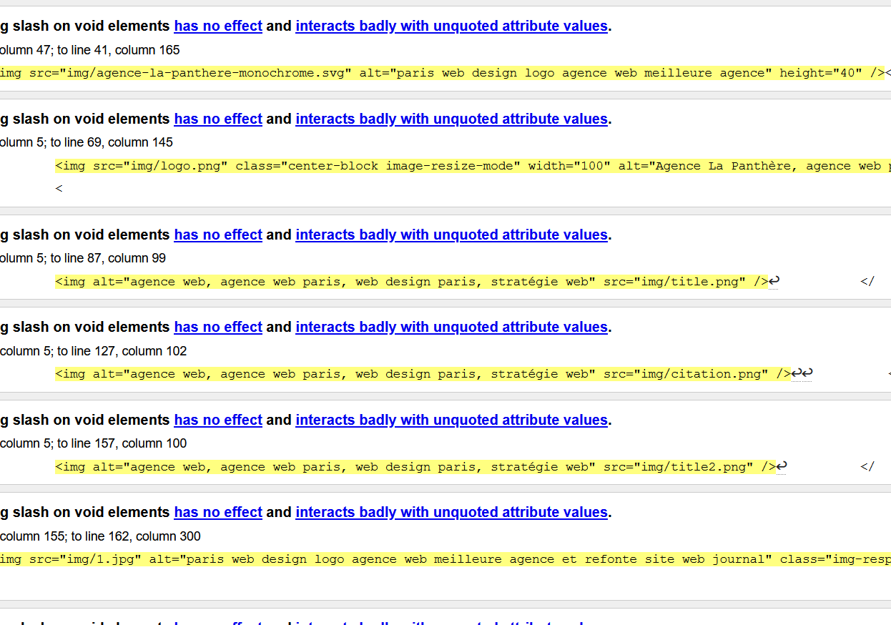

Slide 8
W3C STYLE.CSS

Slide 9
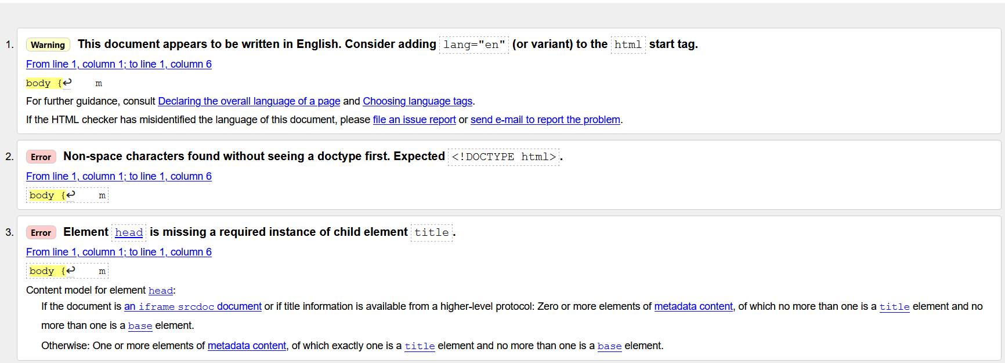

Slide 10
https://chrome.google.com/webstore/detail/wave-evaluation-tool/jbbplnpkjmmeebjpijfedlgcdilocofh
https://wave.webaim.org/

Slide 11
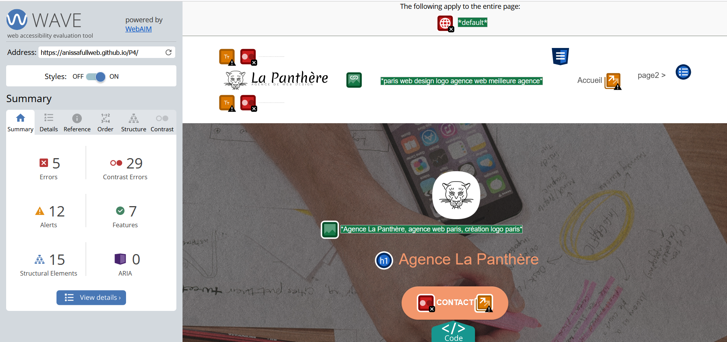

Slide 12
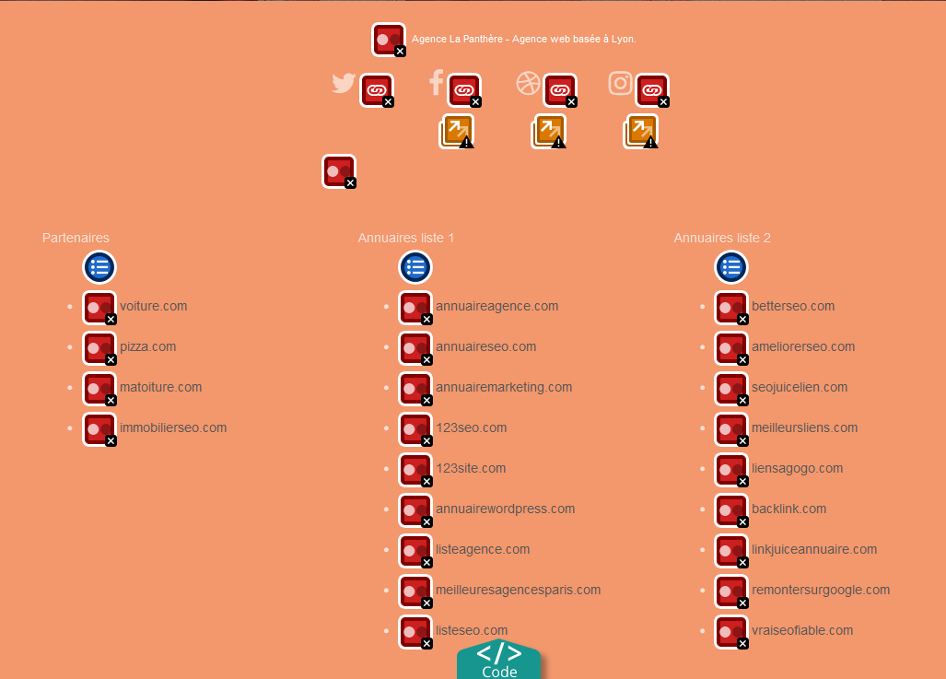

Slide 13
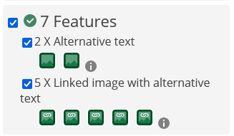
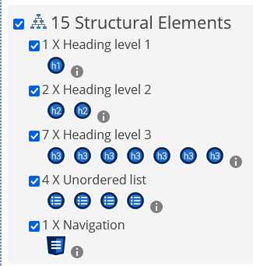
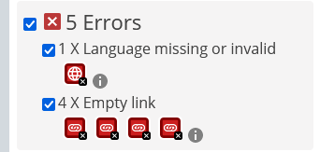
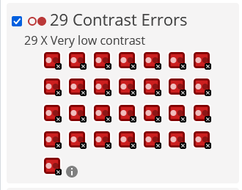

Slide 14
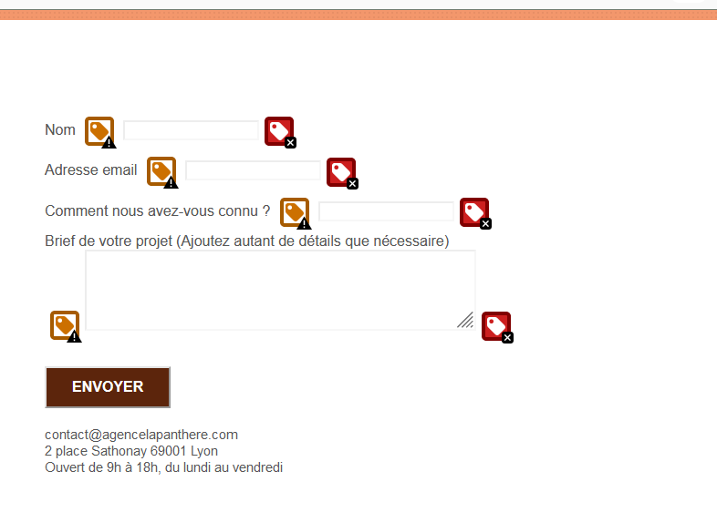

Slide 15
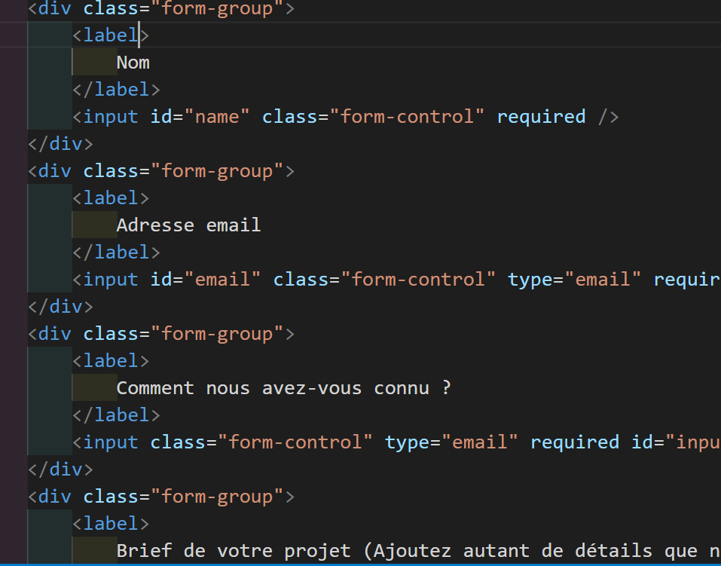

Slide 16
https://developer.mozilla.org/fr/docs/Web/Accessibility/Mobile_accessibility_checklist

Slide 17
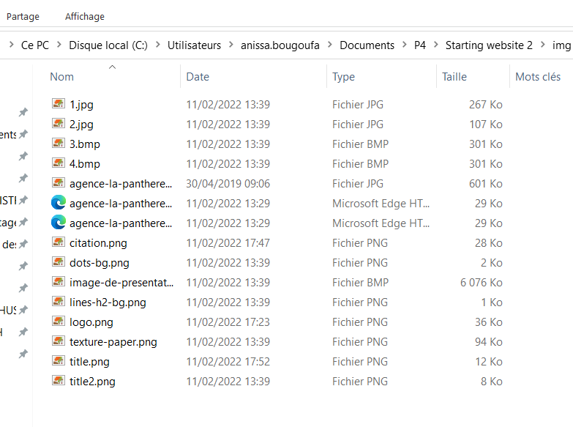

Slide 18
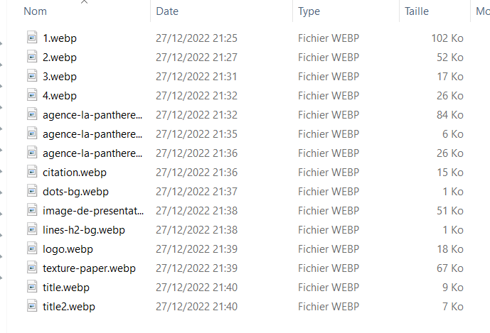

Slide 19
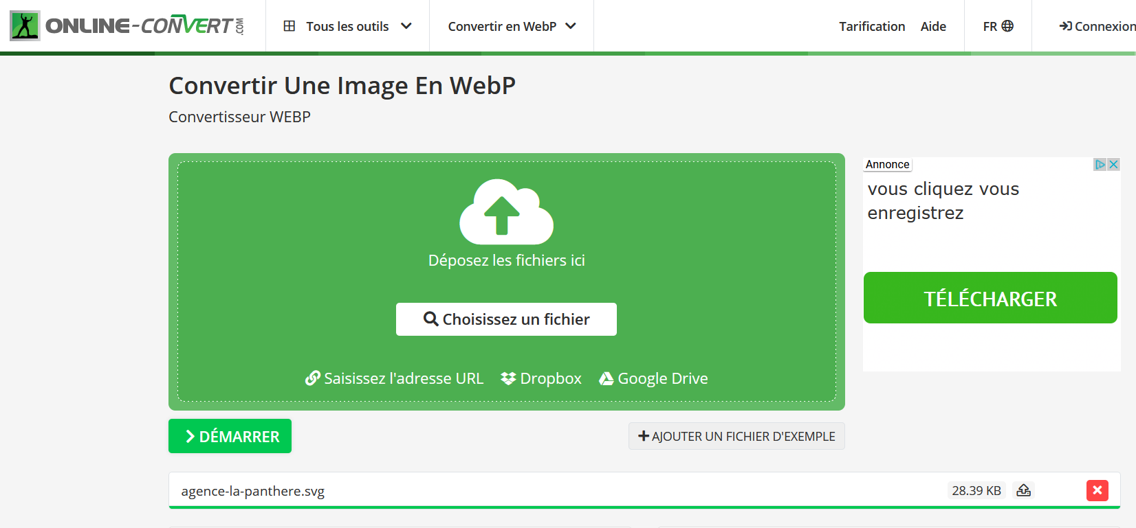

Slide 20
https://image.online-convert.com/fr/convertir-en-webp

Slide 21
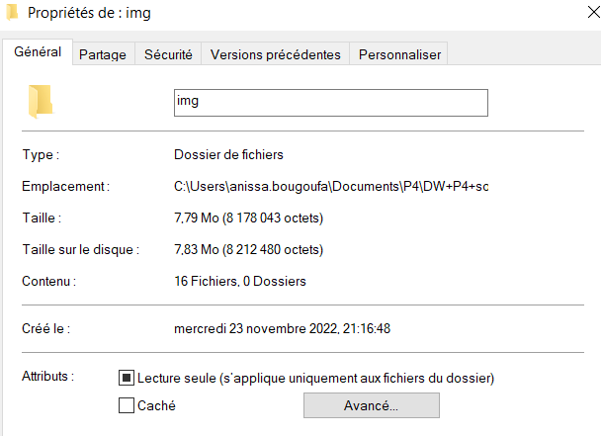
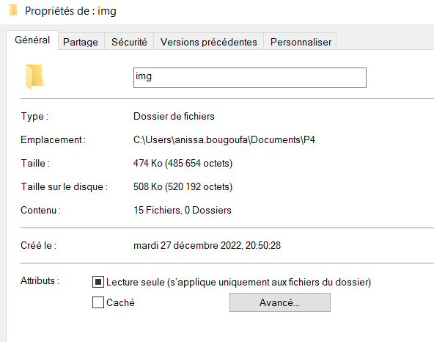

Slide 22
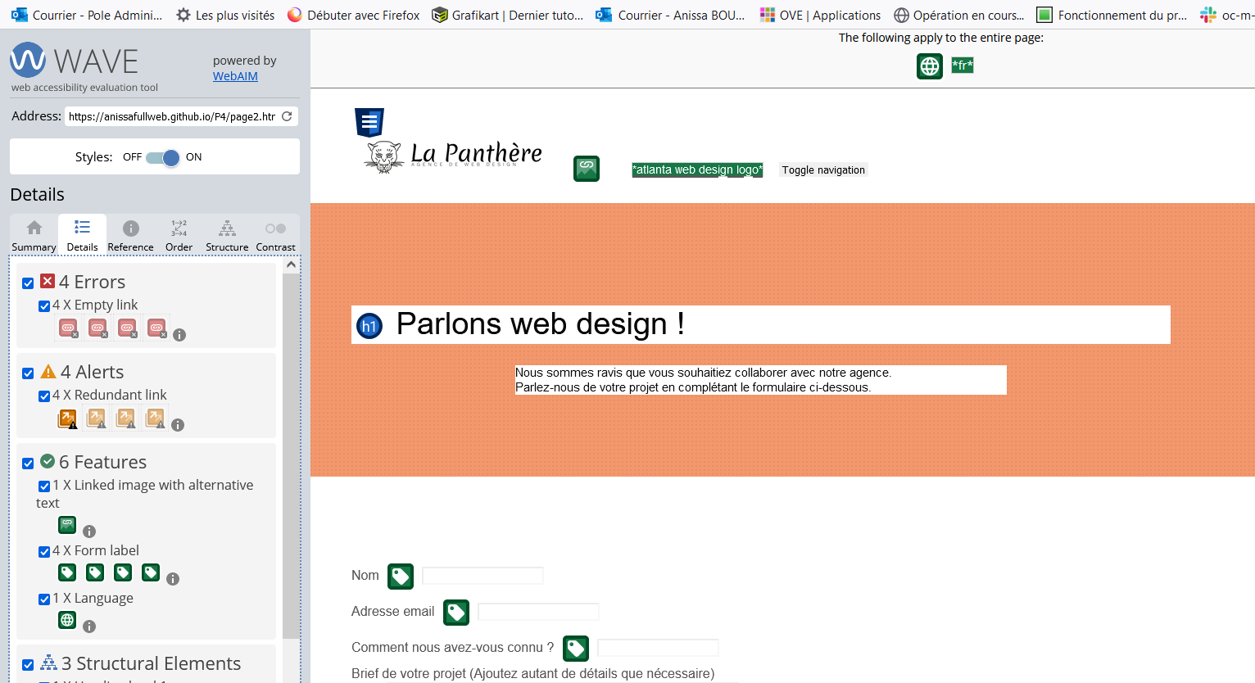

Slide 23
