Slide 1

Power BI Project Amazon Sales Analysis Dashboard
Introduction
This project aims to provide insights into product performance, customer behavior, and sales efficiency using an Amazon Sales Dataset that includes various product and sales-related attributes.
The analysis will be conducted using Power BI, where an interactive dashboard will be developed to visualize key metrics. This dashboard will empower stakeholders to make informed, data-driven decisions regarding product strategy, customer engagement, and sales optimization.

Slide 2

Dataset Information
Amazon_prime Y_or_N : Indicates if the product is eligible for Amazon Prime.
Asin : Unique product identifier (Amazon Standard Identification Number).
Best_seller_tag: Y_or_N – Indicates whether the product is tagged as a Best Seller.
Brand : Product brand.
Colour : Product color variant.
Delivery type : Type of delivery option available.
Discount percentage :The discount applied to the product.
Large : Boolean indicating if the product is in the “large” size category.
Left in stock :Number of items left in stock.
No of reviews :Total number of product reviews.
Description : Short product description.
Product details : Extended product attributes or specifications.
Product name: Name of the product.
Product_url : Product listing URL.
Rating :Product rating (out of 5).
Sales price: Final selling price.
Category : Product category or department.
Seller name : Name of the seller.
Seller ID : Unique seller ID

Slide 3
Project Objectives
Clean and Transform the dataset using Power Query.
Model the data to establish logical relationships where necessary.
Create calculated columns/measures using DAX to enhance insights.
Design a visually appealing dashboard to provide insights into:
- Sales trends and revenue performance. - Top-rated and best-selling products. - Inventory management (e.g., low stock alerts). - Discounts impact on product ratings or sales. - Seller performance comparison. - Prime vs non-Prime sales impact

Slide 4
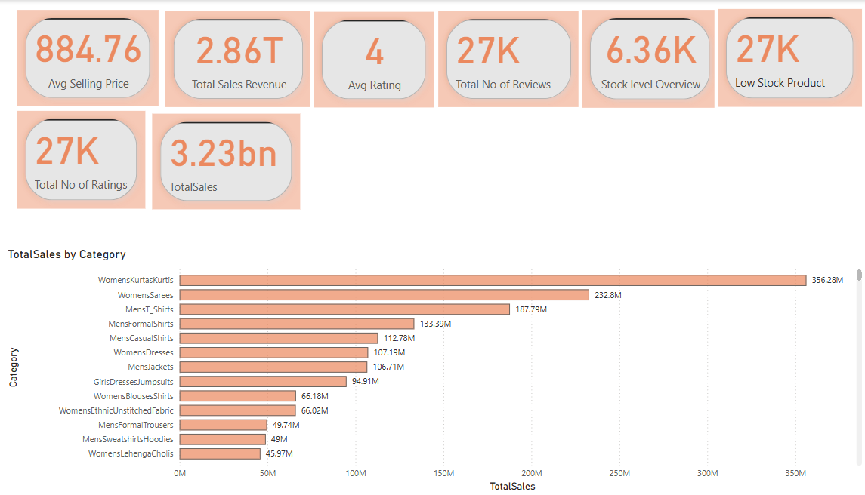
Visual Analysis
This visual displays
The average selling price of each product
The total revenue generated from sales, assuming the quantity of product purchased is the same as the number of reviews per product
Average rating
Total number of reviews
An overview of the stock level
Total number of Ratings
Total Sales
Total Sales by each category in which Womens KurtasKurtis is the top-performing category, contributing the highest share of total sales. This indicates strong market demand or effective sales strategies in that segment

Slide 5
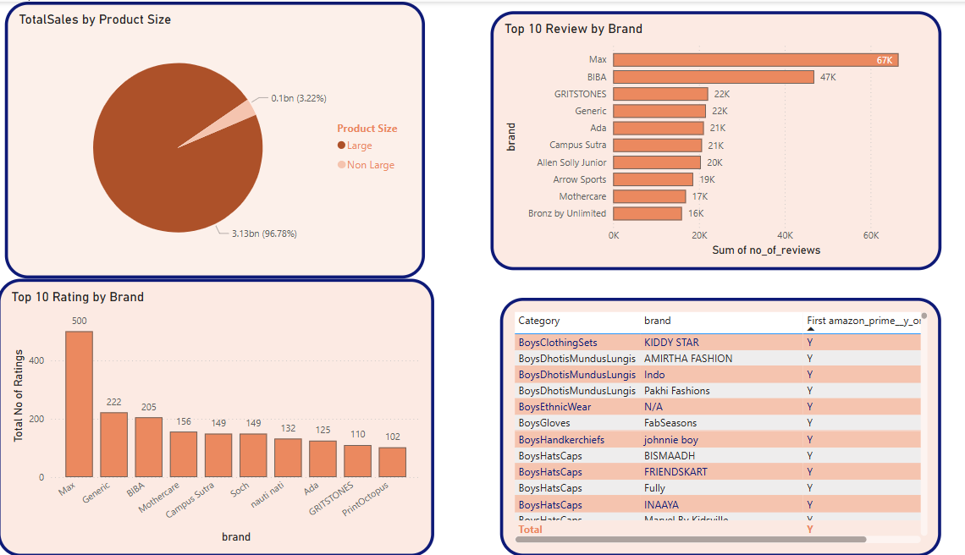
Key Insights
The Pie Chart indicates that large products account for the highest share of total sales, indicating strong customer demand and preference for premium-sized options. This suggests a strategic opportunity to further invest in the promotion, inventory, and supply of Large products to sustain and grow revenue
The top 10 brands with the highest number of reviews, as seen in the second chart, indicate strong customer engagement and brand visibility. The Max Brand leads in review count, suggesting high customer interest or satisfaction. It is therefore recommended that priority be given to the Max Brand in terms of promotion.
Max Brand leads with the highest average rating among the top 10 brands, indicating strong customer satisfaction and perceived product quality. This positions Max Brand as a benchmark for excellence, with potential for brand loyalty, repeat purchases, and positive word-of-mouth
This table highlights which brands and categories are Amazon Prime eligible, enabling quick identification of products that benefit from Prime advantages like faster shipping and increased customer trust. Prime status can significantly influence buyer decisions, especially in competitive categories.

Slide 6
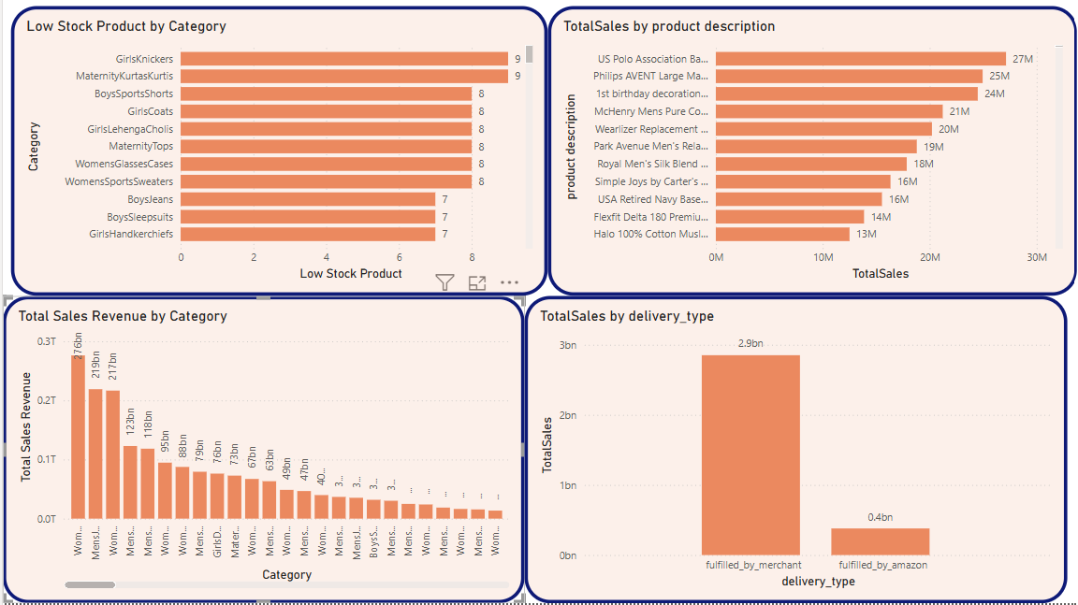
---This first chart categorizes stock levels to highlight products with critically low inventory (9 units and below). These low-stock items pose a potential risk of stockouts and may disrupt sales if not replenished promptly. ---US Polo leads in total sales among all product descriptions, indicating strong market demand, customer preference, or effective brand positioning in the second chart. This highlights US Polo as a top-performing product line, and it is worth continued investment in marketing, inventory, and strategic visibility. ---Women’s Kurtas & Kurtis lead in total sales revenue across all categories, reflecting strong consumer demand and consistent purchase behavior. This category’s performance signals a high-impact area for continued focus in marketing, inventory planning, and sales strategies, which is visibly shown in the 3rd chart. ---Lastly, Shipment Fulfilled by Merchant accounts for the highest total sales among all delivery types, indicating that merchant-fulfilled logistics are performing strongly. This may reflect greater flexibility, faster processing, or broader product availability under this delivery method

