Slide 1
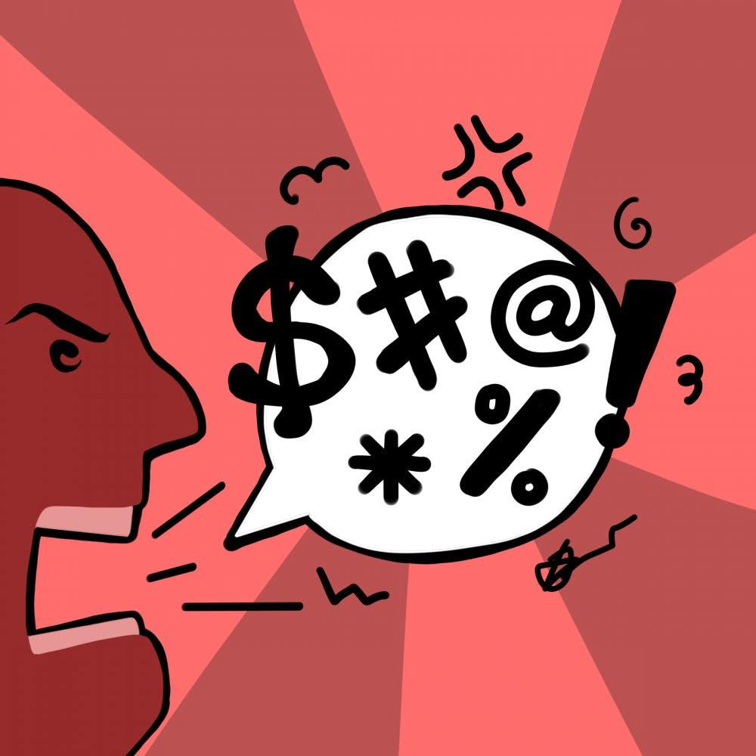
Abusive Language Detection
Presenter : Anita Kouhestanian

Slide 2

Motivation
There is a high risk of being the target of ridicule or even harrasment
The number of people communicating online is increasing
It can affect the mental health of the victims

Slide 3
Data
the data comes from Facebook. The format of the data is the same across training, development, and test sets . Each sample includes the document id, comment, and label.
There are three different classes in this data:
Non-aggressive (NAG):
Overtly aggressive (OAG):
Covertly aggressive (CAG)
 | Training | Development | Test
Total number of samples | 12000 | 2000 | 1001
Total number of tokens | 345538 | 55464 | 16261
Average number of tokens per sample | 29 | 28 | 26

Slide 4
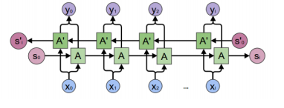
Methodology
Data pre-processing
Word Embedding
Bidirectional Gated Recurrent Unit (GRU) Model
Training the Model
Evaluation

Slide 5
Result
I have trained different models in order to compare them and get the best classifier. The first attempt was implementing the basic Recurrent neural networks. Second, I trained bidirectional GRU mode With only 5 epochs And the result were almost the same as RNN model. Finally, I tried to improve the results by increasing the number of epochs to 10 and it improved the result of the best model by around 5%.
Model | Loss | F1_Score
RNN | 0.0056 | 38.98
BiGRU(5 epochs) | 0.005 | 39.12
BiGRU(10 epochs) | 0.0048 | 45.05

