Slide 1
Exception Handling

Slide 2
Topics to be Covered
What is exception?
Try,catch,throw
Multiple try catch
Built-in exceptions
User defined exception
Asssertion
JUnit Intro

Slide 3
What is an exception?
Exceptional event.
Error that occurs during runtime.
Cause normal program flow to disrupted.
Examples
- Divide by zero errors
- Accessing the elements of an array beyond its range
- Invalid input
- Opening a non-existent file
- Heap memory exhausted

Slide 4
Why exception handling?
The core advantage of exception handling is to maintain the normal flow of the application. Exception normally disrupts the normal flow of the application that is why we use exception handling.
e.g.
statement 1;
statement 2;
statement 3;//exception occurs
statement 4;
statement 5;
When the exception occurs the further code will not be executed.

Slide 5
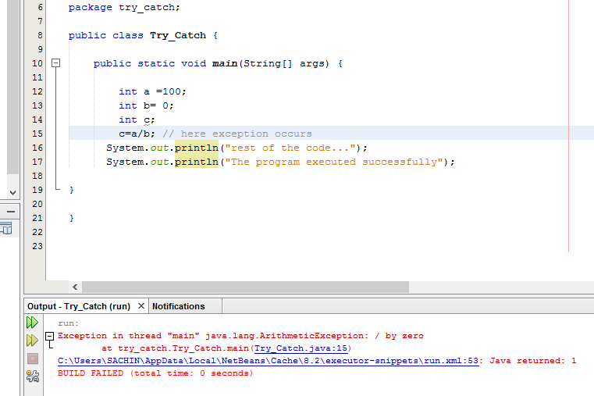

Slide 6
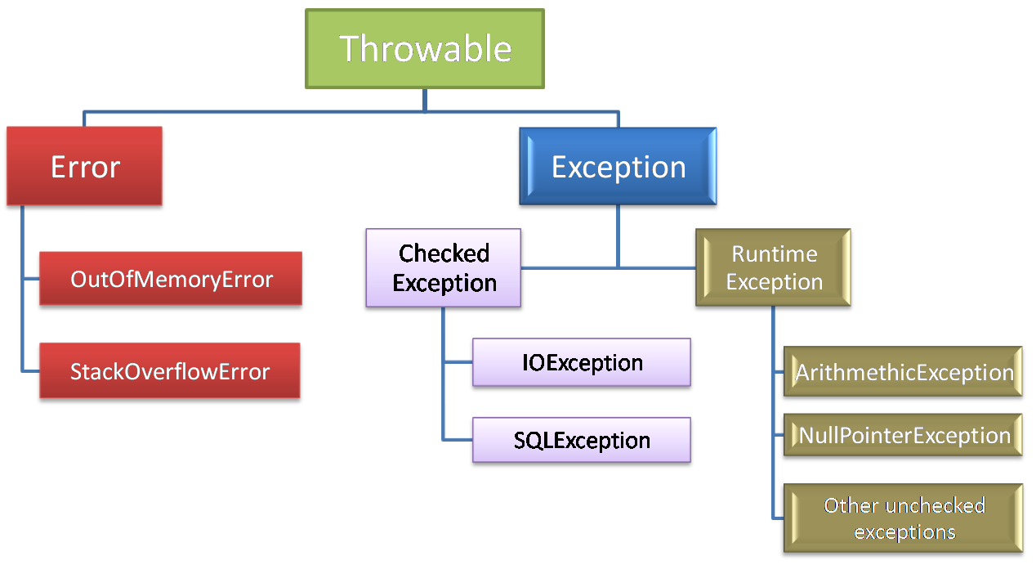
Hierarchy of Java Exception classes

Slide 7
Java try-catch
Java try block is used to enclose the code that might throw an exception. It must be used within the method.
Java try block must be followed by either catch or finally block.
Java catch block is used to handle the Exception. It must be used after the try block only.
Multiple catch block can be used with a single try.
Syntax-
try{
//code that may throw exception
}catch(Exception_class_Name ref){}

Slide 8
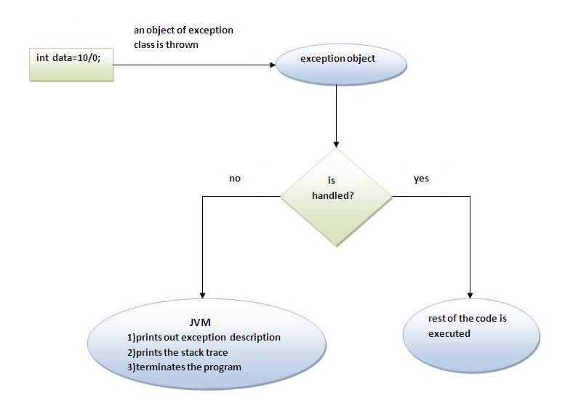
Internal working of a java try-catch block

Slide 9
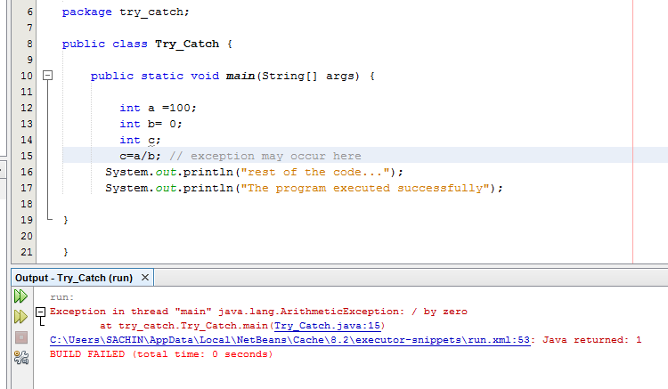
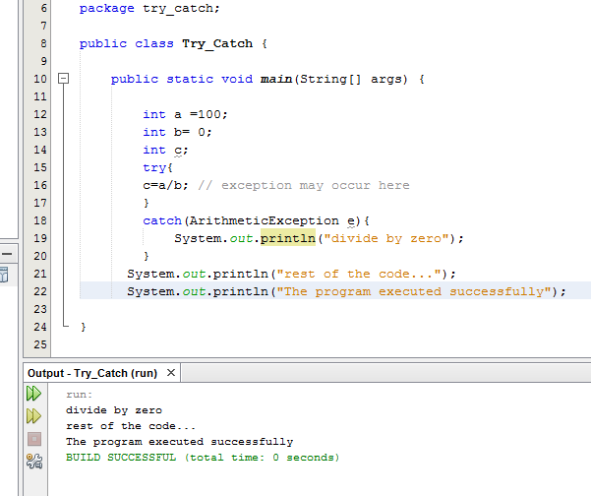
Use of try-catch block
Without try-catch block
With try-catch block

Slide 10
Nested try block
Nested try block is used when a part of a block may cause one error and the entire block itself may cause another error.
Try statement can be inside a block of another try
Each time the try block is entered its corresponding catch block has to be entered.
Syntax-
try
{
try
{ }
catch(Exception e)
{ }
}
catch(Exception e)
{ }

Slide 11
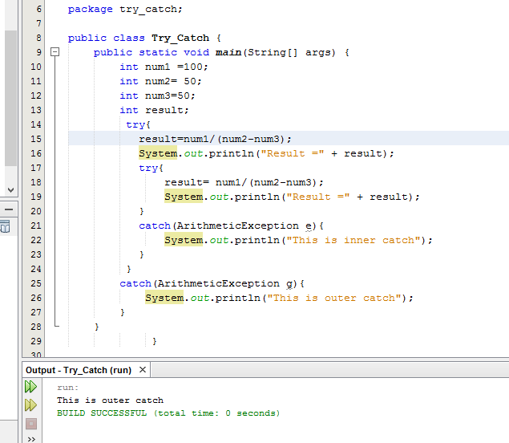
Example

Slide 12
Throw, Throws, Finally & Multiple catch

Slide 13
Throw
is used to explicitly throw an exception.
can throw either checked or unchecked exception
mainly used to throw custom exception

Slide 14
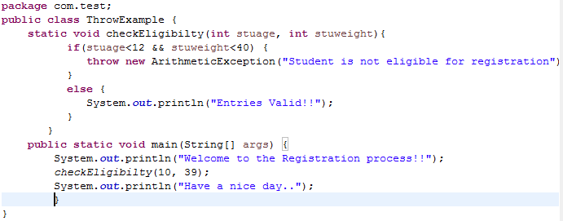

Slide 15
Throws
is used to declare an exception
It gives information to the user so that he can provide the exception handling code so that normal flow can be maintained.
Syntax:
return_type method_name(parameter_list) throws exception_list {
//definition of method
}

Slide 16
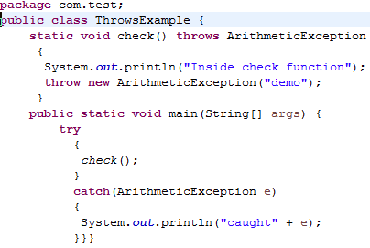


Slide 17
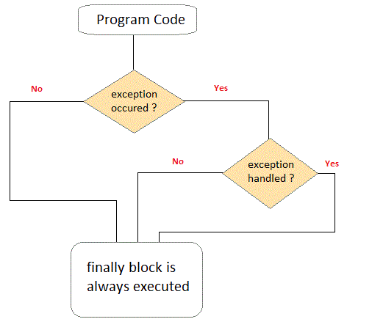
Finally
Finally block in java can be used to put "cleanup" code such as closing a file, closing connection etc.
is always executed whether exception is handled or not.
The finally block will not be executed if program exits(either by calling System.exit() or by causing a fatal error that causes the process to abort).

Slide 18
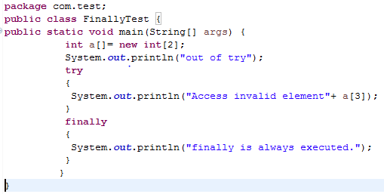


Slide 19
Multiple Catch Block
A try block is followed by multiple catch blocks
At a time only one Exception is occurred and at a time only one catch block is executed.

Slide 20
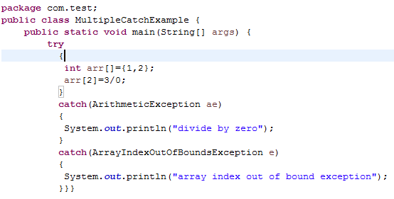
Multiple Catch Block

Slide 21
Unreachable Multiple catch Block
All catch blocks must be ordered from most specific to most general i.e. catch for Arithmetic Exception must come before catch for Exception
While using multiple catch block, always make sure that exception subclasses comes before any of their super classes. Else you will get compile time error

Slide 22
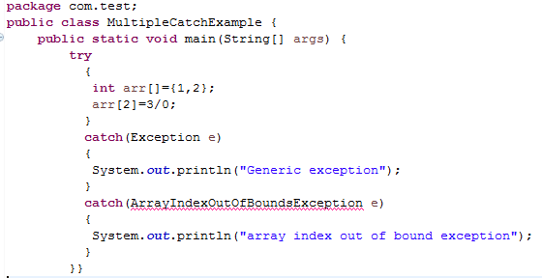

Unreachable Multiple Catch block

Slide 23
Common Exception Class

Slide 24
Common exception classes are basically built-in classes.
Such as
. Arithmetic Exception
NullPointer Exception
ClassNotFound Exception
ArrayOutofBound Exception
Common Exception class

Slide 25
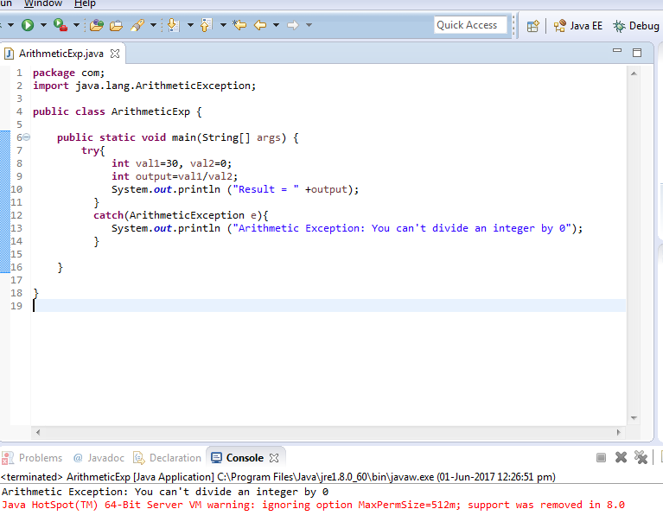
Arithmetic Exception

Slide 26
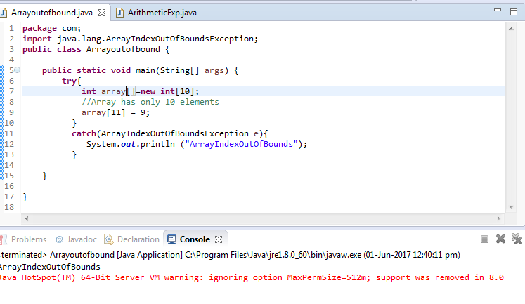
Array IndexOutOfBound

Slide 27
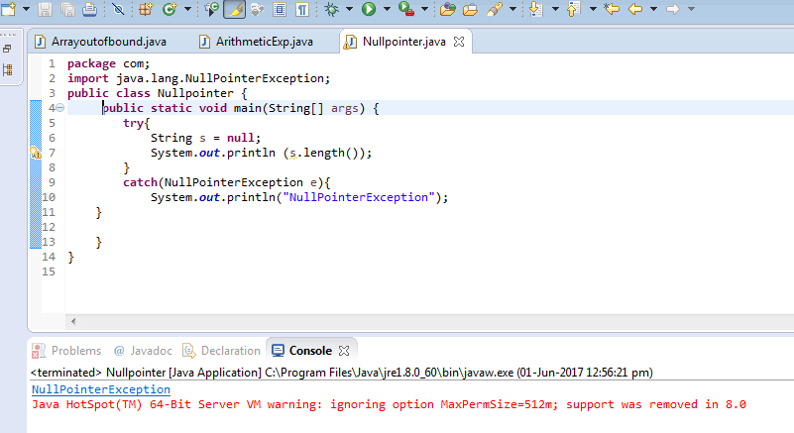
NullPointerException

Slide 28
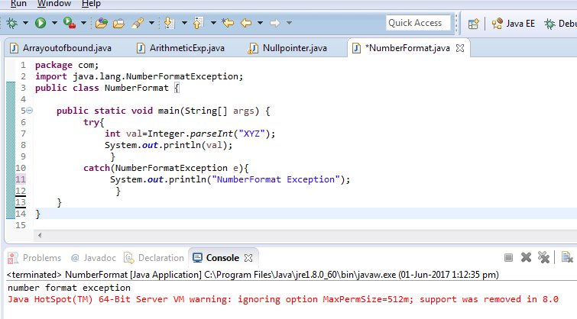
NumberFormatException

Slide 29
Custom Exception

Slide 30


Slide 31

What should I do?

Slide 32

Aahaa.!!!Custom Exception!

Slide 33
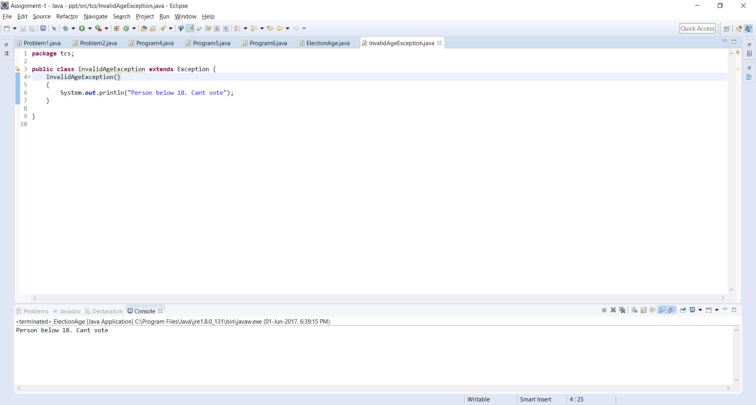
Custom Exception

Slide 34
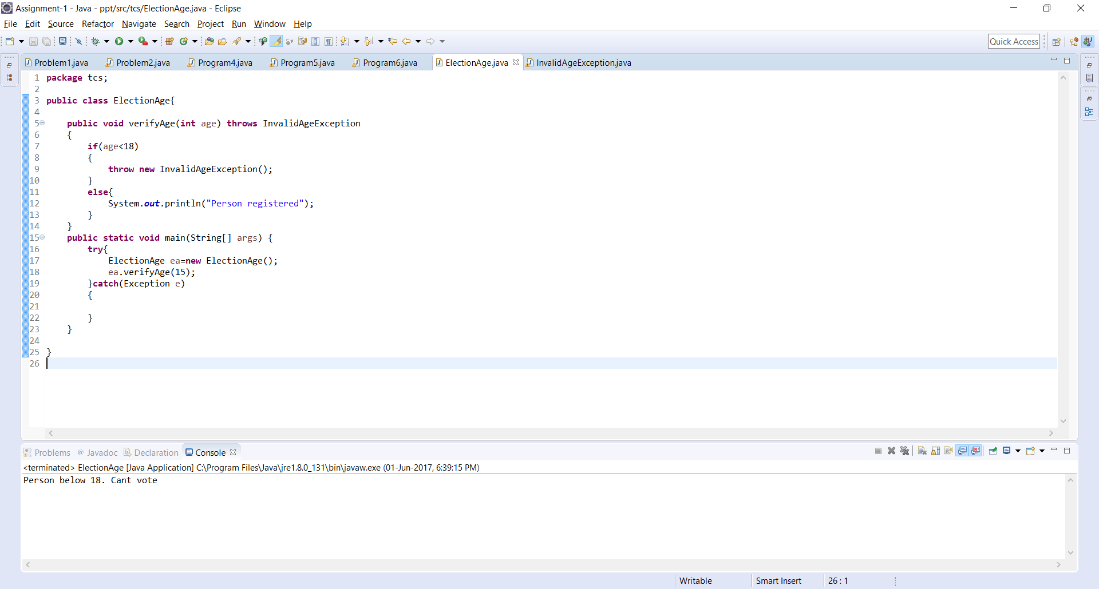
Custom Exception

Slide 35
Assertion

Slide 36
Assertion
Assertion is a statement in java which can be used to test your assumptions about the program.
Syntax:
assert expression;
or
assert expression1 : expression2;
While executing assertion, it is believed to be true. If it fails, JVM will throw an error named AssertionError.

Slide 37
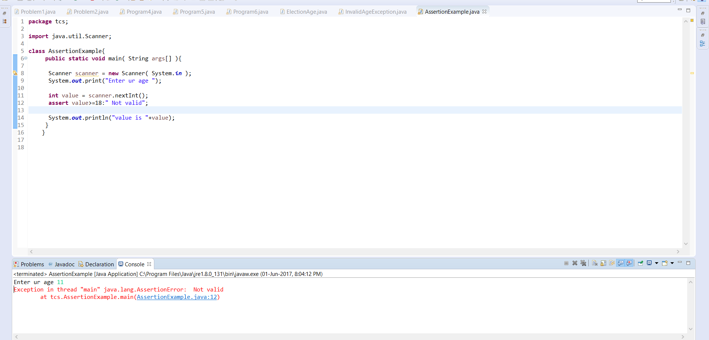
Assertion

Slide 38
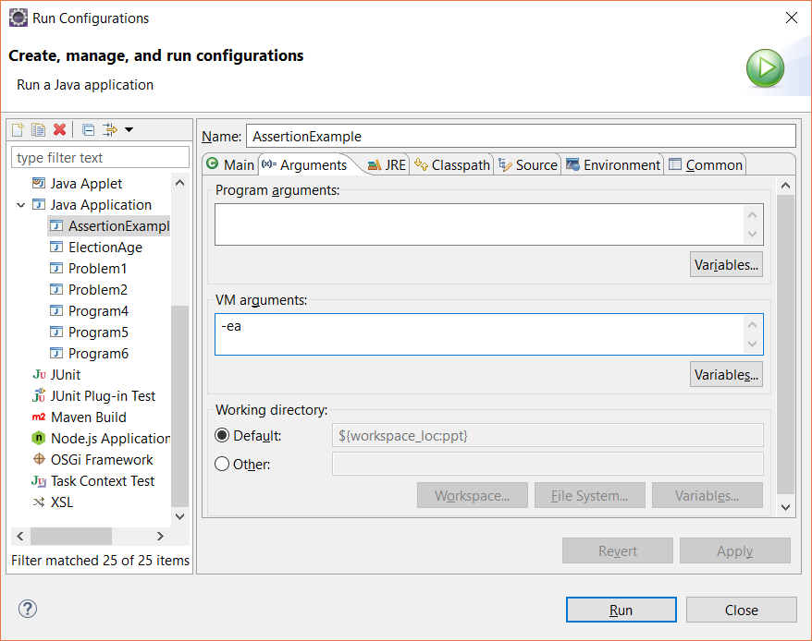
Assertion

Slide 39
JUnit
Open-source java testing framework.
Java programmer can create test cases and test his/her own code.

Slide 40
JUnit Example
Program
public class Calculation {
public static int findMax(int arr[]){
int max=0;
for(int i=1;i<arr.length;i++){
if(max<arr[i])
max=arr[i];
}
return max;
}
}
Creating Test Cases
import static org.junit.Assert.*;
import com.javatpoint.logic.*;
import org.junit.Test;
public class TestLogic {
@Test
public void testFindMax(){
assertEquals(4,Calculation.findMax(new int[]{1,3,4,2}));
assertEquals(-1,Calculation.findMax(new int[]{-12,-1,-3,-4,-2}));
}
}

Slide 41
Thank You for your Patience!

