Slide 1

outlines the approach for
Sprocket Central Pty Ltd submitted by-Anita Paul

Slide 2
Agenda
Outlines the approach we will be taking to identify which of the 1000 customers Sprocket Central Pty Ltd should target, based on this dataset.
Explain the three phases: Data Exploration; Model Development and Interpretation

Slide 3
Problem Statement: Create a PowerPoint presentation which outlines the approach we will be taking to identify which of the 1000 customers Sprocket Central Pty Ltd should target, based on this dataset. Explain the three phases: Data Exploration; Model Development and Interpretation.
Objective: provide valuable customer insights to Sprocket Central Pty Ltd's marketing team, enabling them to optimize resource allocation for targeted marketing efforts. The aim is to improve overall performance by focusing on high-value customers and maximizing the impact of their marketing strategies.
About Dataset:
Sprocket Central Pty Ltd provided us 3 datasets:
Customer Demographic
Customer Addresses
Transactions data
New Customer List (which is the target data)
Steps Taken:
Data Cleaning → Cleaned for better quality
Data Transformation → Merged the transactions, customer demographic, customer address
Data Exploration → Explore the data to reveal insights

Slide 4
Data Exploration: The data exploration phase involves understanding and gaining insights from the dataset. The goal is to explore the data, identify patterns, and gather information that can guide the subsequent phases. Here are the steps involved:
a. Data Preprocessing: Clean and preprocess the dataset to handle missing values, outliers, and inconsistencies. This may involve techniques like data cleaning, data transformation, and feature engineering.
b. Descriptive Statistics: Calculate summary statistics such as mean, median, standard deviation, and correlations to understand the distribution and relationships between variables. This helps in identifying important features and potential data issues.
c. Data Visualization: Create visualizations like histograms, scatter plots, and box plots to visually explore the data and identify patterns or trends. Visualization aids in understanding the distribution of variables, identifying outliers, and discovering relationships.
d. Feature Selection: Analyze the relevance and importance of each feature in predicting the target variable. Feature selection techniques like correlation analysis, chi-square tests, or feature importance scores from machine learning models can be used to identify the most significant features.
e. Exploratory Data Analysis (EDA): Perform in-depth exploratory analysis to gain insights into the data. This may involve segmenting the data based on various criteria, identifying customer segments or clusters, and analyzing their characteristics.

Slide 5
Model Development: In this phase, predictive models are developed using machine learning techniques to predict the target customers. The goal is to create a model that accurately identifies the customers Sprocket Central Pty Ltd should target. Here are the key steps:
a. Data Split: Split the dataset into training, validation, and testing sets. The training set is used to train the model, the validation set is used for hyperparameter tuning and model selection, and the testing set is used to evaluate the final model's performance.
b. Model Selection: Choose an appropriate machine learning algorithm based on the nature of the problem and the available data. This could involve using classification algorithms such as logistic regression, decision trees, random forests, or gradient boosting.
c. Model Training and Evaluation: Train the selected model using the training dataset and evaluate its performance using appropriate evaluation metrics like accuracy, precision, recall, or F1 score. This helps in assessing how well the model generalizes to unseen data.
d. Hyperparameter Tuning: Optimize the model's hyperparameters using techniques like grid search, random search, or Bayesian optimization. This helps in finding the best combination of hyperparameters that maximize the model's performance.
e. Model Validation: Validate the final trained model on the validation dataset to ensure it performs well and doesn't overfit the training data. Make any necessary adjustments to the model based on the validation results.
.

Slide 6
Interpretation: The interpretation phase focuses on understanding and interpreting the results of the model. The goal is to gain insights into the factors that contribute to identifying the target customers. Here are the main steps:
a. Feature Importance: Determine the importance of different features in the model's predictions. This can be done by analyzing feature importance scores generated by the model or using techniques like permutation importance or SHAP values.
b. Model Interpretability: Assess the interpretability of the chosen model. Some models, like decision trees or linear models, provide inherent interpretability, while others like neural networks may require additional techniques such as feature importance or partial dependence plots to interpret their predictions.
c. Insights and Recommendations: Use the insights gained from the model to identify the key characteristics or behaviors of the target customers. Based on these insights, provide recommendations to Sprocket Central Pty Ltd on how to effectively target and engage with these customers.
.

Slide 7
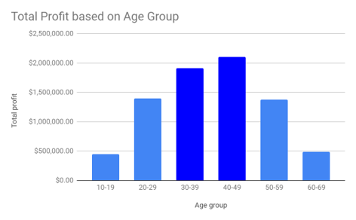
Total Profit based on different Age Groups
Insights:
The customers between 30 to 49 age are the most profitable in terms of recent transaction history with more than 19 lacs profit.

Slide 8
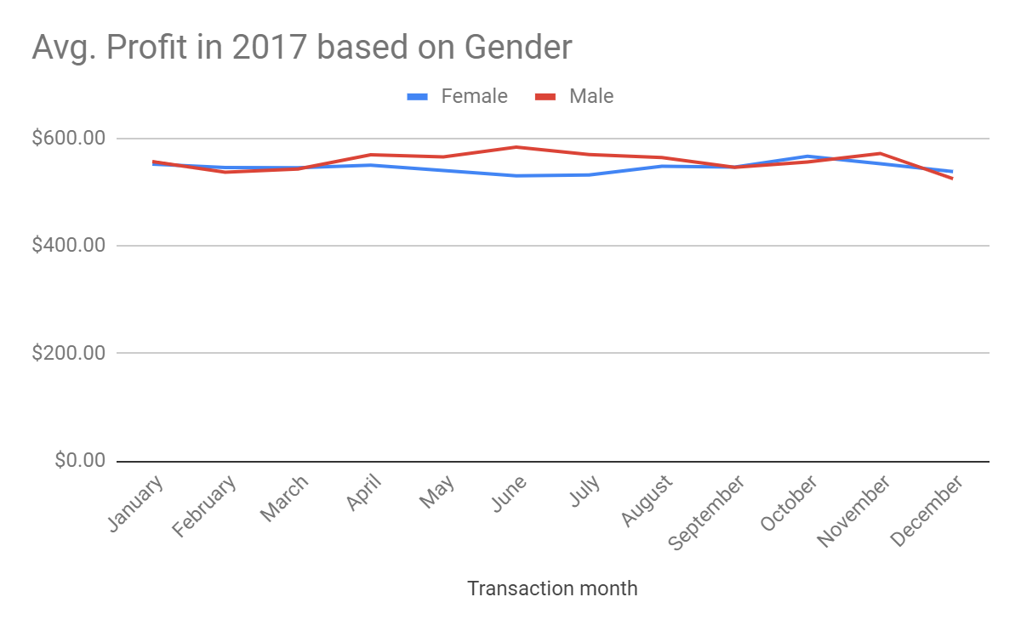
Average Profit in the year 2017 by Gender
Insights:
Male customers are more profitable in the between the mid year April - July while female customers are showing slight peak around October.

Slide 9
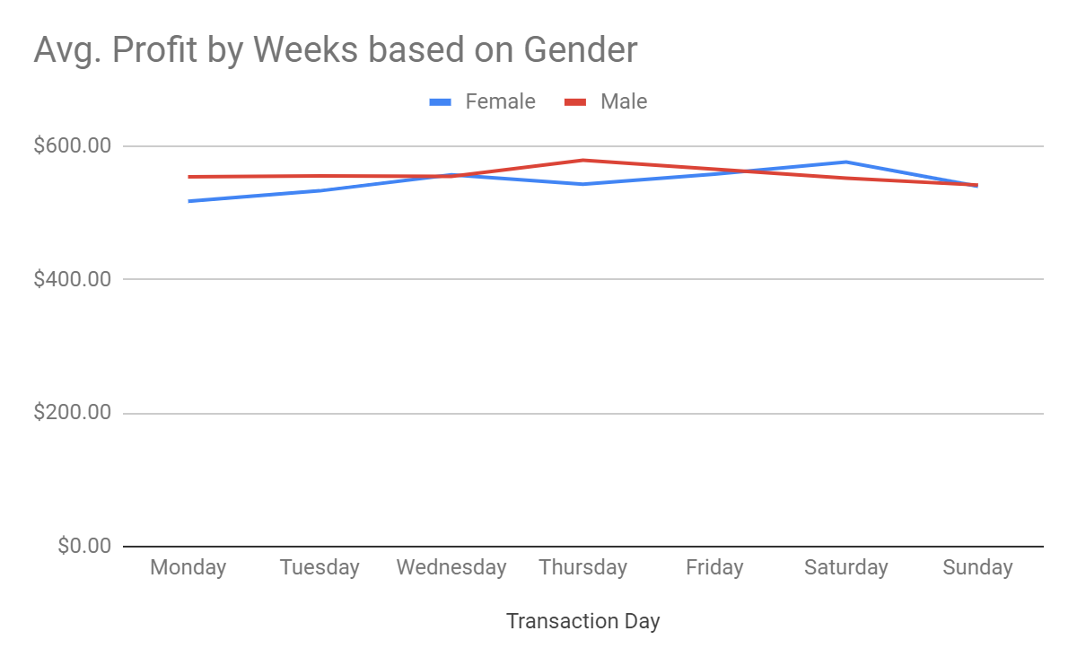
Average Profit by Week based on Gender
Insights:
Male customers do more transactions in mid-week Thursday while female customers are showing more profit during Saturday.

Slide 10
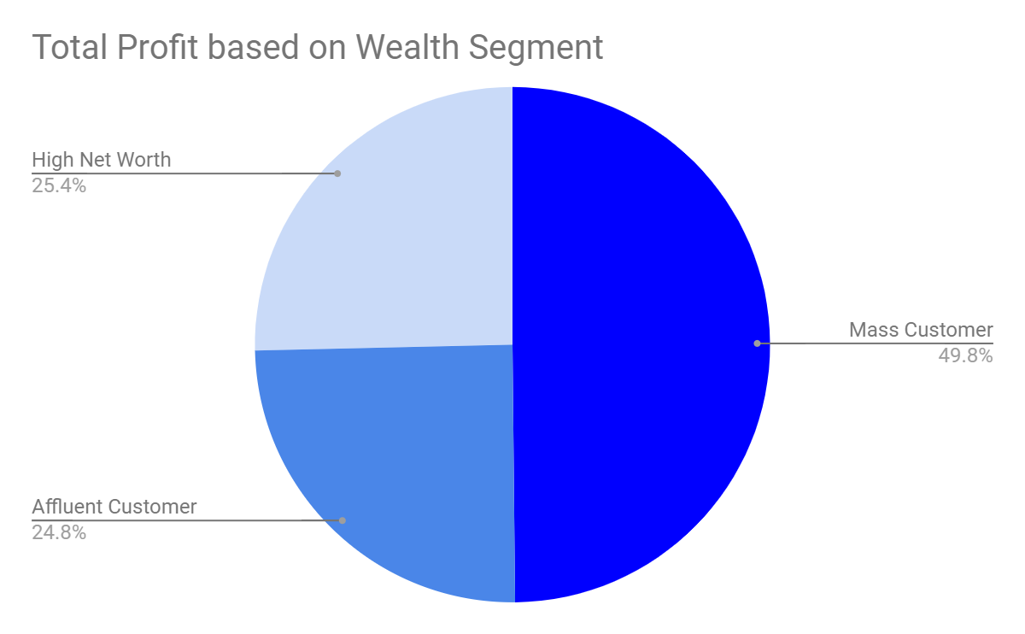
Total Profit based on Wealth Segment of customers
Insights:
The mass customer are the most profitable segment among the three segments as nearly 50% of the profit is made by this segment.

Slide 11
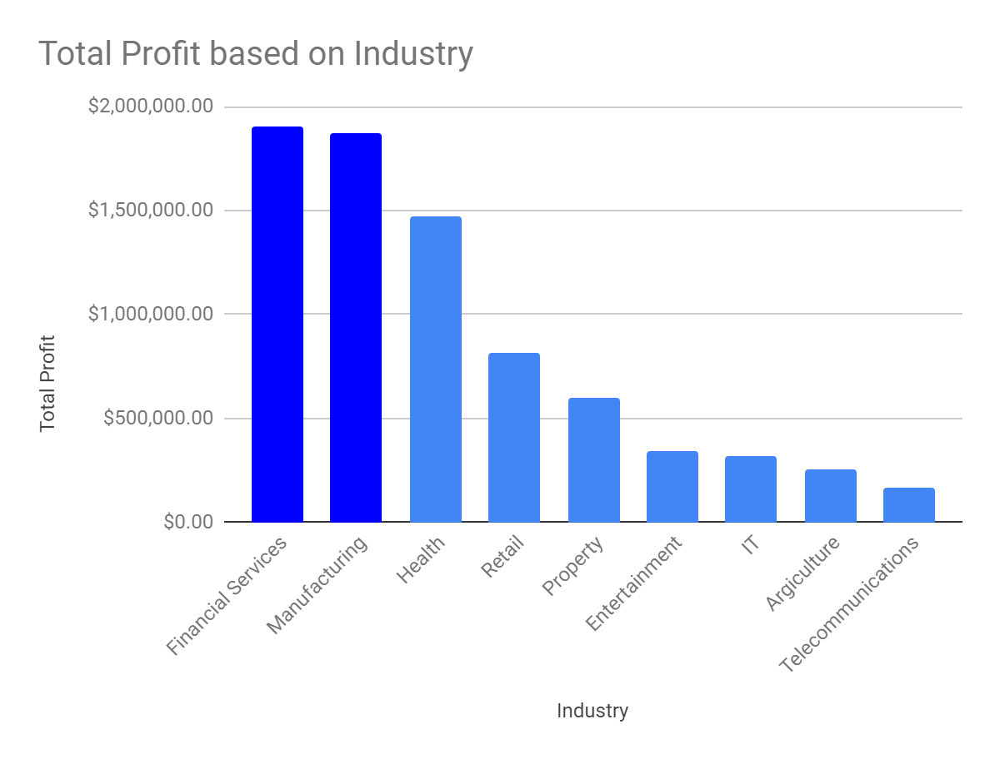
Total Profit based on customers Industry
Insights:
The customers related to Financial Service and Manufacturing showing most profit with 18 lacs + profit.

Slide 12
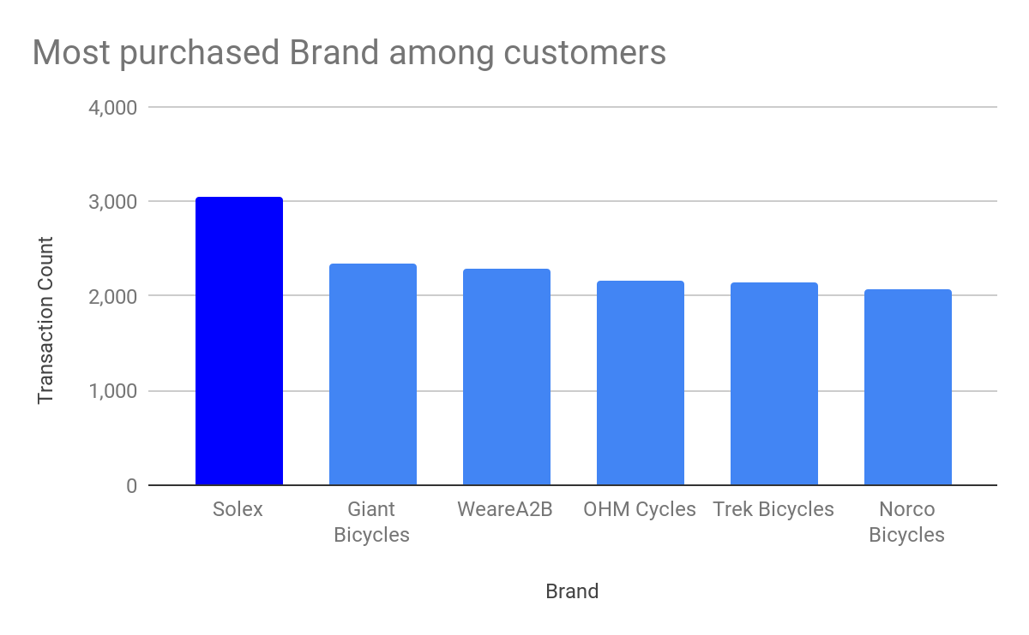
Most purchased brands among customers
Insights:
Customers buys more Solex brand among the other brands with transaction count of more than 3000.

Slide 13
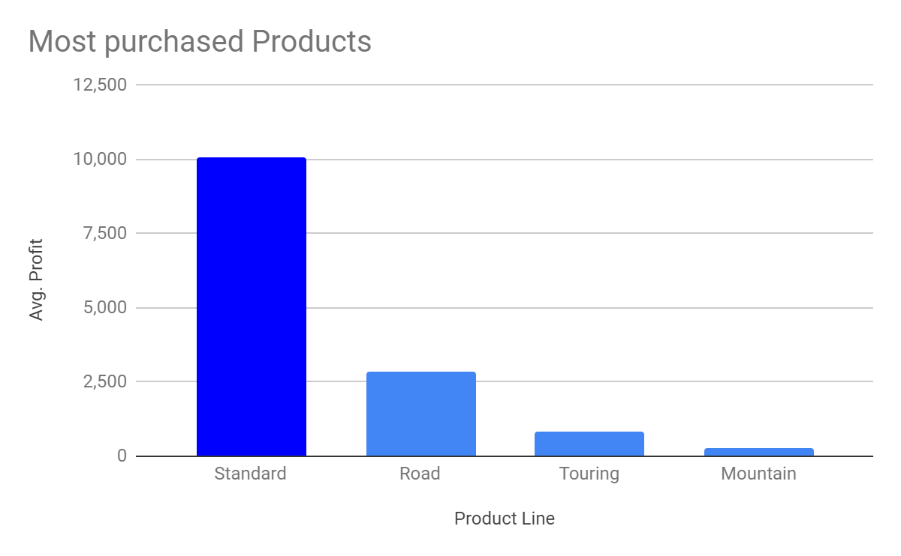
Most purchased products among customers
Insights:
Standard product are most buyable products by customers among the other product with more than 10000 + transactions took place

Slide 14
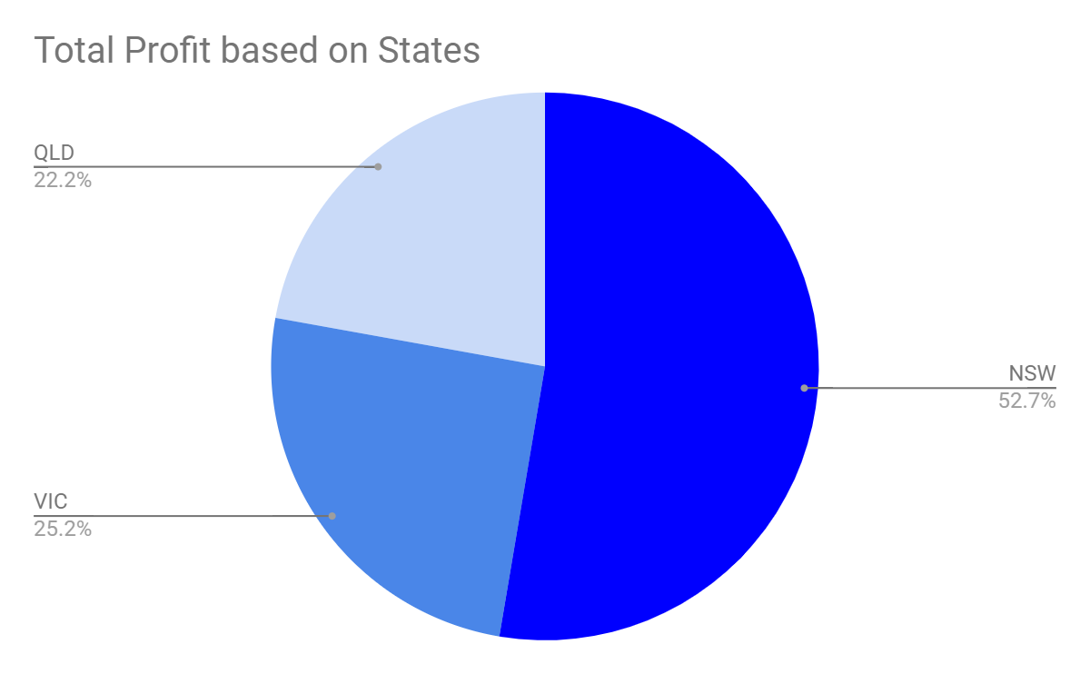
Total Profit based on States in Australia
Insights:
Customers living in New South wales are the most profitable customers with more than 50% profit among the other States.

Slide 15
Summery
Customer between age 30 to 49.
Male customers in the mid-year between April - July and in midweek around Thursday.
Female customers around October and in the start of the weekend, Saturday.
Customers in the Mass Consumer Segment.
Customers related to Financial Services and Manufacturing Industries.
Solex brand and Standard product as the top priority.
Customers living in New South Wales.

Slide 16
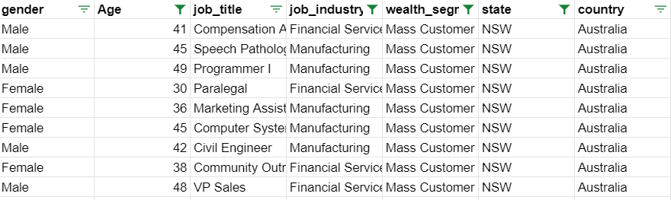
After filtering the targeted customers from the New Customer List, it will look like below

Slide 17
Thankyou!

