Slide 1

outlines the approach for
Sprocket Central Pty Ltd submitted by-Anita Paul

Slide 2
Agenda
Outlines the approach we will be taking to identify which of the 1000 customers Sprocket Central Pty Ltd should target, based on this dataset.
Explain the three phases: Data Exploration; Model Development and Interpretation

Slide 3
Problem Statement: Create a PowerPoint presentation which outlines the approach we will be taking to identify which of the 1000 customers Sprocket Central Pty Ltd should target, based on this dataset. Explain the three phases: Data Exploration; Model Development and Interpretation.
Objective: provide valuable customer insights to Sprocket Central Pty Ltd's marketing team, enabling them to optimize resource allocation for targeted marketing efforts. The aim is to improve overall performance by focusing on high-value customers and maximizing the impact of their marketing strategies.
About Dataset:
Sprocket Central Pty Ltd provided us 3 datasets:
Customer Demographic
Customer Addresses
Transactions data
New Customer List (which is the target data)
Steps Taken:
Data Cleaning → Cleaned for better quality
Data Transformation → Merged the transactions, customer demographic, customer address
Data Exploration → Explore the data to reveal insights

Slide 4
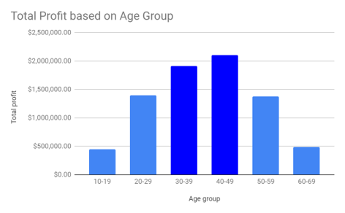
Total Profit based on different Age Groups
Insights:
The customers between 30 to 49 age are the most profitable in terms of recent transaction history with more than 19 lacs profit.

Slide 5
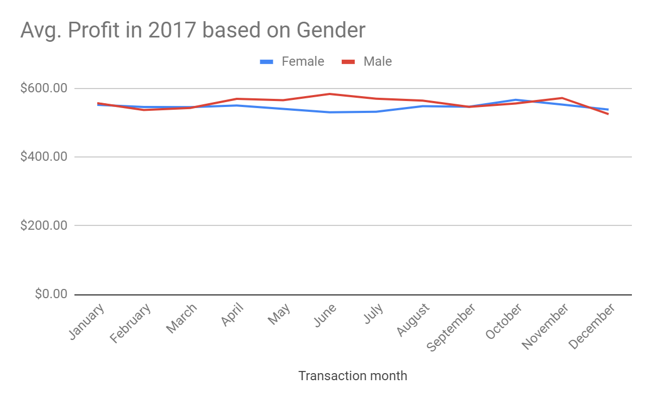
Average Profit in the year 2017 by Gender
Insights:
Male customers are more profitable in the between the mid year April - July while female customers are showing slight peak around October.

Slide 6
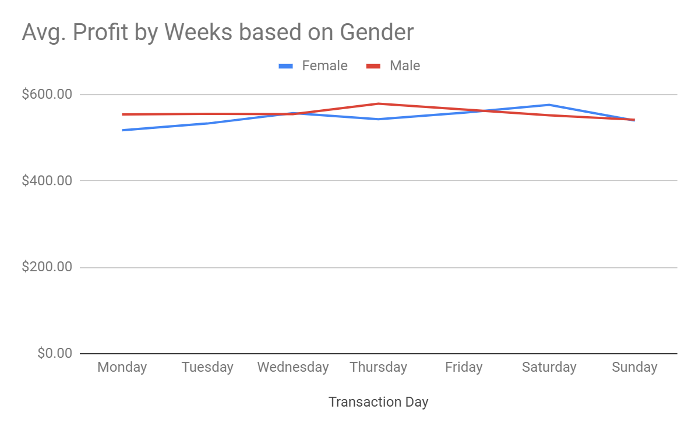
Average Profit by Week based on Gender
Insights:
Male customers do more transactions in mid-week Thursday while female customers are showing more profit during Saturday.

Slide 7
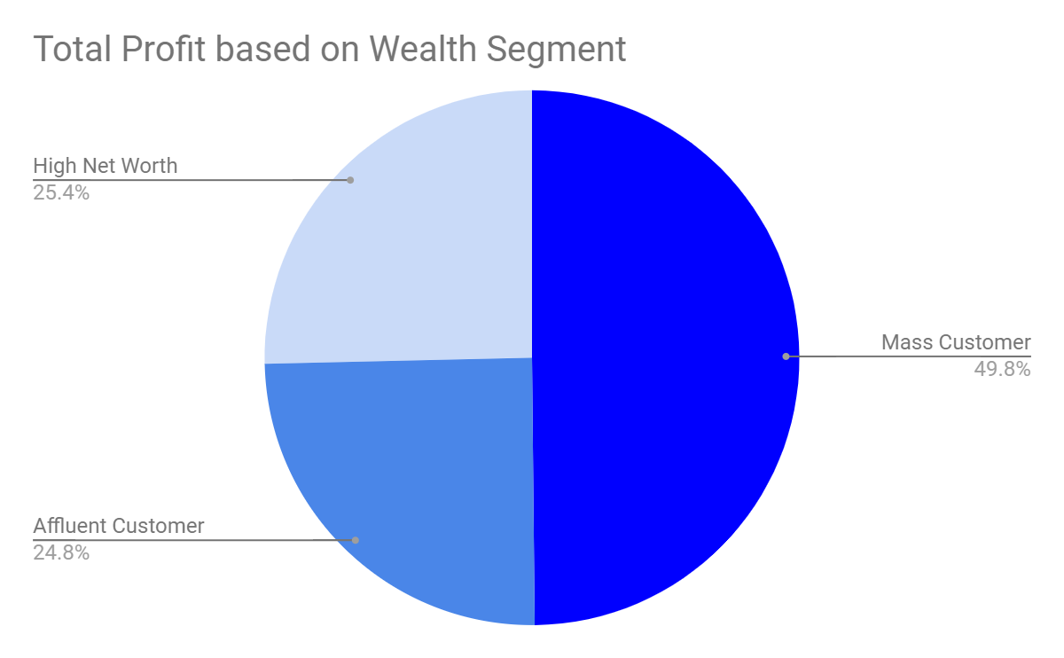
Total Profit based on Wealth Segment of customers
Insights:
The mass customer are the most profitable segment among the three segments as nearly 50% of the profit is made by this segment.

Slide 8
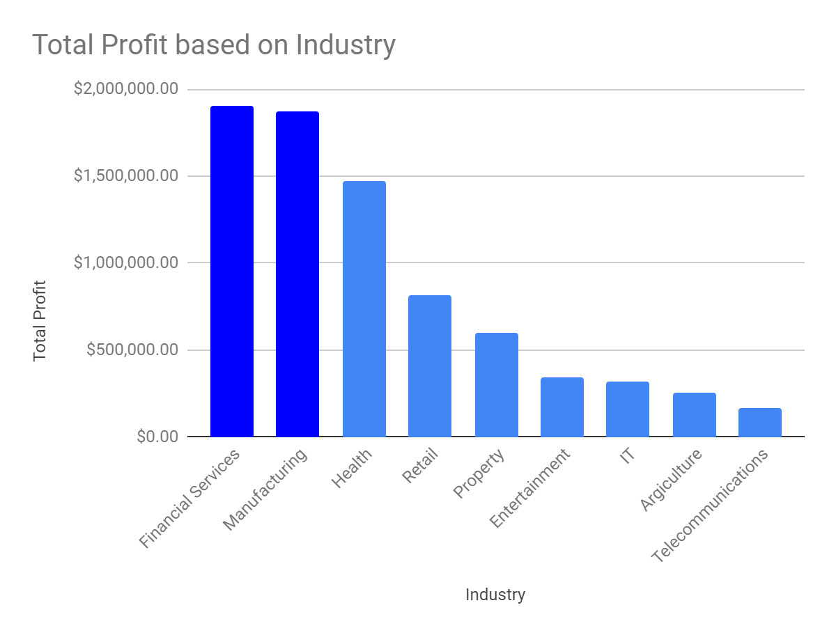
Total Profit based on customers Industry
Insights:
The customers related to Financial Service and Manufacturing showing most profit with 18 lacs + profit.

Slide 9
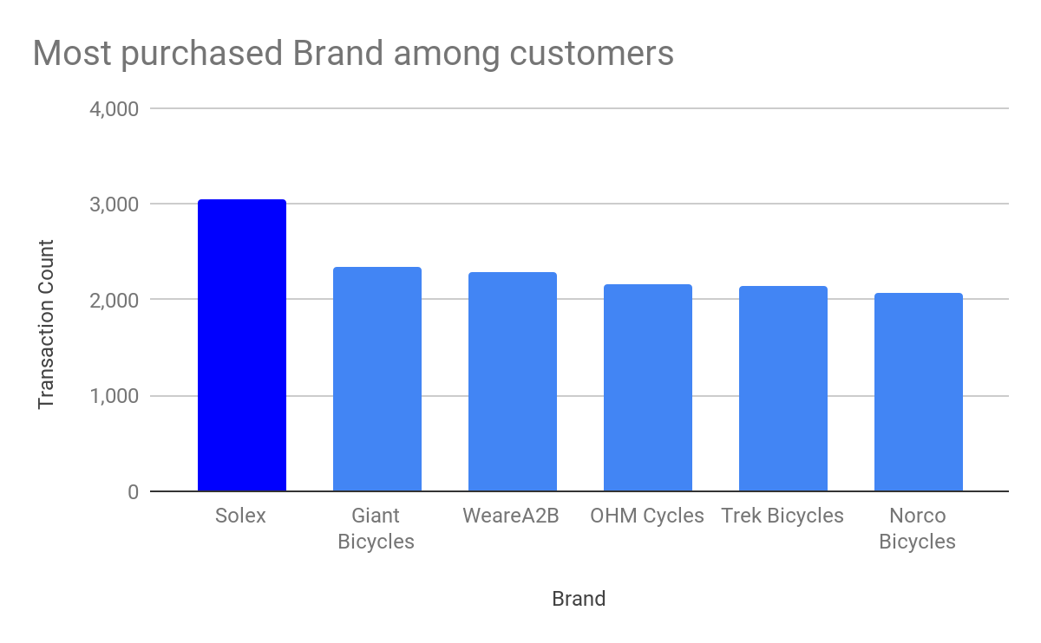
Most purchased brands among customers
Insights:
Customers buys more Solex brand among the other brands with transaction count of more than 3000.

Slide 10
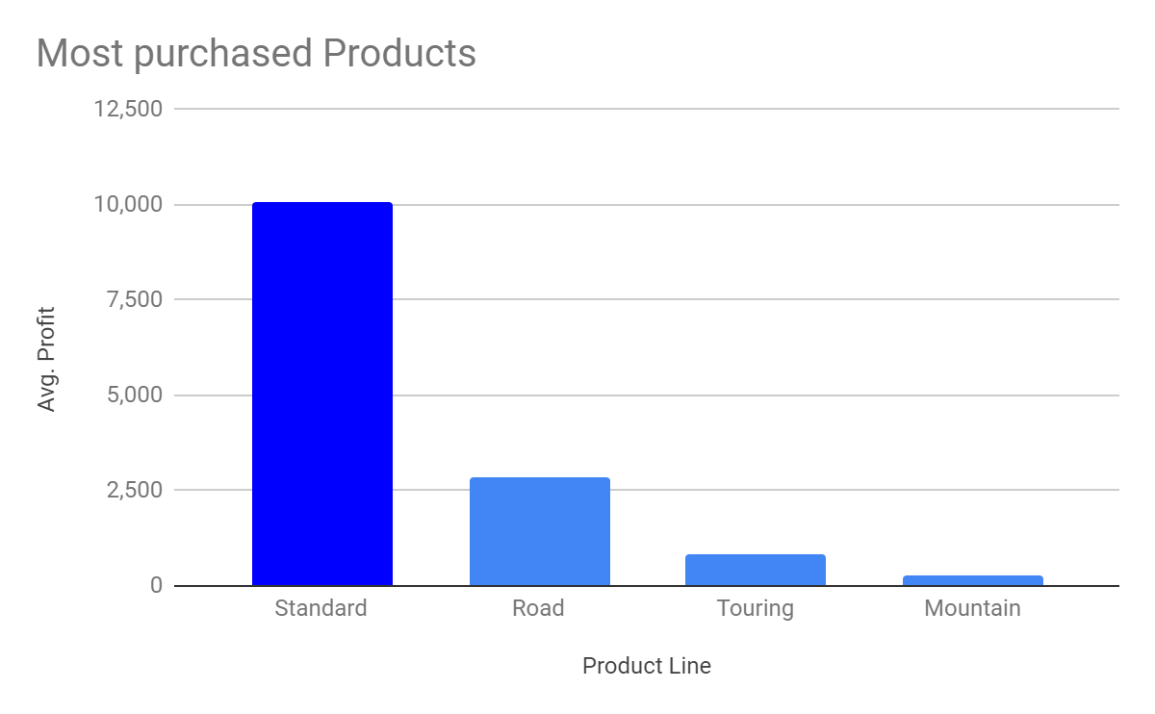
Most purchased products among customers
Insights:
Standard product are most buyable products by customers among the other product with more than 10000 + transactions took place

Slide 11
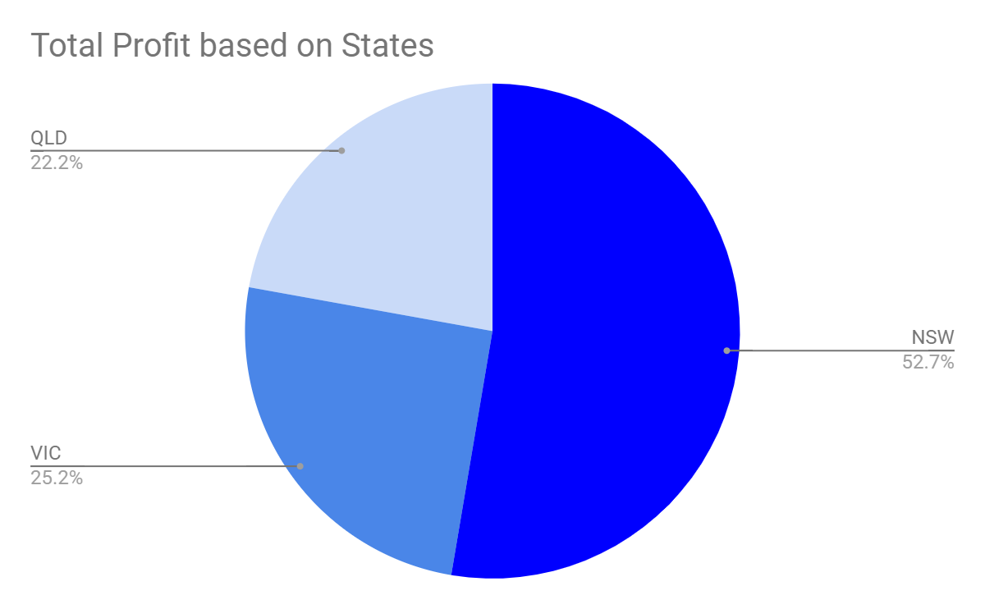
Total Profit based on States in Australia
Insights:
Customers living in New South wales are the most profitable customers with more than 50% profit among the other States.

Slide 12
Summery
Customer between age 30 to 49.
Male customers in the mid-year between April - July and in midweek around Thursday.
Female customers around October and in the start of the weekend, Saturday.
Customers in the Mass Consumer Segment.
Customers related to Financial Services and Manufacturing Industries.
Solex brand and Standard product as the top priority.
Customers living in New South Wales.

Slide 13
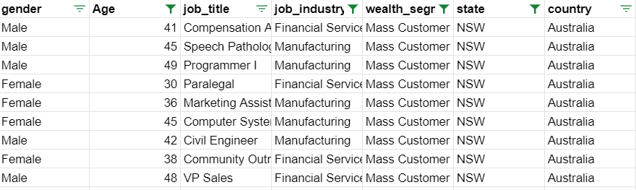
After filtering the targeted customers from the New Customer List, it will look like below

Slide 14
Thankyou!

