Slide 1

Spam Classification
By Anita Tarangi

Slide 2
Problem Statement
A collection of 5573 rows SMS spam messages was manually extracted from the Grumbletext Web site. This is a UK forum in which cell phone users make public claims about SMS spam messages, most of them without reporting the very spam message received. The identification of the text of spam messages in the claims is a very hard and time-consuming task, and it involved carefully scanning hundreds of web pages.
A subset of 3,375 SMS randomly chosen ham messages of the NUS SMS Corpus (NSC), which is a dataset of about 10,000 legitimate messages collected for research at the Department of Computer Science at the National University of Singapore. The messages largely originate from Singaporeans and mostly from students attending the University. These messages were collected from volunteers who were made aware that their contributions were going to be made publicly available.

Slide 3
Exploratory Data Analysis
Checking the size of the dataset
1
Checking the summary statistics of the dataset
2
Checking the data types and null values
3
Dropping NULL’S for columns above 15%
4
Data Standardization
5
Dropping columns which aren’t important
6

Slide 4
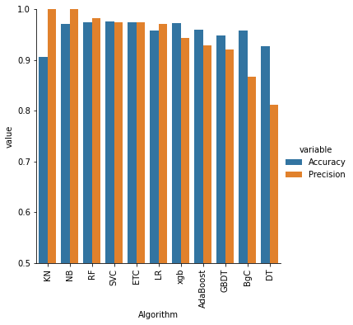
Model Algorithm output

Slide 5
Conclusion
Data exploration, cleaning, visualization is the basic steps, inconsistent data was identified and treated. And then, trained the model using SVC, Decision Tree, Random Forest, XGB Classifier, MultinomialNB, KNeighbours Classifier, AdaBoostClassifier, Gradient Booster, model predicted with different accuracy for every model, out of all the models, SVC has achieved with 97% accuracy rate.
.

