Slide 1

Flight Price Prediction
By Anita Tarangi

Slide 2
Problem Statement
Anyone who has booked a flight ticket knows how unexpectedly the prices vary. The cheapest available ticket on a given flight gets more and less expensive over time. This usually happens as an attempt to maximize revenue based on -
Time of purchase patterns (making sure last-minute purchases are expensive)
Keeping the flight as full as they want it (raising prices on a flight which is filling up to reduce sales and hold back inventory for those expensive last-minute expensive purchases)
So, you must work on a project where you collect data of flight fares with other features and work to make a model to predict fares of flights.

Slide 3
Exploratory Data Analysis
Checking the size of the dataset
1
Checking the summary statistics of the dataset
2
Checking the data types and null values
3
Imputing NULL values
4
Data Standardization
5
Dropping columns which aren’t important
6

Slide 4
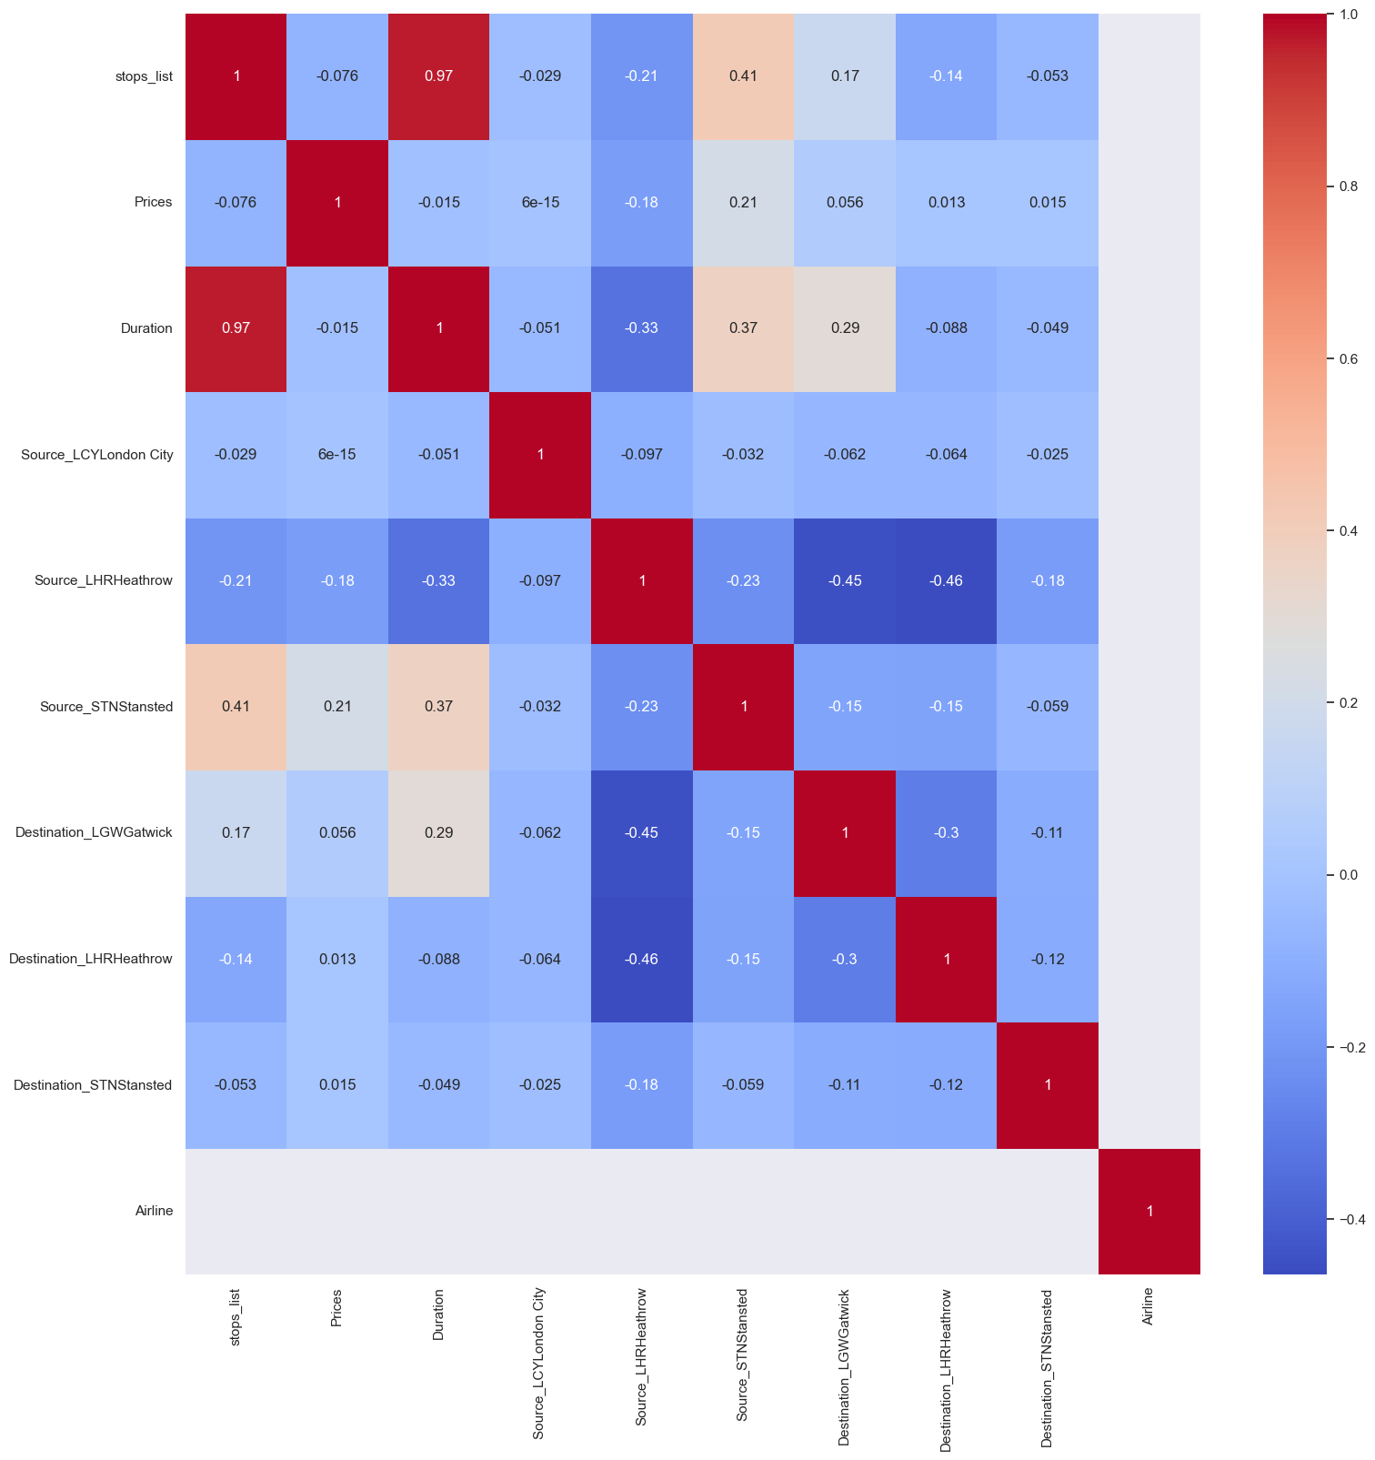
Heatmap

Slide 5
Conclusion
Data exploration, cleaning, visualization is the basic steps, in which imbalanced data was identified and treated. And then, trained the model using Linear Regression, Polynomial, Random Forest, ElasticNet, Ridge, Lasso, model predicted with different accuracy for every model, out of all the models, Random Forest has achieved with 98% accuracy rate.
.

