Slide 1
Proposal for an increased share of Global Fund funding to be allocated to malaria

Slide 2
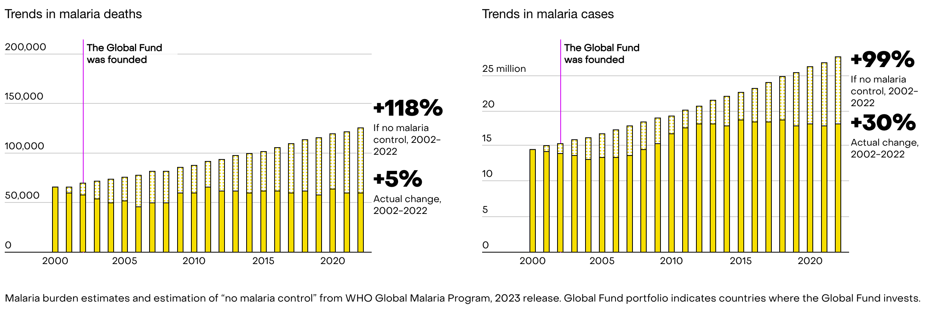
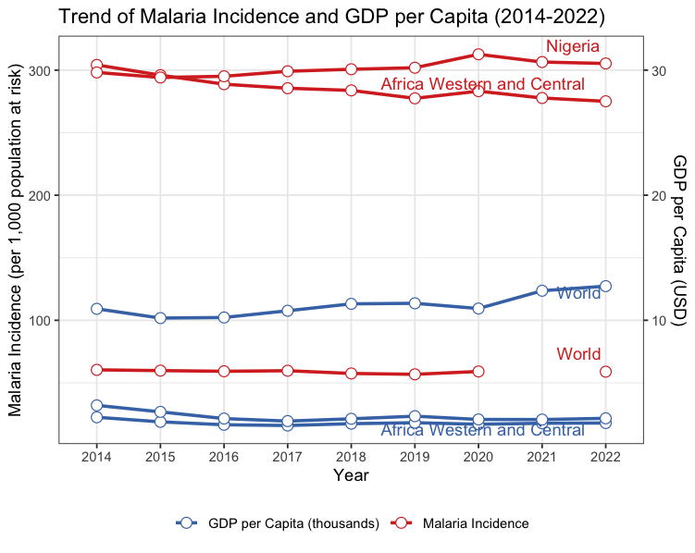
Much progress has been made in
countries where the Global Fund
invests; progress that would
otherwise not be made
without these interventions.
Left: Malaria trends in Western Africa.
Graphic Source: Global Fund
Recently, many endemic countries, especially in subSaharan Africa have had increased rates of malaria cases.
Many of these are Low-and-Middle-Income countries with low GDP per capita.
This situation necessitates increased investment in fighting malaria, if we hope to achieve the 2030 goal to end the disease as a public health threat.
Right: Malaria incidence trends VS GDP per capita for The world, the Western & Central region of Africa, and Nigeria (country case study). Data Source: World Bank

