Slide 1


1501118
Data Structures and Algorithms
Lecture 1: Introduction
School of Information Technology
Copyright 2023 School of IT

Slide 2
Outline
Course Outline
Review of Object-Oriented Programming
Summary

Slide 3
Why Studying Data Structures & Algorithms?
Recently we are in information age
All processes need data i.e. social networking, online shopping etc.
Big data / Information Overload
How to store, access and modify data efficiently?
  Local storage i.e. files and databases
  Cloud or distributed data storage

Slide 4

Why Studying Data Structures & Algorithms?
Data are crucial for processing
To process data efficiently, we need to keep data in suitable structures and select the appropriate algorithms
Efficient data structures and algorithms → less required resources (time, memory etc.)

Slide 5
Example of Data Structures
To keep a value, we can use a variable
To keep two values → use two variables
To keep 100 values?
  It may not be good to declare 100 variables
  It may be difficult to access a value at the 50th position
OK, we can use an array of 100 members
  how about adding a 101st member to an array?

Slide 6
Example of Algorithms
We have five numbers: 4 1 3 5 2
What is the maximum?
What is the minimum?
Can we sort these numbers in ascending and descending orders?
Is there a value “5” in this list? If yes, where is it?

Slide 7
Suggested Self Review
Computer Programming
Object-Oriented Programming
Mathematics 1 / Math for IT 1

Slide 8
Course Description
1501118 Data Structures and Algorithms
Credits 3(2-2-5)
Array; linked lists; stacks; queues; tree; graph; hash table; algorithm analysis; recursion; sorting; searching.

Slide 9
Course Plan: Midterm
16 Jan -20 Jan | Introduction, Review of Computer Programming Fundamentals (Lect 01-02)
23 Jan -27 Jan | Introduction, Review of Computer Programming Fundamentals (Lect 03)
30 Jan – 3 Feb | Array
6 Feb – 10 Feb | Linked Lists 1 (+ Quiz)
13 Feb – 17 Feb | Linked Lists 2 and Algorithm Analysis (+ Quiz)
20 Feb – 24 Feb | Recursion (+ Quiz)
27 Feb – 3 Mar | Stacks (+ Quiz)
6 Mar – 10 Mar | Review and Lab Test * Makha Bucha Day (class will be made up)
13 Mar – 19 Mar | MIDTERM EXAMINATION

Slide 10
Course Plan: Final
20 Mar – 24 Mar | Queues
27 Mar – 31 Mar | Searching and Hash Tables (+ Quiz)
3 Apr – 7 Apr | Sorting (+ Quiz) * Chakri Day (class will be made up)
10 Apr – 14 Apr | Holiday: Songkran Festival (Thai New Year)
17 Apr – 21 Apr | Trees (+ Quiz)
24 Apr – 28 Apr | Graphs 1 (+ Quiz)
1 May – 5 May | Review, and Lab Test * Coronation Day (class will be made up)
8 May – 19 May | Final Examination + Project Presentation

Slide 11
Course Schedule
Onsite:
Sec | Lecture | Lab
1 | Wed 13:00 – 15:00 @ E3-B101 | Fri 13:00 – 15:00 @ S1-201
2 | Wed 13:00 – 15:00 @ E3-B101 | Fri 13:00 – 15:00 @ S1-202
3 | Fri 8:00 – 10:00 @ C1-313 | Fri 10:00 – 12:00 @ S1-201
4 | Fri 8:00 – 10:00 @ C1-313 | Fri 10:00 – 12:00 @ S1-202
5 | Fri 10:00 – 12:00 @ C2-406 | Fri 13:00 – 15:00 @ S1-305
6 | Fri 10:00 – 12:00 @ C2-406 | Fri 15:00 – 17:00 @ S1-305

Slide 12
Evaluation
Self Management
Topic | Score
Online Exercise | 10
Lab Assignment | 10
Online Quiz | 10
Online Lab Test 1+2 | 5+10
Onsite Midterm Exam | 20
Onsite Final Exam | 25
Group Presentation | 10
Total | 100
Understanding
Team Work

Slide 13
Grading
Criteria-based
Score | Grade
[80,100] | A
[75,79.99] | B+
[70,74.99] | B
[65,69.99] | C+
[60,64.99] | C
[55,59.99] | D+
[50,54.99] | D
[0,49.99] | F

Slide 14
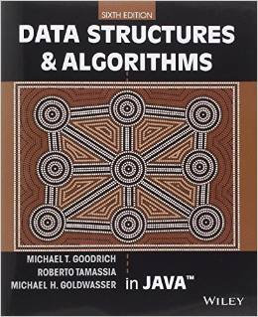
References
M. T. Goodrich, R. Tamassia, and M. H. Goldwasser, Data Structures and Algorithms in Java, 6 edition. Hoboken, NJ: Wiley, 2014.
Image source: http://www.amazon.com

Slide 15
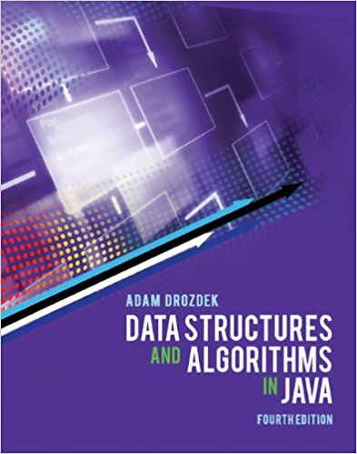
References
A. Drozdek, Data structures and algorithms in Java, 4th edition. Singapore: Cengage Learning Asia, 2013.
Image source: http://www.amazon.com

Slide 16
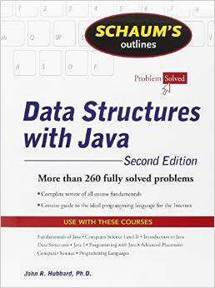
References
J. Hubbard, Schaum’s Outline of Data Structures with Java, 2ed, 2 edition. New York: McGraw-Hill, 2009.
Image source: http://www.amazon.com

Slide 17


Contact Us
Sec | 1-4 | 5-6
Image:
Name: | Aj. Dr.Paweena Suebsombut | Asst. Prof. Dr.Worasak Rueangsirarak
Email: | paweena.sue@mfu.ac.th | worasak.rue@mfu.ac.th

Slide 18
Object-Oriented Programing
(Java—CLASS)
Review

Slide 19
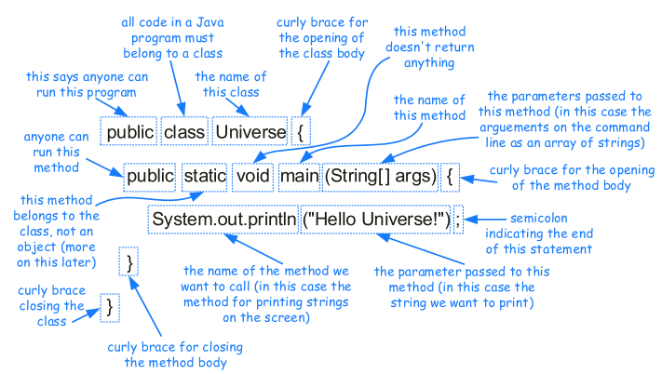
Basic Java
Image source: M. T. Goodrich et. al., Data Structures and Algorithms in Java

Slide 20
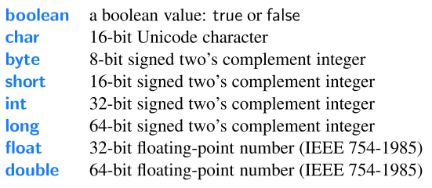
Based Type (Primitive Type)
Image source: M. T. Goodrich et. al., Data Structures and Algorithms in Java

Slide 21
Object-Oriented Programming
Structured (Procedural) Programming
  Algorithm then data structure
  Program is separated to many procedures (functions)
  Good for small problems
OOP
  Data structure (class) then algorithm
  Program is broken down to many classes. Each class has data and methods
  Good for large problems

Slide 22
OOP vs. Structured Programming
Global Data
Object Data
procedure
method
method
procedure
procedure
Object Data
method
procedure
method
Structured
OOP

Slide 23


Example of OOP <Class & Objects>
Class: Sim
Attributes
Name
Gender
Hair color
Behavior: Eat, Dance, Sleep
Ethic
Weight
Height
Personality
Emily
Judy
Heike
Mike
Lucy
Mica
Sandy
Object: Sandy
Name: Sandy
Gender: Female
Hair color: Red
Ethic: Latin
Weight: 45
Height: 160
Personality: Nice

Slide 24

Class’s Components
Properties (Variables)
Behaviors (Methods)
Ex: a class of student
Properties: ID, name
Behaviors: study
I have ID and name
I can study

Slide 25

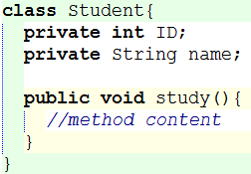
Class Diagram
Ex: a class of student
Properties: ID, name
Behaviors: study

Slide 26
Class Declaration
modifier class CLASS_NAME {
modifier TYPE variable;
modifier method( ){
statement;
}
}
Attribute
Method

Slide 27
Modifier
Java applies concept of information hiding by using modifiers which are applied on both attribute & method
Some Examples of Modifier
Private can be referred only within its own class
Public can be referred from other classes
public
private

Slide 28

Exercise
Design a class of “Dog” by
  listing some properties and methods
  drawing a class diagram
Convert to Java code
* write to the re-use paper provided by lecturer, then submit it to LMS

Slide 29
Objects
A class is only a template. We cannot use it directly
To use a class, we need to create its objects
Object: student1
Class: Student
Object: student2

Slide 30

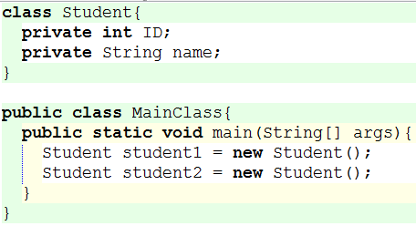

Creating Objects
Object: student1
Object: student2

Slide 31
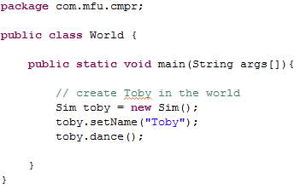
Using Sim Class
When class is in used.
Class is a type, Instance is a variable
New instance
Call public
method members

Slide 32
Getter and Setter
Usually class’s variables are designed to be private (accessible only within its class)
To access them outside of its class, we need two public methods: getter and setter
ID and name are private

Slide 33
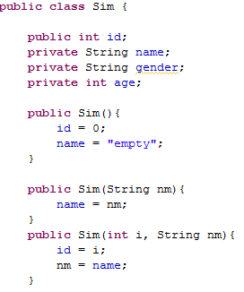



Getter/ Setter
Class: “Sim”
Other class
Error on these statements,
age is private variable member
“By Design, attribute is recommend to be private”
Therefore, we need..
  Setter (Mutator)
  Getter (Accessor)

Slide 34
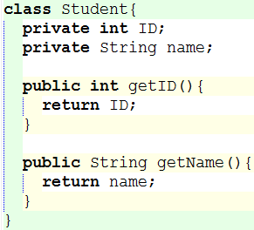
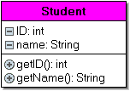
Getter
Getter is a method to return a variable to other classes

Slide 35
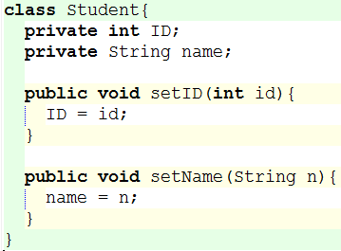
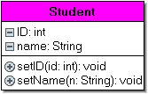
Setter
Setter is a method to change a variable’s value from other classes

Slide 36
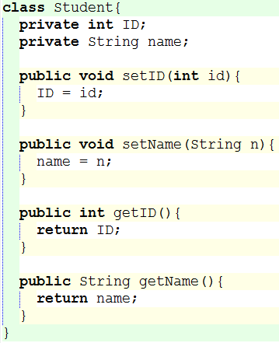
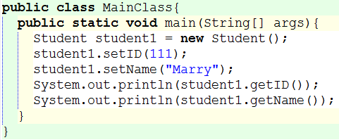
Using Setter and Getter
Use outside of their class
object.setter() and object.getter()

Slide 37
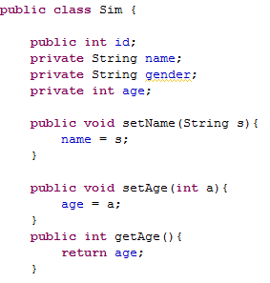
Ex. Getter/ Setter
Modify code of Class: “Sim”
………………………
Also a Setter for setting name
New Setter is added
for setting age variable
New Getter is added for returning age

Slide 38

Ex. Getter/ Setter (Cont.)
Class: “Sim” after modifying
Other class which create object: “toby” inside and then call method: ‘setAge()’ for setting age + method: ‘getAge()’ for getting age
………………………
Result:
18

Slide 39
Exercise
From a class “Dog” of which you have created previously, create setter and getter. Draw a new class diagram and Java code.
* write to the re-use paper provided by lecturer, then submit it to LMS

Slide 40
Constructor

Slide 41
Constructor
Each instances contains different value of data members
For convenience, Java provides Constructor which is method called when creating new instance to initialize/set data members.
Method with same name as class name

Slide 42
Constructor (Cont.)
One class can contains multiple constructors which get different arguments
When constructor is not declared, a constructor without arguments is default

Slide 43
Sample: Constructor
Multiple Constructors
with
different arguments
Methods with
Same name as class name
No return type defined

Slide 44
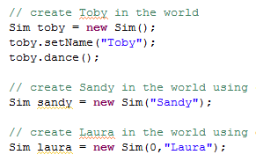
Constructor: How does it work?
How many created objects (people)???
Which constructor is called?

Slide 45
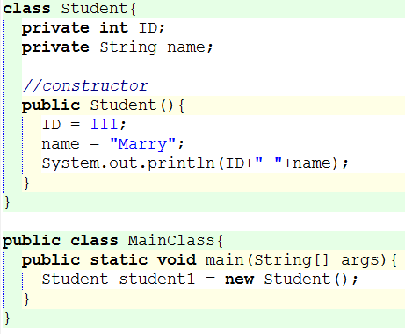
EX. Constructor
A method having the same name of its class
To give the initial values to class’s variables
No return type

Slide 46
Exercise
Add a constructor to your class “Dog”
* write to the re-use paper provided by lecturer

Slide 47
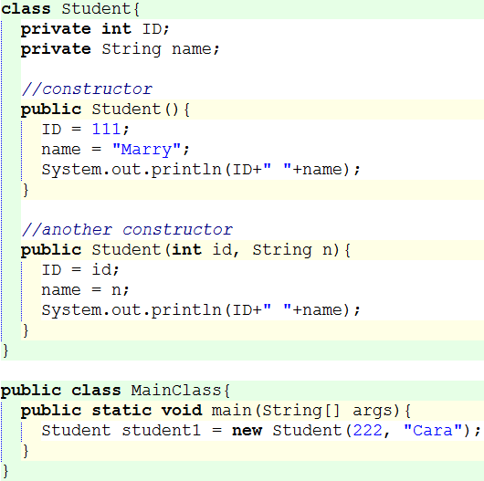
Overloaded Constructors
Two or more constructors with different types or number of parameters

Slide 48
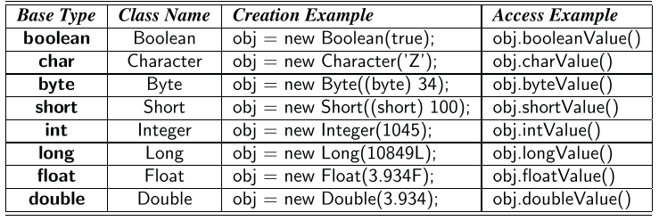
Wrapper Types
Object types comparable with Base types
Image source: M. T. Goodrich et. al., Data Structures and Algorithms in Java

Slide 49
Self Study
Review the following OOP concepts by yourself
  Com Pro: chapter 10
  Static Variable & Static Method
  Keeping encapsulation
  Inheritance
  Polymorphism
  Abstract class and Interface
  Exceptions
  Nested classes

Slide 50
Class Design Hints
Always keep data private
Always initialize data (e.g. by constructor)
Use setter and getter methods
Make classes and methods’ names reflect their responsibilities
If a class is too large, try to split it to smaller classes

Slide 51
Summary
Why do we need different data structures?
What would be advantages for studying data structures and algorithms?
How different is structural programming and OOP?
What is data encapsulation?

