Slide 1

USWDS Monthly Call
June 2023

Slide 2

Hi!
Thanks for being here!

Slide 3
Agenda
USWDS 3.5.0
Content testing critical checklists
Q&A

Slide 4
USWDS 3.5.0
Over 25 new features and big fixes

Slide 5
Key improvements in USWDS 3.5.0
Consistency and legibility of disabled form elements
File input experience for voice and screen readers
Space bar trigger to links styled as buttons
Updated Identifier accessibility link
Updated form guidance to suggest labeling both required fields and optional fields

Slide 6
Other good stuff in USWDS 3.5.0
Stopped using font smoothing
Labeled external links for screen readers
Updated Sass map settings
Added custom accordion background color settings
Removed comments that could bloat compiled CSS
Fixed a bug that prevented links that start with a number from scrolling in In-page navigation

Slide 7
USWDS 3.5.0
Out now

Slide 8
Content testing critical checklists
What we did and what we learned

Slide 9
Teams want to know about the Section 508 and WCAG conformance of our components

Slide 10
Component-based
critical checklists

Slide 11
Quick turnaround from last month

Slide 12
What can we do in just
a couple weeks?

Slide 13
Get folks involved early

Slide 14
Amy Cole
she/her
Accessibility Specialist
Contractor

Slide 15
Jacline Contrino
she/her
UX Researcher
Contractor

Slide 16
What’s our opportunity? How can we be useful?

Slide 17
We can’t all be 508 specialists, but we can all contribute to accessibility testing

Slide 18
We take our role as accessibility supporters seriously

Slide 19
A starting point for anyone assessing the accessibility of their own sites and services

Slide 20
Usable by folks with a wide range of technical skills

Slide 21
Better Section 508 conformance across government

Slide 22
How’d we get started?

Slide 23
Landscape analysis: What are others doing?

Slide 24
Different approaches to accessibility
Many at least mentioned accessibility
Some included the WCAG success criteria, but didn't always connect to specific heuristics checked
Most accessibility resources were written using technical jargon
None had component-level checklists for keyboard, zoom, and screen readers

Slide 25
Interesting elements we might want to explore later
Scripts for what a screen reader should sound announce per component
Component diagrams with accessibility-related callouts

Slide 26
An opportunity to fill a guidance gap

Slide 27
A place where we can share and scale expertise

Slide 28
Government accessibility resources

Slide 29
What content did we test?

Slide 30
Context and instructions for anyone new to the manual testing process

Slide 31
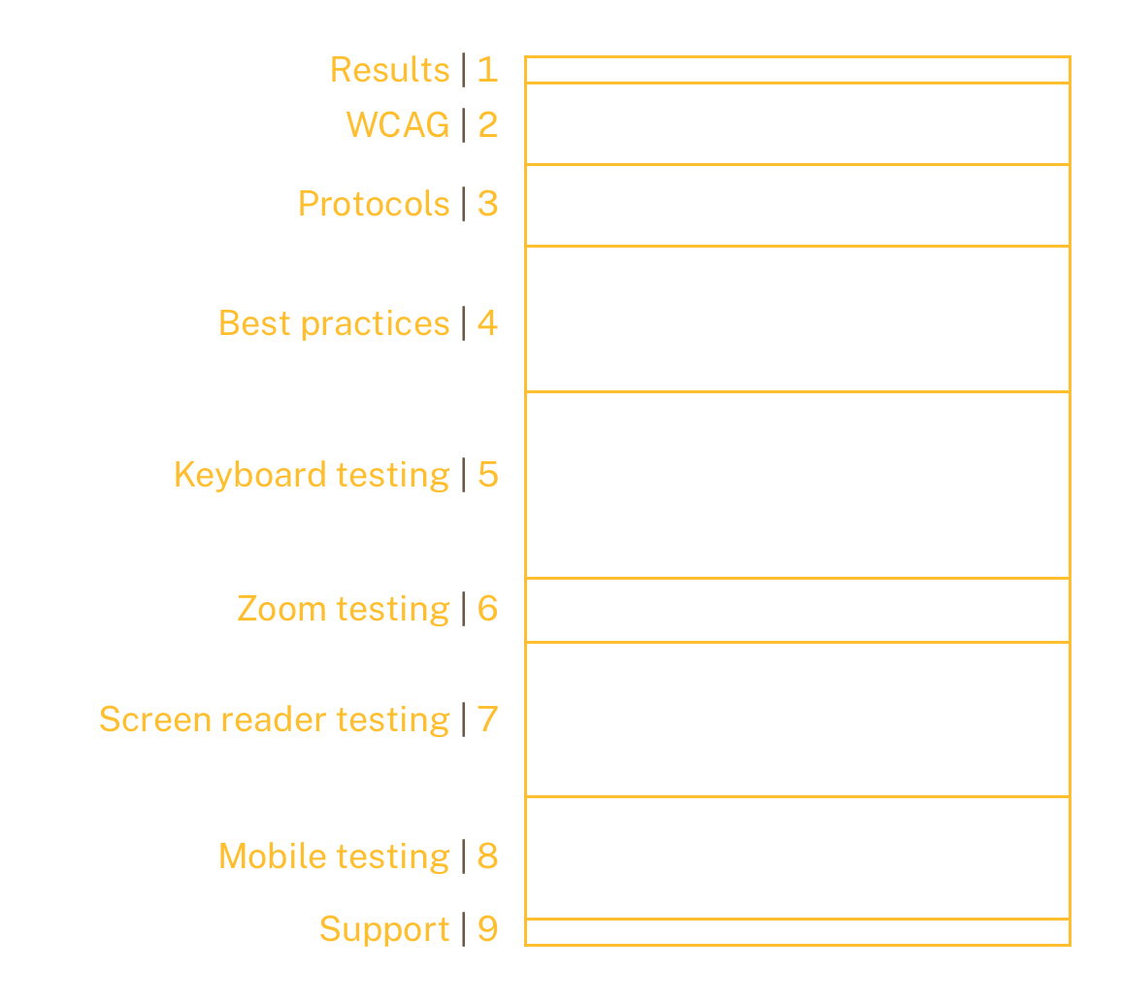
We decided to err on the side of more content
Our first content draft was focused on the Accordion component and consisted of nine sections

Slide 32
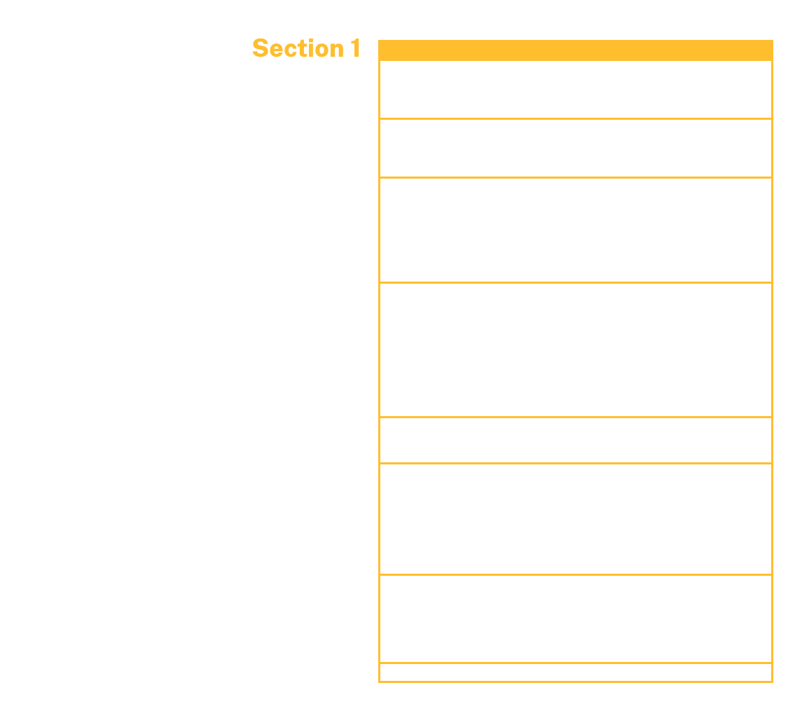
Section 1
Overall accessibility results

Slide 33
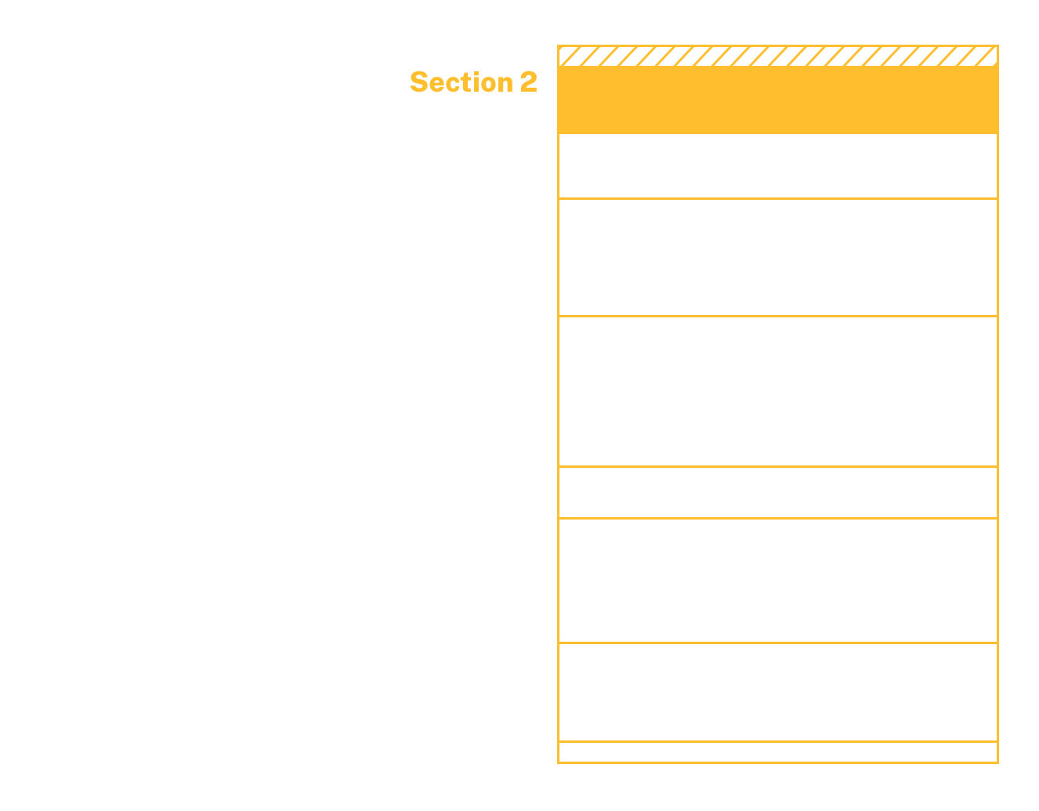
Section 2
Relevant WCAG success criteria

Slide 34
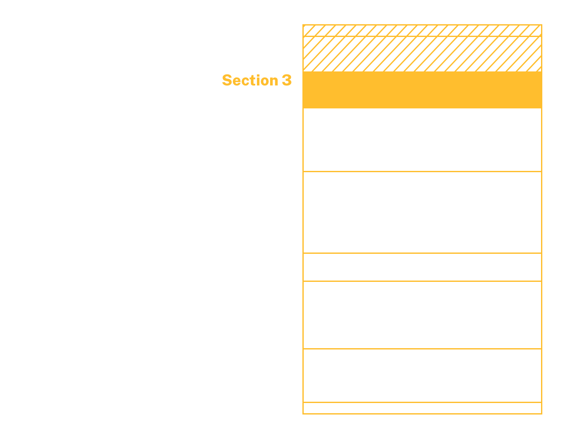
Section 3
Our testing protocols for USWDS components

Slide 35
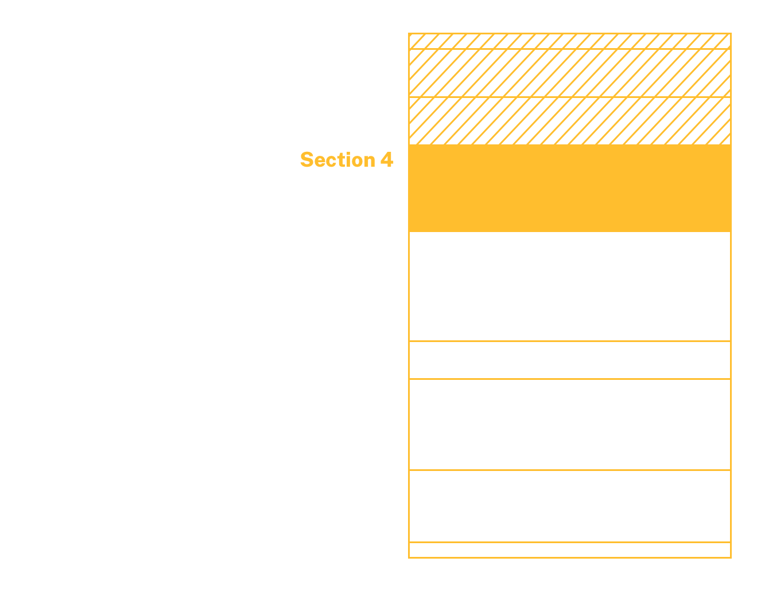
Section 4
Accessibility best practices for the component

Slide 36
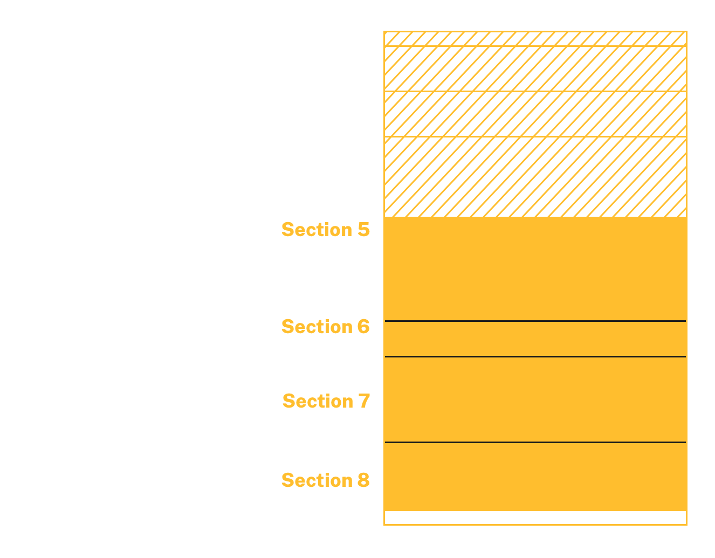
Sections 5–8
Manual testing checklists:
Keyboard control,
Zoom magnification, Screen reader,
Mobile

Slide 37
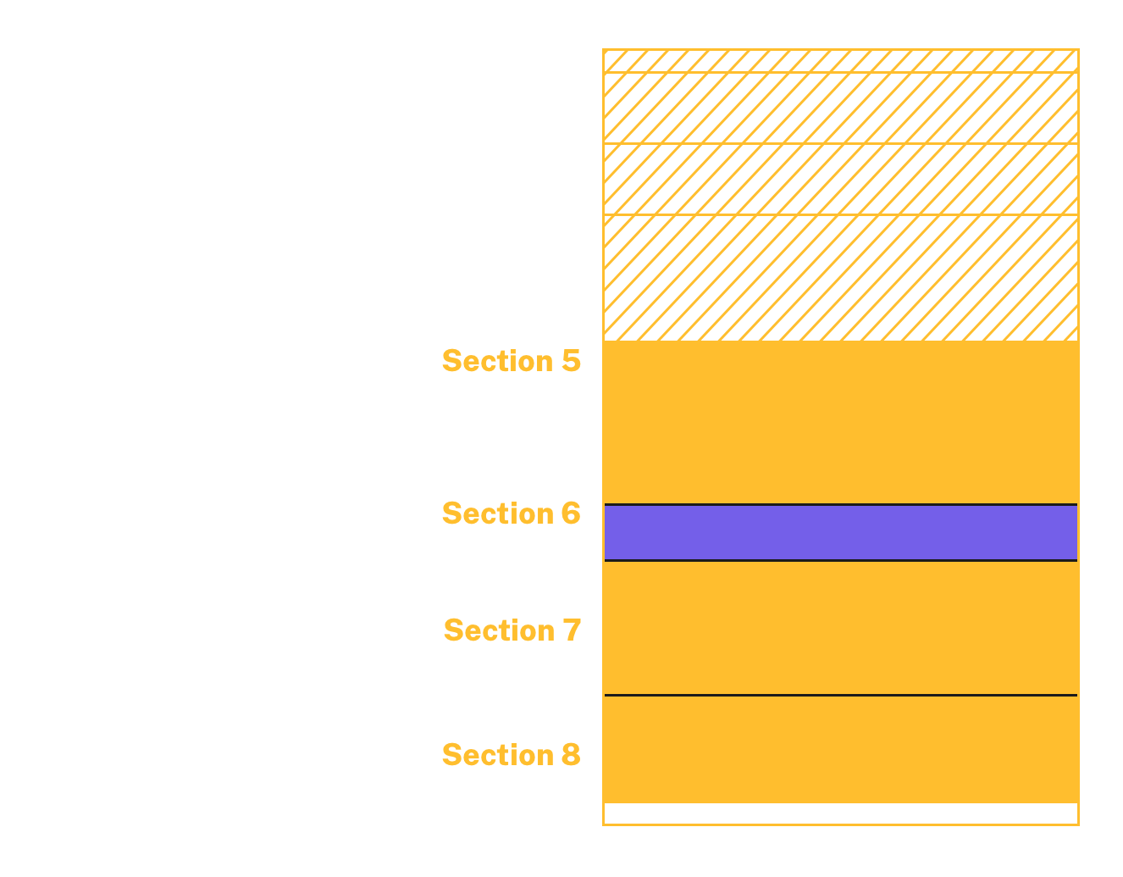
Zoom example: Zoom magnification testing checklist
Navigate to a page on your website where the accordion component is used.
Enlarge the view of your screen up to 200% by going into the browser settings or clicking “ctrl + scroll wheel” (Windows) or “command +” (Mac) until you see 200% in a pop-up window on the top right of your screen.
Test the functionality and visibility of the accordion using a mouse using the Magnification testing checklist.

Slide 38
Zoom example: How to perform magnification testing
Are you able to see all the content in the accordion without horizontal scrolling?
Is any content cut off?
Does any content in the accordion overlap?
Do you see anything covering the accordion (pop ups, images, etc.)?

Slide 39
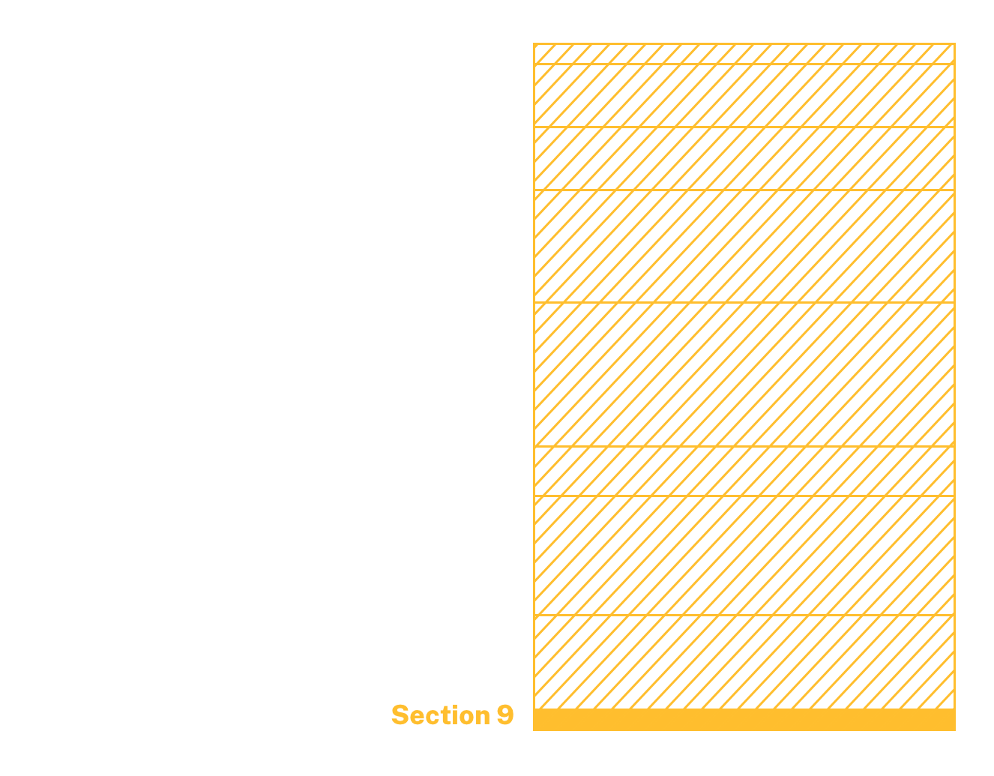
Section 9
Support

Slide 40
There was a lot of content in this test!

Slide 41
Content testing

Slide 42
Were we on the right track?

Slide 43
Content testing options

Slide 44
Semi-structured interviews
Flexible and good for getting general information about content

Slide 45
Cloze tests
Research fill-in-the blank: A measurable way to understand comprehension

Slide 46
Recall-based testing
A quiz to test how well folks understand what they read

Slide 47
Highlighter test
Ask users to highlight passages that evoke certain feelings

Slide 48
A/B testing
Compare effectiveness of two different versions

Slide 49
Test your content with actual or representative users

Slide 50
We decided to use semi-structured interviews

Slide 51
1.
Mental models

Slide 52
2.
Expectations

Slide 53
3.
Comprehension

Slide 54
4.
Gaps

Slide 55
5.
Actionability

Slide 56
How we did it

Slide 57
Did it all in about three weeks

Slide 58
Ethical research practices

Slide 59
Session structure
Expectations
Scanning (30 seconds)
Reading (7 min)
Follow-up questions
30 minutes total

Slide 60
Questions we asked
Would you please summarize the information on that page in your own words?
What was easy or difficult to understand? Why?
What questions do you have after reading that content?
What is missing that you’d like to see/what further information do you need?
What might you change and why?

Slide 61
What we’d do differently:
Try section-level summaries instead of a page-level summary

Slide 62
Fed research pool

Slide 63
What we learned

Slide 64
We’re on the right track.
Mostly.

Slide 65
“I think that it’s hard to think of all the pieces of accessibility… And I think this does a really good job at a high level, considering all of the pieces and also encouraging testing. Even showing or telling them how to test, [the] tools to use. It’s very well put together.”

Slide 66
What worked?
Meets or exceeds user expectations
Increases confidence
Empowering
Comprehensive
Understandable

Slide 67
What can we improve?
Extensive content could be overwhelming
Clarity about responsibilities
The role of ARIA
The basics: Color contrast, font size, etc.
Testing results

Slide 68
Next steps

Slide 69
Working towards the next iteration of these checklists

Slide 70
There’s huge value in getting an early outside perspective from your audience

Slide 71
Our focus: What tests we performed, their result, and when we performed them

Slide 72
Behavior- and outcome-driven tests

Slide 73
Keep the content relevant to the related component

Slide 74
An atomic design model for accessibility

Slide 75
Repeatable structure!

Slide 76
A six-month rollout 😅

Slide 77
Accessibility Discussions

Slide 78
Q&A

Slide 79
Next month
July: Summer break
#uswds-public
github.com/uswds
designsystem.digital.gov

