Slide 1

USWDS Monthly Call
August 2023

Slide 2

Hi!
Thanks for being here!

Slide 3
Agenda
Site launches
Product updates
Roadmap
Q&A

Slide 4
Site launches

Slide 5
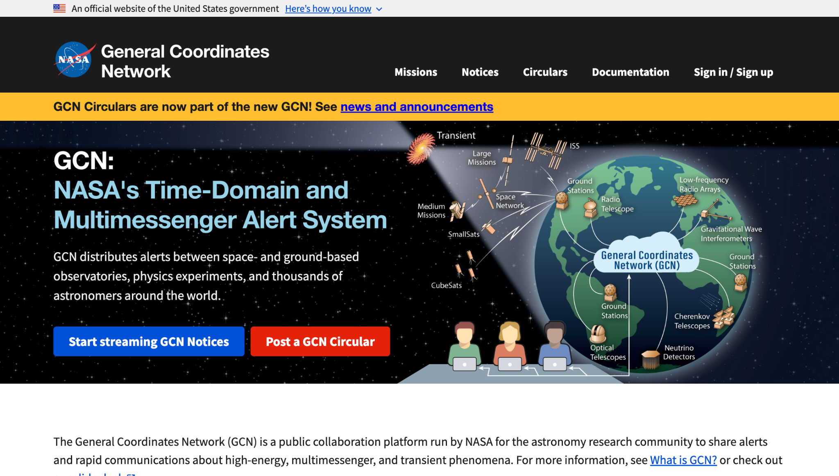
NASA’s General Coordinates Network (GCN)
gcn.nasa.gov

Slide 6
Great work!

Slide 7
USWDS 3.6.0
Important bug fixes

Slide 8
Key improvements in USWDS 3.6.0
Improving in-page navigation
Expanding icon list’s font-size token support.
Color and styling bugs related to disabled styles
Fixing a bug preventing font-[family]-[size] utility classes from generating
Accessibility improvements for memorable date, pagination, and form input components

Slide 9
USWDS 3.6.0
Out this Friday

Slide 10
USWDS Roadmap
Summer 2023

Slide 11
USWDS is about 8 years old

Slide 12
Three key phases

Slide 13
USWDS 1.0
Common starting point
Built to prove

Slide 14
USWDS 2.0
Common design language
Built to adapt

Slide 15
USWDS 3.0
Common component packages
Built to choose

Slide 16
Since USWDS 2.0 usage has about tripled

Slide 17
Sites using USWDS
103 → 461

Slide 18
Pageviews per month
390 million → 1.1 billion

Slide 19
Pageview coverage
9% → 28%

Slide 20
Strong community of practitioners sharing solutions

Slide 21
Dozens of teams doing good work across agencies and silos

Slide 22
Iteratively improving the digital experience of government

Slide 23
Principles-centered progress

Slide 24
Nevertheless, growing pains

Slide 25
“You don’t have what we need.”

Slide 26
“Our standards conflict with yours.”

Slide 27
“You need to prove your solutions are better.”

Slide 28
“It’s just too hard to use.”

Slide 29
“It’s a burden to stay up to date.”

Slide 30
These are reasonable concerns

Slide 31
USWDS always needs to improve

Slide 32
USWDS always needs to evolve

Slide 33
USWDS always needs to change

Slide 34
Lots of issues and feature requests

Slide 35
There’s a lot that we need and want to do

Slide 36
But change isn’t just hard,
it’s costly

Slide 37
Currently, the more teams use the design system, the more costly the change

Slide 38
We want to scale improvements but risk multiplying cost

Slide 39
The costs of change

Slide 40
Two types of cost

Slide 41
Implementation cost

Slide 42
Justification cost

Slide 43
What can we do to
lessen these costs?

Slide 44
Back-end consistency enables front-end change

Slide 45
Implementation : API ::
Justification : Process

Slide 46
As we build to change:
A focus on API and process

Slide 47
The biggest change from 1.0:
Staying up-to-date over time

Slide 48
A dependency not a fork

Slide 49
Mature our technology

Slide 50
Mature our process

Slide 51
The design system: Not just a commonality machine but a change machine

Slide 52
We talked about this in
February 2022

Slide 53
And now we’re going to get it done

Slide 54
“Development isn’t a collection of things, it’s a process that yields things.”

Slide 55
Evolution isn’t simply an ape, a cave dweller, and a modern human standing on a timeline…

Slide 56
…it’s the process that drives ongoing differentiation.

Slide 57
Principles

Slide 58
Start with real user needs

Slide 59
Earn trust

Slide 60
Embrace accessibility

Slide 61
Promote continuity

Slide 62
Listen

Slide 63
Anne Petersen
they/them
Experience Design Lead
USWDS

Slide 64
Being the new person

Slide 65
This is a big job!

Slide 66

Carl Sagan: “To make an apple pie from scratch, you must first invent the universe.”
Image credit NASA/ESA/STScI

Slide 67
How do we start?

Slide 68
Roadmap as Minimum Viable Product (MVP)

Slide 69
We too are maturing

Slide 70
The process is (part of) the product

Slide 71
Process: how and why

Slide 72
Which gets us to… the roadmap

Slide 73
Roadmap 2023–2024
Conduct a content audit of our website
Define component acceptance framework & lifecycle
Establish ongoing accessibility-focused usability testing
Publish updated guidance for using disabled styles
Create critical checklists for components
Develop USWDS web components
Convert design tokens to JSON and CSS variables

Slide 74
Conduct a content audit of our website

Slide 75
Conduct a content audit of our website
Catalog and understand the current organization and content of our website
Why are we doing this?
To gain a holistic understanding of our current content and where there are redundancies and obsolete content.
To learn how to reduce content clutter and better organize our content.
Milestones
First: Identify key metrics and collect data
Next: Page-level audit, reviewing content types, house style, and priority
After: Create an action list, consolidate style guides, and prepare for further organization studies
Total: 6 months (2 months remaining)

Slide 76
Define component acceptance framework & lifecycle

Slide 77
Define component acceptance framework & lifecycle
Outline and publish how components move from proposal to publishing, as well as what happens after we publish, ongoing checks, and what happens when components have major changes
Why are we doing this?
To make it clear what we expect of any design system component.
To bring consistency and transparency to our decision making.
To build a common understanding and a predictable process to the way components develop and change
Milestones
First: Define proposal process and document the complete component lifecycle
Next: Share a collect feedback from community. Prototype process with a component.
After: Publish framework and display lifecycle information on our website
Total: 4-6 months

Slide 78
Establish ongoing accessibility-focused usability testing

Slide 79
Establish ongoing accessibility-focused usability testing
Operationalize usability testing with people with disabilities as a sustainable, repeatable process that other teams could adapt
Why are we doing this?
To better understand how our components perform with real users, especially those with disabilities
To be proactive when it comes to component usability
To be able to share our process with other teams that want to improve their own usability testing capacity
Milestones
First: Develop a process for recruitment, management, compensation, and testing
Next: Pilot this process and develop relationships with communities
After: Perform ongoing testing and share our process with our own community
Total: 6 months (2 months remaining)

Slide 80
Publish updated guidance for using disabled styles

Slide 81
Publish updated guidance for using disabled styles
Update guidance for using disabled styles to discourage most uses, and create a process for documenting and publishing research that supports new guidance and changes to guidance
Why are we doing this?
To improve the usability and accessibility of forms
To codify and improve our process for publishing guidance and research
Milestones
First: Complete research on using disabled fields and improve disabled field styling
Next: Identify scope of updated guidance and publish to our website
After: Prototype repeatable process for publishing research
Total: 6 months (3 remaining)

Slide 82
Create critical checklists for components

Slide 83
Create critical checklists for components
Publish plain-language checklists for validating or revalidating the accessibility of our components with lightweight manual testing
Why are we doing this?
To provide an accessibility baseline for our components that teams can use to validate our work and their own
To democratize accessibility checking across teams and skillsets
To improve the accessibility of sites and services
Milestones
First: Establish component types and voice and tone
Next: Document heuristics for each of our components. Prototype with community
After: Publish checklists to our website alongside a mechanism for updating
Total: 6 months

Slide 84
Develop USWDS web components

Slide 85
Develop USWDS web components
Deliver templated, platform agnostic, web standards–based components with a simple, consistent, documented API
Why are we doing this?
To simplify integrations and provide out-of-the box components
To reduce time and cost of updating to minor and patch versions
To establish a documented API that teams can use with confidence
Milestones
First: Framework evaluation and collect examples from other design systems
Next: Alpha of our core components (banner and identifier). Identify partners for Beta.
After: Beta program, development, and testing. Thoroughly document on website. Publish new major version.
Total: 12 months

Slide 86
Convert design tokens to JSON and CSS variables

Slide 87
Convert design tokens to JSON and CSS variables
Create a portable, canonical data format for USWDS design tokens
Why are we doing this?
To allow more teams to be able to use our design tokens across frameworks and platforms
To reduce our dependency on specialized formats like Sass
To deliver design tokens in a modern, familiar format that teams expect
To support theming web components
Milestones
First: Audit token data, research JSON structures, and determine conversion strategy
Next: Convert system tokens, transform to Sass variables, create token library
After: Convert remaining tokens, transform to CSS variables, and integrate into components
Total: 8 months

Slide 88
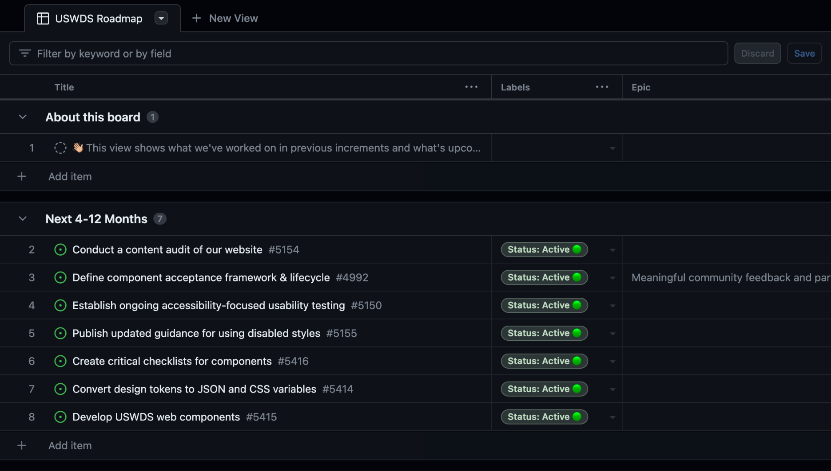
Roadmap board
github.com/orgs/uswds/projects/13/views/1

Slide 89
Does this roadmap set us up for success?

Slide 90
Cadence of change

Slide 91
Supporting a universe
Bringing it together

Slide 92
Next:
Stepping back to
mission and vision

Slide 93
Q&A

Slide 94
Next month
September: Mission and vision
#uswds-public
github.com/uswds
designsystem.digital.gov

