Slide 1

Getting GAO’s message across in the Digital Age by Melanie Fallow + Eden Savino
Getting GAO’s Message Across in the Digital Age
Melanie Fallow + Eden Savino

Slide 2
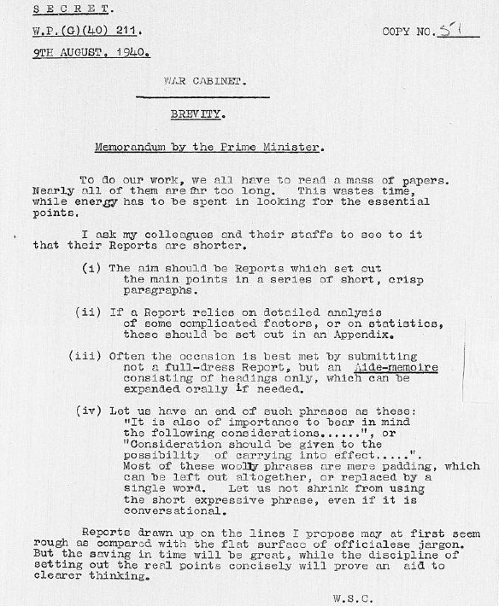


Winston Churchill memo on brevity from 1940
1940 memo from Winston Churchill to his War Cabinet on the need for brevity

Slide 3
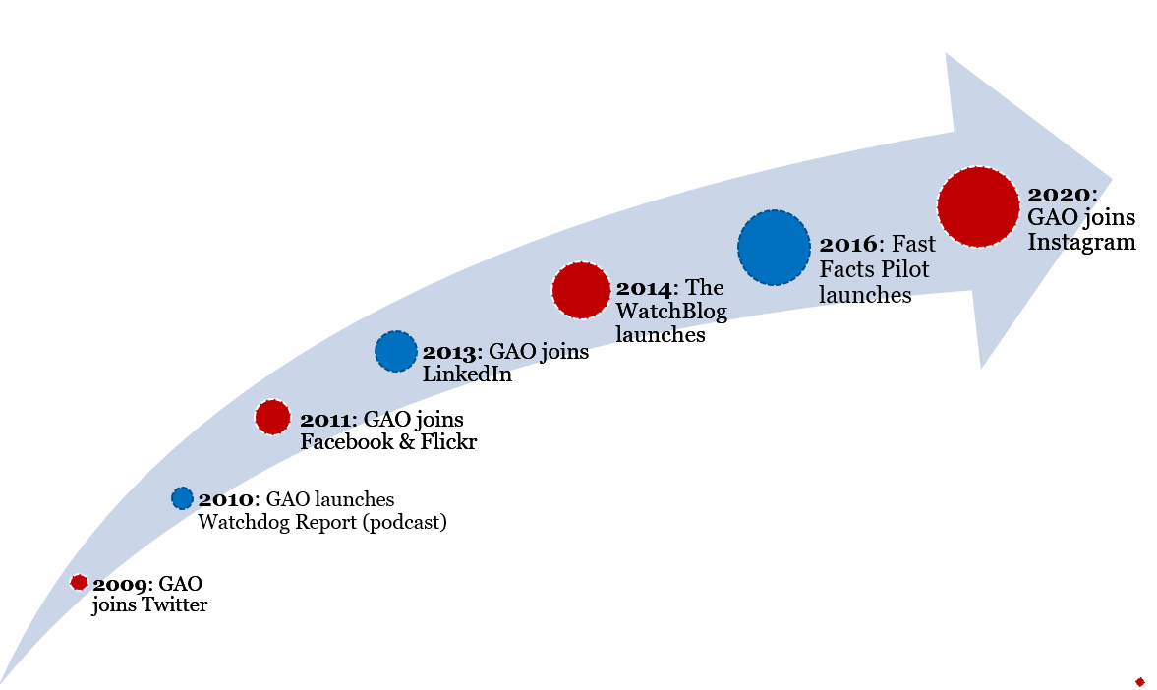
GAO’s social and digital media initiatives
GAO’s Social and Digital Media Initiatives

Slide 4
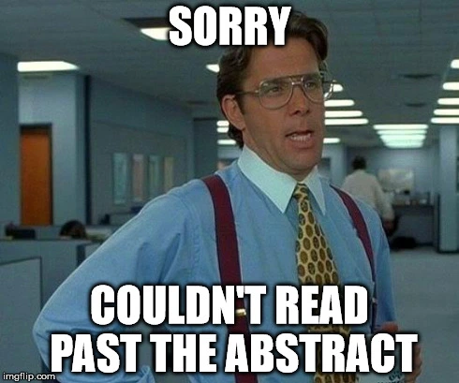
The Need
The Digital Age: deluge of information, new tech, platforms
Peer Review feedback on Highlights
Low engagement based on “bounce rate,” time on page, other metrics

Slide 5
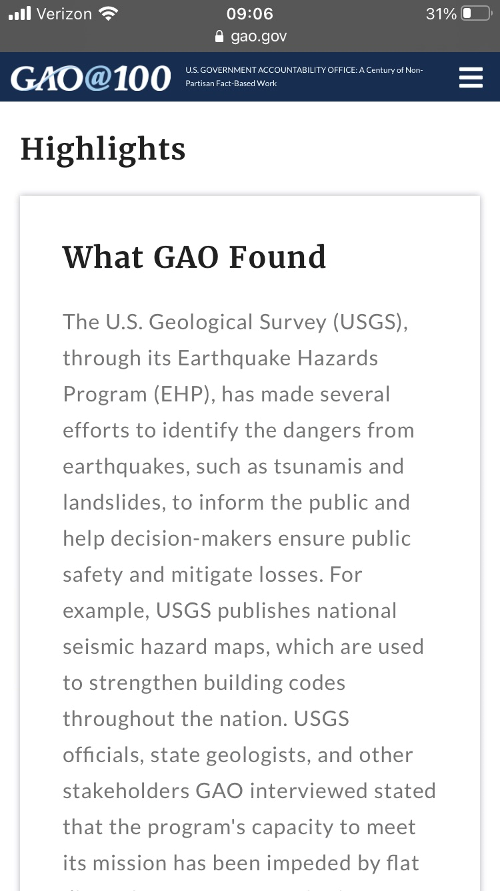
Before Fast Facts
Online Highlights Page
Landing page for all products
Part of the audit product
Few visuals
Not mobile-friendly

Slide 6
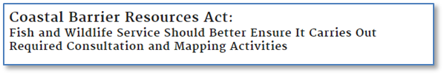
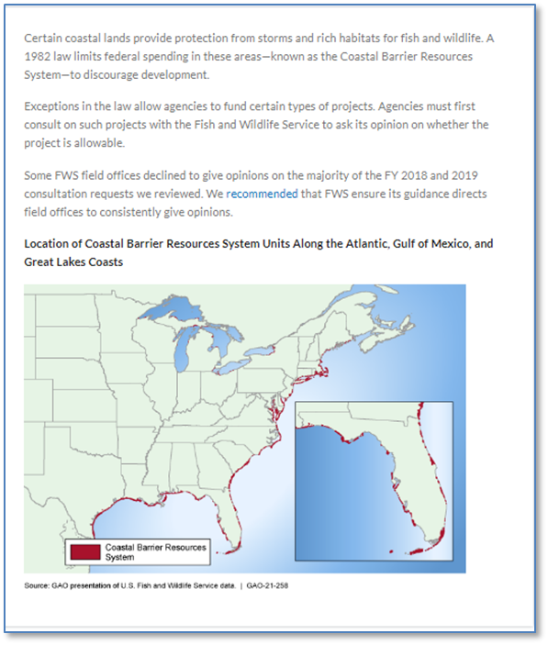
What are Fast Facts?
Brief, 650-character online introductions to GAO reports
Communicate bottom-line findings
Feature engaging visuals
Smartphone friendly

Slide 7
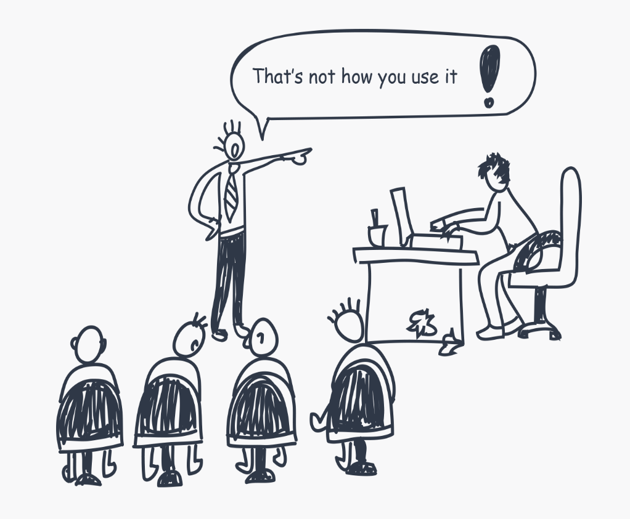
The Pilot
Data
Google Analytics
Internal feedback
Usability tests
Tested Fast Facts with people we want to read our work

Slide 8

The Results – More Engaged Readers
Readers spent 70% longer on GAO.gov (desktop) and nearly 700% longer on mobile devices
40% more report shares
30% more report downloads

Slide 9
The Results – What Our Readers Told Us
Fast Facts has “useful information and the type of information that [elected officials] should know.”
~ Legislative Assistant
“Fast Facts are worth pursuing. It gave enough information to decide a way to go [with my research].”
~ Washington Post Reporter
Fast Facts is “tremendously helpful” and “increases the usefulness of products.”
~ Legislative Assistant

Slide 10
The Awards
In spring of 2021, the Fast Facts team won two awards from the Center for Plain Language for “Fast Facts – Getting GAO’s Message Across in the Digital Age.”
2021 ClearMark Award in the Blogs, Newsletters, & Summaries category
Award of Distinction
Notes:
Comments from the award peer reviewers included: “It’s clear that the authors edit and revise several times to make each “Fast Fact” just that—a “Fast Fact.” “There’s enough bite-sized information to get people up to speed on the issue with overwhelming them.” “The deliberate use of a single image or graphic is clear here.” “Nice work on the usability testing!”

Slide 11
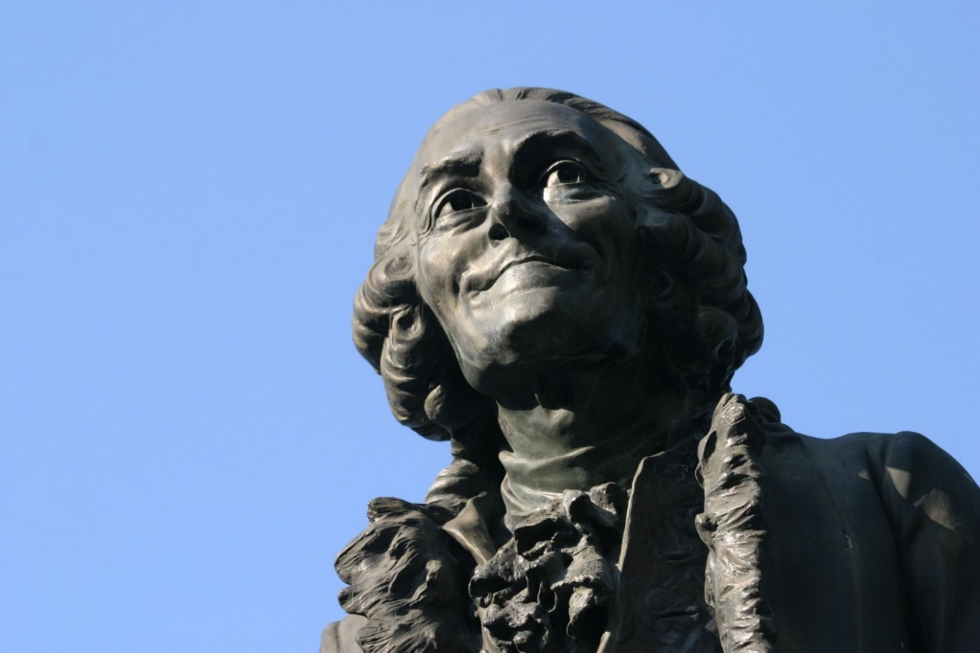
Fast Facts & Beyond
The best way to be boring is to leave nothing out.
—Voltaire
Continuous Process Improvement
Stock photo service
Centering writers and designers
Highlights Pilot
Plain language training, guidance

Slide 12






Connect with @usgao!
Connect with @usgao!
Subscribe to our emails
Read our WatchBlog
Follow us on Twitter
@usgao
Friend us on Facebook @usgao
Follow us on Instagram
@usgao
Connect with us on LinkedIn

