Slide 1
Reframing the role of senior leaders in modern software design
Allison Press
Colin Murphy
Notes:
Set timer for 13 min with 2 min buffer?

Slide 2
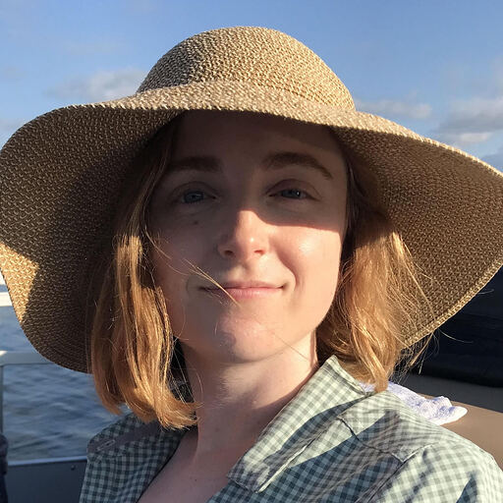
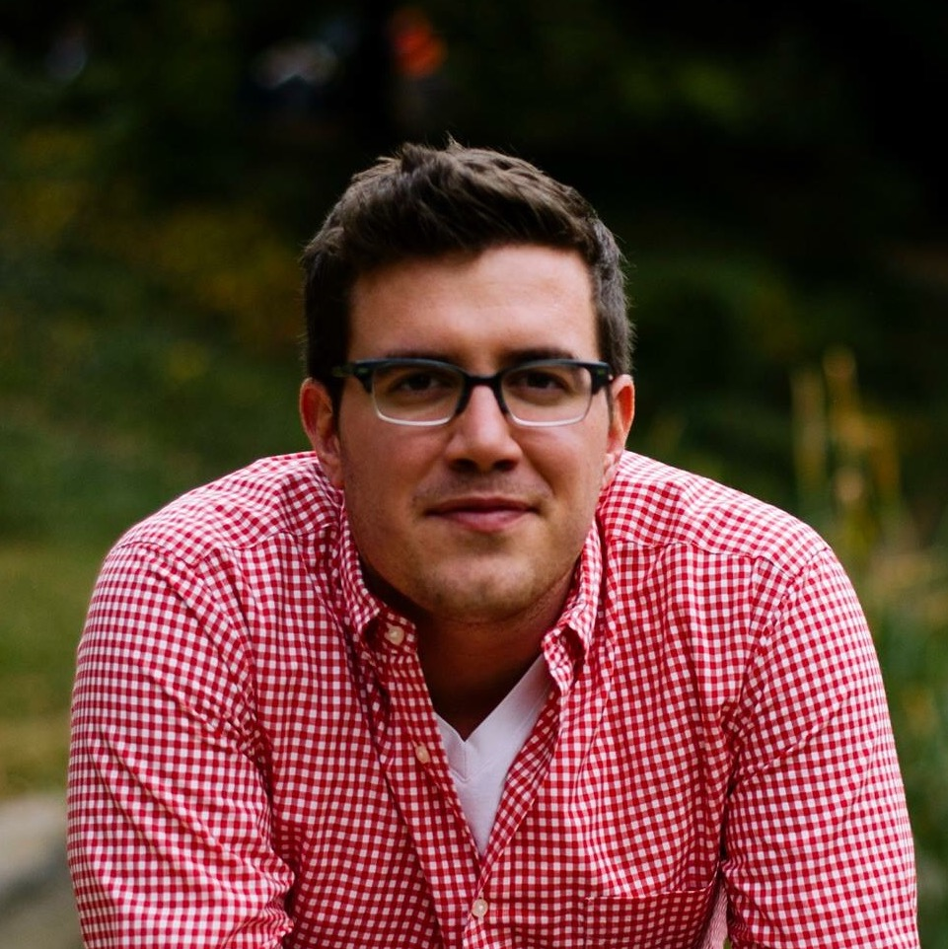
Introductions
Allison Press (she/her) Service Design
18F
On Nacotchtank (Anacostan) and Piscataway land
Colin Murphy (he/him) Product Management
18F
On Erie and Mississauga land
Notes:
Self descriptions
Allison -
Colin -

Slide 3
Only 13% of large government IT projects* succeed * Software projects with labor costs valued at $6 million or greater, in Europe and the United States, that were completed satisfactorily, on time, and within budget.
Yuck.
Source: Johnson, Jim, Hans Mulder, and Ilias Kontakos. 2015. Haze. The Standish Group. Boston, Massachusetts: The Standish Group International, Inc. https://www.standishgroup.com/sample_research_files/Haze4.pdf.

Slide 4
Technology isn’t the challenge — outdated practices are
Spicy.
Review of Federal Field Guide. 2020. De-Risking Government Technology.18F. September 2020. https://derisking-guide.18f.gov/federal-field-guide/.
Notes:
Often senior leaders often enable these outdated practices.

Slide 5
This is “the work.”
“A significant part of our work is to actively seek partners and allies, and invest in being strong partners and allies themselves.”
Source: Harrell, Cyd. 2020. A Civic Technologist’s Practice Guide. San Francisco, California:
Five Seven Five Books.
Notes:
We’ll have to justify the use of this quote because it wasn’t written by the federal government.
But it’s our job as UX practitioners to find partners and allies. Cyd Harrell says…

Slide 6
Hypothesis
Senior leaders are the allies we need in modern software design

Slide 7
Objective
How might we be better allies with our senior leaders?
Notes:
Often senior leaders often enable these outdated practices.

Slide 8
Who: Recruit a cross-functional champions group
How: Ask for more direct involvement
What: Give leaders stories to share

Slide 9
Who: Recruit a cross-functional champions group

Slide 10
Recruit a cross-functional champions group
Example: Champions group at DOJ Civil Rights Division
Role | Accountable for
Chief Operating Officer | Budget and Org success
Director of Human Resources | Staffing
Deputy Director of Human Resources | Staffing
Chief Information Officer | Technology and Security
Senior Advisor of Innovation / Special Projects | Program success

Slide 11
Recruit a cross-functional champions group
“These are people who can give top cover to 99% of the choices facing the team.”
— Senior executive at a peer agency

Slide 12
Recruit a cross-functional champions group
“The Champion’s best role is defining what problems are worth tackling, defining what success looks like if we solve that problem, and what indicators are convincing enough to show success. Then leave the team alone.”
— Senior executive at a peer agency

Slide 13
How: Ask for more direct communication and collaboration

Slide 14
Ask for more direct communication and collaboration
Examples: We asked leaders for their expertise, not just their approval
We asked leaders of FNS SNAP Quality Control Branch and Office of Information Technology to help to weigh in on our primary user groups.
We asked an executive of DOJ’s Civil Rights Division to prioritize content for their knowledge management system.
We asked various Chief Justices of the US Courts to discuss various approaches to building and the architecture.

Slide 15
Ask for more direct communication and collaboration
“Pull relevant people out of the existing organization and draw a new boundary around a new group.”
Source: Christensen, Clayton, and Michael Overdorf. 2000. Review of Meeting the Challenge of Disruptive Change.
Harvard Business Review, March 2000. https://hbr.org/2000/03/meeting-the-challenge-of-disruptive-change.
Notes:
We’ll have to justify the use of this quote because it wasn’t written by the federal government.

Slide 16
Ask for more direct communication and collaboration
The goal is to minimize the layers between user research and strategic decisions

Slide 17
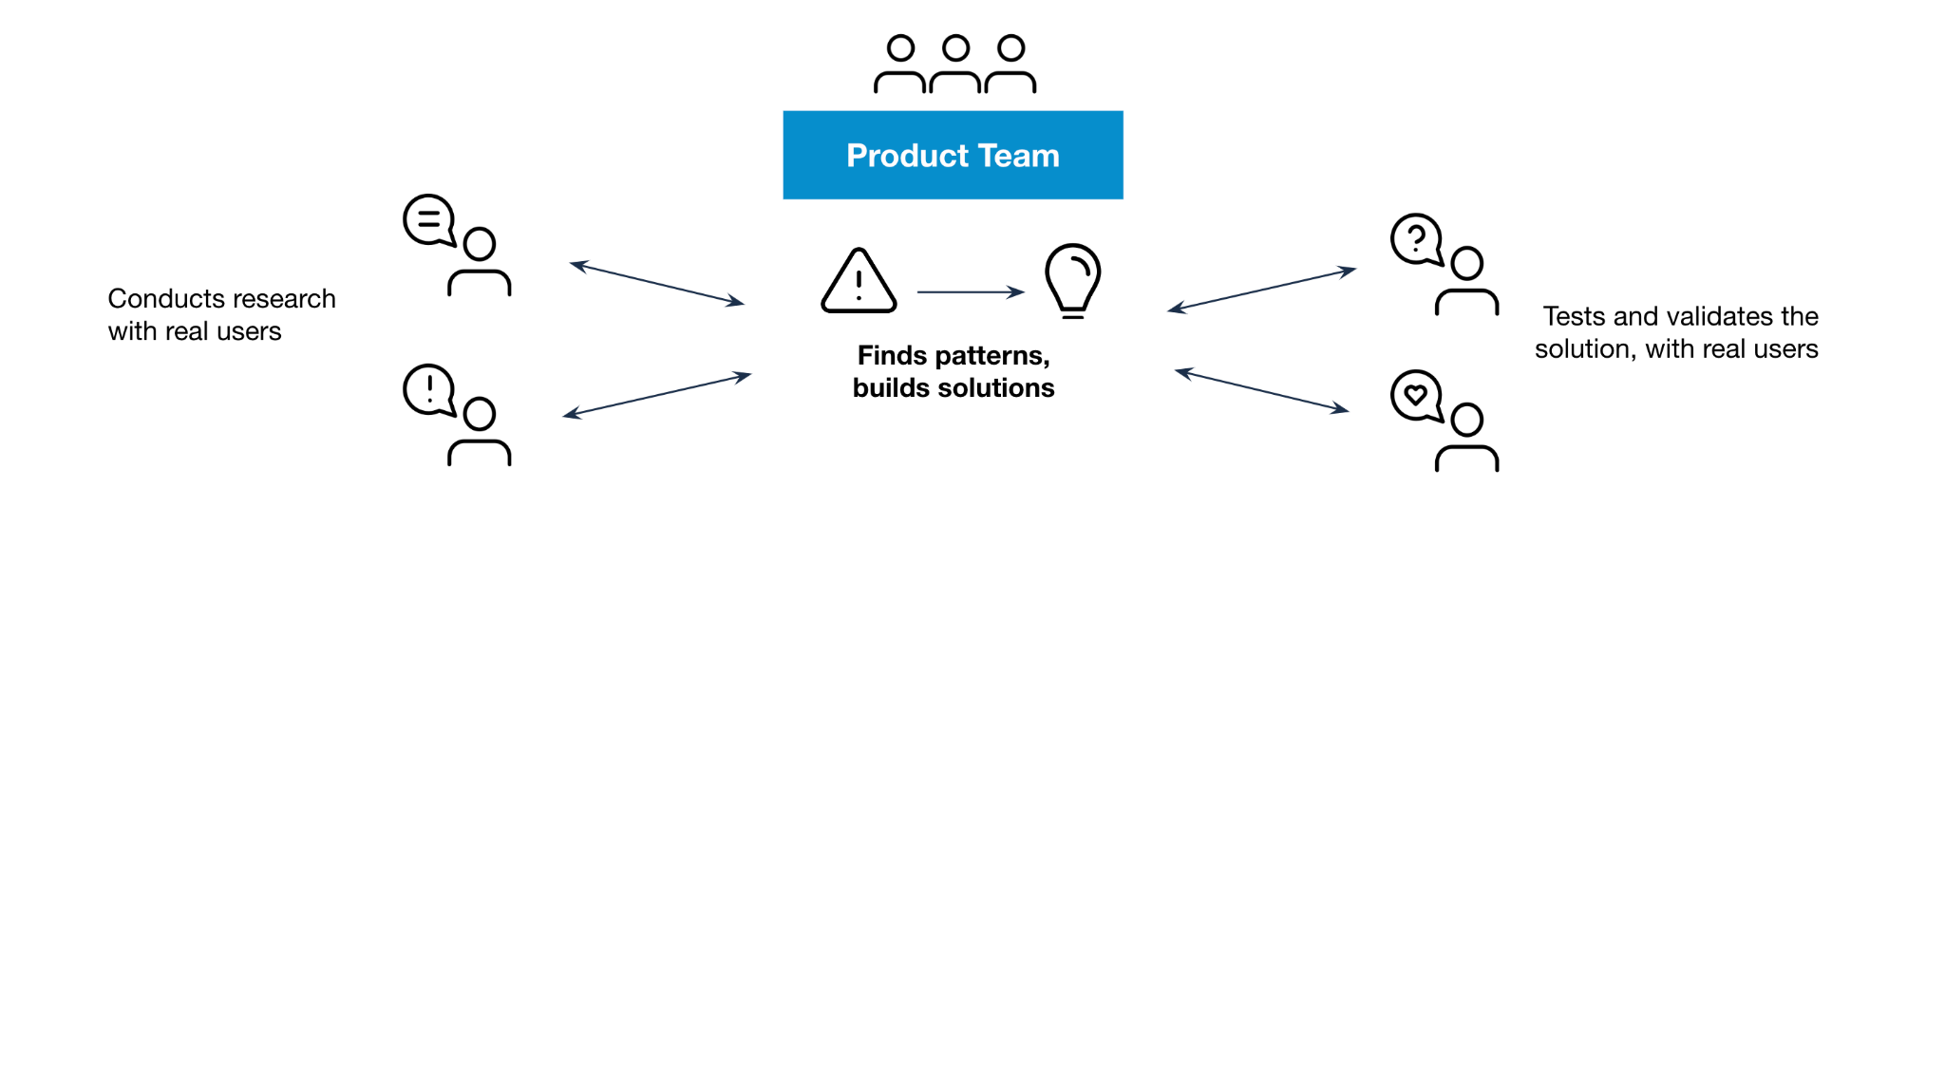
The responsibilities of a product team
Notes:
The diagram shows the responsibilities of a product team in which they gather information from research with real users, find patterns and build solutions, and then test with real users.

Slide 18
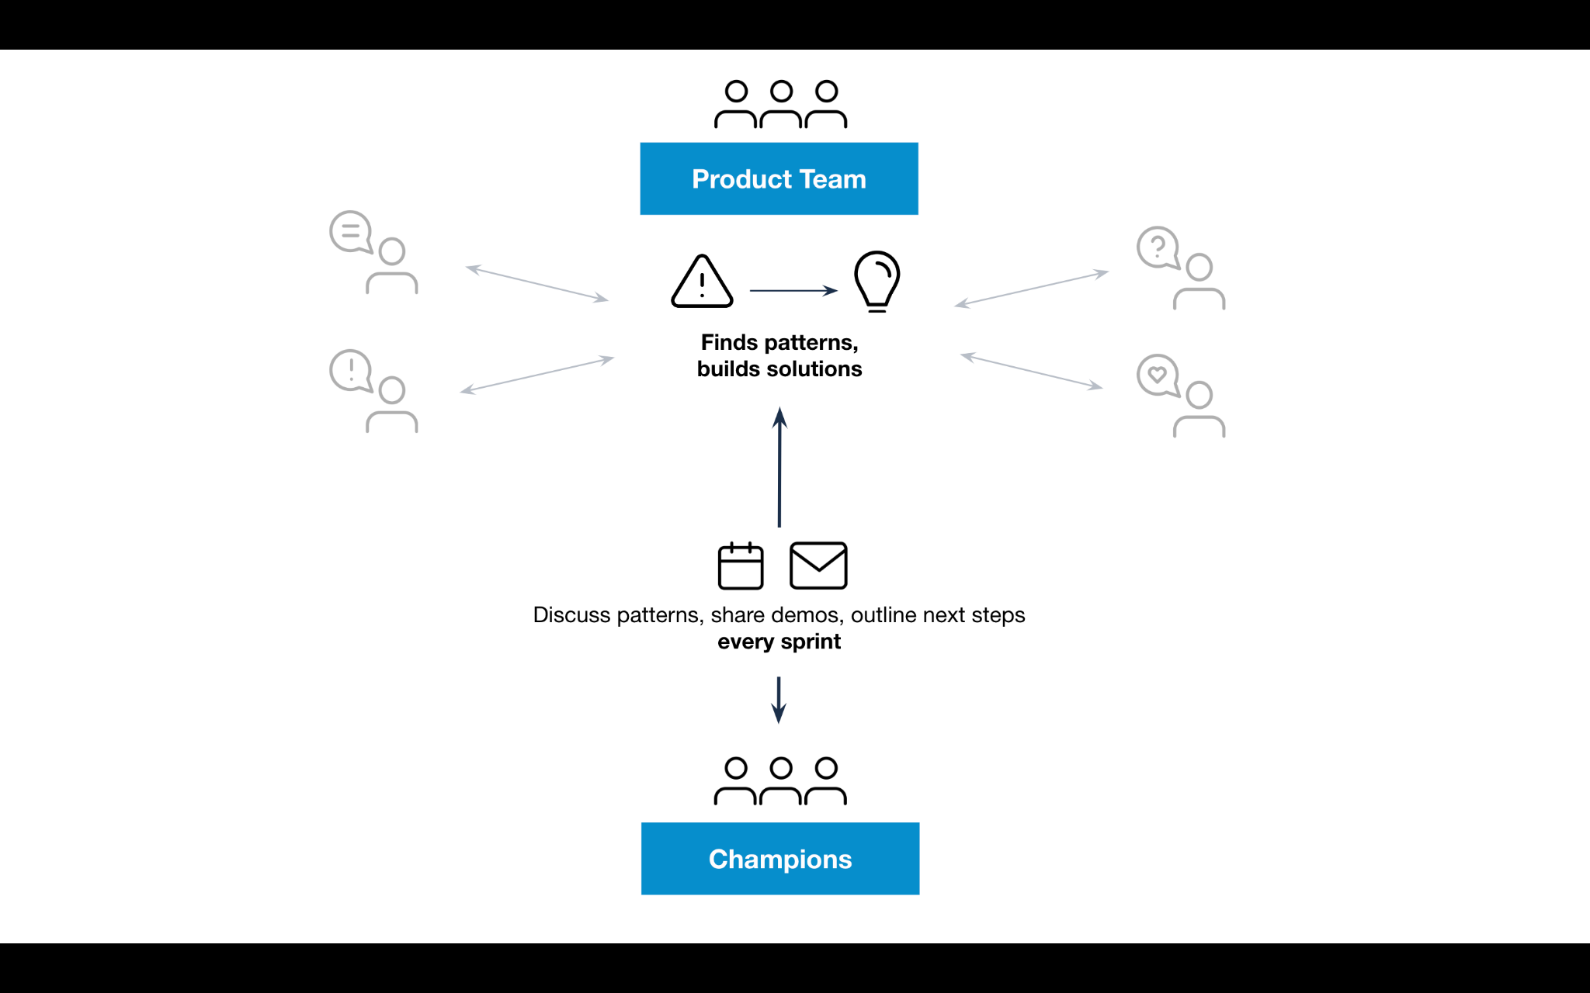
How a product team works with their champions.
Notes:
Building on the previous diagram, the patterns and solutions identified by the Product Team are discussed and shared with the Champions, every sprint – via meetings or emails.

Slide 19
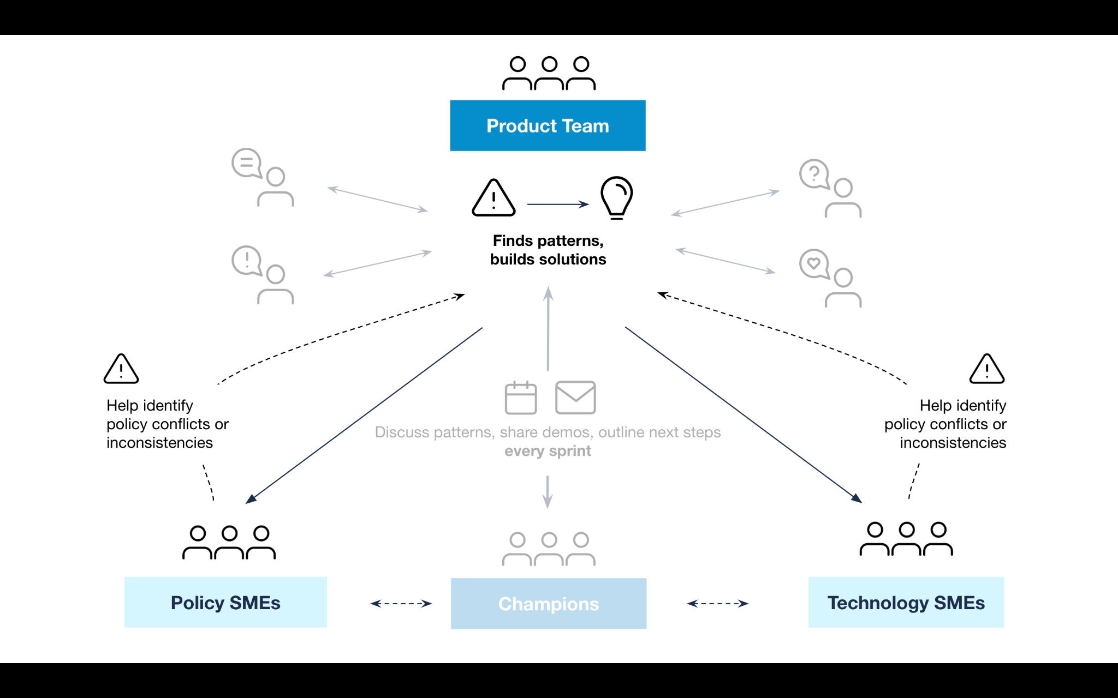
How a product team works with subject matter experts
Notes:
Building on the previous two diagrams, the patterns and solutions identified by the Product Team are also shared with the Policy and Technology subject matter experts, in order to identify conflicts or inconsistencies.

Slide 20
Ask for more direct communication and collaboration
We email a weekly ship
What we did
What’s next
Risks & blockers
Leadership decisions needed

Slide 21
What: Give leaders stories to share

Slide 22
Give leaders stories to share
Example: beta.ada.gov usability test
“This beta site says you’re here, this is where you belong, we can help you. I gravitate towards sites like this because they more sense to me.
When you’re disabled it’s a hard thing, it’s really stinky. No one quite knows what to do with you over the long term, didn’t understand that. You’re sort of, like, extra (I don’t mean extra good) extra aside. This beta site seems to say no, you’re not extra, you’re protected by law, we’re here to help you, this is the law, these are the things you can do. That’s important to me as a disabled person.
I’d go to the site to your [legacy] site for information if I wanted to drill down. On this [beta] site, people are listening, people can hear me, and they are concerned about me. There’s a place in the law for me, it’s not just the law, it’s about people.”
Notes:
Instead of reading this quote now, we’d like to instead play you a recording of the quote. In order to protect anonymity, you will hear the 18F UX Research Lead reading it instead of the participant’s recording.

Slide 23
Give leaders stories to share
These types of stories are most effective:
Struggles / Issues
Demos
Reactions
Notes:
Creating a set of story snippets (demos, audio) for senior leaders to share with people. Criteria for those stories: genuine

Slide 24
Give leaders stories to share
Stories are leading indicators

Slide 25
Summary
Who: Recruit a cross-functional champions group
How: Ask for more direct involvement
What: Give leaders stories to share

Slide 26
Thanks!
Contact 18F@gsa.gov
Follow @18F
Work Together github.com/18F

