Slide 1
Help Them See the Light: Strategies for Training Feds Why Plain Writing Matters
Heather K. Holland, MA
CMS Office of Communications
Notes:
Source: Center’s for Medicare & Medicaid Services (CMS) Office of Communications

Slide 2
Plain writing: barriers in the federal workplace
Misconception that plain writing is just for the public
Myths about “dumbing down”
Legacy documents that never get re-evaluated
“The way we’ve always done it”
Plain writing reviews at the end of a project, not the design stage
Everyone’s a wordsmith

Slide 3
Art vs. Science
Plain writing is a research-based science
Based on decades of research in how people process & use information
Reality: we’re all “cognitive misers”
People don’t read carefully anywhere
Research-based best practices help us design communications that work within these limitations

Slide 4

Our training encourages staff to think about situations where their own communications haven’t gotten results
Didn’t they read the memo I sent? There were 7 pages of instructions explaining this project!
4
Notes:
Image source: stock clipart

Slide 5
example
TO: CMS - All_Email_Users
The Office of Human Capital (OHC) and Office of Support Services and Operations (OSSO) are pleased to announce the completion of the Scheduled and Episodic Flexiplace applications in the new CMS Telework system hosted in the CMS Administrative Technology Solutions (CATS) system. The newly re-designed system will completely integrate the Telework Agreement with the applications processes for Episodic, Scheduled and Fulltime Telework requests. The new Telework Agreement and the Fulltime Telework application segments were deployed during 2017, and we have now completed the Scheduled and Episodic applications.
The new application enhancements will bring improved functionality, usability, and features such as allowing the user to apply for multiple episodic days, enter more specific information about their tour of duty, and view a calendar of scheduled and episodic telework days. With this update, we have migrated your Scheduled Flexiplace information from the old legacy “Flexiplace” task to the new “CMS Telework” task. All employees, who wish to continue on Scheduled Flexiplace must log in to the new system and verify that their current scheduled application in the CMS Telework task is accurate and resubmit it, no later than June 1, 2018.
Your cooperation will ensure that your telework schedule and tour of duty are properly reflected in the new system and will ensure the integrity of the agency’s telework data for future decision making and planning. Scheduled telework users should not make any changes to their currently approved schedules or duty station locations during this information verification period and only update the system to correct in-office and off days or accurately reflect an approved schedule. Similarly, managers are encouraged to review the updated information to ensure the changes reflect previously approved information and then approve the updated requests in the new system. Current teleworkers CANNOT use this time period to change their telework status or duty location (i.e., changes CANNOT be made to current Alternate Duty Station locations). Managers are similarly reminded that this period CANNOT be used to deny access to telework for current teleworkers.
Go to the CATS system.
Go to the Assigned to Me Tab.
Click the CMS Telework task link.
Go to the “My Forms” tab on the home page.
Click the “My Scheduled Applications” tab at the top of the page.
You will see your “Migrated Approved” schedule application listed under the “Scheduled Application(s)” section.
Employees should select the “Verify” link to view and verify their migrated schedule. You will be presented with a screen to verify that you have read the instructions.
Option 1: If you see that your schedule is incorrect, you will have the ability to click the “Cancel Migrated Application” button at the bottom center of the page and create a new one.
Option 2: If you see that your ADS days are correct, use the drop down boxes to select the proper in-office and off days then click the “Verify and Submit” button.
Employees will receive a confirmation once they have verified and submitted their application. Note: The system will generate an email to your first-line manager requesting that they log in to CATS and review your application for approval.)
To assist you with the new features of the CMS Telework system we have created a user guide that can be found here on the CMS Telework website.
Please contact the CMS Telework team at CMS_telework@cms.hhs.gov for any policy questions about the telework program. For system-related issues please contact the Office of Support Services and Operations’ Division of Administrative and Systems Management CATS Team by creating a Customer Service ticket here.
BEFORE
5

Slide 6
Verify Telework Schedule by June 1
example
If you work Scheduled Flexiplace, you must verify your CMS Telework schedule by June 1.
How to verify your telework schedule:
Go to the CATS system
Go to the Assigned to Me Tab
Click the CMS Telework task link
Go to the “My Forms” tab on the home page
Click the “My Scheduled Applications” tab at the top
Your “Migrated Approved” schedule application is listed under the “Scheduled Application(s)” section
Select “Verify”
Need help?
See the CMS Telework system user guide here. For policy questions, contact CMS_telework@cms.hhs.gov. For systems issues, create a Customer Service ticket here.
6

Slide 7

What do we want people to DO?
“To inform” is NEVER the goal of our writing.
Think about the action we ultimately want people to take.
7
Notes:
Image source: CMS owned

Slide 8
Example of content people don’t need
The Centers for Medicare & Medicaid Services (CMS) is always working to make the CRCP more efficient and user friendly for the GHP community. In recent years, the CRCP has added enhancements that allow users to access greater demand details, to receive reports of all open debts, and to opt into electronic correspondence delivery.
In July, a new option will allow CRCP users to associate defenses to the individual claims included in recovery demands. Allowing a more granular response to demands will permit GHPs to increase the accuracy of defense submissions and allow for more efficient defense reviews. The CMS will also be hosting a webinar demonstrating this update to the CRCP in July.

Slide 9
More content people don’t need
With the new season comes a new CyberCARE campaign that focuses on cyber risks associated with remote access. Now that winter is over and spring is finally here, we are all excited to get out and about more, including finding new places to work where you can enjoy the warmer weather. But, before you spring into action looking for that ideal change of scenery, such as traveling to your favorite local café or booking a weekend getaway, or even a longer trip internationally, take a moment to think about and plan how you will work remotely while safeguarding HHS’ network, systems, and information.
Luckily your CyberCARE team has a fresh new approach to working safely outside the office and home – and it’s as easy as one, two, three!
9

Slide 10
Still MORE content people don’t need
BOG is continuing the rollout of our new Business Portal. We are excited to introduce even more CCSQ staff members to the CCSQ BOG Business Portal, which is an intuitive integrated-platform that is easily accessible. We look forward to continuing to support CCSQ’s business operations functions (Budget, Contract, HR, Travel, Training, etc.) in this modernized way of interacting with BOG staff. For more information, please watch the CCSQ BOG Business Portal Video and access the CCSQ BOG Business Portal to further explore the platform yourself.

Slide 11
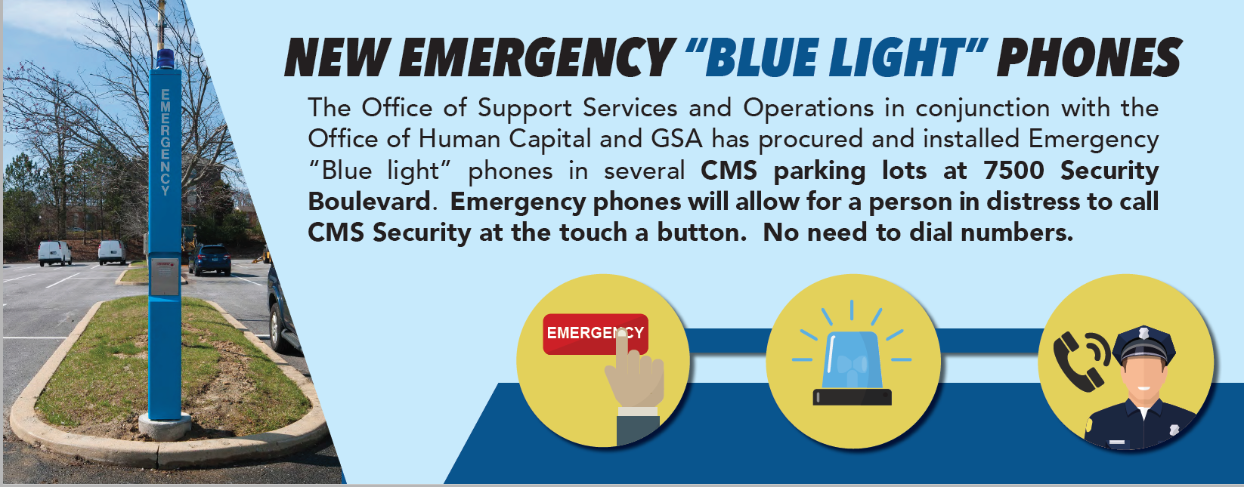
Content focused on the project
11

Slide 12
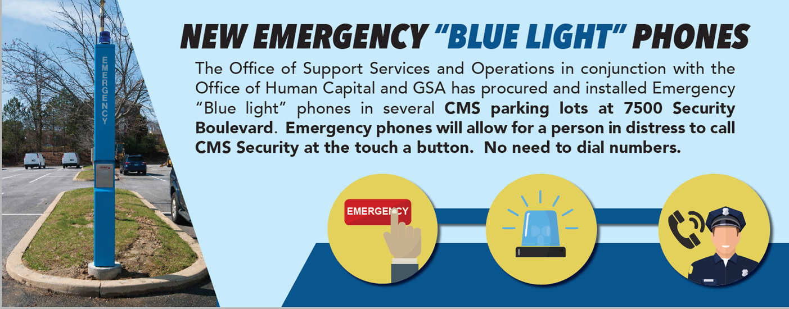
Content focused on the user
Need help in the CMS parking lot?
Call CMS Security at the BLUE LIGHTS in parking lots at 7500 Security Boulevard.
12

Slide 13

Content must be USER-FOCUSED
Reality:
People don’t care about CMS operations & process.
They care about what affects them.
13
Notes:
Image source: https://www.pngegg.com/en/png-eyidg
https://imgbin.com/free-png/narcissistic-personality-disorder

Slide 14
Memo example
As seasons change and inclement weather potentially moves into the region, we are taking steps to be prepared. One of the tools used to keep you informed is ‘Assurance’. To make sure that you continue to receive timely, critical or emergent notifications about facilities and operations, please review and update your Assurance profile.
What is Assurance?
Assurance is the employee emergency notification system. Assurance automatically broadcasts emergency notifications via email, phone, or other electronic devices, alerting employees of adverse events, such as building evacuations or weather- related closings.
Why use Assurance?
Personal alerts increase the likelihood of reaching employees during an emergency event.
How will Assurance be used?
Our component has pre-populated the Assurance system with employee work information, such as a work email address and a work telephone number. Also, keeping your personal contact information updated ensures that you will continue to receive emergency notifications about facilities being closed or late openings. All of the information is kept private.
What’s next?
Very soon you will receive an email (see example below) from Sungard AS, with the subject line: Request – Please update your NM (Notification Manager) profile, to update your personal data. The email will contain a link will take you directly to your personal profile. Please take a moment to review and update your information.
If you have already updated your profile, you may click “No Changes” to confirm. It is strongly encouraged that you review the information to verify its accuracy.
14

Slide 15
Much better!
Get building closure alerts
To get emergency notifications about building closures, update your contact profile in the emergency notification system (Assurance).
Assurance broadcasts emergency notifications via email and phone to let you know about things like building evacuations or weather-related closings.
Watch for an email to update your contact details.

Slide 16
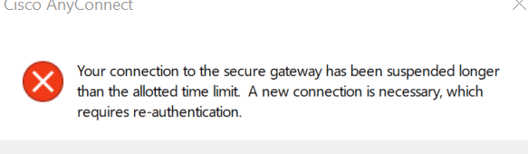
Another example
ORIGINAL
REVISED
Connection timed out
Please reconnect!
16

Slide 17
Letter example
Hello Medical Officers,
Many of you are already aware of the Office of Medical Engagement through previous Medical Officer calls. For those not familiar with the office, we are located within the Center for Clinical Standards and Quality. Our Mission and Vision are:
Mission: The Office of Medical Engagement partners with colleagues across other agencies to channel clinician feedback regarding their experiences with us into transformative agency programmatic priorities, to enable clinicians to focus upon their patients, provide high-quality care and improve health outcomes for their patient populations.
Vision: The Office of Medical Engagement will be recognized by clinicians as an honest broker in representing their concerns and recommendations for change to our agency and its Federal partners. In this role, OME will help achieve substantive, impactful change that enhances the beneficiary experience, drives efficiency of care, and supports the well- being of clinicians as engaged, valued partners in our programs.
The Mission and Vision of the Office of Medical Engagement apply as strongly to the experiences, feedback and attention to the well-being of clinicians within our agency as to our external colleagues. As a critical step to understanding the perspectives of Medical Officers, we are asking for your feedback and guidance to our agency through the attached survey. The survey is voluntary and anonymous. It is essential to this effort that we have a high rate of participation, as an indication that this attention and commitment to their experiences with our agency are valued by Medical Officers as engaged partners. Please make every effort to complete the survey as faithfully and honestly as possible, and please offer comments as you see fit. Each question has a “no response” option – we recognize that there may be sensitivity to some questions, and we respect your judgment in selecting this option. While each “no response” is a missed opportunity for feedback, if such responses cluster in an identifiable pattern, this may suggest areas in which we need to build trust between Medical Officers and leadership. The survey will run for six weeks, following which we will be analyzing responses to present to and discuss with leadership. If at any point along the way you have questions, concerns, or suggestions regarding the survey, please contact us. Thank you, again, for your participation and support of this work.
BEFORE
17

Slide 18
Why this letter isn't working:
Many of you are already aware of the Office of Medical Engagement through previous Medical Officer calls. For those not familiar with the office, we are located within the Center for Clinical Standards and Quality. Our Mission and Vision are:
Mission: The Office of Medical Engagement partners with colleagues across other agencies to channel clinician feedback regarding their experiences with us into transformative agency programmatic priorities, to enable clinicians to focus upon their patients, provide high-quality care and improve health outcomes for their patient populations.
Vision: The Office of Medical Engagement will be recognized by clinicians as an honest broker in representing their concerns and recommendations for change to our agency and its Federal partners. In this role, OME will help achieve substantive, impactful change that enhances the beneficiary experience, drives efficiency of care, and supports the well- being of clinicians as engaged, valued partners in our programs.
The Mission and Vision of the Office of Medical Engagement apply as strongly to the experiences, feedback and attention to the well-being of clinicians within our agency as to our external colleagues. As a critical step to understanding the perspectives of Medical Officers, we are asking for your feedback and guidance to our agency through the attached survey. The survey is voluntary and anonymous. It is essential to this effort that we have a high rate of participation, as an indication that this attention and commitment to their experiences with our agency are valued by Medical Officers as engaged partners. Please make every effort to complete the survey as faithfully and honestly as possible, and please offer comments as you see fit. Each question has a “no response” option – we recognize that there may be sensitivity to some questions, and we respect your judgment in selecting this option. While each “no response” is a missed opportunity for feedback, if such responses cluster in an identifiable pattern, this may suggest areas in which we need to build trust between Medical Officers and leadership. The survey will run for six weeks, following which we will be analyzing responses to present to and discuss with leadership. If at any point along the way you have questions, concerns, or suggestions regarding the survey, please contact us. Thank you, again, for your participation and support of this work.
Focused on the component, not the reader
Mission & vision are background & not helpful for these readers
The ask is buried halfway down paragraph 4: take our survey
Instructions on response options aren’t useful here
Survey deadline is last (!)
Doesn’t give contact information where readers need it
18

Slide 19
Much better
Hello Medical Officers,
Medical Officers are valuable partners to the Office of Medical Engagement. To better understand your perspectives and concerns, we’re asking you to complete a voluntary, anonymous survey about your experiences.
Please complete the attached survey as honestly as possible by April 3, 2018. Afterwards, we’ll analyze your responses to discuss with leadership.
Thank you for your participation and support of this work! For questions or suggestions, please email us at OME@hhs.cms.gov.
19

Slide 20
Recognizing “CMS-speak”
This initiative will leverage existing contract resources in order to most effectively engage with and assist our stakeholders, partners and other organizations to plan and conduct local community outreach and education activities.
We’ll use contracts already in place to help stakeholders and partners educate their communities.
20

Slide 21
Consumer letter example
You’re getting this notice because you qualify for Extra Help paying for Medicare Part D drug coverage. To get Medicare drug coverage and the Extra Help, you need to join a Medicare Part D drug plan.
What to do next: You have 3 options
Option 1: You can join a Medicare Part D drug plan on your own.
See the list of plans on the back of this notice. You can join any one of these plans and pay $0 of the monthly premium because you qualify for Extra Help.
Option 2: Medicare will enroll you in a Medicare drug plan.
If you don’t join a Medicare drug plan, Medicare will enroll you in a plan and your coverage starts right away. Here’s what you’ll pay with this plan in 2019:
$0 of the monthly premium
Up to $85 of the yearly deductible
Up to 15% of the cost of each prescription covered by the plan
Option 3: You can decline Medicare drug coverage (“opt out”).
If you have other drug coverage, like coverage from an employer or union, joining a Medicare Part D drug plan may not be right for you. If you don’t want a Medicare drug plan, call 1-800-MEDICARE (1-800- 633-4227) or the plan shown above and tell them you want to opt out of Medicare drug coverage. TTY users can call 1-877-486-2048.
Get help & more information
For more information, call 1-800-MEDICARE. You can also call your State Health Insurance Assistance Program for free, personalized health insurance counseling.
21

Slide 22
Tips for good makeovers
It’s not about shame – don’t call out authors
Avoid presenting a group’s own work back to them
Acknowledge that this is a new way of thinking for many groups
Start a collection of good “bad” examples & ask others for theirs
Examples can also work as interactive exercises

Slide 23
Help staff see the light!
Plain writing is more than just wordsmithing for the public
Highlighting frustrating internal communication pieces is a great way to help federal staff see the universal impact of plain language & information design
Feedback on the CMS training regularly calls out the internal makeovers as the most helpful part

Slide 24

Thank you!
Heather K. Holland, MA
Centers for Medicare & Medicaid Services
Office of Communications
Heather.Holland@cms.hhs.gov

