Slide 1
Hispanic Heritage Month
September 15 – October 15
Multilingual Community of Practice
10/14/2021

Slide 2
History
1968 President Lyndon Johnson – one week observance (Hispanic Heritage Week)
Years later, President Ronald Reagan proposed extending to a month
1988 enacted into law and officially designated Sept 15 to Oct 15 Hispanic Heritage Month
Notes:
Just for reference:
https://www.npr.org/2021/09/17/1037741009/yes-were-calling-it-hispanic-heritage-month-and-we-know-it-makes-some-of-you-cri
https://swarthmorephoenix.com/2015/11/19/the-argument-against-the-use-of-the-term-latinx/
https://www.washingtonpost.com/archive/politics/2003/10/15/the-roots-of-hispanic/3d914863-95bc-40f3-9950-ce0c25939046/?utm_term=.28665723ea83

Slide 3
History continued
Why is Hispanic Heritage Month in September and October?
Many countries in Latin America celebrate independence day September 15: Costa Rica, El Salvador, Guatemala, Honduras and Nicaragua
Mexico and Chile celebrate their independence days on September 16 and September 18, respectively.
Notes:
Black Heritage Month is February 1st to March 1st
Asian American and Pacific Islander is May 1st to May 31st

Slide 4
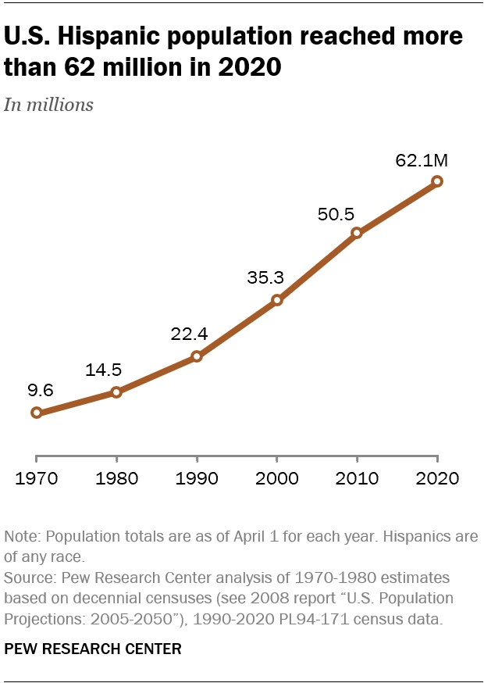
Graphic for US Population of persons of Hispanic Descent

Slide 5
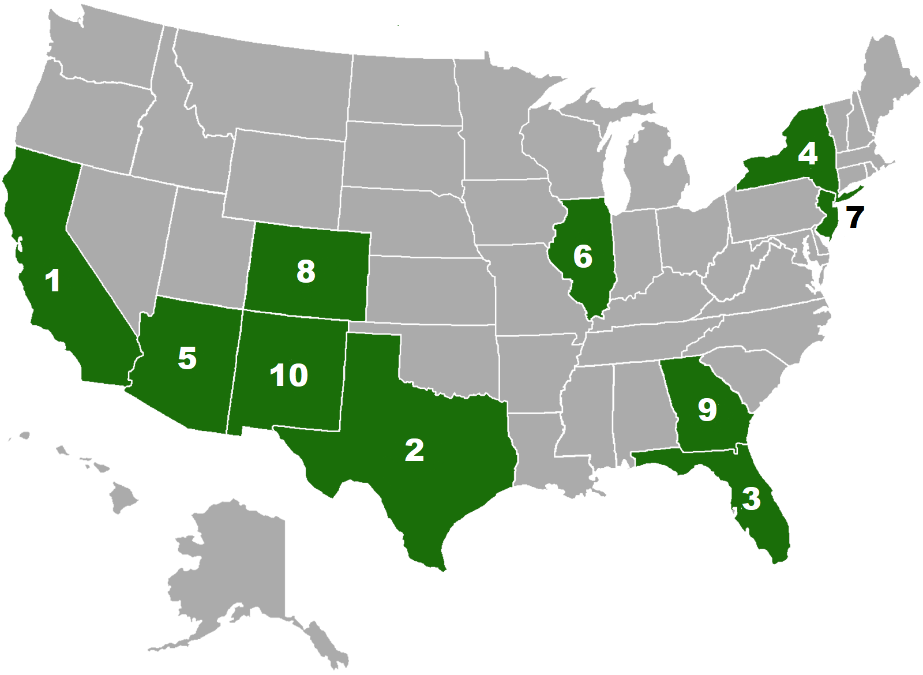
Top 10 States with the largest Hispanic populations
Source: Office of Minority Health (HHS)
CA TX FL NY AZ IL NJ CO GA NM

Slide 6
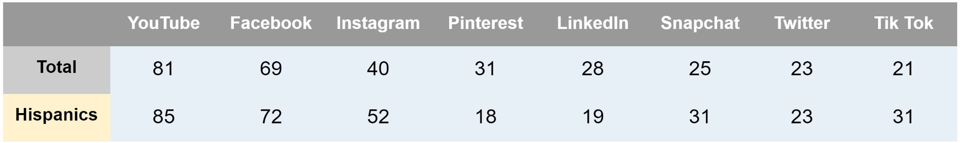
Hispanics and Social Media
Use of online platforms. % of Hispanics who say they ever use...
“Social Media Use in 2021” Pew Research Center, Washington, D.C. (April 7, 2021) https://www.pewresearch.org/internet/2021/04/07/social-media-use-in-2021/
Notes:
YouTube and Facebook are the most used platforms across the population. Facebook and YouTube the two most used platforms among the older population.
Other sites and apps stand out for their demographic differences:
Instagram: About half of Hispanic (52%) and Black Americans (49%) say they use the platform, compared with smaller shares of White Americans (35%) who say the same.2
WhatsApp: Hispanic Americans (46%) are far more likely to say they use WhatsApp than Black (23%) or White Americans (16%).
LinkedIn: Those with higher levels of education are again more likely than those with lower levels of educational attainment to report being LinkedIn users. Roughly half of adults who have a bachelor’s or advanced degree (51%) say they use LinkedIn, compared with smaller shares of those with some college experience (28%) and those with a high school diploma or less (10%).
Pinterest: Women continue to be far more likely than men to say they use Pinterest when compared with male counterparts, by a difference of 30 points (46% vs. 16%).

Slide 7
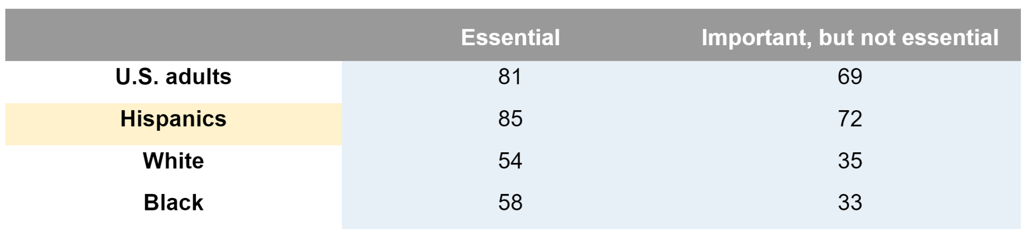
Hispanics and Social Media
During COVID Times
% of U.S. adults who say the internet has been… for them personally during the coronavirus outbreak
“How the internet and technology shaped Americans’ personal experiences amid COVID-19” Pew Research Center, Washington, D.C. (September 1, 2021) https://www.pewresearch.org/internet/2021/09/01/how-the-internet-and-technology-shaped-americans-personal-experiences-amid-covid-19/
Notes:
As the pandemic unfolded, we saw our lives reshaped by school closures, remote work, stay-at-home orders… We relayed on video chats to celebrate any holidays; whatsapp, e-mail, face time, texting to get in touch with family members here and overseas or in lieu of cancelled travel plans.
For some, technology became a way to stay in touch with others whom they could not visit in person since the pandemic began. Americans’ (and for the whole world, probably) reliance on technology early in the pandemic was apparent in several ways, from using technology to communicate with others to hosting virtual gatherings.
Video use differed in the different demographics. Black and Hispanic adults are more likely to have used video calling than Whites. And doing so several times daily!

Slide 8
Hispanics/Latinos/Latinx
About 23% of self identified Hispanic/Latino adults heard of the term Latinx
Just 3% use the term to describe themselves
Young Hispanic women are the most likely to use the term
Term Latinex not used in Latin America and Spain
Source: Pew Research

Slide 9
Thank You

