Slide 1

The Business Case For Innovation
The Business
Case For
Innovation
Wednesday
June 8
2022
Mike Catania
US Dept. of
Veterans
Affairs
Notes:
Image Source: Microsoft Office / Mike Catania using photoshop

Slide 2
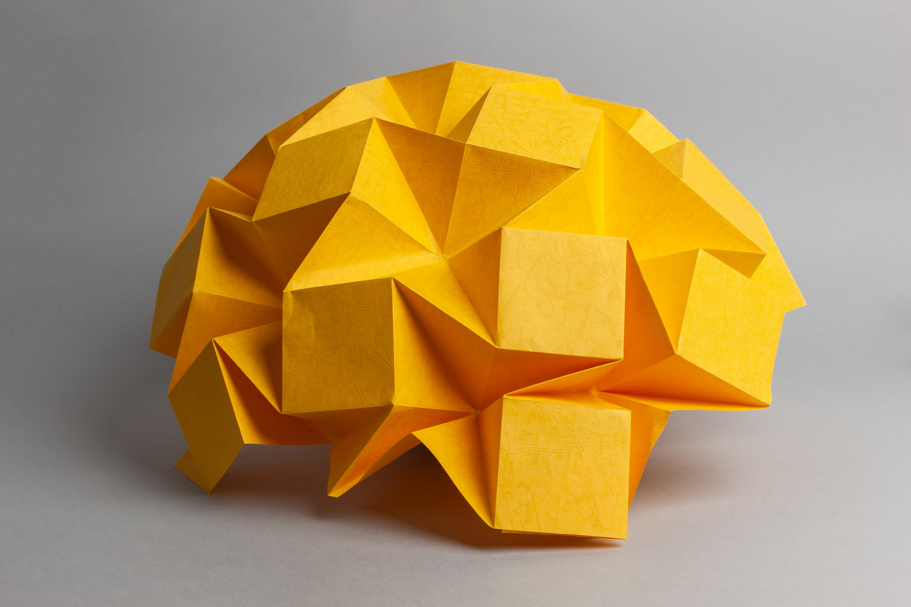
Innovation and the uselessness of the term
Notes:
Image Source: MS Office

Slide 3
2021 VA Innovation Fellows of Greater Los Angeles
Notes:
Source: Justin Sternberg (with permission)

Slide 4
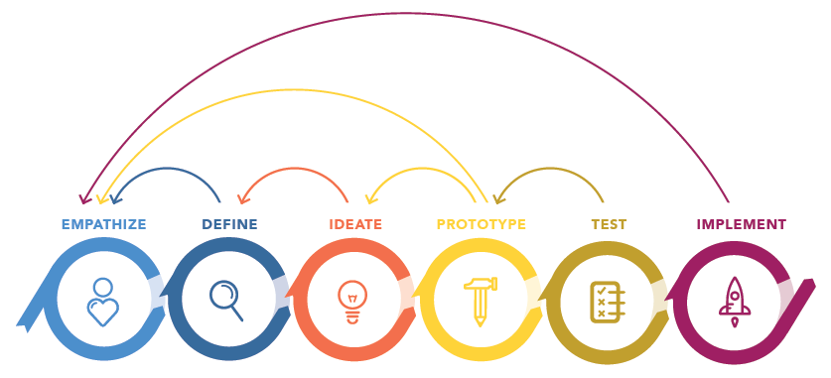
The process of human-centered design
Notes:
Source: VHA Innovation Ecosystem via VA Office of Healthcare Innovation and Learning

Slide 5
Return on Investment (ROI)
ROI =
(Amount Gained – Amount Spent)
Amount Spent
* 100%
Sample Calculation of ROI in Three Steps
If you bought a house for $100,000 and sold it for $150,000 your ROI would be 50%.
For every $1 you put in, you would get
$0.50 back plus your initial investment.
($150,000 - $100,000)
$100,000
* 100%
$50,000
$100,000
* 100%
0.5 * 100% = 50%

Slide 6
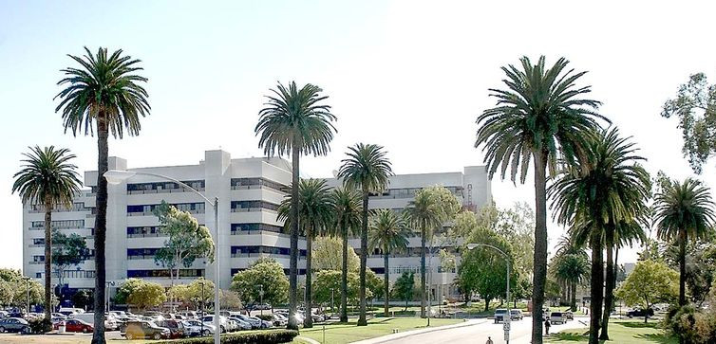
Pitch 1: Reducing Same-Day Cancellations at VA Greater Los Angeles
Notes:
Source: VA Greater Los Angeles

Slide 7
Return on Investment (ROI): Overnight COVID Testing Kits
ROI =
(Amount Gained – Amount Spent)
Amount Spent
* 100%
Sample Calculation of ROI in Three Steps
We’ll spend $102K annually in kits and delivery to capture $547,500 in cost avoidance.
For every $1 you put in, you would get
$4.37 back plus your initial investment.
($547,500 - $102,000)
$102,000
* 100%
$445,500
$102,000
* 100%
4.37 * 100% = 437% ROI

Slide 8
ROI on Overnight COVID Testing Kits: User Journey Findings
User Journey Findings
60 | Daily Scheduled Procedures Performed at the Hospital Each Day
80% | Percentage of Daily Procedures Performed on Untested Veterans
48 | Daily Scheduled Procedures Performed on Untested Veterans (60 * 80% = 48)
17,520 | Number of kits annually (365 * 48)
$5.82 | Cost per kit + bulk rate overnight shipping
5 | Untested Veterans Sent Home After Testing Positive for COVID-19
$300 | Cost of rescheduling one same-day procedure
$1500 | Daily cost of rescheduling same-day procedure ($300 * 5 Untested Veterans who test positive)
$547,500 | Annual costs of rescheduling same-day procedures (365 * $1500)
$102,000 | Annual costs of mailing kits (17,520 kits * $5.82)
(Amount Gained – Amount Spent)
Amount Spent
ROI =
* 100%
Sample Calculation of ROI in Three Steps
($547,500 - $102,000)
$102,000
* 100%
$445,500
$102,000
* 100%
4.37 * 100% = 437% ROI

Slide 9

Measuring ROI on Innovation Programs
Notes:
Source: MS OFfice

Slide 10
The process of human-centered design reprise
Notes:
Source: VHA Innovation Ecosystem via VA Office of Healthcare Innovation and Learning

Slide 11
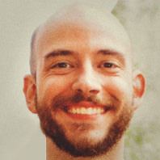
How do we measure returns on learning?
ROL =
ABS(New Range – Old Range)
Amount Spent
* 100%
Notes:
Source: Mike Catania

Slide 12
The process of human-centered design part two
Notes:
Source: VHA Innovation Ecosystem via VA Office of Healthcare Innovation and Learning

Slide 13
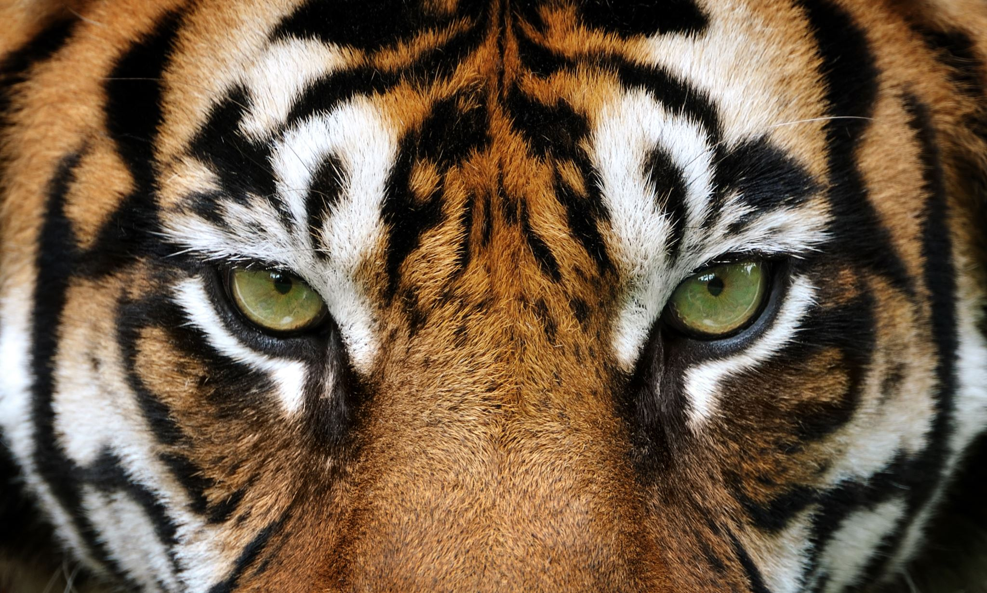
The eye(s) of the tiger
Notes:
Source: MS Office

Slide 14

VA’s Spark Seed Spread program
Notes:
Source: VHA Innovation Ecosystem via VA Office of Healthcare Innovation and Learning

Slide 15
Return on Investment (ROI): Portfolio Wide instead of Project Wide
Spent: $102K
Portfolio ROI
(($527K+0) – ($102K+$45K))
---------------------------------
($102K+45K)
Overnight Testing Kits
* 100%
HCD Innovation Program
Returned: $527K
($527K – $147K)
---------------------------------
($147K)
* 100%
Spent: $45K
($527K – $147K)
---------------------------------
($147K)
* 100%
Blockchain
Scheduler
2.59 * 100% = 259% ROI
Returned: $0

Slide 16
Return on Investment (ROI): Balanced 50/50 outcomes
Spent: $102K
Portfolio ROI
(($527K+0) – ($102K+$45K))
---------------------------------
($102K+45K)
Overnight Testing Kits
50%
* 100%
HCD Innovation Program
Returned: $527K
($527K – $147K)
---------------------------------
($147K)
* 100%
Spent: $45K
($527K – $147K)
---------------------------------
($147K)
* 100%
Blockchain
Scheduler
50%
2.59 * 100% = 259% ROI
Returned: $0

Slide 17
VA’s Spark Seed Spread program reprise
Notes:
Source: VHA Innovation Ecosystem via VA Office of Healthcare Innovation and Learning

Slide 18
How iNet invests in the Spark Seed Spread Program
No
(20%)
No = Did we invest?
20% of applicants did not receive investments
No
(20%)
Invest?
Yes
(80%)
($1000)
Yes
($1000)
Yes = Did we invest?
80% of applicants received an investment of $1,000/ea
Spark
Challenge

Slide 19
Breakdown of iNet investments
No
(20%)
Invest?
No
(40%)
Yes
($1000)
No
(50%)
Yes
($2000)
No
(75%)
Fail
(50%)
$0
Yes
($5000)
Yes
($10,000)
Decent
(40%)
$200K
Hit
(10%)
$400K
Spark
Challenge
Spark Idea
Seed
Spread

Slide 20
Even deeper breakdown of iNet investments and portfolio returns
v
No
(20%)
Invest?
32%
No
(40%)
Yes (80%)
($1000)
No
(50%)
Yes
(60%)
($2000)
80%
No
(75%)
Fail
(50%)
$0
48%
Yes
(50%)
($5000)
Yes
(25%)
($10,000)
Decent
(40%)
$200K
Hit
(10%)
$400K
Spark
Challenge
Spark Idea
Seed
Spread

Slide 21
Even deeper breakdown of iNet investments and portfolio returns with joint probabilities
v
No
(20%)
Invest?
32%
No
(40%)
Yes (80%)
($1000)
24%
No
(50%)
18%
Yes
(60%)
($2000)
80%
No
(75%)
Fail
(50%)
$0
48%
Yes
(50%)
($5000)
3%
Yes
(25%)
($10,000)
24%
Decent
(40%)
$200K
2.4%
9.22%
Hit
(10%)
$400K
Spark
Challenge
0.6%
Spark Idea
Seed
Spread

Slide 22
Even deeper breakdown of iNet investments and portfolio returns with JPs and portfolio value
v
No
(20%)
$954,080
Portfolio Value
Invest?
32%
No
(40%)
Yes (80%)
($1000)
24%
No
(50%)
18%
Yes
(60%)
($2000)
80%
No
(75%)
Fail
(50%)
$0
48%
Yes
(50%)
($5000)
3%
Yes
(25%)
($10,000)
24%
Decent
(40%)
$200K
2.4%
9.22%
Hit
(10%)
$400K
Spark
Challenge
0.6%
Spark Idea
Seed
Spread

Slide 23
Return on Investment (ROI): Innovation Portfolio
ROI =
(Amount Gained – Amount Spent)
Amount Spent
* 100%
Sample Calculation of ROI in Three Steps
We’ll spend $375,000 annually on innovation to capture $950,000 in cost avoidance and increased revenue.
For every $1 you put in, you would get
$1.53 back plus your initial investment.
($950,000 - $375,000)
$375,000
* 100%
$575,000
$375,000
* 100%
1.53 * 100% = 153% ROI

Slide 24

Hines Medical Center in Chicago
Notes:
Source: Veterans Healthcare Administration

Slide 25
Summary
Notes:
Source: MS Office

Slide 26
Questions
Questions?
Mike Catania
michael.catania@va.gov

