Slide 1
Debunking the Oversimplification Myth: Making the Case for Plain Language in Health Communications August 24, 2022
Shuly Babitz, M.A. and Kathryn Karnell, M.A.
Maternal and Child Health Bureau (MCHB)

Slide 2
Part 1 of 2
Plain Language - Written Materials
2

Slide 3

Revealing the Magic of Plain Language
Notes:
Image from: https://img.buzzfeed.com/buzzfeed-static/static/2017-03/16/11/enhanced/buzzfeed-prod-fastlane-03/enhanced-32698-1489677286-1.jpg

Slide 4
Making the Case for Plain Language
Define Plain Language
Plain Language Legislation: Why Now?
Common Concerns & Myths
Strategies to Build Trust in Plain Language

Slide 5
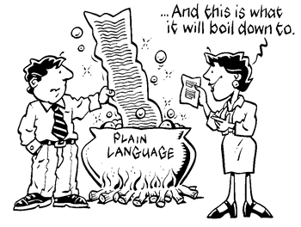
Defining Plain Language
Info you can FIND, UNDERSTAND and USE!
Notes:
Image from: https://uahtechcomm.com/2014/11/01/plain-language-simple-tips-to-make-your-content-more-accessible/

Slide 6
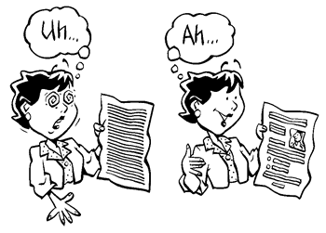
Plain Language Legislation: Why Now?
Plain Language Act of 2010:
21st Century IDEA Act
Requires federal agencies to use language that the public can understand and use in communication.
Integrated Digital Experience Act (IDEA)
Modernize websites & improve user experience
Notes:
Image from: https://uahtechcomm.com/2014/11/01/plain-language-simple-tips-to-make-your-content-more-accessible/

Slide 7
Concerns & Myths about Plain Language
Plain language is unprofessional.
Readers expect official language.
Technical terms are authoritative.
Plain language is imprecise.
This is how we’ve always done it.

Slide 8
Strategy: Build Trust with Positivity
Share WHY
Share HOW
Build TRUST
Show RESULTS

Slide 9
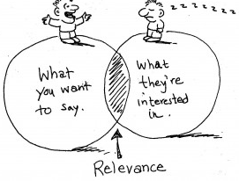
Strategy: Build Trust with Effective Editing
Notes:
Image from: https://advanceexpository.wordpress.com/2016/04/10/knowing-your-audience/

Slide 10

Strategy: Build Trust with Data
KEEP
CALM
and
LET THE DATA
SPEAK
for itself

Slide 11
Strategy: Know When to Compromise
SOME
plain language
is better than
NONE

Slide 12

Part 2: Plain Language and Websites
Using your expertise to build credibility with leadership and subject matter experts

Slide 13

Problem
Conflicting ideas and competing priorities
Nuance versus user needs
Differing levels of buy in
Caught in the middle
Systems of clearance
Level/Types of authority

Slide 14

Moving Toward Solutions
Recognizing limitations and opportunities
Leverage shared goals
Focus on areas that provide best return on time invested
This means understanding your goals/bandwidth/audience needs
Be Pragmatic
Use your expertise as authority / right support at right times
Using research and best practices
Learning your own agency content!

Slide 15
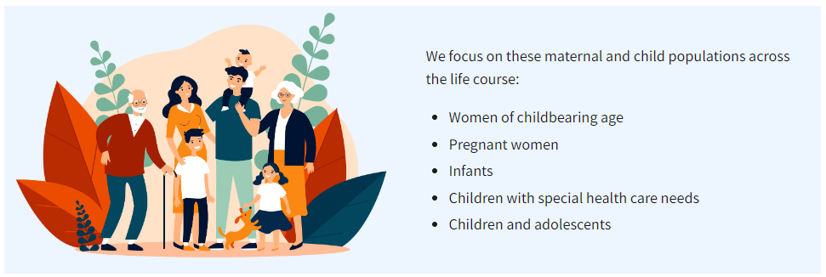
Examples
Maternal and Child Health Bureau Webpages
Example 1
2021 About webpage
Current About webpage

Slide 16
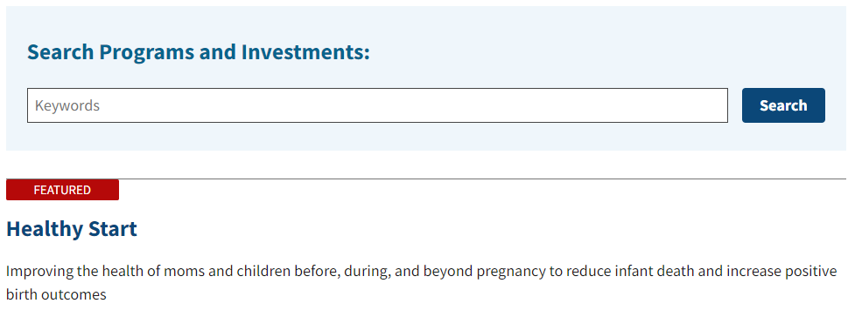
Examples continued
Maternal and Child Health Bureau Webpages
Example 2
2021 Program Structure
Current Program Structure

Slide 17
Takeaways
Metrics and Usability Research
Paint a picture / Use in context
Use for leverage
Anecdotal website feedback
Positive strides naturally open further opportunities
Plain language
It’s a path, not a product.

Slide 18
Reach Out to Us
Shuly Babitz, M.A.
Health Communications Specialist
sbabitz@hrsa.gov
Kathryn Karnell, M.A.
Digital Communications Specialist
kkarnell@hrsa.gov
Public Affairs Team, Office of Policy and Planning
Maternal and Child Health Bureau (MCHB)
Health Resources and Services Administration (HRSA)

Slide 19






Connect with HRSA
Learn more about our agency at:
www.HRSA.gov
Sign up for the HRSA eNews
FOLLOW US:

