Slide 1
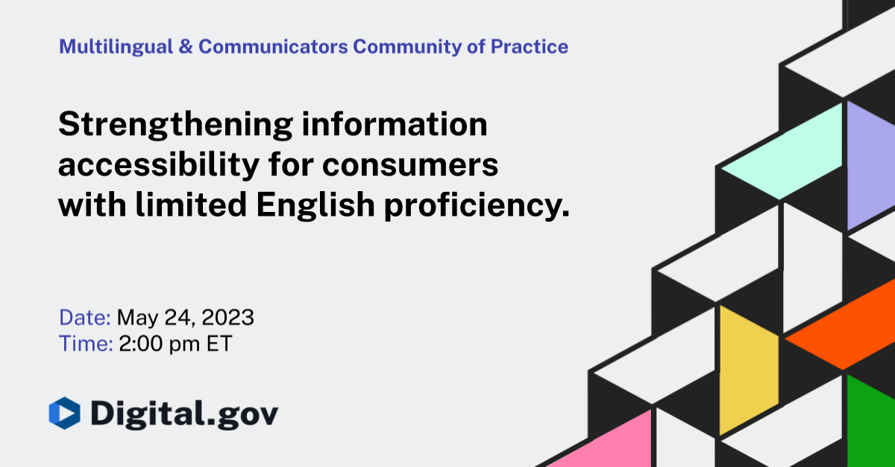
Strengthening information accessibility for consumers with limited English proficiency
1
1

Slide 2
Disclaimer
This presentation is being made by a Consumer Financial Protection Bureau representative on behalf of the Bureau. It does not constitute legal interpretation, guidance, or advice of the Consumer Financial Protection Bureau. Any opinions or views stated by the presenter are the presenter’s own and may not represent the Bureau’s views.

Slide 3
About the project
Consistent with Executive Order 13166, “Improving Access to Services for Persons with Limited English Proficiency”, CFPB’s Language Access Task Force, led by the Office of Financial Education (FinEd) established a plan to:
Examine in language resources and tools provided by the Bureau,
Determine Limited English Proficiency (LEP) consumer needs and experience with CFPB in language resources and,
Develop and implement a system to ensure LEP consumers can have meaningful and equitable access to CFPB resources.
FinEd conducted landscape analysis and market research to better understand LEP consumers and develop strategies to strengthen the Bureau's outreach, education, and communication to them.

Slide 4
Project methodology
The observations and opportunities reflected in this document are based on:
A qualitative and quantitative study of the CFPB's current LEP consumer outreach efforts and understanding of other federal agencies efforts,
In-depth interviews with practitioners and intermediaries who provide direct and indirect assistance on financial matters to LEP consumers,
In-language focus groups in Arabic, Chinese, Haitian Creole, Korean, Tagalog, and Vietnamese-speaking LEP consumers, and
Usability tests of the CFPB's updated in-language resources

Slide 5
Summary of observations from consumers
5

Slide 6
1. Awareness and understanding of the CFPB
“Our [customers don’t] know about CFPB. Plain and simple: they don’t know about CFPB.” (Practitioner)
“I go to either a relative or friend who works in the industry and has a track record for successful clients or even their personal finance...” (Consumer, Filipino segment)
LEP consumers noted the need to build awareness and strengthen understanding of the CFPB
LEP consumers are generally unaware of the existence of the CFPB.
They are not visiting the CFPB website in large volumes, are submitting minimal complaints, and are not inclined to immediately trust the CFPB as a resource unless recommended by trusted messengers in their respective communities.

Slide 7
2. Resources offered for practitioners and intermediaries
“That's the thing about these mission-driven direct service providers is that a lot of them come from community themselves and have that lived experience. And so it's much easier to build that trust and that familiarity.” (Practitioner)
“We worked really hard to have that buy-in from their community elders…” (Practitioner)
“[The CFPB website] is a good source of information for the advocates who then translate that for our clients.” (Practitioner)
Community-based partners can help bridge the distance to LEP consumers at the intersection of language access and financial literacy.
Practitioners and intermediaries that provide assistance on financial matters to LEP consumers have longstanding community relationships and consistent touchpoints with this target audience year-round.

Slide 8
3. Resources offered for LEP consumers
“Here in USA everything is in English or Spanish, no one ever bothered to communicate anything in Arabic because we are a minority group here.” (Consumer, Arab segment)
“A lot of people think if we just make materials in another language, that’s sufficient. But you’re making an assumption that they can read in their native language.” (Practitioner)
“It's of no use to have materials…that focus on saving money every pay period when the LEP client is working three jobs just to stay afloat and saving money doesn’t even come into the picture.” (Practitioner)
There can be better alignment between what resources the CFPB offers and who need to access those resources.
While there has been extensive investment in Spanish language resources and content, there are fewer resources in the CFPB’s in language resources.
Reaching these other language groups will require special attention to their diverse cultural contexts, literacy levels, and minimal understanding of the U.S. banking and financial system.

Slide 9
4. Website design, content, and experience
“If you have videos, people will be very happy to see it. They will know that if it's a real story from a real person.” (Consumer, Vietnamese segment)
“We really try to make sure that whatever we share with them, one, is digestible and it's in two languages and we go to the source.” (Practitioner)
“You see the American flag and it's in Korean, but...image representation that doesn't have any Asians. Maybe you could feature an Asian [person]... I think that way you relate to it, and you would feel like, ‘Oh, maybe I can get their services or help.’” (Consumer, Korean segment)
The design and user experience for the CFPB’s in-language webpages can be improved to better cater to the content and language preferences of LEP users.
The vast majority of visitors to the CFPB website are using a mobile device. Many LEP users are multilingual and prefer to cross-reference information across languages as assurance that important information is not lost in translation.
Consumers noted that they would respond more favorably to the website if it included more culturally relevant images and LEP consumer testimonies.

Slide 10
Potential Opportunities
10

Slide 11
1. Website Development
Continue efforts to build a best-in-class, culturally and linguistically accessible website that can serve as a one-stop resource for LEP consumers as well as the practitioners and intermediaries that support them.
Scale the availability of in-language content, focusing especially on Vietnamese, Chinese, and Korean language content in the short-term. Utilize machine translation where needed to support content production in other languages. Leverage website and publications analytics to identify the most relevant topics that should be made available to all languages.
Review in-language content for grammar, cultural relevance, and literacy levels. Utilize plain-language with less complex technical vocabulary and incorporate English language terms where relevant to support comprehension.
Develop more specific, culturally-relevant messaging that will resonate with the priority language groups. Use videos featuring LEP consumers and/or written copy to clearly convey the CFPB’s purpose and address frequently asked questions.

Slide 12
2. Marketing and outreach
Conduct an education and outreach campaign to raise awareness and build understanding of the CFPB as a resource for LEP consumers.
Utilize a “surround sound” approach to ensure diverse cultural contexts, language needs, technology preferences, and trusted messengers are covered.

Slide 13
Current progress
13

Slide 14
Steps taken
Launched newly redesigned language landing pages that include:
Similar layouts across all eight languages (Arabic, Chinese, Haitian Creole, Korean, Russian, Tagalog, and Vietnamese) for easier comparison
Added images and iconography to better reflect the communities we're reaching
More "bite-sized" content in simpler language to aid comprehension
Glossaries of commonly-used financial terms and acronyms
A more detailed explanation of the consumer complaints process

Slide 15
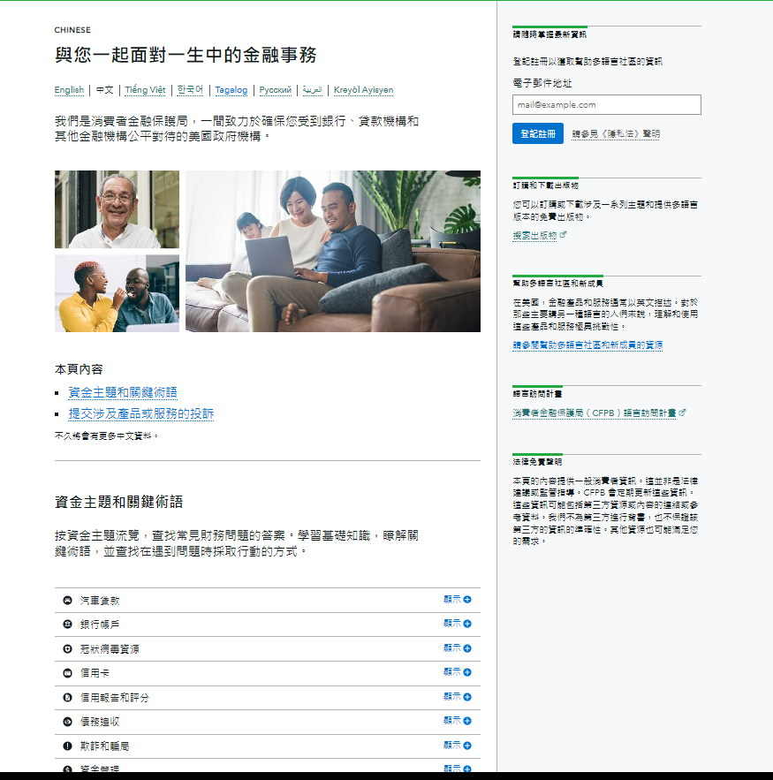
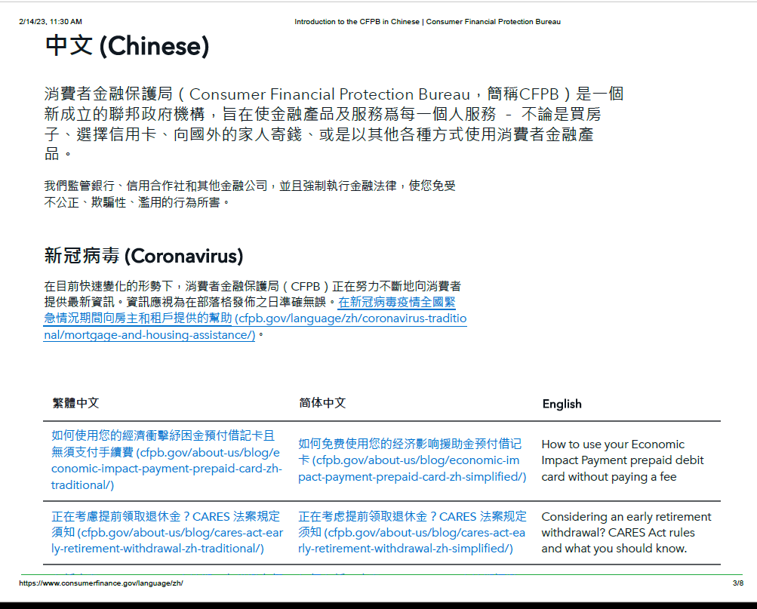
Old website
New website

Slide 16
Translation Process
Translations intake form submitted by product owner
CFPB sends request to vendor for quote
CFPB sends to the Library Of Congress (LOC) for audit
Completed translation is sent back to CFPB by vendor
LOC sends completed audits to CFPB (track changes and clean version)
Vendor sends quote and CFPB reviews and approves quote
CFPB reviews audited documents and sends clean version to product owner
LOC sends quote and CFPB reviews and approves quote

Slide 17
Thank you!
17

Slide 18

Digital.gov
Join our other communities to get involved!
digital.gov/communities/
18

