Slide 1
Designing Digital Products
For Adults with Low Prose Reading Literacy
Sheila Walsh, U.S. Department of Health and Human Services
Note: Some slides may contain presenter notes
1

Slide 2

Meet Gail
Notes:
Source: Getty Images, item 1298108434 (obtained through HHS/ASPA account)
Credit:Tomwang112
Creative #:1298108434
License type: Royalty-free
Collection: iStock / Getty Images Plus

Slide 3
Gail is one of many
* Benchmark is Level 3 or 4 score on the Program for the International Assessment of Adult Competencies (PIAAC)
Notes:
Source for data: https://nces.ed.gov/surveys/piaac/national_results.asp
Source for Dr. Larson https://digital.gov/event/2020/05/13/average-american-reader-needs-you-write/

Slide 4
Common patterns
Reading every single word – not scanning
Ignoring information on the right or left side
Avoiding dense blocks of text
Link surfing
Satisficing quickly
Avoiding search or typing misspellings
Spending more time to complete an online task
Blaming themselves for a poor user experience
Notes:
Sources: Personal observations during usability tests and http://eprints.rclis.org/7038/1/Summers_Reading.pdf

Slide 5
Internet access
More mobile usage
Less mobile data
Less desktop/laptop
Less home broadband access

Slide 6
6 User Experience Best Practices
6

Slide 7
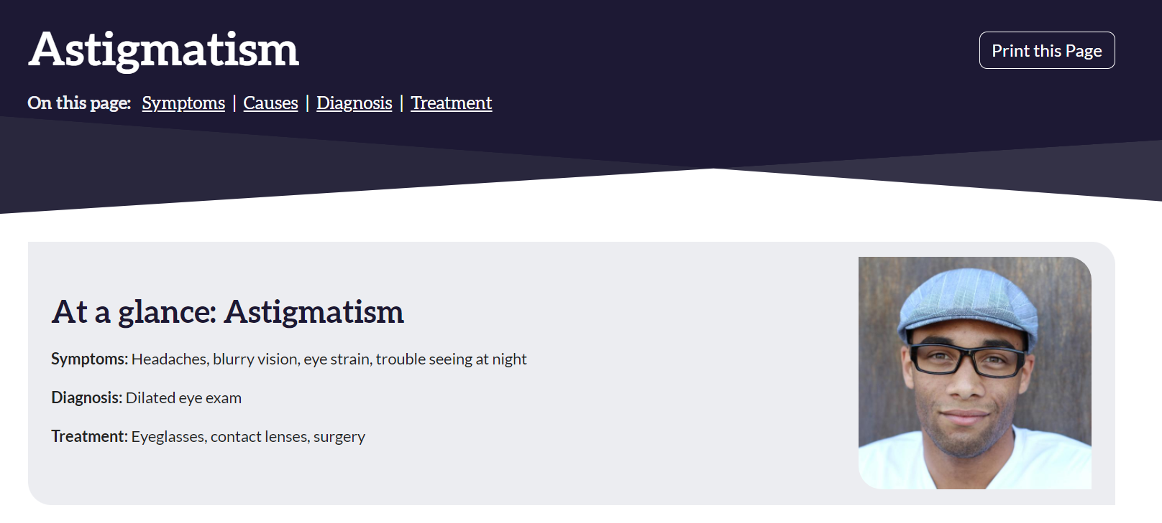
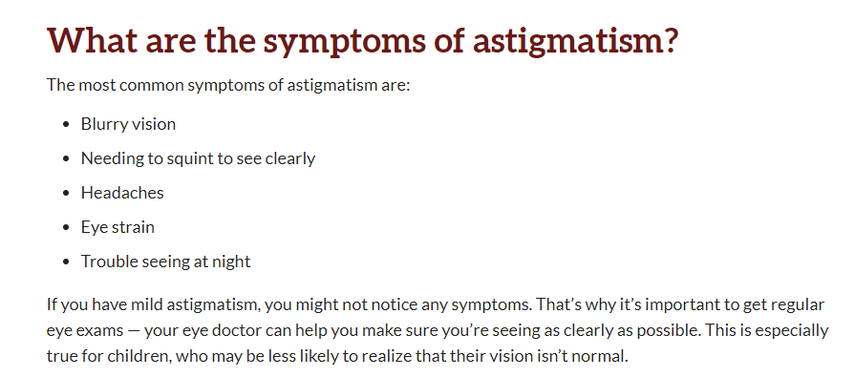
1. Follow plain language guidelines
Notes:
Sources: National Eye Institute, National Institutes of Health, https://www.nei.nih.gov/learn-about-eye-health/eye-conditions-and-diseases/astigmatism

Slide 8
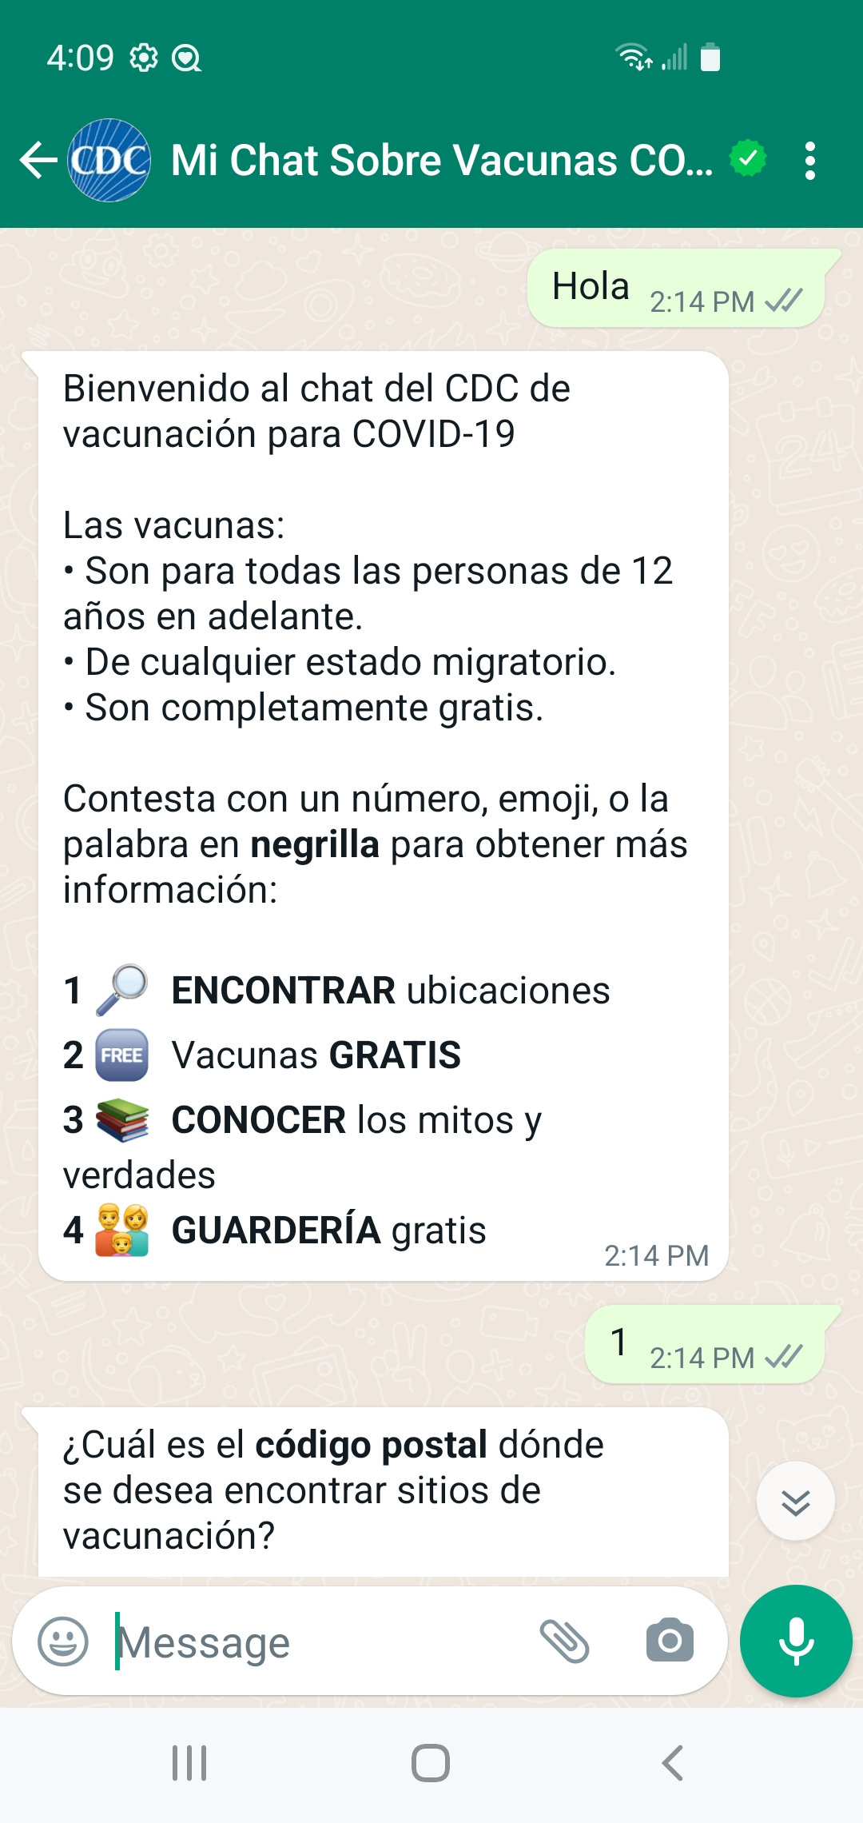
2. Vary typography
Bullet points to break up long chunks of text
Use of familiar, colorful icons
Leverage numerical literacy
Bold important words

Slide 9
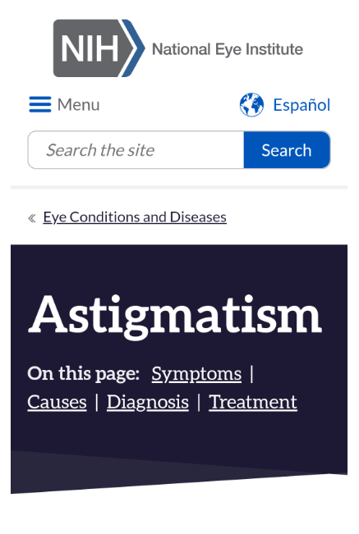
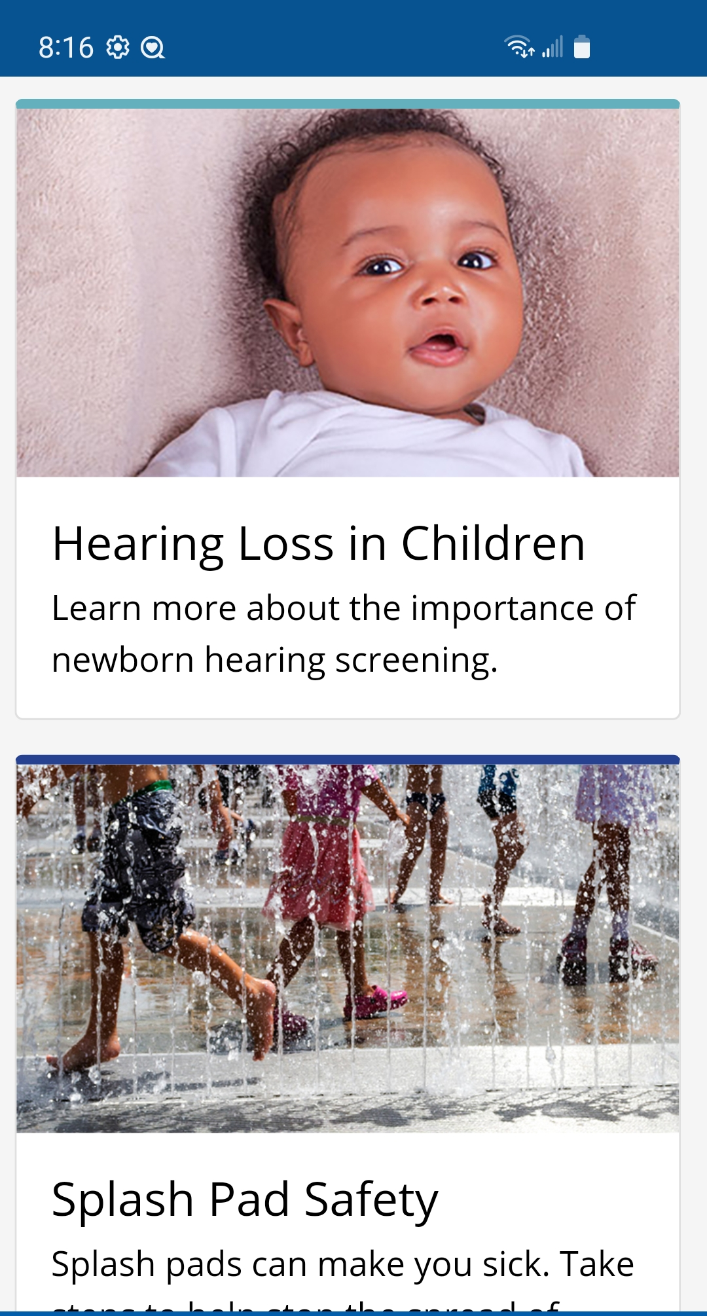
3. Design for mobile
Notes:
Here are two examples of mobile-friendly web content, one the mobile version of the astigmatism page published by NIH’s National Eye Institute. The second screenshot comes from CDC – the images communicate meaning and the language is clear and simple.

Slide 10
4. Follow design guidelines
White space
Large default text size, at least 16 pixels
Design for mobile display and fat fingers
On desktop, avoid placing key information on far left or right of screen
Use meaningful link text and headers
Understand that web forms are extremely difficult, and either avoid them altogether or keep them brief.

Slide 11

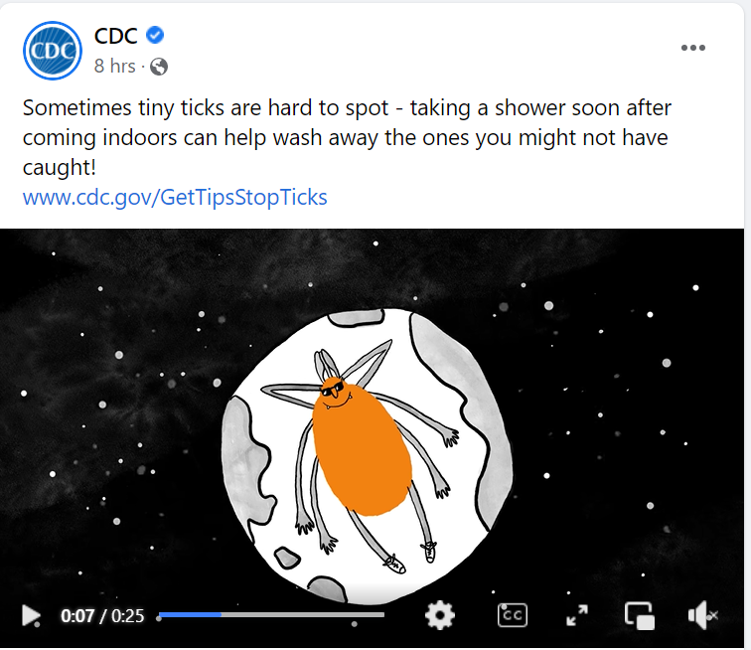
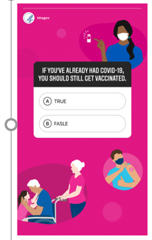
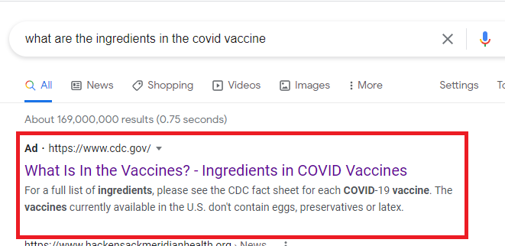
5. Use multiple content types
Notes:
Sources:
(left) CDC video: https://fb.watch/dbU8pGBT7V/
(middle) WeCanDoThis COVID-19 campaign quiz – previously on wecandothis.hhs.gov, content is now retired.
(right) Screenshot of Google search results page

Slide 12

6. Inclusive usability test participant recruitment
Notes:
Source: Getty Images, Item #590580206

Slide 13

A path forward for Gail
Notes:
Source: Getty Images, Item #486348232

Slide 14
Resources
Health Literacy Online, health.gov (contains usability testing and user experience guidelines)
The Average American Needs You To Write Even More Clearly, digital.gov webinar
Plainlanguage.gov
Clear Communication, National Institutes of Health

