Slide 1

USWDS Monthly Call
April 2022
1

Slide 2

Hi!
Thanks for being here!
2
Notes:
My name is Dan Williams, and I'm the USWDS product lead and this is my avatar, which maybe looks a bit like my best self — bright-eyed and positive perhaps! Thanks for being here!
First, I'd like to mention that we're recording this monthly call, so please refrain from turning on your camera. We will manually turn off any cameras to ensure the recording doesn't show us on camera.
I’d also like to remind you that all attendees must abide by the TTS Code of Conduct, which is available at handbook.tts.gsa.gov/code-of-conduct. We’ve posted the link to the code of conduct in the chat.
We'll be posting other links and references into the chat as we go along, and I encourage you to ask questions in the chat at any time. If any member of our team can answer your question in the chat, we'll do so, otherwise there'll be some time for questions and answers at the end of the hour. Also, be sure to introduce yourself in the chat as well — it's nice to know who's here. It's good to have you here today.
For those of you who find the chat distracting, you’re welcome to close or hide the chat window during the main presentation. You can reopen it later during the Q&A session at the end of this call.
So thanks! And, with that, let's get started!

Slide 3
Agenda
Site launches Product updates USWDS 3.0 in the real world Q&A
3

Slide 4
Site launches

Slide 5
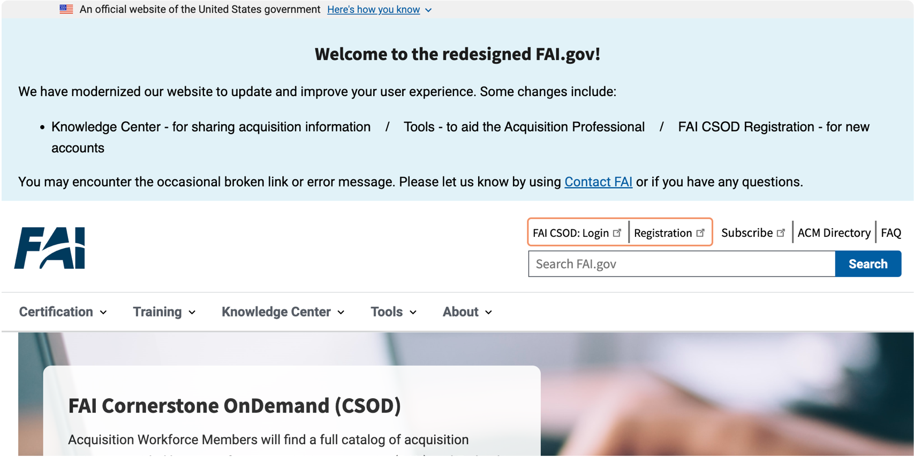
Federal Acquisition Institute
fai.gov

Slide 6
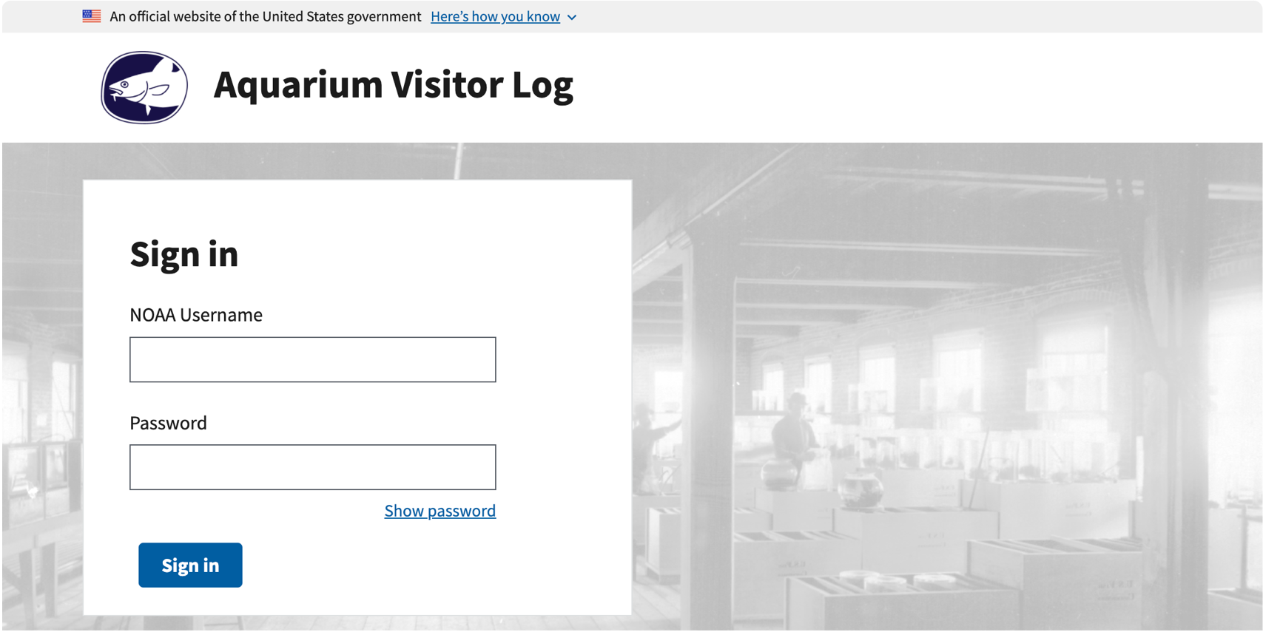
National Oceanic and Atmospheric Administration Wood’s Hole Aquarium Visitor Log
apps-nefsc.fisheries.noaa.gov/AVL

Slide 7
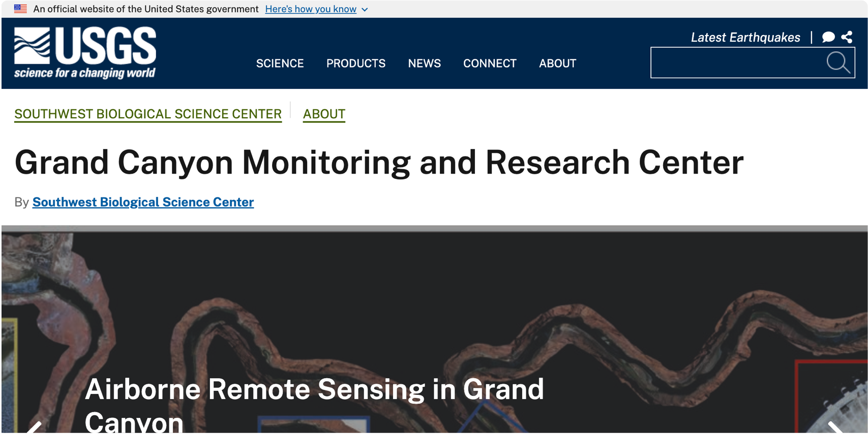
National Geospatial Program’s Grand Canyon Monitoring and Research Center
gcmrc.gov

Slide 8
Great work!
Notes:
Congratulations, and great work, everyone! Each month there's a lot of hard work reflected in these humble screenshots. Be sure to let our team know when a new site launches, either with an email or a note on the USWDS public Slack channel!

Slide 9
Product updates
Notes:
So now, a few product updates.

Slide 10
USWDS 2.13.3 Out now

Slide 11
USWDS 3.0.0 Beta 5 Out now

Slide 12
USWDS 3.0.0 Next Thursday: 4/28/22

Slide 13
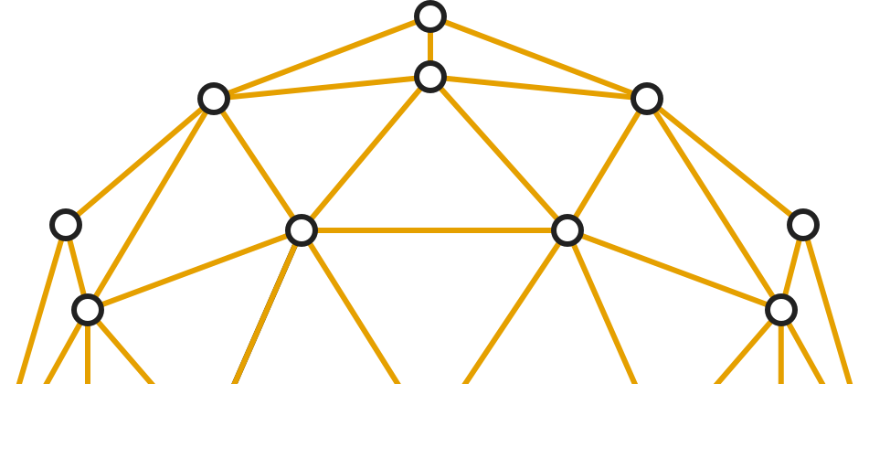
USWDS 3.0 in the real world

Slide 14
Matthew Bogdan
Lead Engineer (Detail) Digital.gov

Slide 15
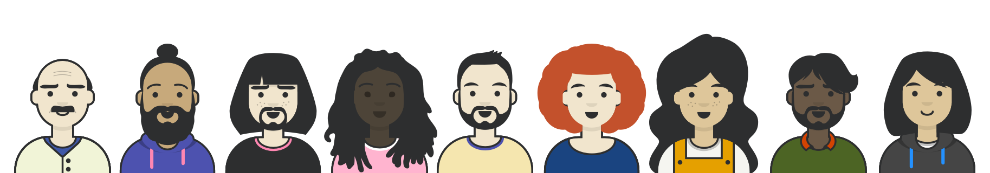
Q&A

Slide 16



Next month
May: Optimizing USWDS 3.0
#uswds-public
USWDS on GitHub
USWDS website

