Slide 1
Plain language and compassion meet moments of crisis
Amanda Costello & Cordelia Yu Content strategists, 18F
Part of GSA’s Technology Transformation Services

Slide 2


We’re content strategists from the government, and we’re here to help.
Cordelia Yu
Amanda Costello

Slide 3
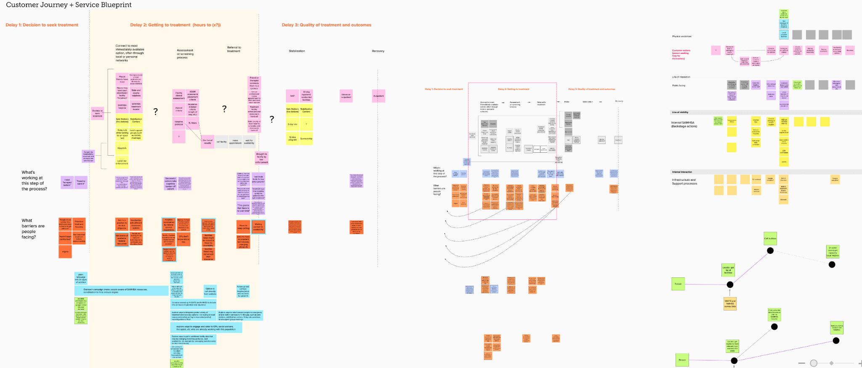
Mapping the whole journey
(Image from big mural board)

Slide 4
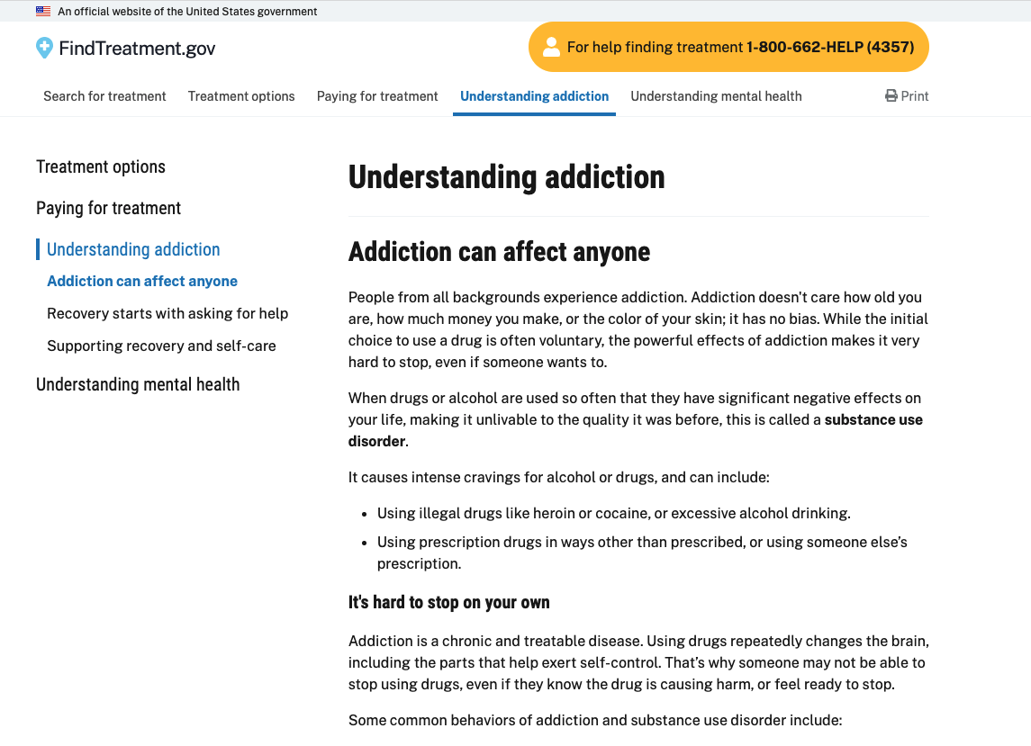
Supporting the whole journey

Slide 5
findtreatment.gov needed to connect seekers with treatment options that met their needs.
The common blockers to this connection are:
Understanding different types of treatment
Finding a nearby treatment option that fits their needs
Paying for treatment

Slide 6
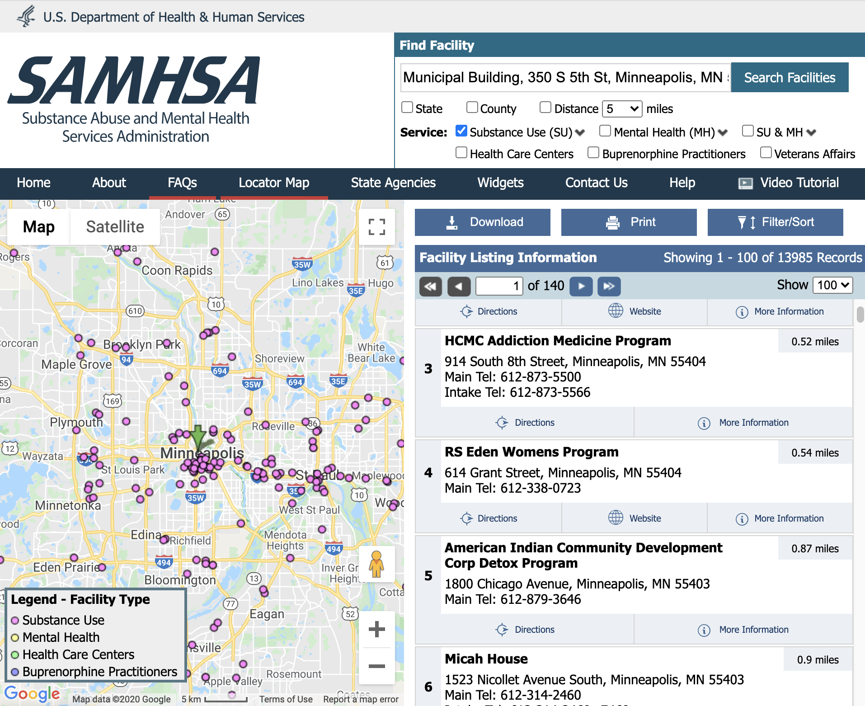
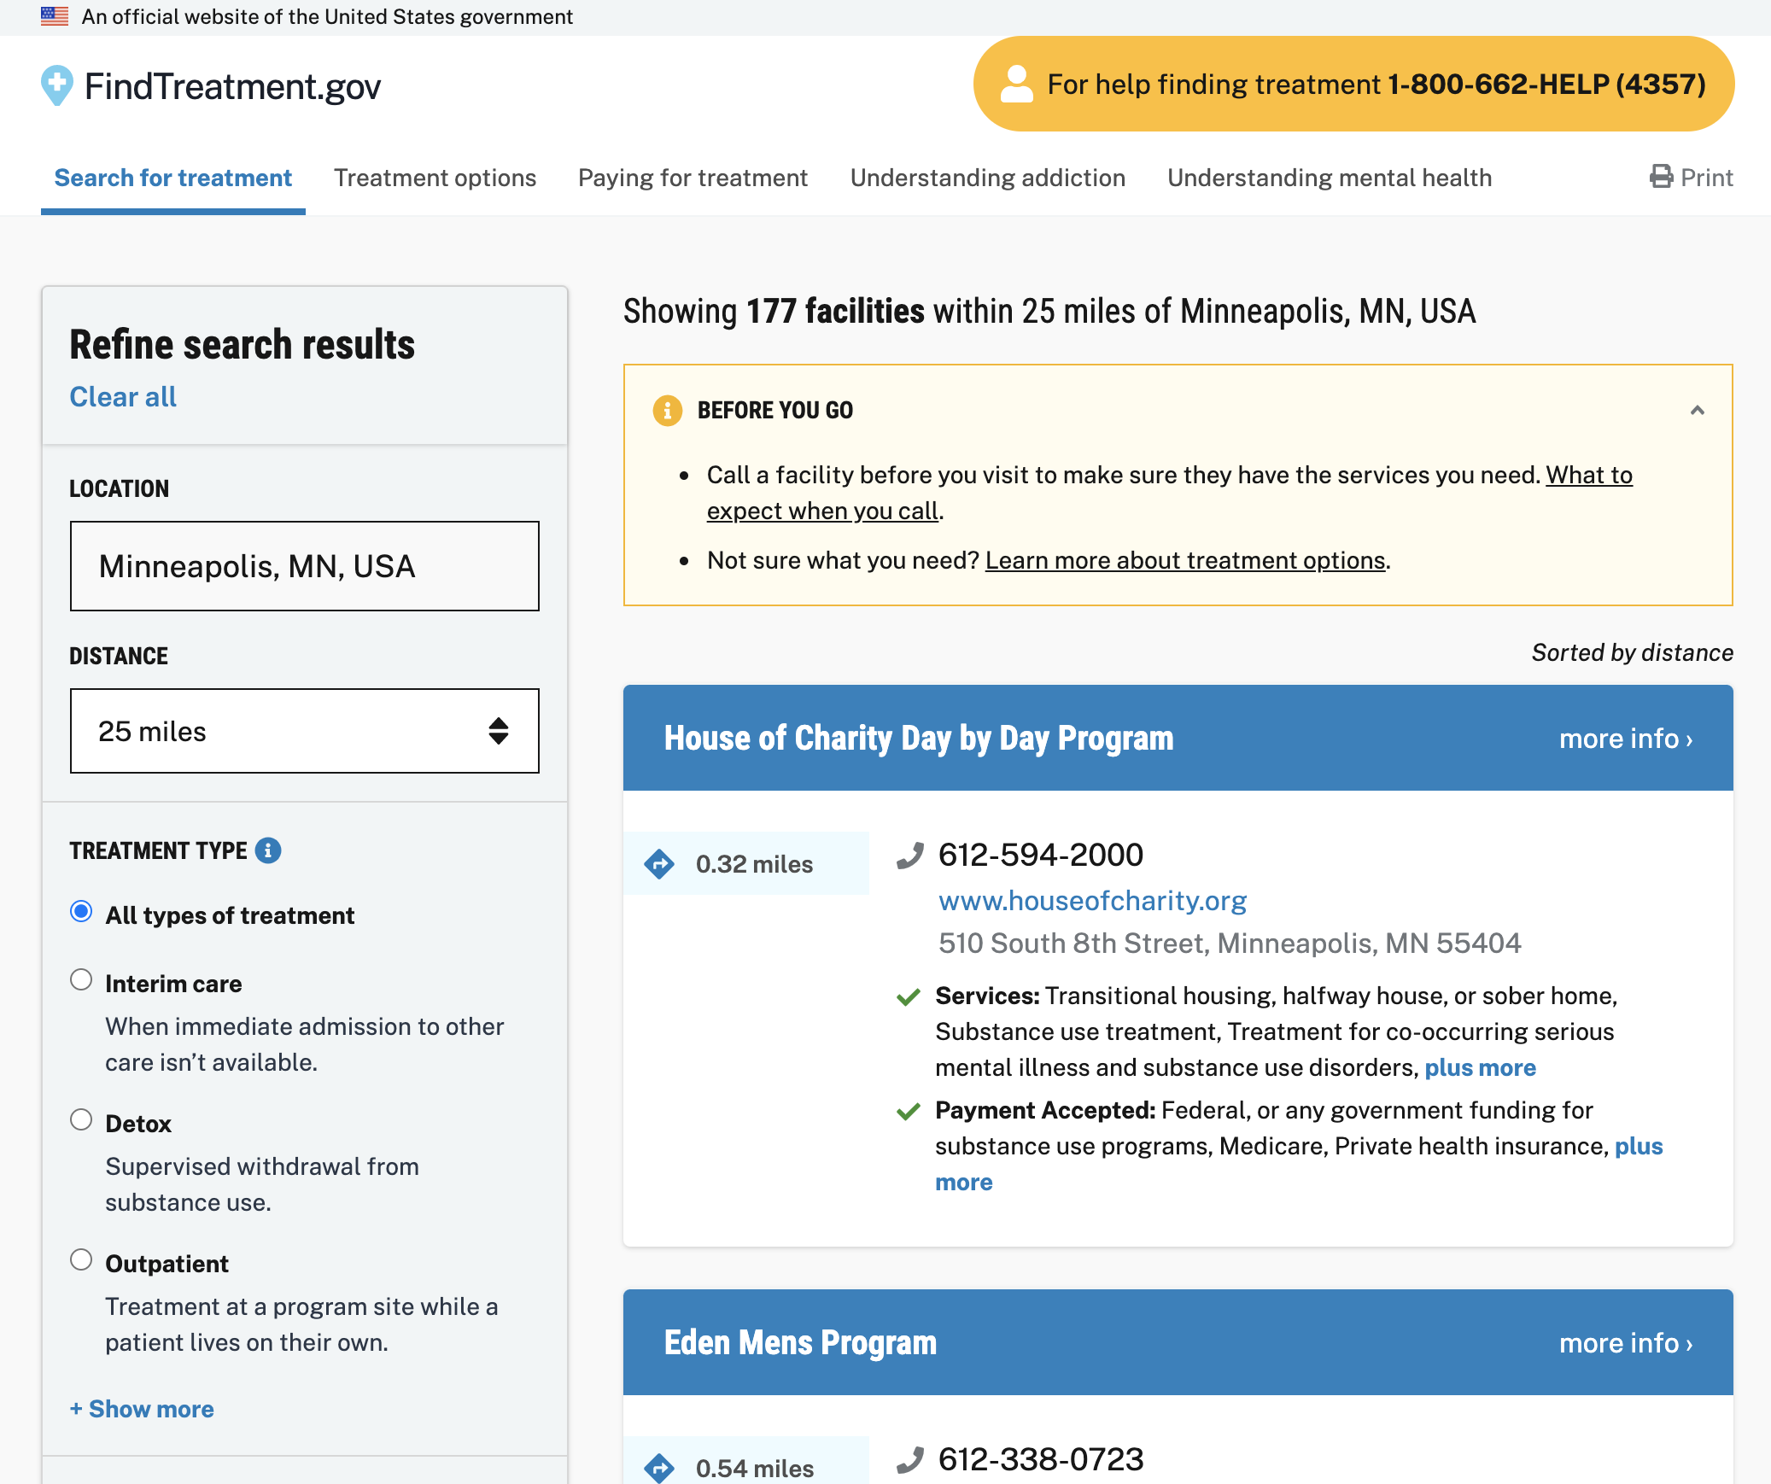
Before and after
Before
Unclear content hierarchy
After
Scannable search filters and results

Slide 7
Meet people where they are; reduce cognitive load.

Slide 8
Reducing cognitive load
People are likely coming to this site in high stress, possibly crisis
Be honest about what “new” requirements you have of them
Website layout
Tool to use
Language and terms
… and reduce this where you can.
Speak their language: “detox”
Scalable definitions

Slide 9
Examples of what we did:

Slide 10
Be honest about things
that are hard.

Slide 11
Help people feel prepared for the next step (not for every possible future step)
Questions you may be asked
If you’re calling for yourself or someone else.
Which drugs or alcohol have you been using, for how long, and how much.
Current health conditions and medications, including pain medications you’re currently taking.
What financial resources are you working with (insurance, money from a loved one, etc.?)
Questions you may want to ask the facility
When can I get an appointment?
How much will treatment cost? Do you accept my insurance?
What do I need to bring? What should I not bring?
How do I get to the facility? Is there public transportation? Can you pick me up?
Consider asking questions that are important for you and your situation:
Is the facility smoke-free or is smoking allowed?
Are there childcare options available?
What types of medications am I allowed to take while in treatment?
What kind of family contact is allowed, and when?
This is a confidential call. Answering the questions honestly is important, and you won’t be reported to law enforcement for talking about using illegal drugs.

Slide 12
Health insurance: still tough to figure out
We created content for people who already have health insurance.
Defining common terms or services
Deductible, which is for all medical expenses
Co-pay, something already encountered
Preferred providers and case managers
Information about mental health and substance use parity
Mental Health Parity and Addiction Equity Act (MHPAEA) of 2008
That means your insurance company can’t tell you “we don’t do substance abuse treatment” or “mental health isn’t covered." If they do this, they’re breaking the law.

Slide 13
Self-care when you’re working on difficult subjects
Plan for what you can do after a heavy conversation beforehand (take a walk, call a friend, watch your favorite show on Netflix, work out, etc)
Set up your workspace during these calls in a way that's comfortable (warm beverages, comfy clothes, ideally, a puppy on your lap)
Assess how you feel after and debrief with someone from our team or elsewhere
Take time to process through your feels
Your teammates are a resource, we are here to debrief if you need to.

Slide 14
But also…
Connect with other people and agencies as much as you can to avoid duplicating effort.
You may get stuff wrong, but have a process to fix it quickly.
Celebrate every small victory. Even tiny changes at a high level can have tremendous effects.

Slide 15
Thank you!

