Slide 1
Designing Digital Products
For Adults with Low Prose Reading Literacy
Sheila Walsh, U.S. Department of Health and Human Services
Note: Some slides may contain presenter notes

Slide 2

Meet Gail
Notes:
Source: Getty Images, item 1298108434 (obtained through HHS/ASPA account)
Credit:Tomwang112
Creative #:1298108434
License type: Royalty-free
Collection: iStock / Getty Images Plus

Slide 3
Gail is one of many
* Benchmark is Level 3 or 4 score on the Program for the International Assessment of Adult Competencies (PIAAC)
Notes:
Source for data: https://nces.ed.gov/surveys/piaac/national_results.asp
Source for Dr. Larson https://digital.gov/event/2020/05/13/average-american-reader-needs-you-write/

Slide 4
Common patterns
Reading every single word – not scanning
Ignoring information on the right or left side
Avoiding dense blocks of text
Link surfing
Satisficing quickly
Avoiding search or typing misspellings
Spending more time to complete an online task
Blaming themselves for a poor user experience

Slide 5

It takes a team
Notes:
https://www.gettyimages.com/detail/photo/alone-were-weak-together-were-strong-royalty-free-image/646424550?adppopup=true – purchased by HHS

Slide 6
6 Best Practices

Slide 7
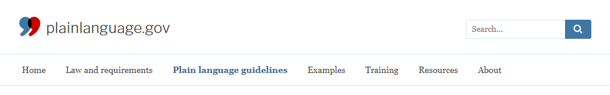
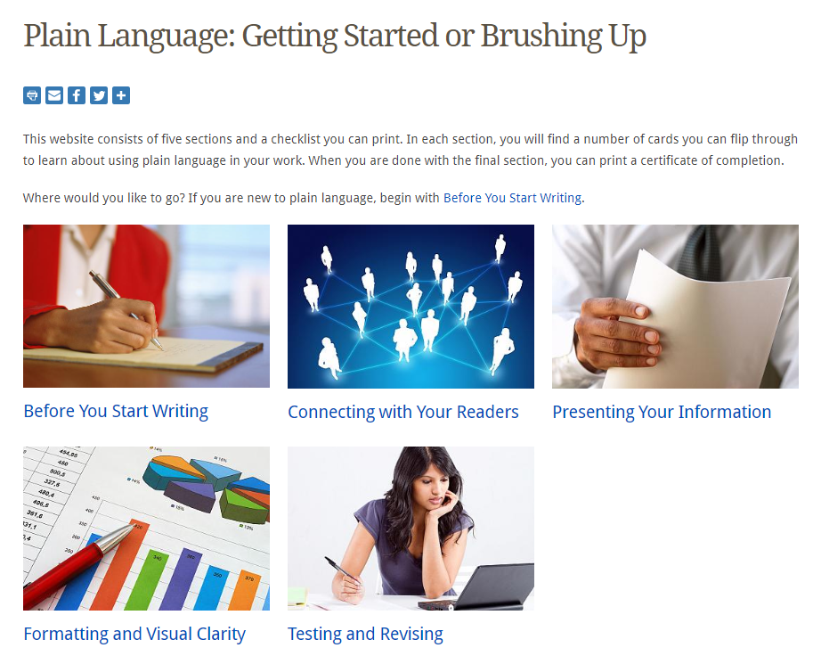
1. Follow plain language guidelines
Resource: NIH Clear
Communication
Notes:
Source: https://www.plainlanguage.gov/

Slide 8
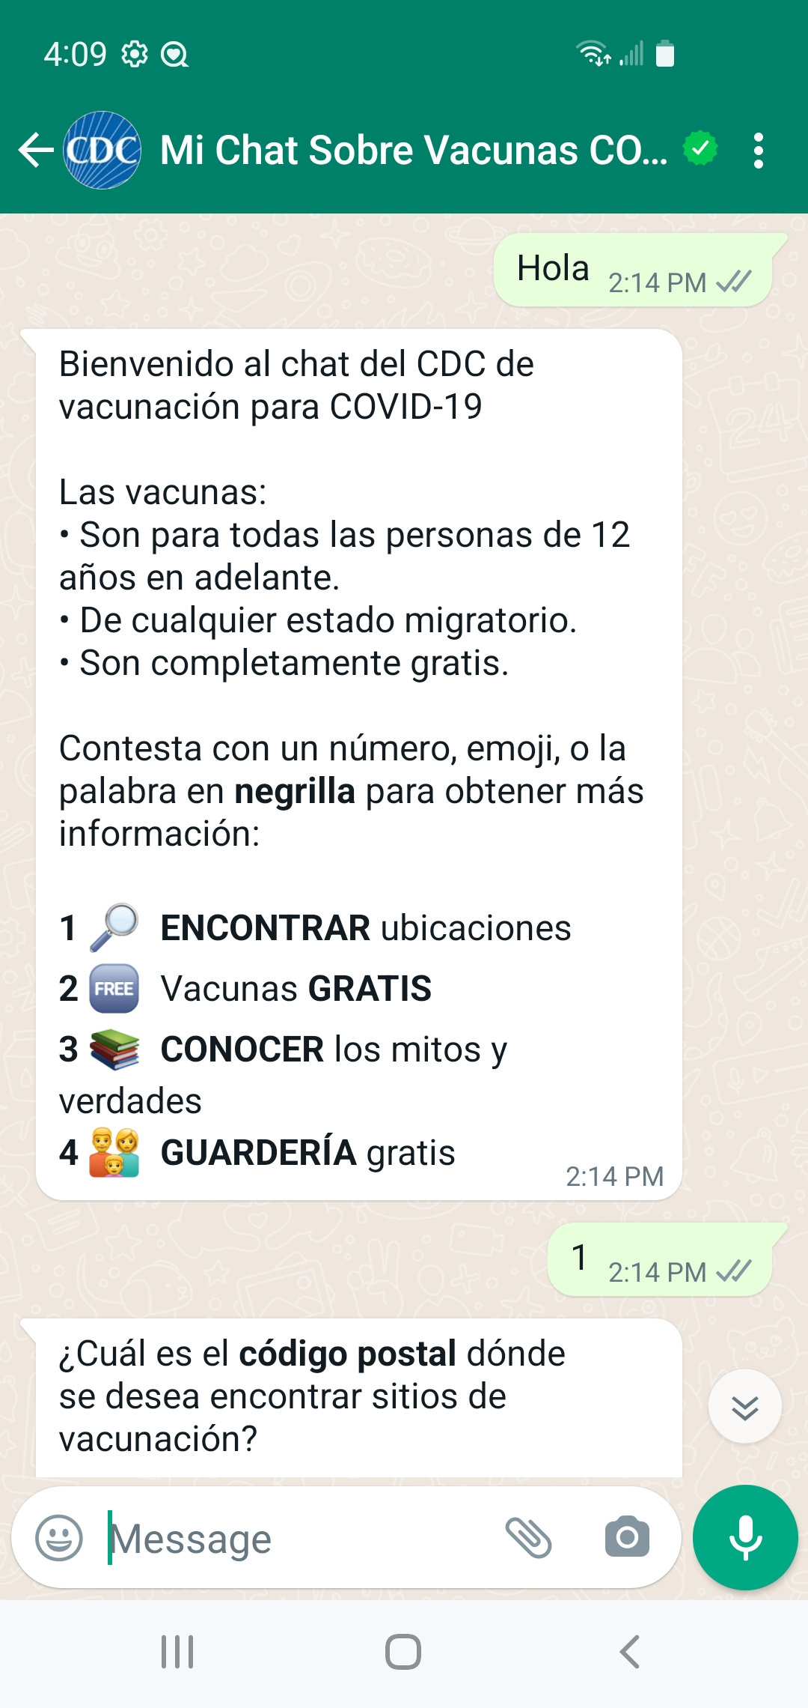
2. Vary typography and include meaningful images
Bullet points to break up long chunks of text
Use of familiar, colorful icons
Leverage numerical literacy
Bold important words

Slide 9
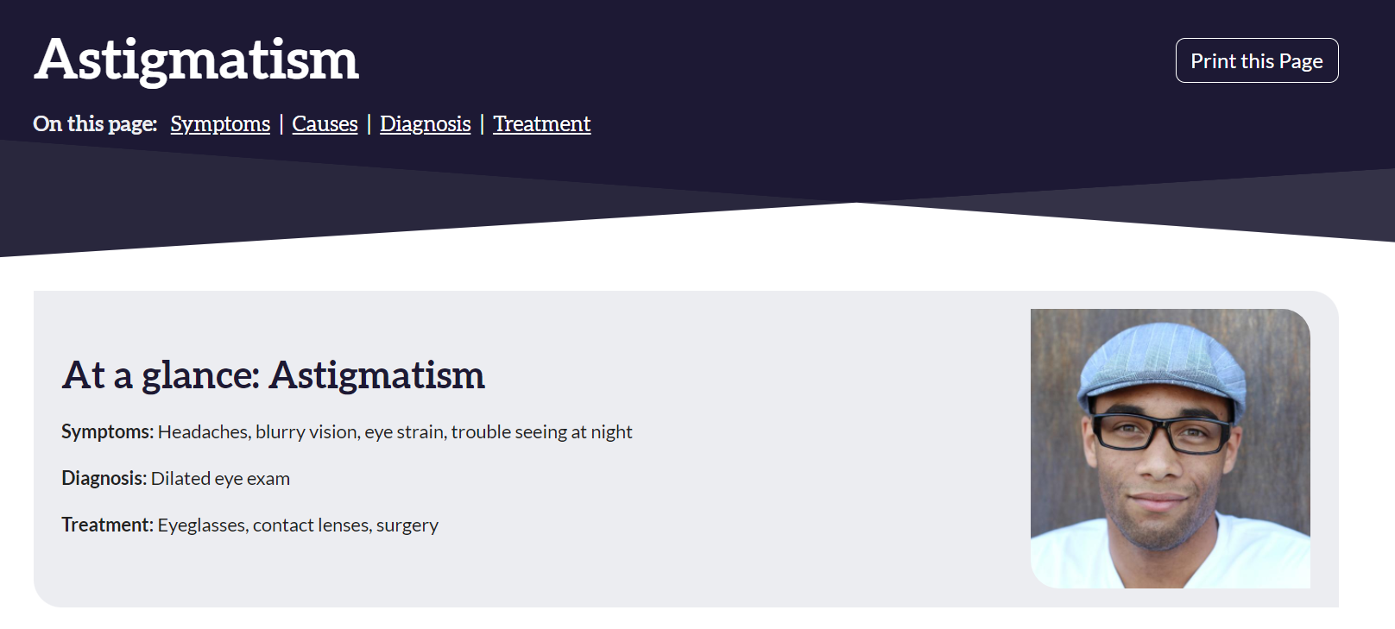
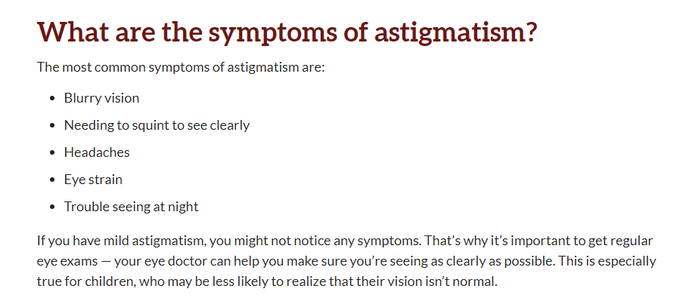
Example: National Eye Institute
Notes:
Sources: National Eye Institute, National Institutes of Health, https://www.nei.nih.gov/learn-about-eye-health/eye-conditions-and-diseases/astigmatism

Slide 10
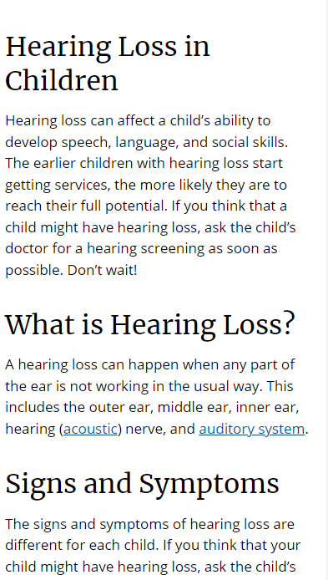
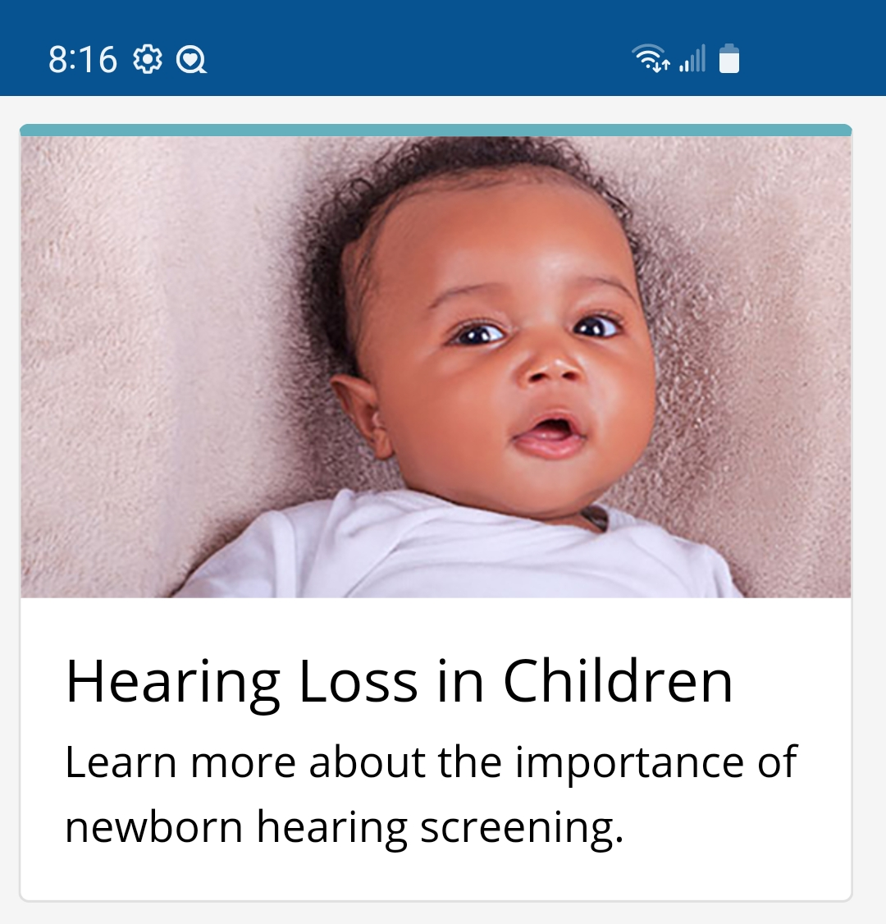
3. Design for mobile
Notes:
Sources: CDC.gov

Slide 11

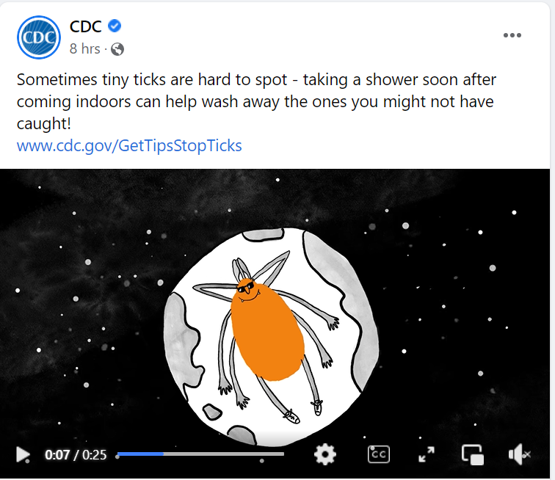
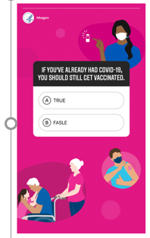
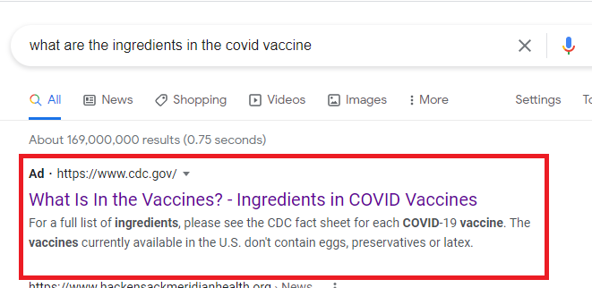
4. Use multiple channels and content types
Notes:
Sources:
(left) CDC video: https://fb.watch/dbU8pGBT7V/
(middle) WeCanDoThis COVID-19 campaign quiz – previously on wecandothis.hhs.gov, content is now retired.
(right) Screenshot of Google search results page

Slide 12

5. Inclusive usability tests
Related Resource: Testing Reading Levels of Participants (NIH)
Notes:
Source: Getty Images, Item #590580206

Slide 13
6. Look beyond “web content”
Plain language writing is needed for
Help text
Web forms
Step-by-step processes
Error messages
Alt text for accessible images

Slide 14
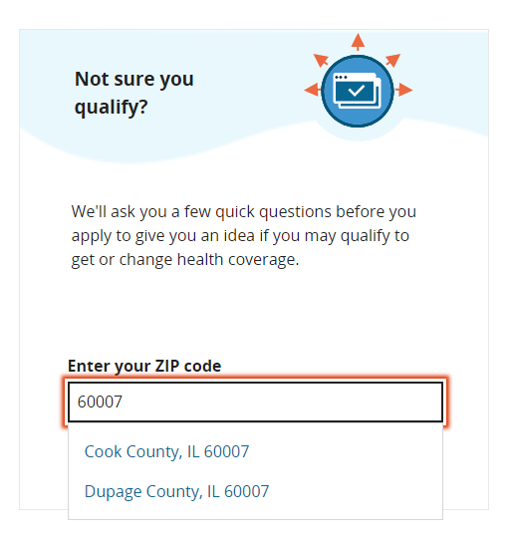
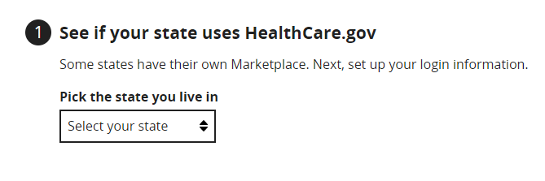
Example: Healthcare.gov
Notes:
Sources: Healthcare.gov

Slide 15

A path forward for Gail
Notes:
Source: Getty Images, Item #486348232

Slide 16
Resources
Health Literacy Online, health.gov (contains usability testing and user experience guidelines)
The Average American Needs You To Write Even More Clearly, digital.gov webinar
Plainlanguage.gov
Clear Communication, National Institutes of Health
Testing usability test participants’ reading levels

