Slide 1
Language Connections
Tips to Create, Maintain, and Present Non-English Digital Content
Michael Mulé, Attorney-Advisor
Federal Coordination and Compliance Section
Limited English Proficiency Committee
Title VI Interagency Working Group
Notes:
We all use websites and digital services to provide information and services to the public, accept applications, and manage accounts.
Digital services involve the electronic delivery of information over the internet, including data and content, across multiple platforms or devices, such as text, audio, video, mobile applications, and graphics.
It is important to make sure that Limited English proficiency (LEP) persons have meaningful access to vital information, in their language, on the website and digital services we create and maintain.
Based on federal, state, and local laws, regulations, and executive orders, many agencies and entities are required to take reasonable steps to ensure meaningful access for LEP individuals.

Slide 2
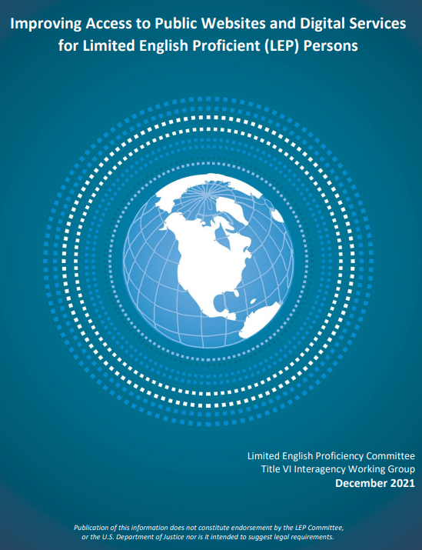
Overview
go.usa.gov/xt8uj
Ideas
Examples
Resources
1
Notes:
The LEP Committee of the Federal Title VI Interagency Working Group gathered ideas, resources, and examples and issued a guide in December 2021 to help anyone seeking to improve language access to their websites and digital services.
This presentation is based on that guide and covers three topics:
ideas and considerations related to content in other languages,
examples of features to support multilingual content, and
resources related to these topics.
The guide, which you can access using the short link here, includes more information on each topic and additional examples.

Slide 3
Ideas
2
Notes:
The guide includes ideas and considerations when creating or assessing content in languages other than English, including
understanding machine translation,
signs of trouble,
best practices for providing this content,
effective design strategies, and
the importance of usability testing with LEP persons.

Slide 4

Machine Translation
A translation without a human translator
Before posting, secure a competent human translator to proofread the content for accuracy
3
Notes:
It is important to understand what machine translation means when you are talking about access to websites and digital services for LEP users.
Machine translation refers to a variety of applications or software that convert written text from one language to another without the involvement of a qualified human translator.
If machine translation is used, you will need to have a competent human translator proofread all content containing vital information to ensure the accuracy of that content before it is posted to your website or social medial accounts.
A competent translator is a highly trained individual who is able to render text from a source language into a target language while preserving the meaning and adhering to generally accepted translator ethics and principles, including confidentiality.

Slide 5

Signs of Trouble
Directions for translations only in English
Use machine translation, not a translator
Inaccessible voicemail or call lines
4
Notes:
There are a few signs of trouble to consider when assessing translated content.
First, content is translated in other languages, but the directions that explain how to access that translated content are only provided in English. For example, a website explains in English that you can access a Korean version of the complaint form by clicking a link, but that information is not written in Korean.
Using automated machine translation only, instead of a qualified human translator. For example, the website has button that allows a user to select a non-English language and the machine translation application automatically translates the content, instead of having a competent human translator provide a professional translation of the English content in that non-English language.
Voicemail menus or customer service lines or phone numbers are not accessible to LEP persons because they are only recorded in English. A website has a phone number at the bottom of the page, but when a Chinese-speaker calls after business hours they do not know how to leave a voicemail because all of the voicemail instructions are only in English.

Slide 6

Best Practices
Multilingual notice of language services
Translated indicator for English content
Accessible call numbers and voicemail
Translated vital information
5
Notes:
Best Practices for Developing Websites and Digital Services
Multilingual notices inform LEP persons about the availability of free interpreters and translated materials and how to request them in a language that LEP individuals can understand. This includes translated notices in prominent locations on main pages that explain the process to request interpreter services or translated materials.
Placing a translated notice that indicates when a link leads to English content. When a user is on a page that has content only in Spanish, and they select a link that will take them to a page that has content only in English, they first receive a notice in Spanish that they are going to a page with English content and can decide whether to proceed or stay on the current page.
Telephone numbers connect to an individual who can access a qualified interpreter and voicemail menus are recoded in languages other than English. If telephone numbers are listed on any website or digital service, the person who receives that call needs to know how to connect to an interpreter to enable communication with the LEP person.
Vital information in footers, disclaimers, and on social media is translated. Because this information is vital, it needs to be translated by a competent human translator instead of relying solely on automatic or machine translation services.

Slide 7

Effective Design
Prominently display translated content
Language selector in the upper right of each page
Links to language specific pages
6
Notes:
Effective Design Strategies
Prominently display multilingual content on your homepage. LEP individuals should be able to easily find content in their language.
Language selectors are in the upper right of each page. A language selector allows the LEP user to choose their non-English language and then they are taken to a site or page with content that has been translated into that language. Instead - or using only flags, icons, or a list of non-languages that is written only in English - languages in the language selector need to be written in the specific non-English language or dialect.
Links lead to language-specific landing pages with translated content in one or more languages.

Slide 8

Usability Testing
LEP users test a site or digital service
Collect data, identify features that are helpful and problematic for LEP users
7
Notes:
Usability testing is a way to evaluate a website or digital services by testing it with representative users, but if you do not include LEP users in your usability testing, you will not be able to identify their usability problems.
It is important to have a process where LEP users test a website or digital service for ease of use.
The goal is to collect data and to identify features or components that are useful to LEP audiences and problems that need to be addressed to improve access for LEP users.

Slide 9

Examples
8
Notes:
Based on those ideas and considerations, there are many examples in the guide of website and digital services that have features that support multilingual content and ensure meaningful access for LEP users.

Slide 10

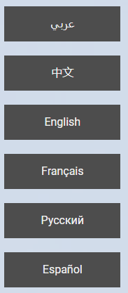
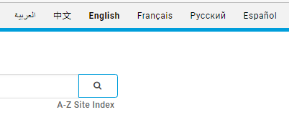

Language Selector
Welcome
Header
Mobile
9
Notes:
When addressing effective designs choices, I talked about language selectors. This is an effective example from the United Nations website.
A language selector appears on the welcome page for both the desktop and mobile versions of the website.
On the desktop version of the website, the header of all pages includes the language selector.
In the mobile version of the website, the language selector is included in the mobile menu.
An LEP user can easily find an select their non-English language and when they select a language they are taken to a page with content in that language.

Slide 11
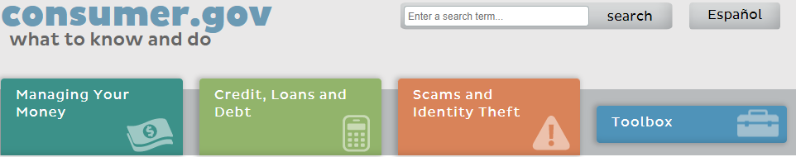
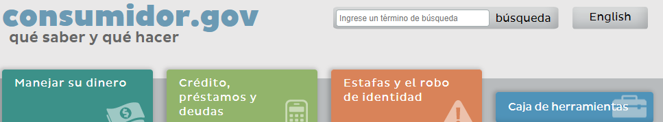
Mirror Site
English
Spanish
10
Notes:
A mirror site means all the content on an English website is translated into a non-English language on a replica website.
In this example, a mirror version of the English website www.consumer.gov is translated into Spanish, and has a Spanish website address: consumidor.gov. The language toggle button in the upper right corner of both sites allows you to easily switch between the Spanish and English sites.

Slide 12

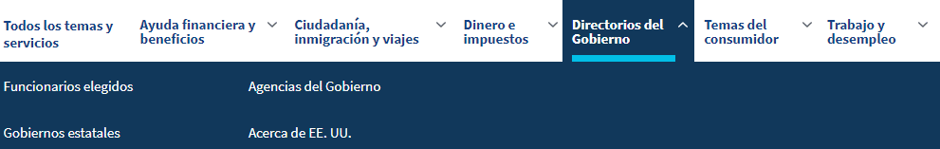

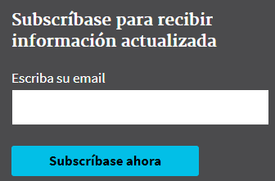
User Features
Menu
Search
Subscriptions
11
Notes:
When the features and components of your website, in addition to the content, is translated into a language other than English, LEP users will have improved access to your programs, services, and information.
The Spanish version of the USA.gov website has many features that provide easy access for users who read Spanish. These include:
The main menu and the submenus, which are on each page, are translated into Spanish.
Spanish words and phrases can be used in the search bar which is at the top of every page.
Instructions for the subscription service at the bottom of the page is translated into Spanish.

Slide 13


Social Media
Twitter
Facebook
12
Notes:
Many entities with websites also have social media accounts that provide information to the public. It is important that these social media accounts also have information in languages other than English.
Here, the Center for Disease Control (CDC) has two Spanish-language social media accounts that provide translated versions of vital information provided on the CDC English social media accounts.

Slide 14
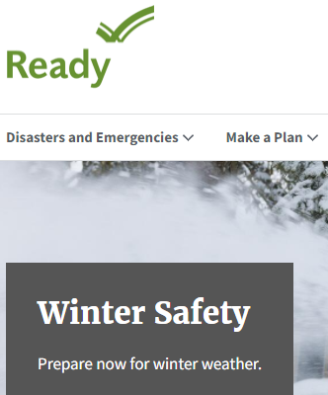
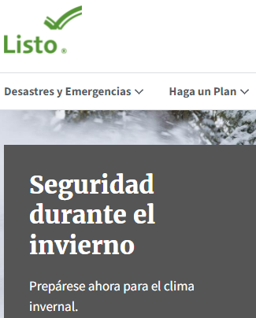
Translated Page Address
ready.gov
listo.gov
13
Notes:
One way to make your website easier to find for LEP users who reads a specific non-English language is to have a website address that matches the language of the content on your translated website.
Here, the Spanish version of the website ready.gov has the address listo.gov, which means ready in Spanish.
Earlier, you saw how the website address for Spanish version of the website consumer.gov was conumidor.gov because the Spanish word for consumer is consumidor.

Slide 15
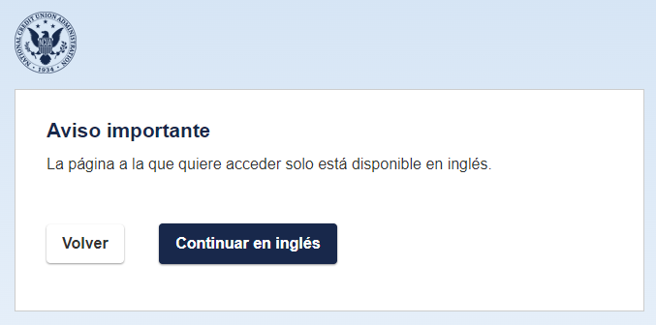
Translated Notices
espanol.ncua.gov
14
Notes:
One of the best practices mentioned earlier was having a translated notice that explains to an LEP user that a link will take them to a page that has content only in English so they can decide whether to proceed or stay on the current page.
The Spanish version of the National Credit Union Administration website includes these notices, and this example is from that website.

Slide 16
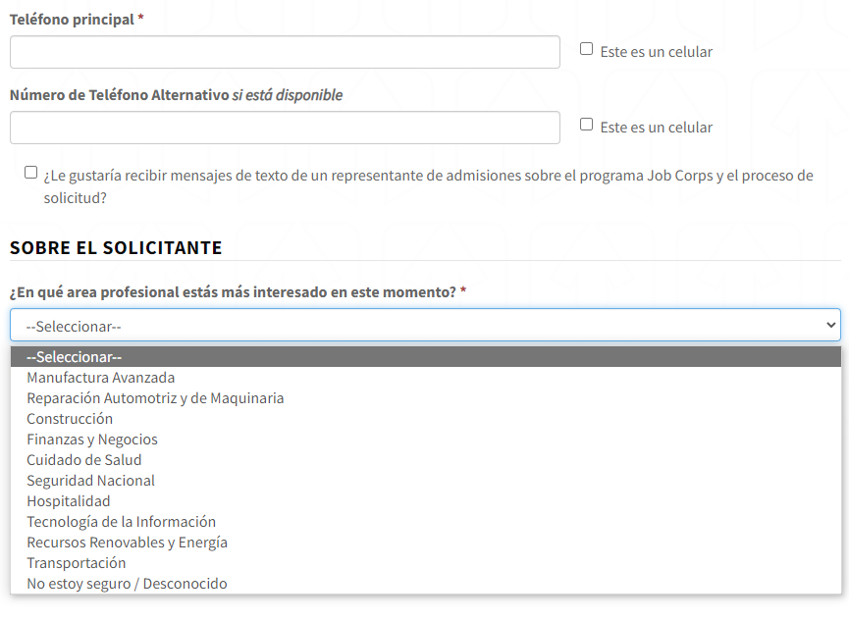
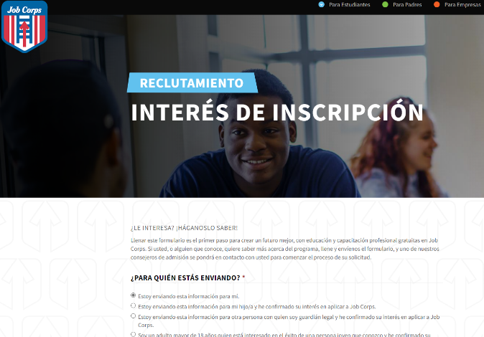
Translated Forms
jobcorp.gov/es
15
Notes:
If you collect information or require users to complete forms or applications on your website or digital services to access your programs or activities, provide these materials in languages other than English to ensure meaningful access for LEP users.
The English version of the Job Corps website has an interest form on its website. On the Spanish version of the Job Corp website, this interest form is translated into Spanish.

Slide 17
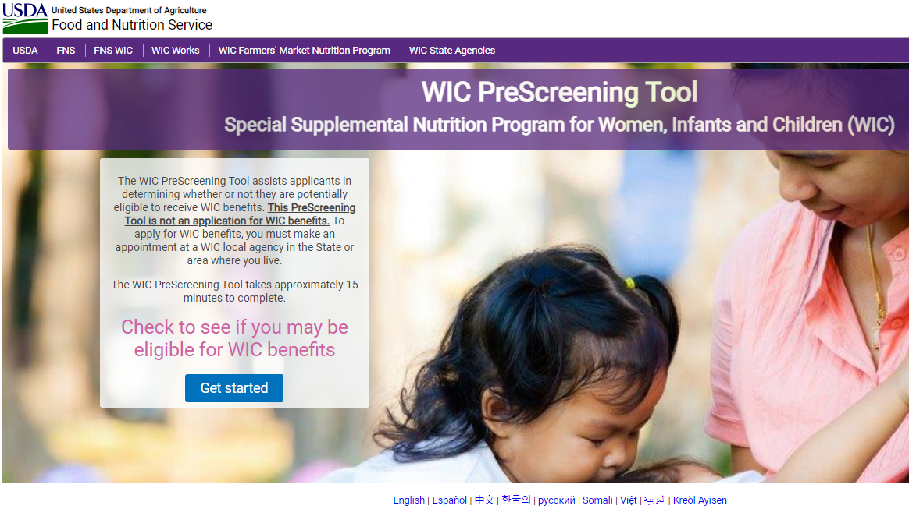
Main Page Links
wic.fns.usda.gov/wps/pages/preScreenTool.xhtml
16
Notes:
The main page of a website or digital service should indicate the availability of that site or any content in other languages.
This U.S. Department of Agricultures website for the WIC pre-screening tool lists several non-English languages. When an LEP user selects a language, they are taken to a translated version of that page and can then complete the pre-screening tool in that non-English language.
https://wic.fns.usda.gov/wps/pages/preScreenTool.xhtml

Slide 18

Resources
17
Notes:
Lastly, a few resources that are included in the guide and that are related to the topics covered today.

Slide 19
Resources
Improving Access to Public Websites and Digital Services for LEP Persons, go.usa.gov/xtXee
Digital.gov Multilingual Community, go.usa.gov/xtXeu
GSA, Automatic Translation Good Solution or Not, go.usa.gov/xtXtb
Usability.gov, go.usa.gov/xtXtB
18
Notes:
LEP.gov, Guide: Improving Access to Public Websites and Digital Services for Limited English Proficient (LEP) Persons, https://www.lep.gov/sites/lep/files/media/document/2021-12/2021_12_07_Website_Language_Access_Guide_508.pdf
Digital.gov, Multilingual Community, https://digital.gov/communities/multilingual/
Lost in Translation: Automatic Translation Good Solution or Not, U.S. General Services Administration, https://digital.gov/2012/10/01/automated-translation-good-solution-or-not/
Usability.gov, Usability Testing, Running a Usability Test, https://www.usability.gov/how-to-and-tools/methods/usability-testing.html

Slide 20
Questions
Michael Mulé, Michael.Mule@usdoj.gov
19

