Slide 1

Communicators Community of Practice
Supporting inclusive language through automation
Date: July 19, 2023
Time: 1:00 pm ET

Slide 2

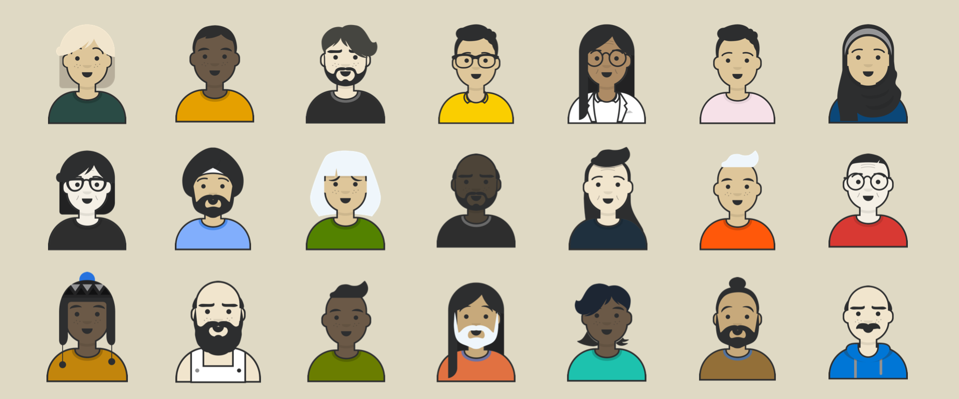
Let’s talk about supporting
inclusive language through automation

Slide 3
Anne
they/them
Experience Design
TTS

Slide 4
Greg
he/him
Engineering
TTS

Slide 5
Cordelia
she/they
Design strategy TTS

Slide 6
Executive Order (EO) 14035
“As the Nation’s largest employer, the Federal Government must be a model for diversity, equity, inclusion, and accessibility, where all employees are treated with dignity and respect. Accordingly, the Federal Government must strengthen its ability to recruit, hire, develop, promote, and retain our Nation’s talent and remove barriers to equal opportunity.”
(emphasis added)

Slide 7
Useful for the
federal government and beyond!

Slide 8
So you can automate inclusion?
Well, not really— but automation can help!

Slide 9
What is Inclusion Bot?
It’s an automatic response on our internal chat system that responds to specific words or phrases. It helps by:
Nurtures a “shared language”
Shortening the feedback loop for team norms, values, and expectations
Helping our team learn about exclusionary language and more inclusive alternatives

Slide 10
Inclusion bot is a learning tool, not a shaming tool!

Slide 11
Creating a shared language
“Shared language refers to people developing understanding amongst themselves based on language (e.g. spoken, text) to help them communicate more effectively.”
“Shared language: Towards more effective communication” Joyce Thomas, Deana McDonagh

Slide 12
Why is it important?
Inclusive organizations have ​​less turnover, higher-performing employees, and more innovative teams

Slide 13
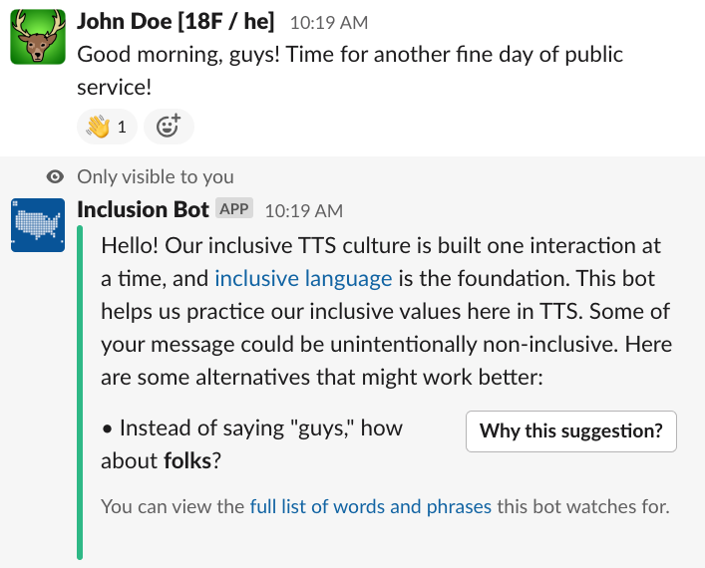
TTS Inclusion Bot 1

Slide 14
TTS Inclusion Bot 2

Slide 15
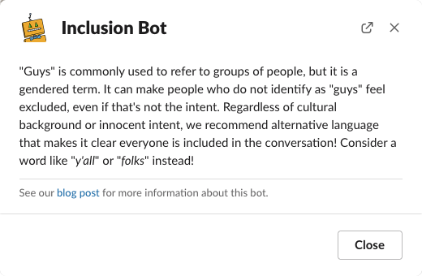
TTS Inclusion Bot 3

Slide 16
TTS values
Inclusion
Integrity
Impact
https://handbook.tts.gsa.gov/about-us/tts-history/

Slide 17

TTS Inclusion Bot, version 1

Slide 18
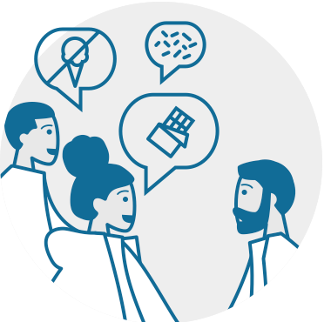



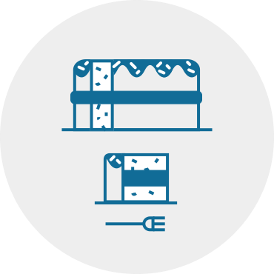

We are an iterative organization
Learn about users
Make prototypes and test them
Build a small version of the real thing
Get feedback from real users
Use feedback to adjust and improve
Rinse and repeat!

Slide 19
TTS Inclusion Bot, version 2

Slide 20
Responses in public

Slide 21
Emoji changes

Slide 22
How do you start?
Start simple
Consider your culture
Create a list of terms

Slide 23
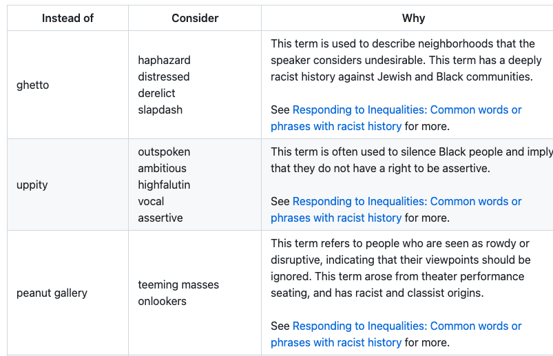
How do you start? 2
Blog: https://18f.gsa.gov/2022/11/14/improving-inclusion-continuously-
how-we-iterated-on-our-bot-to-promote-more-inclusive-and-thoughtful-language/
Word list: https://github.com/18F/charlie/blob/main/InclusionBot.md

Slide 24
How do you continue?
Listen!
Talk about it
Discuss questions in the open so people understand why changes are happening

Slide 25
How do you start technically?
This is easier than the cultural part!
But it will depend on your tool: they’re all different
Take your list of phrases, and have the tool respond with the alternatives
Exact details will depend on your choices

Slide 26
What can’t you automate?
These auto-responses are a blunt tool
They do not replace real conversations
They help us learn
But people have to be willing to change

Slide 27
Be inclusive. Be respectful.
Listen for changes in terms and pay attention to
your culture.

Slide 28
Let’s talk! How can automation help us consider inclusion?

Slide 29


Get involved
digital.gov/communities
Seven communities, one great experience
1. Communicators
2. Multilingual
3. Plain Language
4. Social Media
5. User Experience
6. Web Analytics
7. Web Managers
29

