Slide 1
FedRAMP & DAP Case Study Part 2: Reporting and Decision-Making
See how the FedRAMP team assessed their analytics objectives and key performance indicators (KPIs) prior to the launch of their redesigned site, fedramp.gov.

Slide 2
Overview
Second webinar in a 2 part series
If you didn’t attend part 1 which was focused on strategy, be on the lookout for an upcoming blog summary on digital.gov.
Please note - you’ll see both DAP (paid version) and independently managed analytics tool.
What is FedRAMP?

Slide 3
A big thank you to the FedRAMP team
Partnering with just some of our colleagues on the FedRAMP team in our 2 part webinar series.
Thank you
Betsy Steele
Matt Silber
Janelle Thalls
Bailey Feldman

Slide 4
Quick Recap of
Part 1
We presented Analytics Case Study Part 1: Assessment
What is analytics strategy?
Brief Overview of our methodology
Website Mission, Goals & Key Performance Indicators (KPIs)
Defined 3 specific goals

Slide 5
What we’ll cover today in Part 2
Difference between DAP & independently managed Analytics tool
We'll walk through step by step:
How to use DAP Google Analytics & FedRAMP’s analytics tool to pull reporting
3 goals we established from part 1 of this webinar
How we configured our Tag Management System (TMS)
How we created goals
The goal today is to illustrate a real world example to empower you in analyzing your site
Notes:
Theme - GA is something fedramp chose, but you could use something different.

Slide 6
DAP vs. Independently Managed Analytics Tools
DAP Google Analytics
DAP has features preconfigured - set it and forget it
DAP provides configuration assistance (filters, custom dimensions, etc.)
Supported & managed by the GSA
Tracks engagement w/ YouTube videos, outbound link clicks, file downloads, special custom dimensions
No extra work for you! - simply configure the script per our Github repo
Does not support Goals (limited to 25 goals per view) - with hundreds/thousands of websites, we cannot equitably distribute goals to all sites
Independently Managed Analytics Tool
You need to configure all aspects
Managed by your team
Does not automatically track engagement w/YouTube videos, outbound link clicks, file downloads, special custom dimensions like “Agency” & “Subagency”
You will likely need to configure a TMS
Does support Goals
Use both an independently managed tool & DAP Google Analytics - in fact, we recommend it!
Benefit of using both - compare data sets to make sure your data is more congruent

Slide 7
Webinar Part 1 Recap
Analytics framework & strategy:
Measurement: How you assess performance
Collection: How the tool is implemented
Reporting: How to pull relevant data from reports
Analysis: How you understand the data
Optimizing: How you use insights to improve your site’s user experience

Slide 8
Collection
How your analytics tool is implemented to collect data about site performance.
How you track your data
Analytics Tool
DAP Google Analytics
Tag Management System
You need to consider when implementing:
Analytics tools knows nothing about your site so it needs to be customized to your site
Marketing strategy, content strategy, website taxonomy, content types, audience and how you define success all impact how you implement
You need to know the questions you're trying to answer to know what to track
Configuring Goals in your Analytics tools

Slide 9
Reporting Objectives
How your team identifies and pulls relevant data sets from DAP Google Analytics.
Using your Website mission, goals & KPIs
How to pull reporting in your Analytics tools and DAP Google Analytics

Slide 10
Reminder - Define your website mission, goals & KPIs
Mission: Why does my site exist? Define a simple, straightforward way of describing what your site is designed to do.
Goals: What do you want your users to do on your site? This needs to be something that we can track with Google Analytics.
KPI: Metrics used to measure performance of your goals - usually a ratio, such as conversion rate. This is required.
Notes:
Pageview paradigm - never will be able to move the needle just reporting on pageviews

Slide 11
Goals summarized from Part 1
Goal 1: Decrease the percentage share of stakeholders reaching out to info@fedramp.gov directly from the website, by making information more easy to find.
Goal 2: Increase percentage share of downloads by stakeholders to support them successfully navigating the FedRAMP process.
Goal 3: Increase average session duration on fedramp.gov by X% month over month through leveraging new content, marketing and events.
We’ll look at a very limited, initial data set for these
We’re looking at both DAP & fedramp.gov’s Independently Managed Analytics Tools
Notes:
In the last webinar we had matt and betsy on to discuss why they chose these goals, and today we’re going to look at the data in reporting for these goals

Slide 12
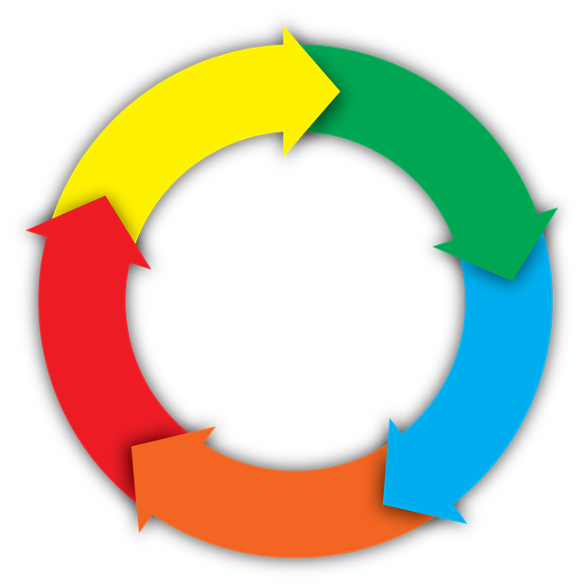
How we approached assessing FedRAMP’s Analytics Tools
Develop
Inject TMS Container
Test & QA
TMS
Assess
Goals, GA & TMS
Engage
Customer
Launch
TMS Enhancements

Slide 13
Goal 1
Goal: Decrease the percentage share of stakeholders reaching out to info@fedramp.gov directly from the website, by making information more easy to find.
KPI: # of clicks on info@fedramp.gov divided by total sessions entering fedramp.gov

Slide 14
Let’s speak with the FedRAMP team
Why is this goal meaningful to your team?
How does this goal fit into your larger strategic vision for fedramp.gov?
How do you use this goal in real world terms to make decisions?
Notes:
Why is this important?
How do you use this in your day to day?

Slide 15
How did we approach figuring out this goal?
In DAP, we know we have event reporting for mailto link clicks
We also implemented mailto tracking in the Independently Managed Analytics Tools via a tag manager

Slide 16
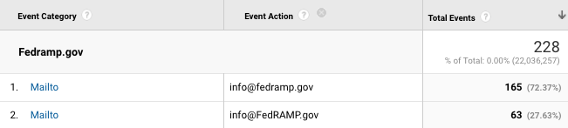
How did we approach figuring out this goal?
Let’s illustrate this in DAP:
Date | Sessions (entering fedramp.gov) | Events (email clicks) | Conversion Rate
July 2021 | 49,191 | 228 | 0.5%
Notes:
Make this point - as we can seee in this screenshot, the way that events coming into the reporting interface are case sensitive - be aware of this so you’re not accidentally excluding data
Go into DAP and show this?

Slide 17
How did we approach figuring out this goal?
In FedRAMP’s independently managed analytics tool:
We set up Events for mailto link clicks using a TMS
FedRAMP wanted Goals configured in their independently managed analytics tool to track performance
Required next step - set up events for mailto link clicks in our TMS

Slide 18
Let's demo how we addressed this in our TMS

Slide 19
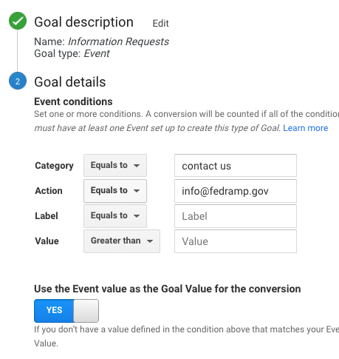

Setting up the

Slide 20
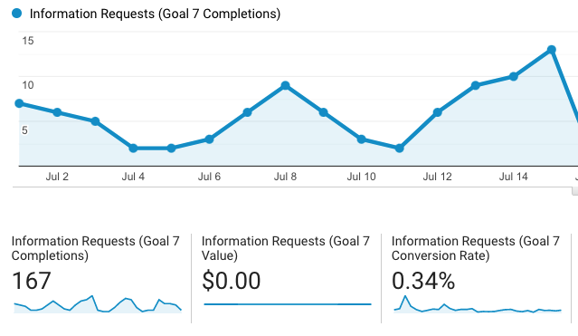
Viewing the
in reporting
Notes:
Conversion rate is not accounting for different cases (as seen in DAP) - this is a good example of why you want to know that and track every case sensitive version of the email addresses. They should find email addresses all standard case.

Slide 21
Let’s chat with the FedRAMP team
Now that we’ve demonstrated the data...
How does FedRAMP plan to take action?
Notes:
Based on what we've seen in the data, what are some things fedramp team is planning on taking action on to increase or decrease goal conversion?

Slide 22
Goal 2
Goal: Increase percentage share of downloads by stakeholders to support them successfully navigating the FedRAMP process.
KPI: # of PDF downloads divided by total number of sessions.

Slide 23
Let’s speak with the FedRAMP team
Why is this goal meaningful to your team?
How does this goal fit into your larger strategic vision for fedramp.gov?
How do you use this goal in real world terms to make decisions?
Notes:
Why is this important?
How do you use this in your day to day?

Slide 24
How did we approach figuring out this goal?
In DAP and FedRAMP’s analytics tool, we know we have downloads tracked.
Look under Behavior → Events → Top Events

Slide 25
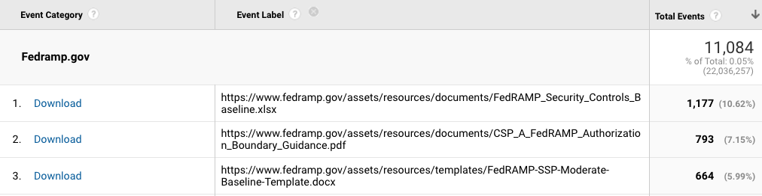
How did we approach figuring out this goal?
Let’s illustrate this in DAP:
Date | Sessions (entering fedramp.gov) | Events | Conversion Rate
July 2021 | 49,191 | 11,084 | 22.53%
Notes:
Maybe I’ll do a live demo in DAP?

Slide 26
How did we approach figuring out this goal?
In FedRAMP’s analytics tool:
We set up Events for file downloads using our TMS
FedRAMP wanted Goals configured in their analytics tool to track performance
Required next step - set up events file downloads in TMS

Slide 27
Let's demo how we addressed this in our TMS

Slide 28
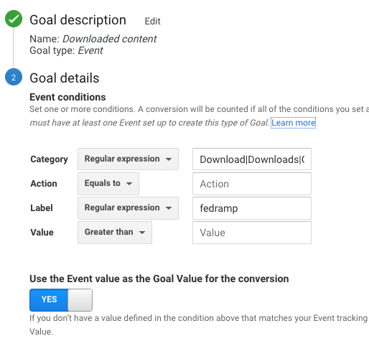
Setting up the

Slide 29
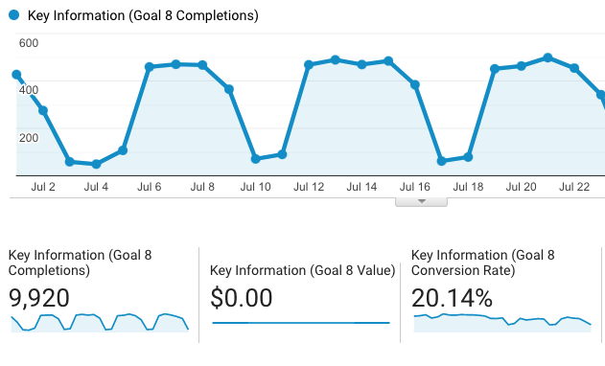
Viewing the
in reporting

Slide 30
Let’s chat with the FedRAMP team
Now that we’ve demonstrated the data...
How does FedRAMP plan to take action?
Notes:
Based on what we've seen in the data, what are some things fedramp team is planning on taking action on to increase or decrease goal conversion?

Slide 31
Goal 3
Goal: Increase average session duration on fedramp.gov by X% month over month through leveraging new content, marketing and events.
KPI: % increase or decrease of avg. session duration
How does DAP Google Analytics calculate this? Add together the duration of each session and divide by the total number of sessions

Slide 32
Let’s speak with the FedRAMP team
Why is this goal meaningful to your team?
How does this goal fit into your larger strategic vision for fedramp.gov?
How do you use this goal in real world terms to make decisions?
Notes:
Why is this important?
How do you use this in your day to day?

Slide 33
How did we approach figuring out this goal?
In DAP and FedRAMP’s analytics tool, we know we have average session duration in the landing pages report
Filter for your specific domain in this report
You can pull the average of the average session duration over one year - this was 1 minute 28 seconds.

Slide 34
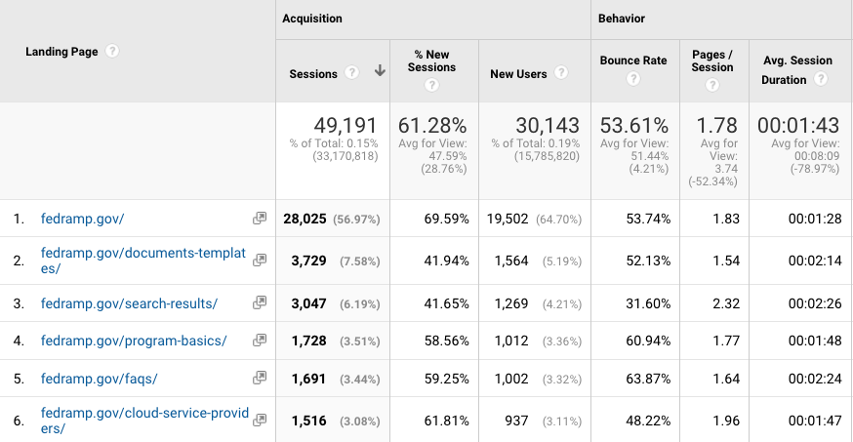
How did we approach figuring out this goal?
Let’s illustrate this in DAP:

Slide 35
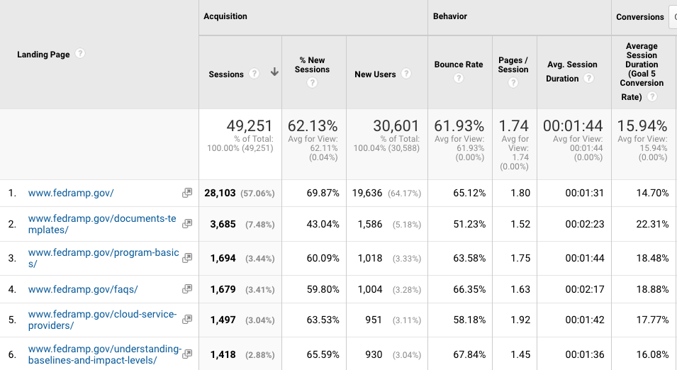
How did we approach figuring out this goal?
In FedRAMP’s analytics tool:

Slide 36
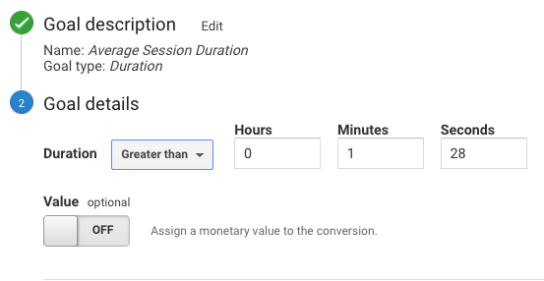
Setting up the

Slide 37
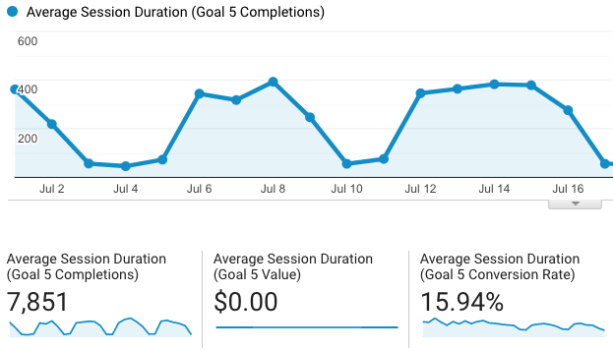
Viewing the
in reporting
Notes:
Describe screenshot - rolling average - more engaged than the historical average
If fedramp finds they’re doing a successful job, they can change this baseline
All ties back to the mission of the site - depends on the desires of your audience - there is no golden metric
don’t want to folks to spend too little or too long on the site, need to have goals running for a while to find that sweetspot 1min 28 isn’t long
fedramp can change this baseline in the future.

Slide 38
Let’s chat with the FedRAMP team
Now that we’ve demonstrated the data...
How does FedRAMP plan to take action?
Notes:
Based on what we've seen in the data, what are some things fedramp team is planning on taking action on to increase or decrease goal conversion?

Slide 39
You’ll notice sometimes that the conversion rates in your independently managed analytics tool are different vs. DAP
All depends on how you configure goals in your independently managed account
You’ll likely see differences with DAP data and your account - this is normal in any analytics reporting platform
Analytics isn’t accounting - data is directional
Approach configuring your goals: monitor, QA, verify and modify goals (if needed) over a number of weeks to ensure accuracy
Takeaway - use DAP as a baseline to help you test your independently managed analytics tool goals

Slide 40
So that was a lot! Questions?

Slide 41
Thank you!
Please fill out the survey - we appreciate feedback.
Please contact us at dap@support.digitalgov.gov

