Slide 1

USWDS Monthly Call
March 2023

Slide 2

Hi!
Thanks for being here!

Slide 3
Agenda
Product updates
Making sense
Q&A

Slide 4
USWDS 3.4.1
Lots of small improvements

Slide 5
Key improvements in USWDS 3.4.1 (1 of 2)
Output only woff2 in our @font-face rules
Improve contrast of incomplete step indicator steps
Allow full-page width headers
Remove grid dependency from usa-banner package
Properly vocalize secondary navigation items
Improve wrapping of external links and icons

Slide 6
Key improvements in USWDS 3.4.1 (2 of 2)
Allow date pickers inside modals
Improve URL display for in-page navigation links
Allow any spacing unit in alert padding settings
Fix broken outline-05 utility
Expanded and improved our Gender Identity and Sex patterns and guidance.

Slide 7
USWDS 3.4.1
Out now

Slide 8
Making Sense
Attention, grouping, and decisions

Slide 9
There are lots of different angles on design

Slide 10
Intentional decision making

Slide 11
We’re designing for people

Slide 12
Engineers of human attention

Slide 13
Attention is a resource with its own properties

Slide 14
Attention is the focus of awareness

Slide 15
Our intention directs our attention

Slide 16
Forgetting and ignoring

Slide 17
Working memory

Slide 18
Just-in-time system

Slide 19
“The world is its own memory”

Slide 20
From gist to specific

Slide 21
An unusual task

Slide 22
The random warehouse

Slide 23
The mystery house

Slide 24
Create gists and spot differences

Slide 25
Gestalt

Slide 26
Our brains store models

Slide 27
Gestalt Principles of Grouping

Slide 28

Prägnanz
We’re inclined to find an elegant explanation to describe a collection of data

Slide 29
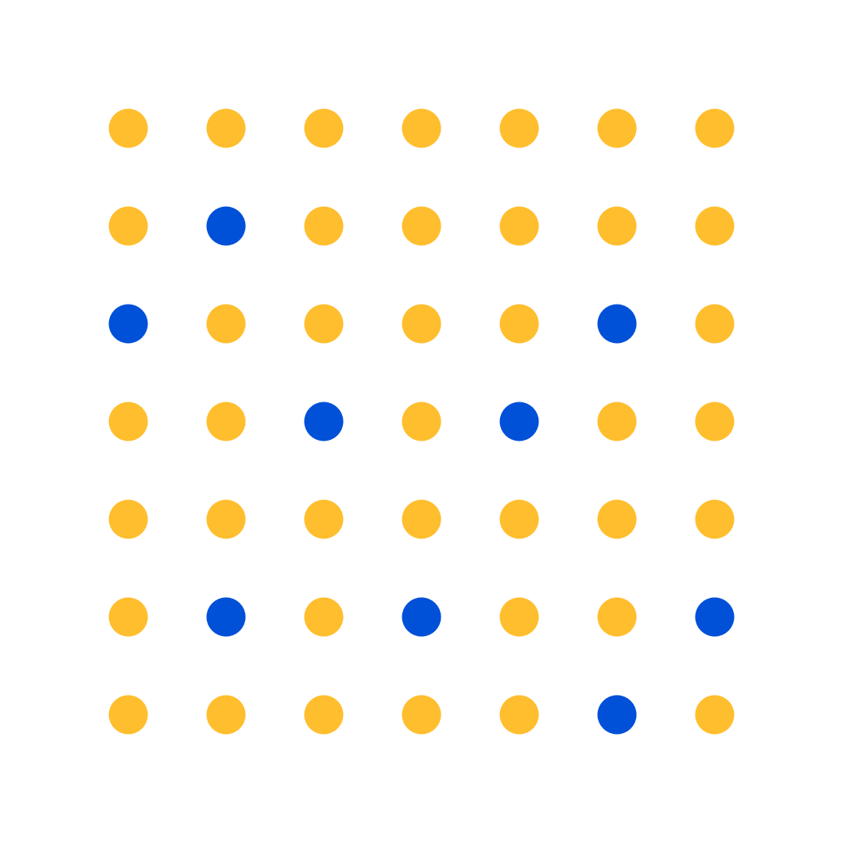
Similarity
We’re inclined to group together objects that have similar characteristics

Slide 30

Proximity
We’re inclined to group together objects that are closer together physically

Slide 31

Common Region
We’re inclined to group together objects that are found in the same closed region

Slide 32

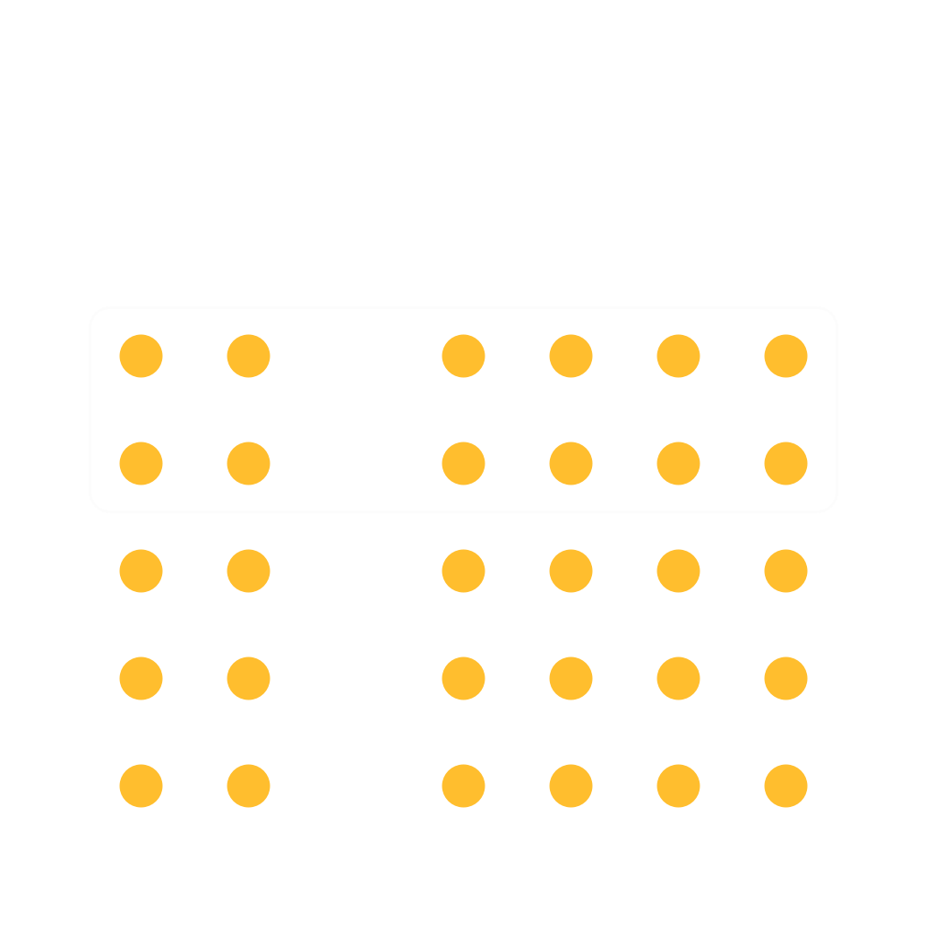
Common Fate
We’re inclined to group together objects that are moving together

Slide 33

Continuity
We’re inclined to group together objects that follow a common path, and that we favor smooth or curved paths

Slide 34

Closure
We’re inclined to fill in blanks to perceive a complete object whenever an external stimulus partially matches that object

Slide 35
The pop-out effect

Slide 36

Luminance
Needs a difference color grade of about 50 to really pop

Slide 37

Size

Slide 38

Shape

Slide 39
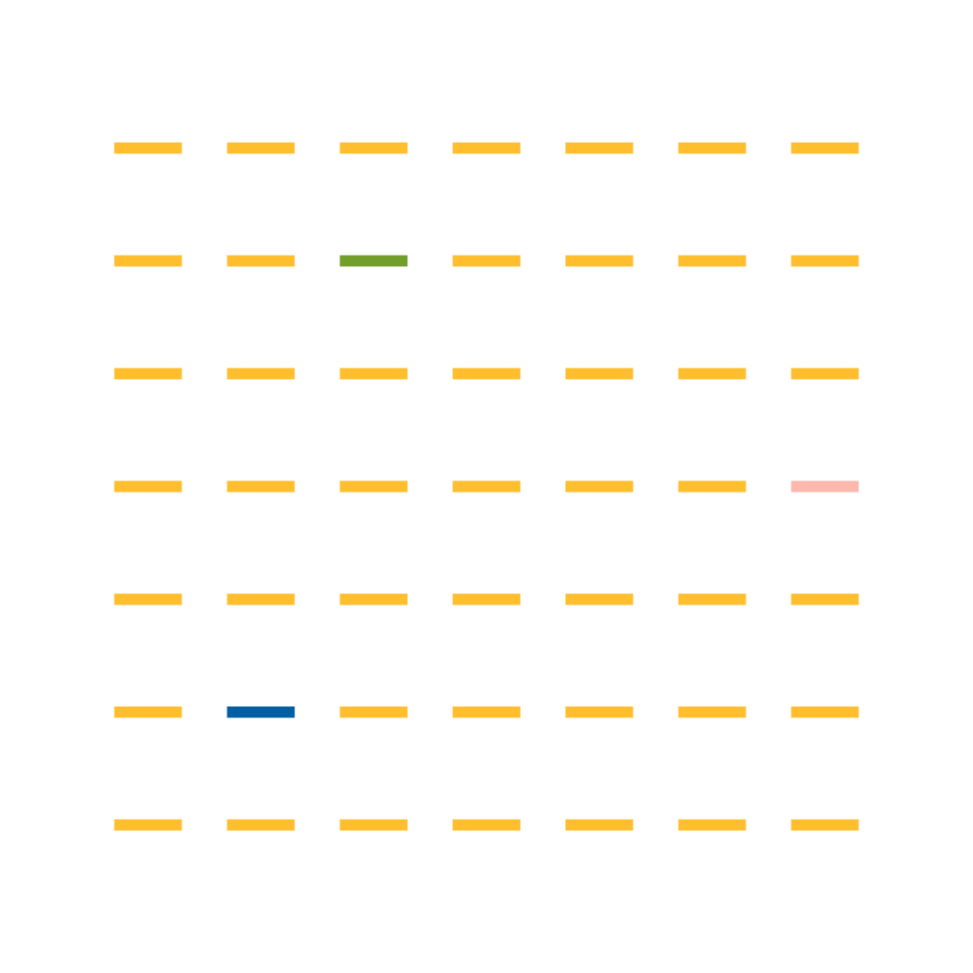
Hue

Slide 40

Alignment

Slide 41
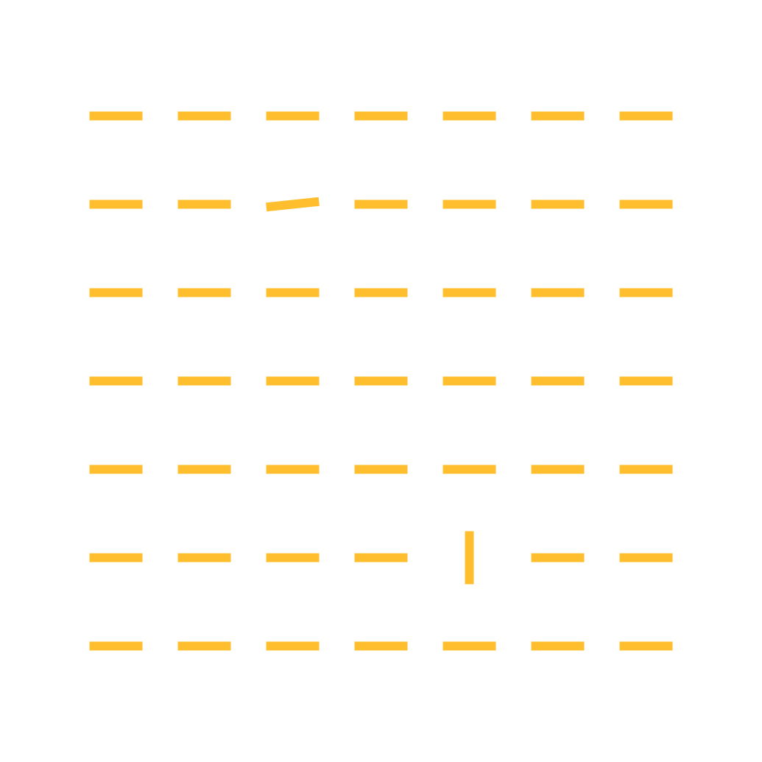
Orientation

Slide 42
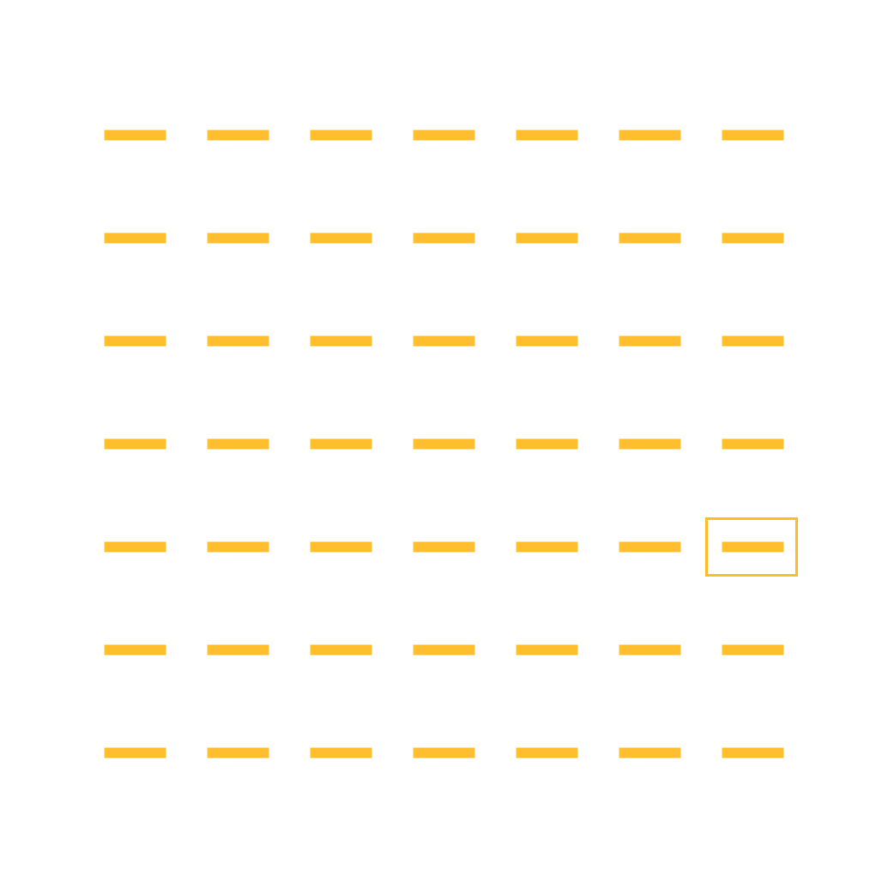
Outline

Slide 43
Reinforce grouping and finding key details with meaning

Slide 44
What Do I Do Now?

Slide 45
Cognitive load

Slide 46
Distractions, stresses, and fatigue

Slide 47
A navigable decision tree

Slide 48
Groupings should be meaningful

Slide 49
Not just for visual design

Slide 50
Grouping with markup and ARIA

Slide 51
Layering and redundancy

Slide 52
Grouping in content design

Slide 53
Support human-centered design

Slide 54
For more information, search for the following:
Gestalt principles of grouping
Max Wertheimer
cognitive psychology
attention
cognitive load
working memory
unconscious pop-out
selective attention test video

Slide 55
Q&A

Slide 56
Next month
April: Top tasks synthesis
#uswds-public
github.com/uswds
designsystem.digital.gov

