Slide 1

USWDS Monthly Call
March 2022
1

Slide 2

Hi!
Thanks for being here!
2
Notes:
My name is Dan Williams, and I'm the USWDS product lead and this is my avatar, which maybe looks a bit like my best self — bright-eyed and positive perhaps! Thanks for being here!
First, I'd like to mention that we're recording this monthly call, so please refrain from turning on your camera. We will manually turn off any cameras to ensure the recording doesn't show us on camera.
I’d also like to remind you that all attendees must abide by the TTS Code of Conduct, which is available at handbook.tts.gsa.gov/code-of-conduct. We’ve posted the link to the code of conduct in the chat.
We'll be posting other links and references into the chat as we go along, and I encourage you to ask questions in the chat at any time. If any member of our team can answer your question in the chat, we'll do so, otherwise there'll be some time for questions and answers at the end of the hour. Also, be sure to introduce yourself in the chat as well — it's nice to know who's here. It's good to have you here today.
For those of you who find the chat distracting, you’re welcome to close or hide the chat window during the main presentation. You can reopen it later during the Q&A session at the end of this call.
So thanks! And, with that, let's get started!

Slide 3
Agenda
Site launches Product updates USWDS 3.0 Preview Q&A
3

Slide 4
Site launches

Slide 5
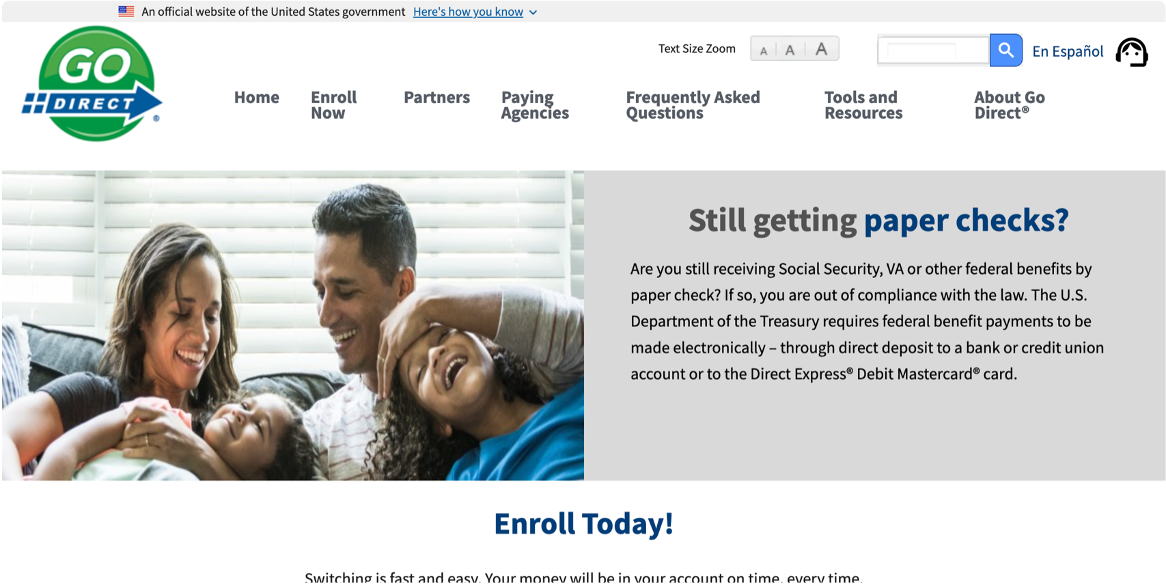
Department of the Treasury electronic payments
godirect.gov

Slide 6
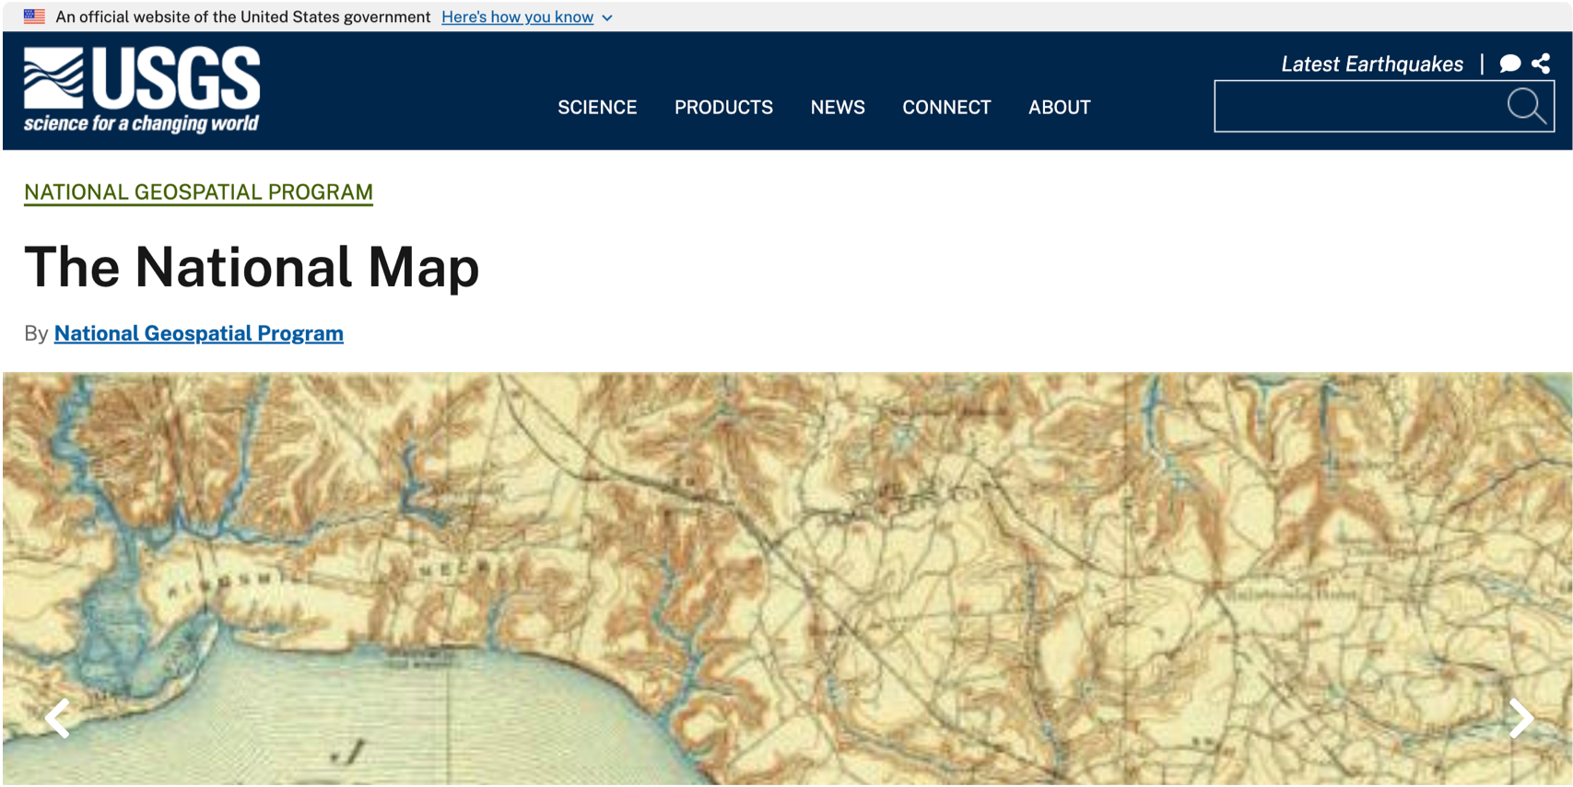
National Geospatial Program’s The National Map
nationalmap.gov

Slide 7
Great work!

Slide 8
Product updates

Slide 9
USWDS 2.13.3 High Contrast Mode

Slide 10
High contrast mode and forced colors

Slide 11
Improved Footer accessibility

Slide 12
USWDS 2.13.3 Available next week.

Slide 13
USWDS 3.0.0 Beta 4 @uswds/uswds

Slide 14
Modular architecture and package structure

Slide 15
USWDS 3.0.0 Beta 4 Out now

Slide 16
USWDS Compile Beta 2 USWDS 3.0 compatibility

Slide 17
The best way to migrate to USWDS 3.0

Slide 18
USWDS Compile Beta 2 Out now

Slide 19
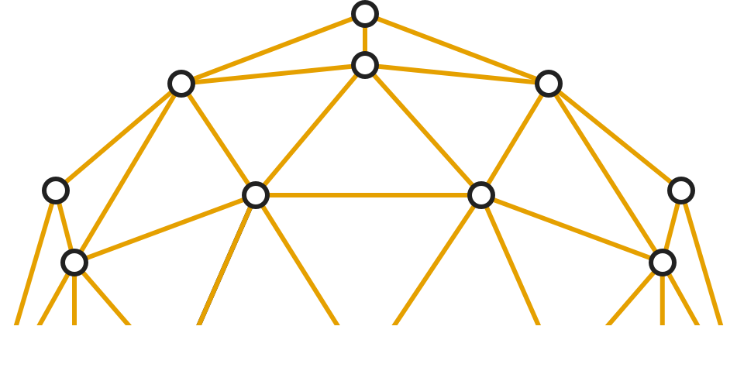
USWDS 3.0 Preview

Slide 20
James Mejia
USWDS Core Team
Contractor

Slide 21
Demo

Slide 22
USWDS 3.0 will be here next month.

Slide 23
USWDS Packages have grown up.

Slide 24
USWDS unbundled.

Slide 25
Define, customize, update.

Slide 26
Above all, simple migration.

Slide 27
Thinking of migrating? Check out USWDS Compile.

Slide 28
Next month: More real-world examples

Slide 29

Q&A

Slide 30



Next month
March: USWDS 3.0 in the real world
#uswds-public
github.com/uswds
designsystem.digital.gov

