Slide 1

Results of the 2021 Federal Report Card
David Lipscomb, Vice Chair
Center for Plain Language

Slide 2
Agenda
Basics of the Federal Report Card
Results from this year’s Federal Report Card
Questions

Slide 3
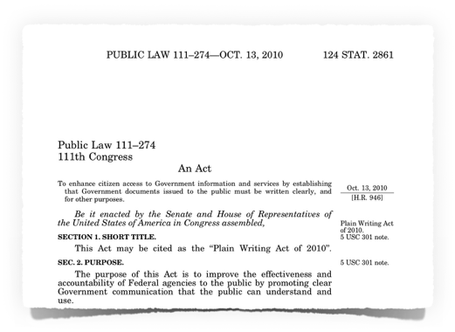
2010 Plain Writing Act
Requires agencies to:
Staff, train, and report on PL
Communicate in Plain Language

Slide 4
Federal Plain Language Report Card grades agencies on …
Staffing, training, and reporting
Plain language writing

Slide 5
2021 Federal Report Card
More than two-thirds earned an A for staffing, training and reporting
Average Grade on Coronavirus pages jumped from C to a B
Average Grade on FOIA request pages was a C+

Slide 6
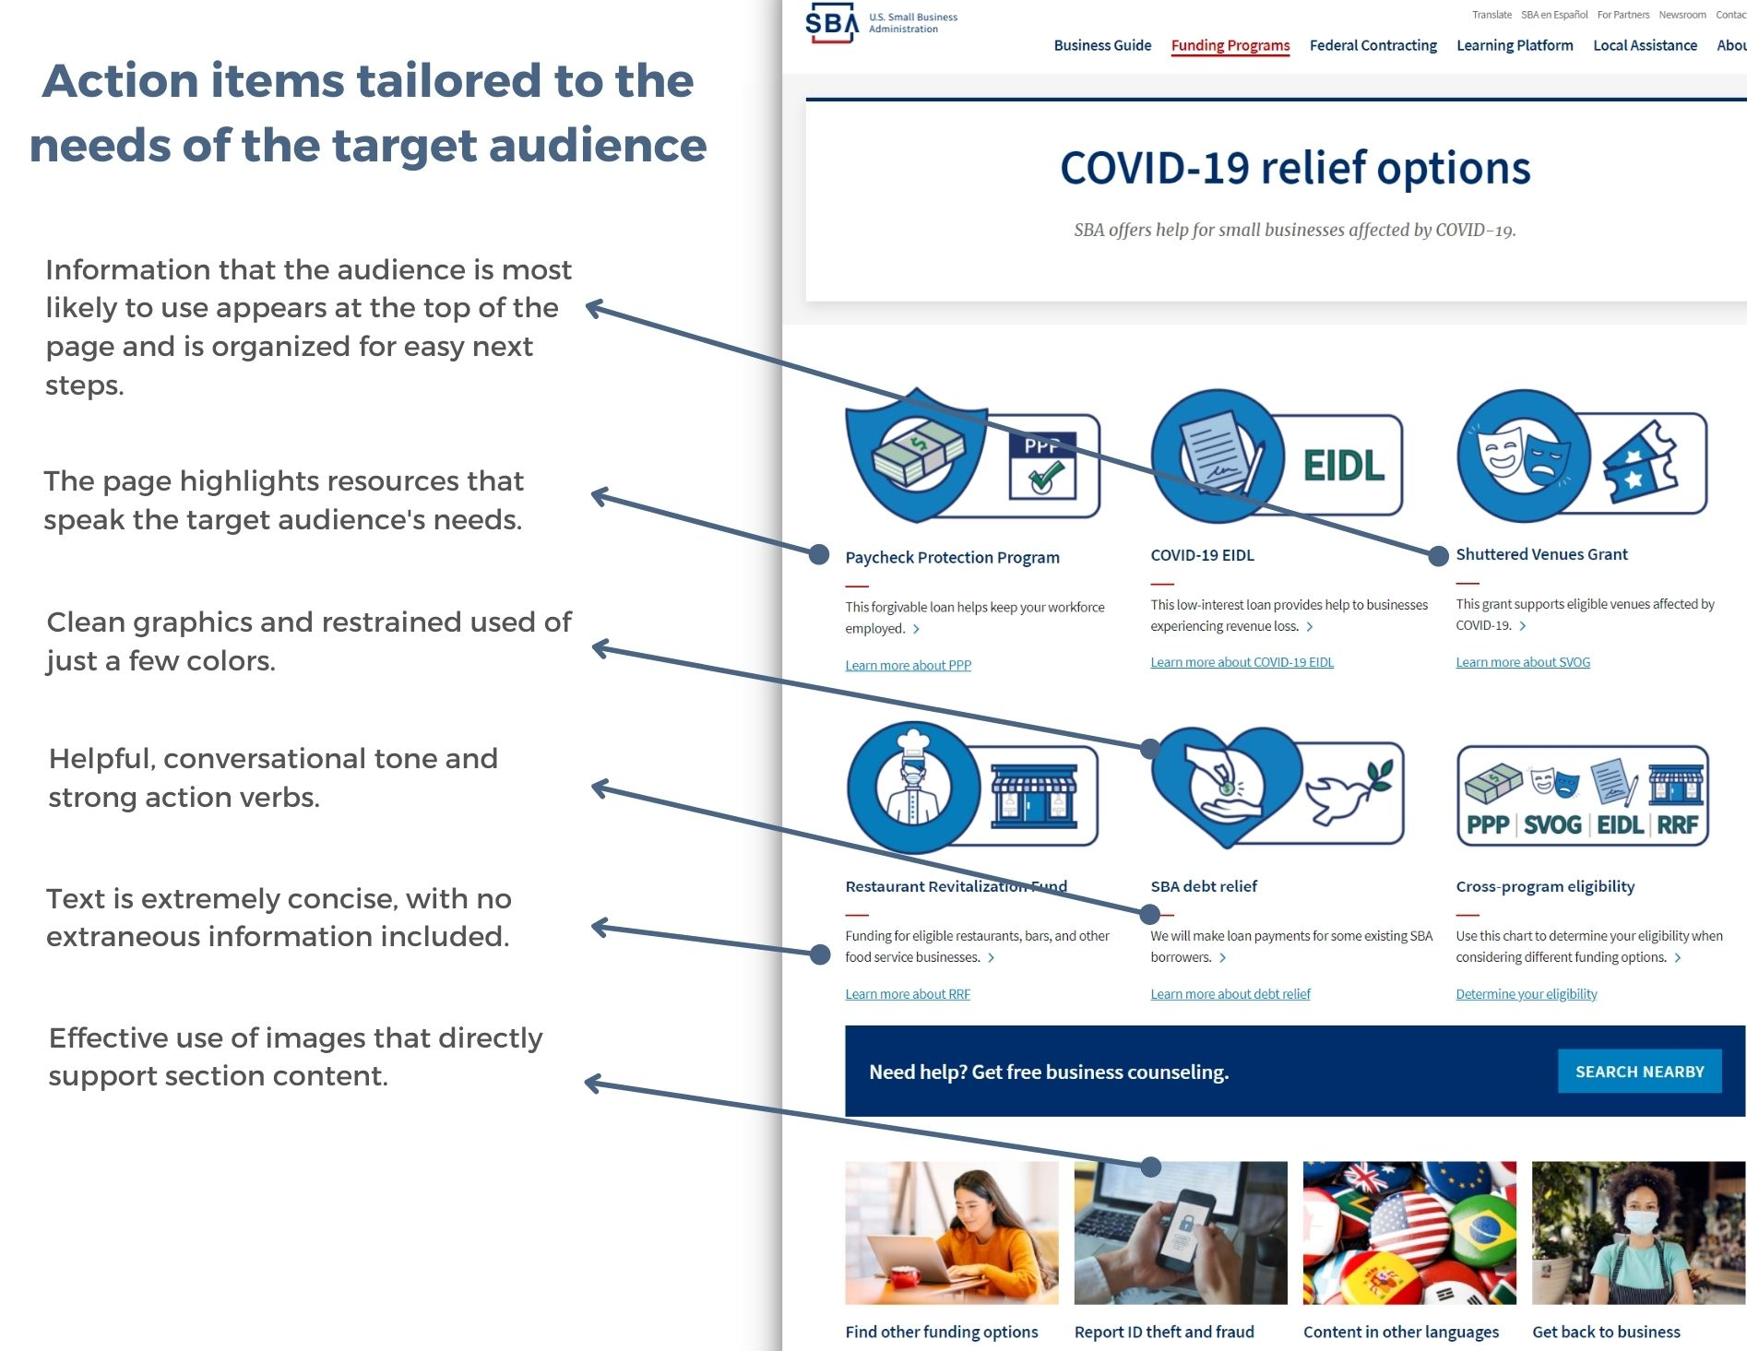
Good COVID page

Slide 7
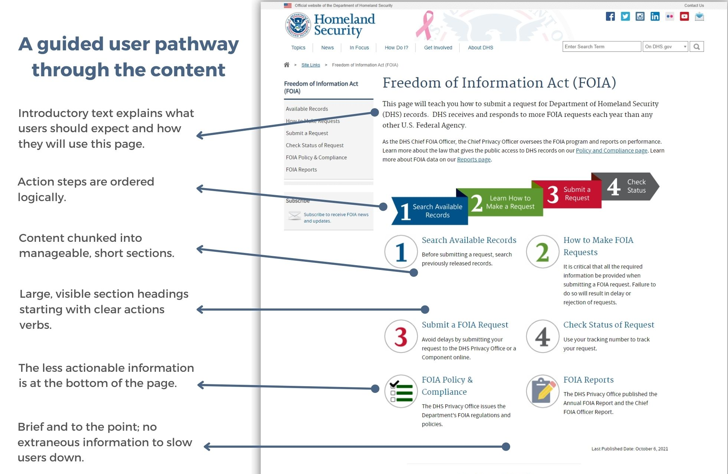
Good FOIA request page

Slide 8
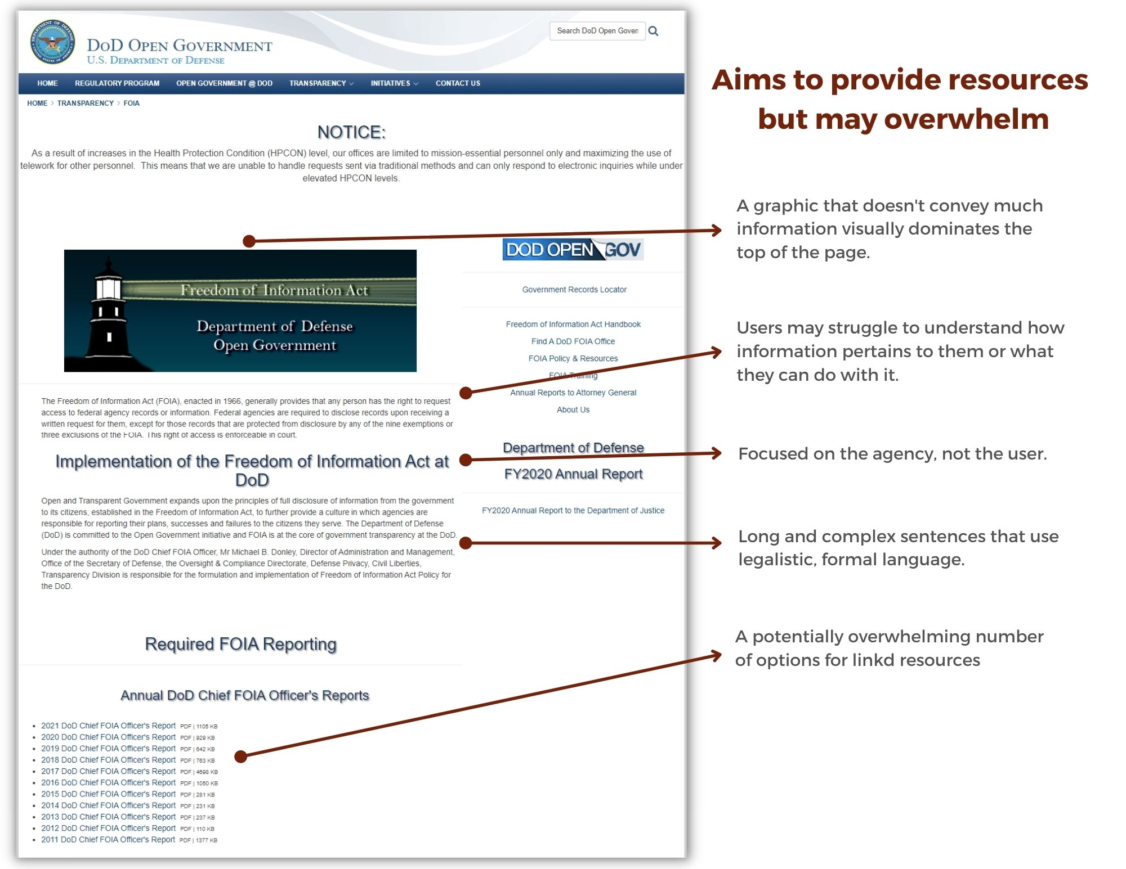
FOIA request page that needs work

Slide 9
Questions?

