Slide 1
Title
Inclusive Civic Design: Engaging diverse communities to improve the early career experience
June 14, 2023

Slide 2


Introductions
Kelly Wisneski
Design Researcher, USAJOBS
Patricia Morris
Design Strategist, Lab at OPM
McKenna Cole
Design Strategist, Lab at OPM
Simone Saldanha
Design Researcher, Lab at OPM

Slide 3


Who We Are
Team Discovery Design Research
As the federal government's official employment site, USAJOBS connects job seekers with federal employment opportunities across the United States and around the world.
The Lab at the U.S. Office of Personnel Management builds capacity throughout government to transform programs, processes, and people through human centered design.

Slide 4
Project Team
USAJOBS
Kelly Wisneski
USAJOBS Project Lead, Design Researcher
Felipe Flores
Design Manager
Elizabeth Ferguson
Design Researcher
Victoria Clark
UI/UX Designer
The Lab
Patricia Morris
Lab Project Lead, Design Strategist
McKenna Cole
Design Strategist
Simone Saldanha
Design Researcher
Paul Roberts
Design Strategist

Slide 5
Key Takeaways
Conducting inclusive design research requires a system of support, outreach, and approvals.
Examples and precedents are key to building your systems for inclusive design research. We'll share our process as one example.
Building an inclusive design research practice is an iterative process. It is important to make time and space to build your practice as you go.

Slide 6
Agenda
Founding a Design Research Team
Centering the Early Career User
Conducting Inclusive Research

Slide 7
1 Founding a Design Research Team

Slide 8
A New Design Research Team Early 2022
1 Founding
Product Teams
Design Team

Slide 9
A New Design Research Team Today
1 Founding
Product Teams
Design Team
Team Discovery

Slide 10
Establishing an Inclusive Practice
1 Founding
How do we find people to talk to?
How do we ensure that we are talking to a diverse range of people that reflect the American public and USAJOBS' users?
How do we do outreach while respecting the boundaries and capacities of our stakeholders?
How do we design with, not for?

Slide 11
2 Centering the Early Career User

Slide 12

Using Human-Centered Design with the Lab
2 Centering
Human-centered design (HCD) is a creative and strategic approach to solving complex problems. HCD methods allow us to rapidly generate and test new ideas while prioritizing people’s needs, behaviors, and ways of thinking.
HCD helps identify the right starting point.

Slide 13
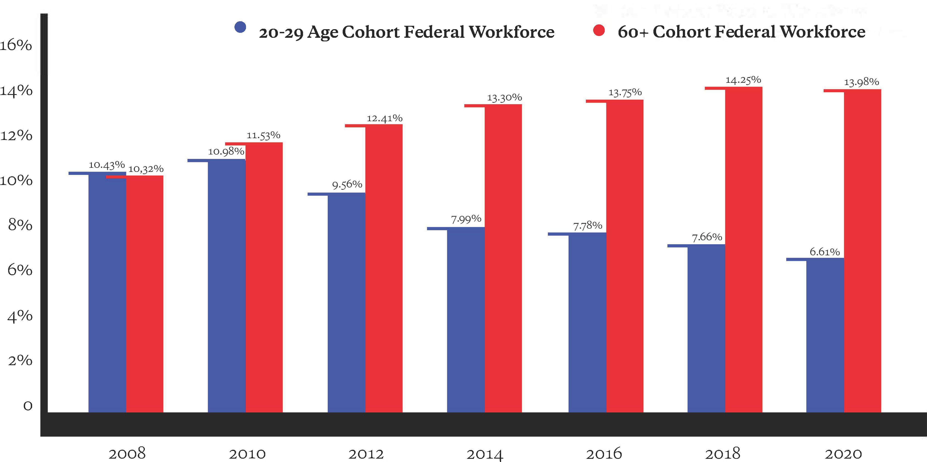
Opportunity: Strengthening Federal Workforce
2 Centering
The gap in Federal employee age range continues to increase
Presidential Management Agenda Strategy 1
"Attract and hire the most qualified employees, who reflect the diversity of our country, in the right roles across the Federal Government."
Early career individuals
(<30 years old) make up only
8% of the federal workforce.
White House, Presidential Management Agenda, Strengthening the Federal Workforce, May 2021
Age of cohort | 2008 | 2010 | 2012 | 2014 | 2016 | 2018 | 2020
20-29 Age Cohort Federal Workforce | 10.43% | 10.98% | 9.56% | 7.99% | 7.78% | 7.66% | 6.61%
60+ Cohort Federal Workforce | 10.32% | 11.53% | 12.41% | 13.30% | 13.75% | 14.25% | 13.98%

Slide 14
Goal and Approach
2 Centering
Goal – Early Career Hub
A centralized place to attract an early career audience and encourage learning about Federal careers, so they can apply for a career in the Federal Government.
Approach – Design Research
Design research to understand their experiences searching and applying for Federal internships, fellowships, and jobs.

Slide 15
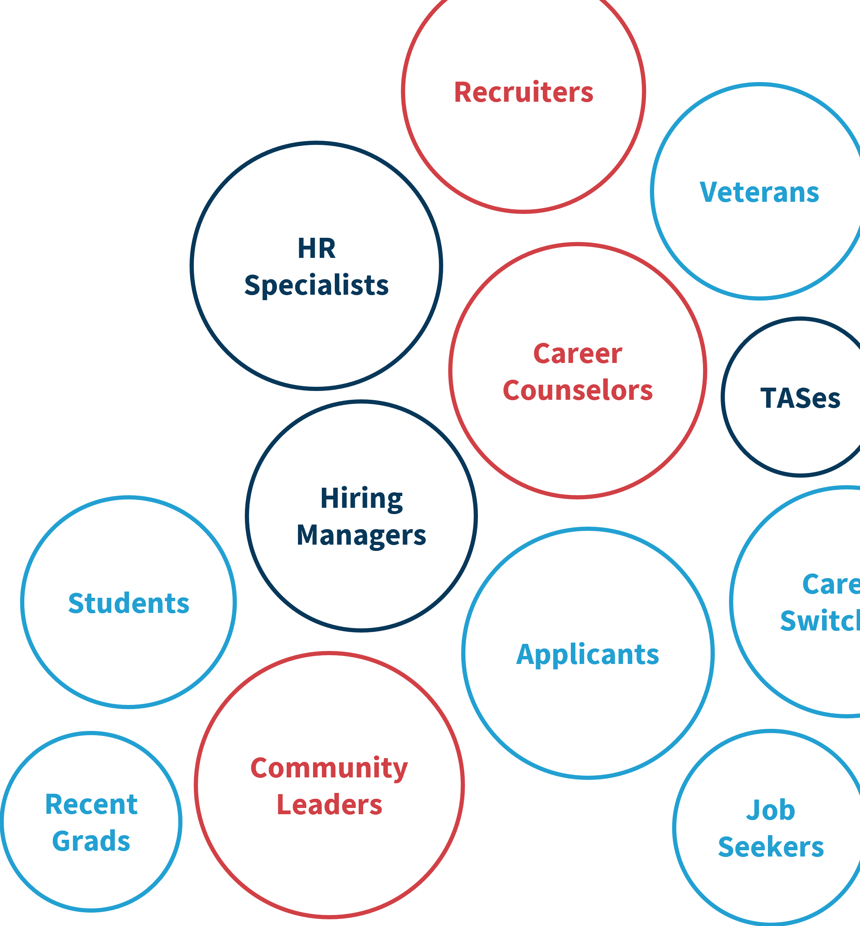
The Right User
2 Centering
Who are the right people to talk to?
Who is doing similar work?
Who are connected to the system?
Who will use this product?
Whose voices can we amplify?

Slide 16
Project Timeline
2 Centering
Building Systems
PRA Approval
Incentive Approval
Prototype Creation
Recruiting Development
Jan – Apr 2023
Phase 1 Interviews &
Synthesis
Nov – Dec 2022
Phase 2 Interviews (Public),
Synthesis &
Project Wrap-up
May – Jun 2023
Problem Framing &
Discovery Research
Sept – Oct 2022

Slide 17
Initial Insights
2 Centering
If you have friends, family, or contacts in the Federal Government, you have a better chance of navigating USAJOBS and filling out the application well.
Early Career individuals are often just discovering what careers exist and their own career interests.
Problem Framing &
Discovery Research
Sept – Oct 2022
Phase 1 Interviews &
Synthesis
Nov – Dec 2022

Slide 18
3 Conducting Inclusive Research

Slide 19


Setting up Interviews with the Public
3 Conducting
Participant criteria
~20 students or recent graduates, all members of the public
Interested in a federal government career
Diverse by race/ethnicity, public/ private academic institutions, location, sexual orientation, disability status
Strategy: Prototype Testing
Give them something to respond to!

Slide 20

What We Needed
3 Conducting
The right practices and networks make it possible to access the right stakeholders. This makes it easier to cast a wider net for research participants.
Logistics
PRA Clearance + ICR Approval
Participation Incentives
New Recruiting Channels
Knowledge
Leadership & Product Support
UI/UX Design Expertise
Research / Testing Expertise

Slide 21
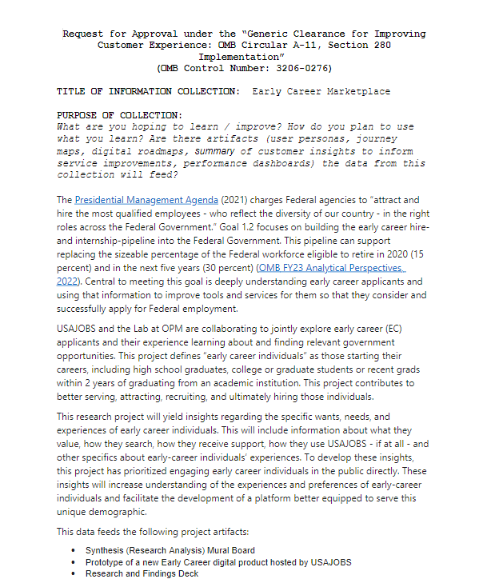

Casting a Wide Net PRA Clearance + ICR Approval
3 Conducting
Understand what does and doesn't require PRA approval
Use Section 280 A-11 "CX" Clearance, if possible
Budget the process into your project timeline

Slide 22
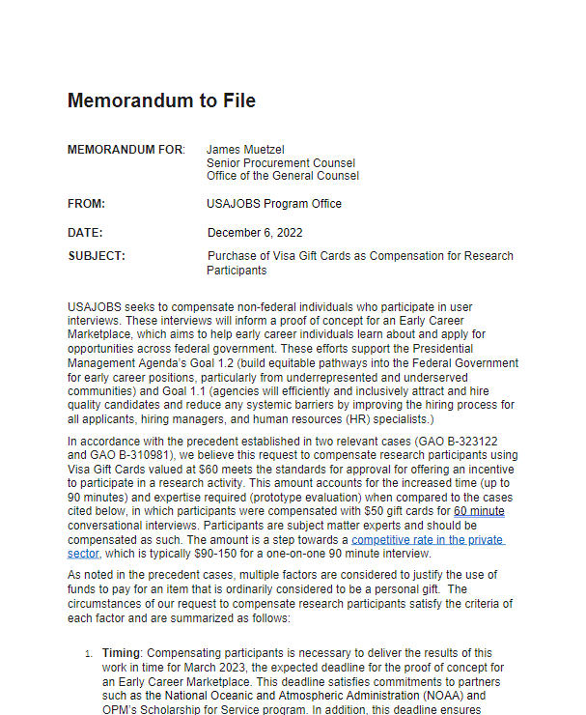
Casting a Wide Net Participation Incentives
3 Conducting
Work from examples
Take advantage of momentum, strategic goals, and priorities
Test your language internally

Slide 23
Casting a Wide Net Recruitment Channels
3 Conducting
Connect to the Connectors
OPM Office of Public Engagement
USAJOBS Engagement Team
Career Counselors
Office of the Director (Intern Portal)
Build connections to last

Slide 24
Treat the Project like a Prototype
Building an inclusive research practice is an iterative process. Don't be afraid to make space in your project to build systems, documentation, and connections.
Identify your champions
Collect examples and document your process
Take advantage of high-momentum priorities
Build connections to last

Slide 25
Thank you!

