Slide 1
Change the Way Work Gets Done
Enabling an End-to-End Digital Transformation
Agenda
Speaker introduction
The Digital End to End Efficiency (DEEE) Framework
How to get started digitizing and automating your own processes
Q&A

Slide 2
Speakers
Jesrael Lopez
Program Manager as well as one of the Diversity, Equity, Inclusion and Accessibility (DEIA) leaders at Treasury's Bureau of the Fiscal Service, supporting financial management transformation initiatives that emphasize the use of new and emerging capabilities.
Bernadette Goodwin
Acting Executive Architect in the Office of Financial Innovation and Transformation within Treasury’s Bureau of the Fiscal Service (Fiscal Service). In this role, she leads innovation efforts to transform Federal financial management.

Slide 3
The federal government is instrumental in delivering services for the public, yet many business processes we rely on today are manual and costly.
The challenge
We are still focused largely on transaction management.
There are many processes that remain heavily manual.
Fixes have been segmented, focusing on improving isolated parts of a task, rather than process.

Slide 4
The Playbook helps agencies identify improvement opportunities through detailed analysis of process documentation, while also understanding the experience, needs, expectations, and pain points of the users involved.
The DEEE Playbook

Slide 5
DEEE
Playbook
Traditional Process Analysis
Collect summary data and existing analysis on major FM challenges, identify and examine process documentation.
Human-Centered Design (HCD)
Apply techniques focused on collaboration, conversation, and engagement from customers.
Fact-Based Transparency from Historical Data.
Quickly find opportunities.
Analysis not dependent on other people's schedules.
Obtain a clear End-to-End picture of documented process.
Assists in managing users’ expectations and levels of satisfaction with the process/service.
Result is more efficient and effective.
Users develop a sense of ownership with solution implementation.
The collaborative process generated more solution options.

Slide 6
Key stakeholders to engage
Process Improvement Project Team
Agency Leadership
A selected group of agency representatives identified to work towards improving a selected business process and sponsored by agency leadership.
CFOs, Directors, Branch Chiefs, and/or other leaders of customer and provider agencies responsible for leading business transformation efforts and empowered to make decisions.
Process Owners
Process SMEs & Users
Individuals (end users & service provider) that oversee or manage the selected process overall and have insight into processes, procedures, policies, tools, and workforce.
Stakeholders that execute or carry out the selected process (“fingers on keyboards”) and those with expert process knowledge (end user & service provider).
OCIO/Technology Teams
Policy/Audit/Risk Teams
Practitioners who understand, maintain, and deploy agency technology systems and experts to help assess emerging technologies.
Individuals or teams responsible for auditing and assessing policy controls of end-to-end processes.
Deploying this Playbook requires engaging a cross-level, cross-organization set of stakeholders to understand perspectives across different organizations and drive feasible, desirable, and viable solutions.

Slide 7







DEEE Playbook summary
DEEE
Select Solution(s)
Where to start?
What to solve?
how to solve?
Deploy selected solution(s) and expand across processes
Reduce/Optimize:
Eliminate cumbersome process steps and streamline
Digitize:
Move from manual to systematic or automated processes
Innovate:
Transform digital capabilities with intelligent automation
Define Scope
Select Process
Analyze Process
Assess Solutions
Prioritize Solutions
Provides a set of opportunities for process improvement
Produces a set of prioritized solutions
Results in a set of deployed and scaled solutions

Slide 8
Where to start?
The most important thing is to start with the full depth and breadth of processes – all the various business scenarios and all facets of processes.
Organize them, if they aren’t already, into a process taxonomy which is basically a way to decompose multiple layers of sub-processes to overall high-level business processes.
Look for opportunities based on key criteria.

Slide 9
Where to start continued
Key criteria to select processes with most potential cost savings:
Transactional (vs. Analytical)
High Volume
More Manual
Many Staff Members
Transactional activities are more routine and generate value from quick and accurate processing, which lends itself to digitization and automation.
Greater volume translates to scale for efficiency gains and results in larger overall opportunity.
Manual tasks are generally more costly, less scalable, susceptible to error, and can be digitized for cost savings.
The more staff involved in manual tasks, the greater the inefficiency and potential gain from digitization.

Slide 10
What to solve?
Identify your pain points: A challenge or process inefficiency from the user’s experience.
While analyzing a process, many pain points may be uncovered. Categorizing helps in the prioritization and identification of the pain points that represent the greatest opportunity for efficiency.

Slide 11
What to solve continued
Redundancies or duplicative activities across teams
Manual process steps
Disconnected steps or inefficient handoffs within a process
Service delivery inefficiencies
(incl. customer issues/complaints)
Opportunity Categories
Historical internal control risks and/or audit findings
High volume of occurrences
Activities to improve the process outcome (vs. process efficiency)
Data quality issues

Slide 12
How to solve?
To help think through the potential solution set for a given pain point, DEEE divides solutions into three solution categories with varying level of cost and technical advancement.

Slide 13
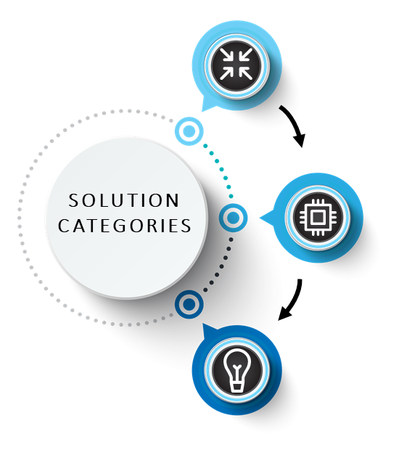
How to solve continued
Reduce/Optimize: Eliminate cumbersome process steps and streamline
What it is: Reduce unnecessary activities considering whether the way business is done today is how it needs to be done (including policy changes to enable process changes or trainings, etc.)
Investment: Low to no cost (non-technology solution)
Digitize: Move from manual to systematic or automated processes
What it is: Apply digital technology to automate/eliminate manual steps, reduce paper-based steps, and streamline the process
Investment: Limited cost (often using existing technology or capabilities)
Innovate: Transform digital capabilities with intelligent automation
What it is: Apply new and emerging technologies to transform business processes and unlock long-term efficiency gains
Investment: Variable cost (may include net new investments)

Slide 14

Questions

Slide 15
Supplementary Tools & Job Aids (1/2)
The DEEE Job Aids and Tools can be leveraged during each step of the playbook to analyze end to end (E2E) processes, identify pain points, and evaluate solutions to reduce/optimize, digitize, or innovate processes.
DEEE Framework Step | What is it?
End to End Business Processes | There are 11 end to end processes definitions that provide a standardized understanding of how government carries out a specific financial management process. Each start with a user's goal and goes through the steps to take until the goal is fulfilled.
Process Selection Criteria | This criteria allows users to identify the end-to-end business process with the greatest opportunity for efficiency gains.
Process Overview Visualization Template | A simplified process visual that can be leveraged to build process understanding and facilitate stakeholder interviews, accelerating findings by focusing in on the key interactions of roles along a process journey.
Interview Guide Template | This job aid guides the user during interviews to understand the interview experience, identify pain points and areas for improvement, and validate methods.
Journey Map Template | This tool assists in creating representative journey maps and personas to document user goals (for outcomes/experience of the process), core traits, needs, and frustrations.

Slide 16
Supplementary Tools & Job Aids (2/2)
The DEEE Job Aids and Tools can be leveraged during each step of the playbook to analyze end to end (E2E) processes, identify pain points, and evaluate solutions to reduce/optimize, digitize, or innovate processes.
DEEE Framework Step | What is it?
Pain Point Catalog Template | This job aid is used to document and organize pain point information to trace and reference when collecting process information.
Pain Point Down Select Tool | This tool helps agencies analyze the full scope of challenges which may require solutioning and/or resolution to optimize the end-to-end process and down select to those best aligned to project goals and agency priorities.
Solution Category Decision Tree | This job aid guides the user in the process of determining potential solution categories for a pain point (reduce/optimize, digitize and/or innovate).
Solution Prioritization Tool | This tool helps prioritize potential pain point / solution combinations using criteria and agency goals/priorities to identify the best use of resources to resolve each pain point.
Transformation Blueprint Template | A Transformation Blueprint can be used to help visualize key process pain points, and associated reduce, optimize, and digitize solutioning opportunities.

