Slide 1


USWDS Monthly Call
January 2023

Slide 2

Hi!
Thanks for being here!

Slide 3
USWDS FAQ
Component testing
Tabs
Design kits
Theming USWDS
Custom fonts and colors
Banner flash
USWDS in other frameworks
Importing USWDS component JavaScript

Slide 4
James Mejia
he/him
Engineer
USWDS Core Team
Contractor

Slide 5
Amy Leadem
she/her
Front End Developer
USWDS Core Team
Contractor

Slide 6
USWDS FAQ Our frequently asked questions

Slide 7
Do we test components with real users before releasing?
Notes:
DW

Slide 8
Yes and no.
And we can also do better.
Notes:
DW

Slide 9
We always do an internal review that includes manual accessibility testing
Notes:
DW

Slide 10
We always review our work with developers and our community
Notes:
DW

Slide 11
We’ve started adding
testing with real users of assistive technology
Notes:
DW

Slide 12
This has proven extremely valuable
Notes:
DW

Slide 13
We always respond to issues in our code repo
Notes:
DW

Slide 14
Testing with real users needs to be an ongoing part of a component’s lifecycle
Notes:
DW

Slide 15
Accessibility-first
usability testing is a big focus of our short-term roadmap
Notes:
DW

Slide 16
More to come this year
Notes:
DW

Slide 17
What’s going on with Tabs?
Notes:
DW

Slide 18
We’re designing a repeatable process. And it’s going slowly.
Notes:
DW

Slide 19
“If you wish to make an apple pie from scratch, you must first invent the universe.”
Carl Sagan
Notes:
DW

Slide 20
Fair, practical, and repeatable.
Notes:
DW

Slide 21
Common component acceptance criteria checklist
Notes:
DW

Slide 22
Component lifecycle model
Notes:
DW

Slide 23
Pattern-first development.
Notes:
DW

Slide 24
We appreciate your patience.
Notes:
DW

Slide 25
When will the design kit be updated?
Notes:
DW

Slide 26
We update the design kit after every release with design changes.
Notes:
DW

Slide 27
Sketch
Adobe XD
Figma
Notes:
DW

Slide 28
Coming Spring 2023.
github.com/uswds/uswds-for-designers
Notes:
DW

Slide 29
Are you allowed to change how USWDS looks?
Notes:
DW

Slide 30
Yes.
Notes:
DW

Slide 31
We want USWDS to be a tool for designers
Notes:
DW

Slide 32
Make decisions faster
Notes:
DW

Slide 33
Start with defaults and customize with tokens
Notes:
DW

Slide 34
Experimentation drives adaptation
Notes:
DW

Slide 35
Let us know what you find.
Notes:
DW

Slide 36
How do you set custom fonts and colors?
Notes:
DW

Slide 37
It’s all in settings.
Notes:
DW

Slide 38
Use tokens when possible
Notes:
DW

Slide 39
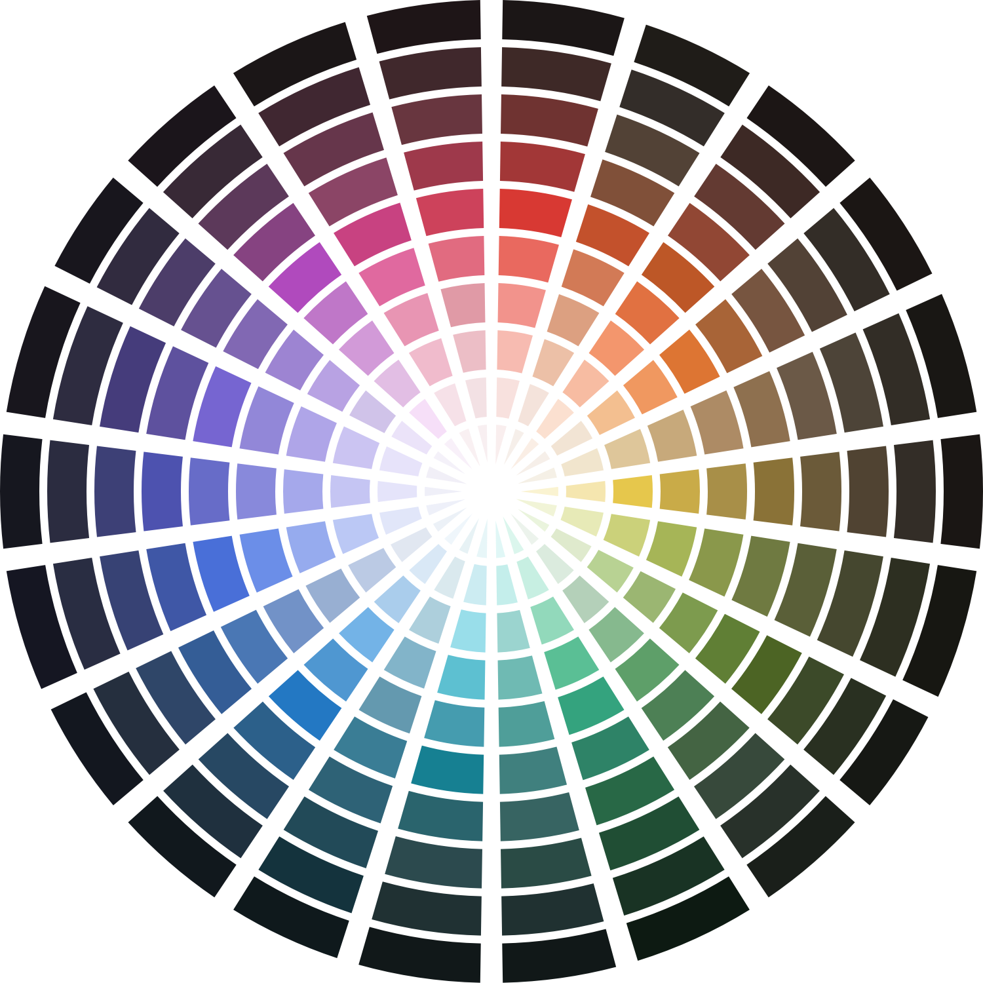
System color tokens
Over 400 colors in 25 color families, like red-30 and blue-warm-40v
Notes:
DW

Slide 40
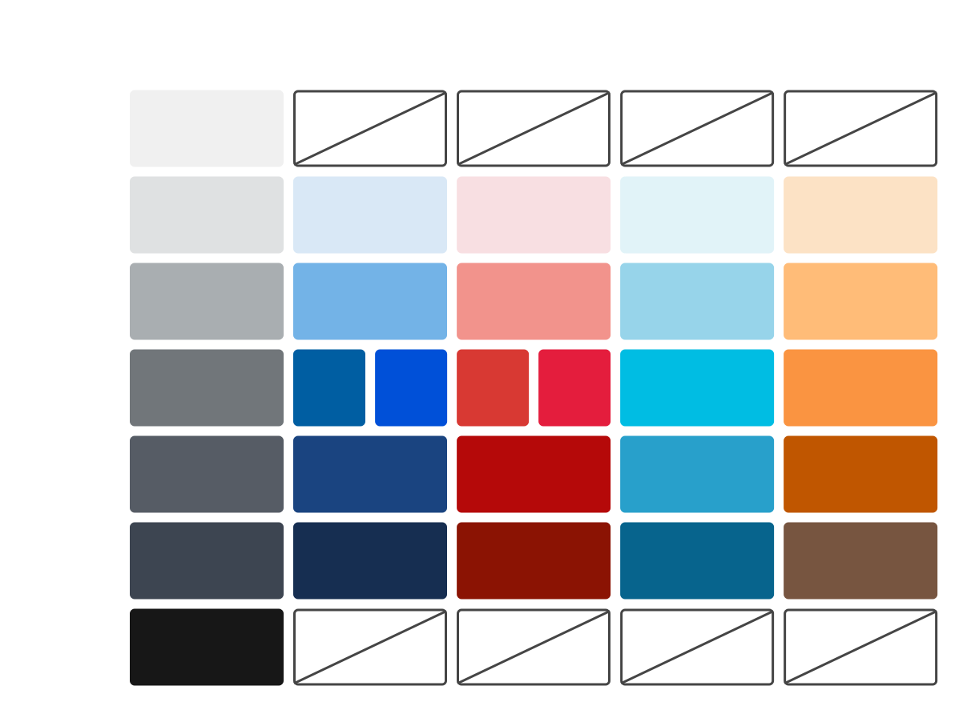
Theme color tokens
Type-based tokens used in our component stylesheets, like base and primary-light.
Notes:
DW

Slide 41
Adding custom colors via settings…
@use "uswds-core" with (
$theme-color-primary-lighter: "gold-30v",
$theme-color-primary-light: "gold-40v",
$theme-color-primary: "gold-50v",
$theme-color-primary-vivid: #F5CA55,
$theme-color-primary-dark: "gold-60",
$theme-color-primary-darker: "gold-70",
)
.example {
background-color: color("primary-vivid");
}
…then using the customized token in component code.
Notes:
DW

Slide 42
Accessibility considerations
Do this:
@use "uswds-core" with (
$theme-color-primary: #8068D8,
$theme-link-color: "primary";
)
Not this:
a { color: #8068D8; }
Use color settings
when possible and
get built-in
contrast checking
Notes:
DW

Slide 43
Adding a custom font
Notes:
DW

Slide 44
Adding a font from a hosting service
Add a reference to the JavaScript and CSS provided by the font hosting service in the head of your markup
Create a new font token in USWDS
Use the font new token in your theme
Notes:
DW

Slide 45
Creating and using
a new font token
@use "uswds-core" with (
$theme-typeface-tokens: (
"lato": (
"display-name": "Lato Web",
"cap-height": 364px,
"stack": "Helvetica Neue",
Helvetica, Roboto, Arial,
sans-serif',
),
),
$theme-font-type-sans: "lato",
$theme-font-role-heading: "sans",
)
.example {
@include u-font("sans", "md");
}
Define the typeface token, assign it to a font type, and use it in your stylesheets.
Notes:
DW

Slide 46
Adding a self-hosted font
Create a new font token in USWDS
Assign this new token to font type
Add custom path information for this font type
Use the new font type token in your theme
Notes:
DW

Slide 47
Adding custom path information for a font type
Given a path:
[$theme-font-path]/lato/Lato-Regular.otf
[$theme-font-path]/lato/Lato-Regular.ttf
Use settings like:
@use "uswds-core" with (
$theme-font-sans-custom-src: (
dir: "lato",
roman: (
400: "Lato-Regular",
700: "Lato-Bold",
),
italic: (
400: "Lato-Italic",
700: "Lato-BoldItalic",
),
),
)
You’ll need .woff, .woff2, and .ttf versions of your self-hosted font.
Notes:
DW

Slide 48
Considerations
Notes:
DW

Slide 49
How do I stop the banner from flashing open on page load?
Notes:
DW

Slide 50
Use the uswds-init script.
Notes:
DW

Slide 51
How to add uswds-init
to your project
Notes:
DW

Slide 52
Can I use USWDS with
[framework name here]?
Notes:
DW

Slide 53
Yes. Probably. But we don’t have direct support.
Notes:
DW

Slide 54
Technical requirements
NodeJS (LTS version 16)
SASS (with load paths)
Autoprefixer
JavaScript bundler (optional)
Notes:
DW

Slide 55
A couple known issues
Notes:
DW

Slide 56
How do I import USWDS component JavaScript into my project?
Notes:
DW

Slide 57
Import and destructure
or
Import directly from a package
Notes:
DW

Slide 58
Importing USWDS component JavaScript
Import and destructure
import USWDS from “@uswds/uswds/js”;
const { accordion } = USWDS;
Or, import directly from a package
import accordion from
"@uswds/uswds/js/accordion";
Notes:
DW

Slide 59
Q&A
Notes:
DW

Slide 60
Next month
February: Token Talk
#uswds-public
github.com/uswds
designsystem.digital.gov

