Slide 1
Overcoming Your Fear of Data
How to Succeed in Insight Generation Without Really Trying (Too Hard)
January 13, 2021

Slide 2
Presentation Purpose
To document the development process
Across divisions and offices
In conjunction with cross-NLM insight generation process development
Measure standardization
Tool development
Data collection processes
To establish best practices for development of research tools and practices for NLM

Slide 3
Why Analytics?
Saying "we completed the project" or "we built the website" is no longer enough. The "so what" is becoming ever more important.
Internal and external audiences have ever-shorter attention spans, ever-greater demands on their time, and are swamped with information.
All institutions—including government—have seen trust in them erode and are working to understand what customers need, and how well they are meeting those needs.
We're required to track and analyze customer experience:
OMB Circular A-11, Section 280
IDEA Act
Evidence-Based Policy Making Act
President's Management Agenda and December 13, 2021 Executive Order

Slide 4
Can surveys address the new Executive Order, Section 6d? (bullets are the exact text)
Surveys can directly help with…
May answer, Whom should we study?
Feedback from public engagement
Human-centered design methodologies such as journey mapping
Examination, from a customer perspective, of how to navigate the agency’s service offerings, apply for a benefit, or comply with a requirement of the agency
Observations of customer interaction with the agency’s website or application processes and tools
Ethnographic research
Direct observations
Observations of customer support service delivery such as activities at call centers
Can be combined with other data
Operational and administrative data analysis
Experiential data (including, as appropriate, through randomized controlled trials or other rigorous program evaluation)

Slide 5
Common Pushback
"I don't understand this stuff. I went into public policy because I didn't want to do math."
"Who gave you permission to get/work with/publish these data?"
"How are you going to use this? Why are you collecting it? How is it going to affect me/my budget/my team/my program?"
"I don't want to give my boss even the slightest inkling that I'm not doing my job effectively."

Slide 6
These things are critical:
Value of measurement: top-down endorsement
What to measure: baseline measures that are non-controversial but bring as many as possible aboard
Agreeing on what to measure prevents further feedback loops and questioning of the premise
Agreement on essentials
Making sure product teams develop comfort with data
Make insight generation and presentation routine
Making part of regular work

Slide 7
From Project Management to Product Ownership
Project Management Mentality
Product Ownership Mentality
Done at the behest of leadership-the project is done when it's done
Continuous improvement-project is never "done"
Development tasks are thrown “over the wall” to developers
Developers and product owners work together to continuously identify customer needs
"Success" means project is on time and under budget
Measures of success are defined and tracked by product owners

Slide 8
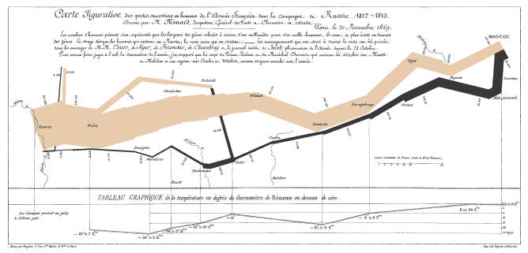
When Visualizing Data, Show, Don't Tell
Charles Joseph Minard's chart of Napoleon's march to Moscow is one of the classic examples of how to show a great deal of data in one chart.
Plots six dimensions (time, force strength, temperature, direction, and location on a two-dimensional surface).
Most graphics are simpler-but idea of including what the audience needs to explore is timeless.

Slide 9
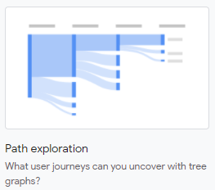
Just sayin’
Minard, 1834
Google Analytics 4, 2022

Slide 10
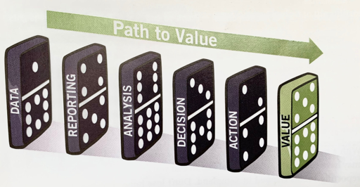
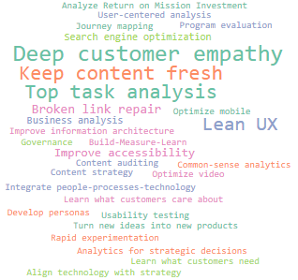
Focus on the big picture
What yields value?
Nothing in isolation!
Brent Dykes 2012, Web Analytics Action Hero

Slide 11
Two information displays might help…
1. Customer Listening Post
To build empathy for customers that guides actions
2. CX Health Check
For rapid sensemaking: What’s going on?

Slide 12
Customer listening post – Who-What For reading feedback as it comes in
Customer role
Survey data table
Key Questions Answered: Who is coming to my website? What are they trying to accomplish? And what are they saying?
The Procedure:
Overview first
Zoom and filter
Details on demand
Reason for visiting
Visit frequency

Slide 13
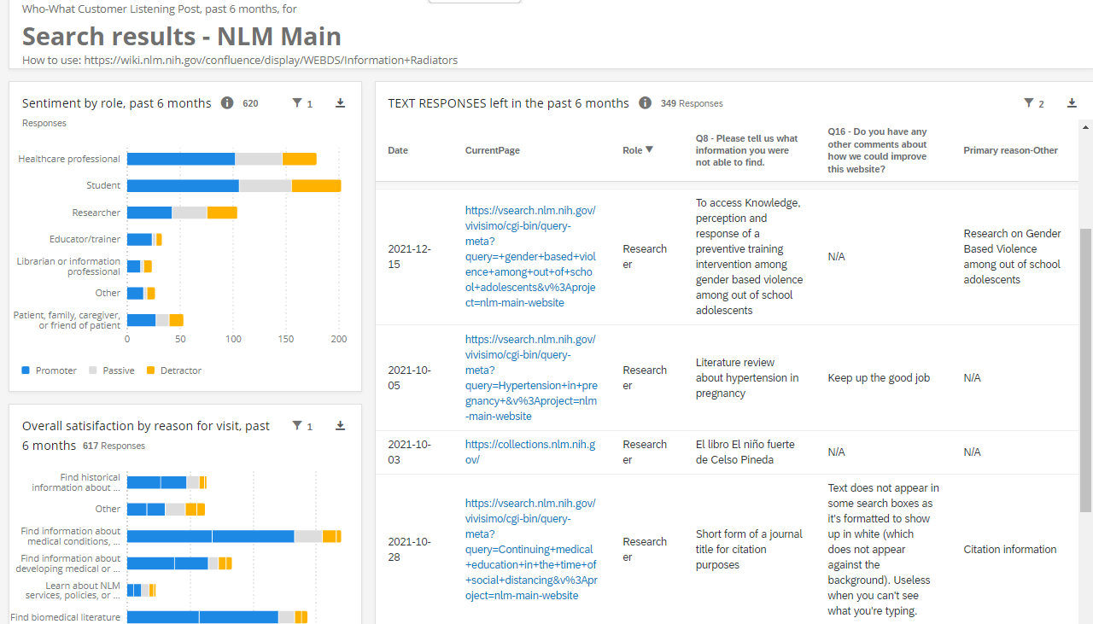
Overview First (default view)
Let’s click here
Overview first (The default view)

Slide 14
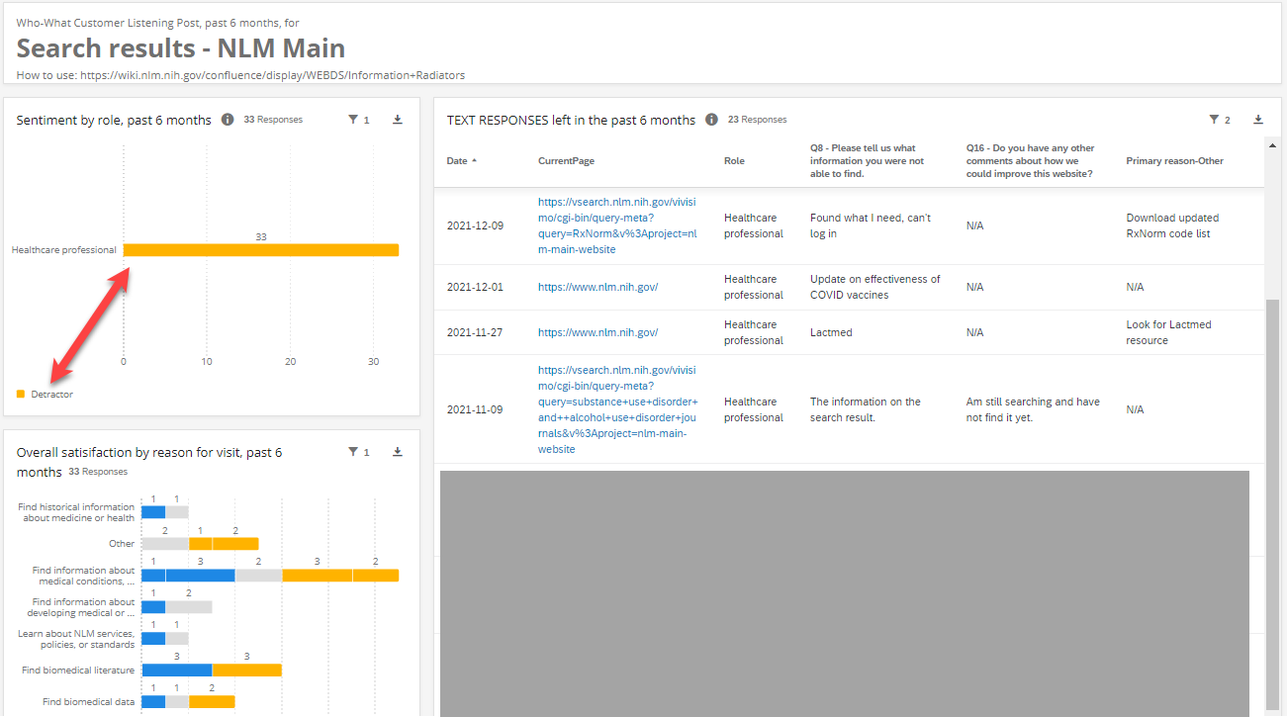
What frustrates our health professionals?
Zoom and filter: What frustrates our health professionals?
(Some frustration I’m not sharing today)

Slide 15
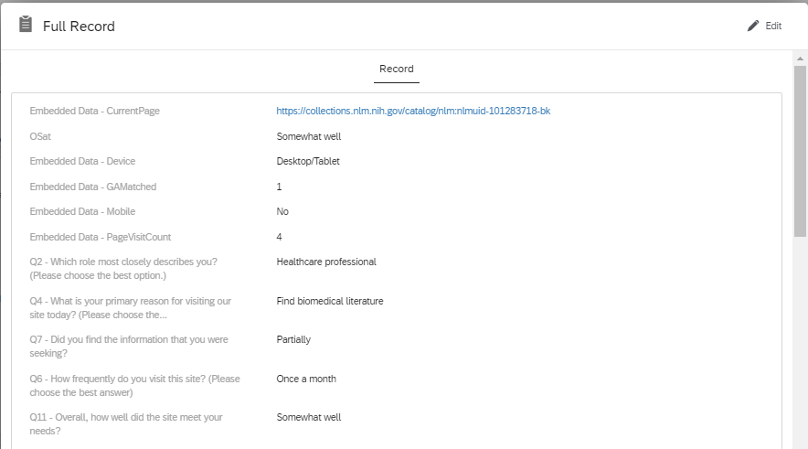
Details on Demand: View additional information
Details on demand: View additional information

Slide 16
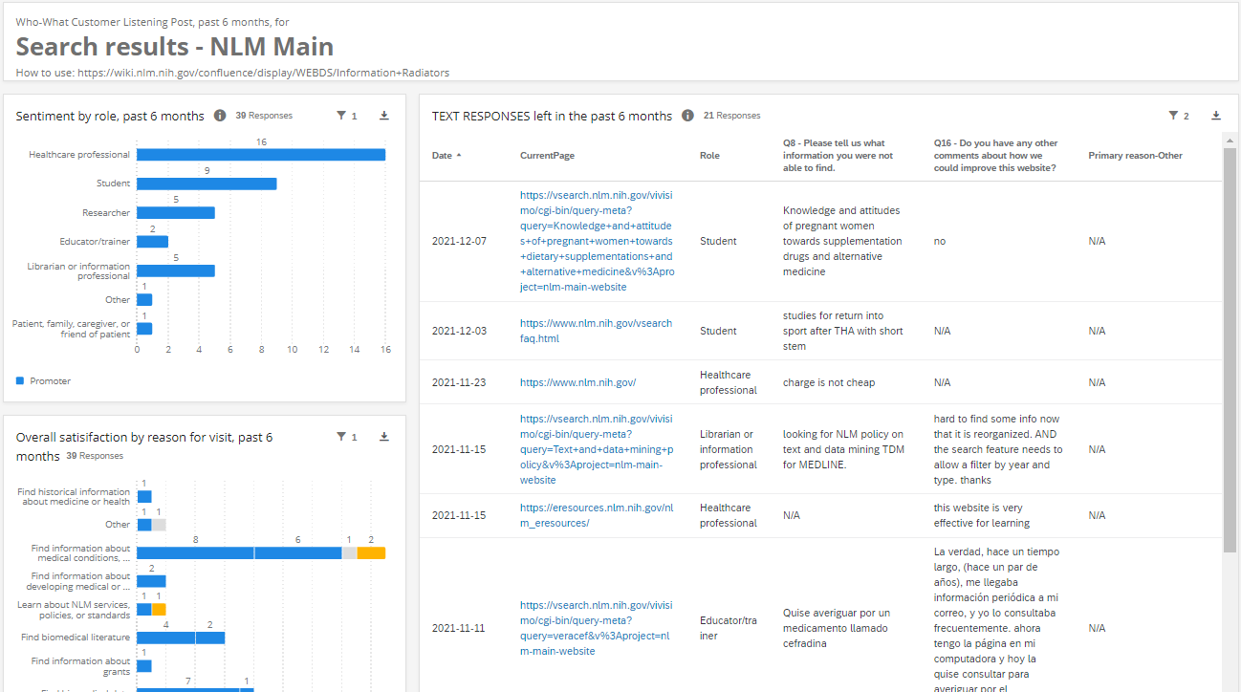
How can we help daily users who are boosters?
Participants who visit daily AND are happy:
What might make them even happier?

Slide 17
For the analyst: Run quick Health Checks Rapid sense-making
Key Question Answered: How can we make sense of what is happening, quickly?
Health check for ______________
chart
chart
chart
chart
chart
chart
chart
chart
chart

Slide 18
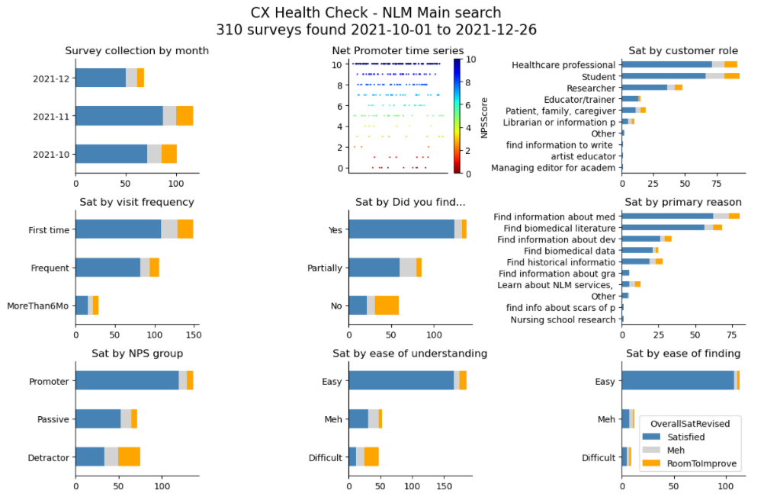
CX Health Check for analysts (Platform-agnostic instant report)
Key Question Answered: How can we make sense of what is happening, quickly??

Slide 19
Other CX skills
Persona Development and Customer Journeys

Slide 20
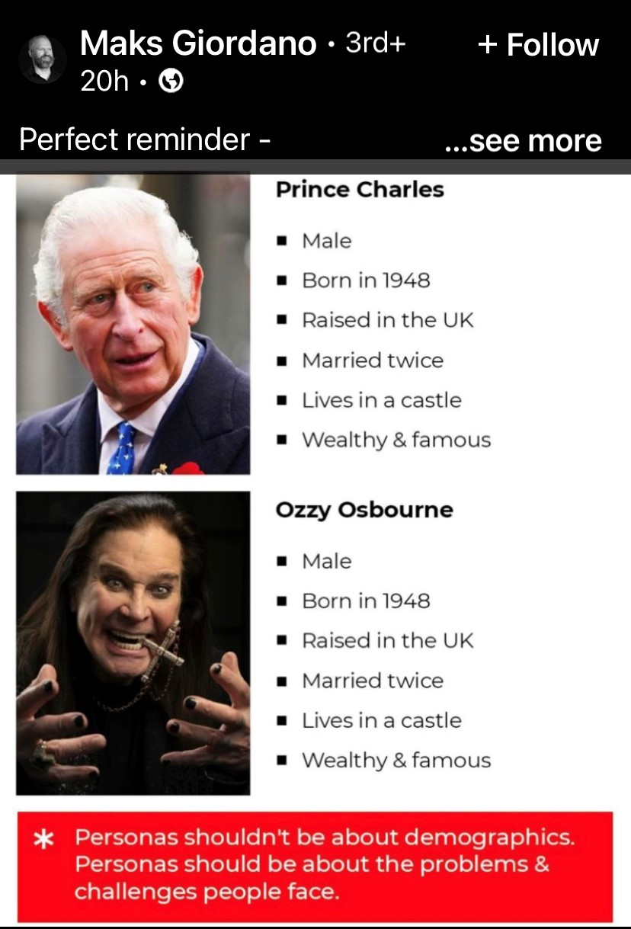
Personas: Whom Do We Serve?
Think about the kinds of people whom you serve and describe them.
Focus on needs, wants, motivations, and characteristics – not demographics.
Give your personas names – this facilitates discussion and thinking about them.
Use your personas to define your customers and what their needs are:
What are they trying to accomplish?
What is easy or hard for them?
What frustrates them?

Slide 21
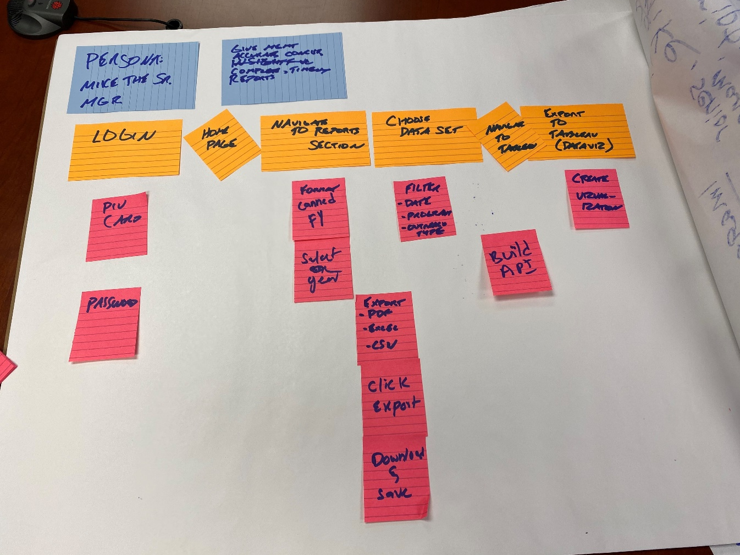
Journeys: What Are Our Customers Doing?
Think about the individual actions that your customers—internal or external—need to take in order to accomplish a specific goal or meet a specific need.
What is easy for them? What is hard for them?
How can you map their process through your product?
What development tasks should your product team prioritize?

Slide 22
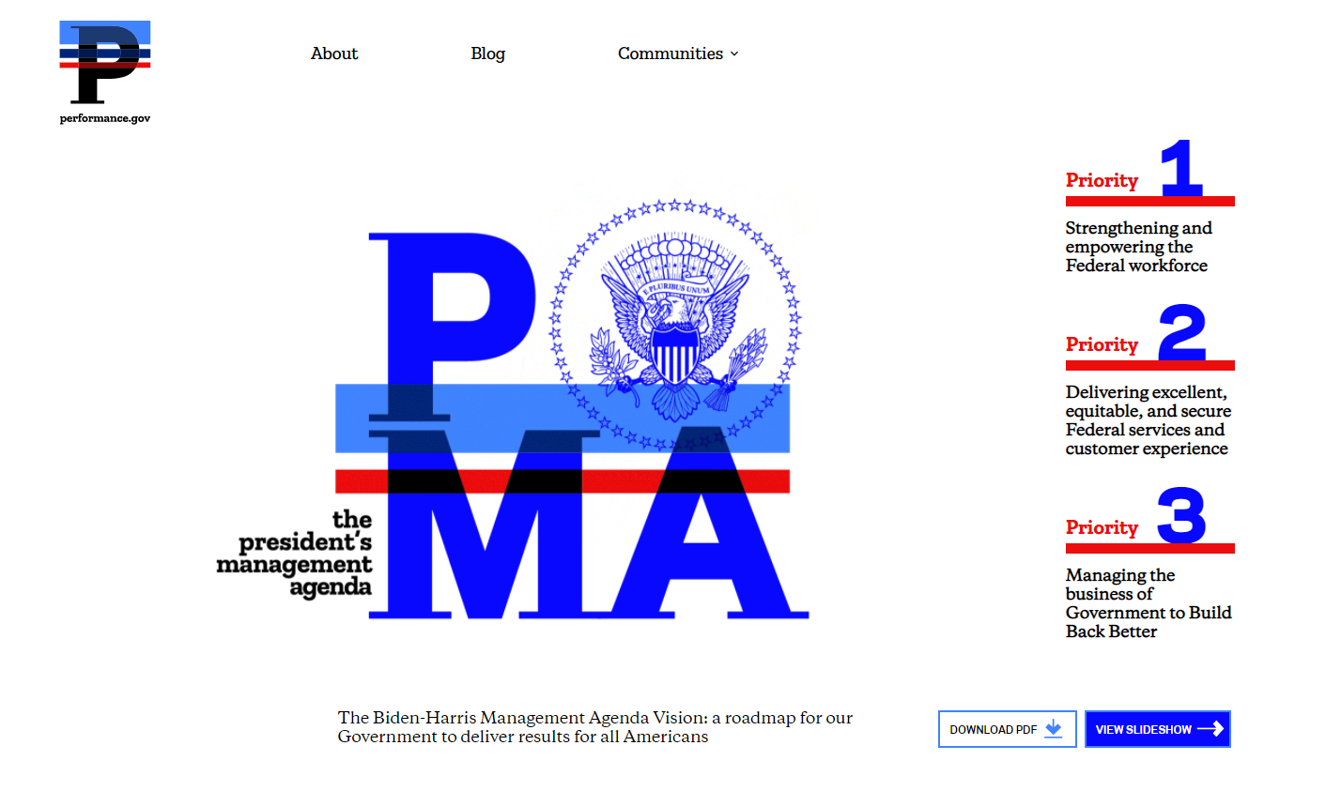
Strategic Assessment
Using the PMA Vision as an example, CX measurement helps us state how effectively we are addressing our strategic goals.
How well are we:
Strengthening and empowering our workforce?
Delivering excellent customer experience?
Managing the business of government?

Slide 23
Core influences
Maturity models for UX, analytics – use your fav search engine
User Story Mapping, Jeff Patton. Mapping Experiences, Jim Kalbach
Strategic Analytics, HBR Press
Measuring the Digital World, Gary Angel
Lean UX, Gothelf and Seiden
Storytelling with Data, Cole Nussbaumer Knaflic
https://digital.gov/communities/
https://www.performance.gov/cx/
https://www.performance.gov/cx/assets/files/a11-280.pdf

Slide 24
Questions and Discussion
Dan Wendling, National Library of Medicine
wendlingd@nlm.nih.gov
www.linkedin.com/in/danwendling/
Adam Korengold, National Library of Medicine (Contractor), SCI Group
akorengold@nih.gov
www.linkedin.com/in/adamkorengold/

