Slide 1

USWDS Monthly Call
April 2023

Slide 2

Hi!
Thanks for being here!

Slide 3
Agenda
Product updates
Top Tasks
Q&A

Slide 4
USWDS 2.14.0
Long-term archive of v2

Slide 5
2023 Customer Loyalty Survey
It’s not spam!

Slide 6
Top Tasks
Discovering what matters most

Slide 7
Jacline Contrino
she/her
UX Researcher
USWDS Core Team
Contractor

Slide 8

All but the simplest services are composed dozens of tasks

Slide 9

Not all tasks are equally important to your audience

Slide 10
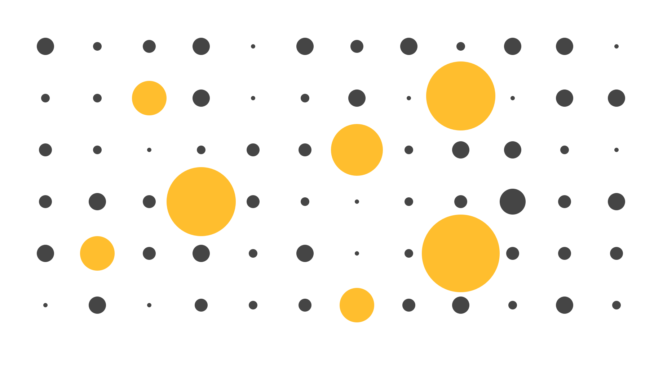
How do we identify the tasks that our audience values?

Slide 11
Top tasks

Slide 12
What are Top Tasks?

Slide 13
The things that matter most to a majority of your users

Slide 14
Imagine booking a flight online…

Slide 15
Ten or fewer tasks

Slide 16
What matters most

Slide 17
Gerry McGovern

Slide 18
Prioritize features and content
Design more effective information architecture
Implement meaningful metrics
Top Tasks can help

Slide 19
Long list → Short list → Survey

Slide 20
Analytics & search queries
Customer feedback
Stakeholder interviews
Past UX research
Other design systems
Sources for the long list

Slide 21
Goldilocks consideration:
Not too broad, not too specific. Just right.

Slide 22
Track tasks in a spreadsheet.

Slide 23
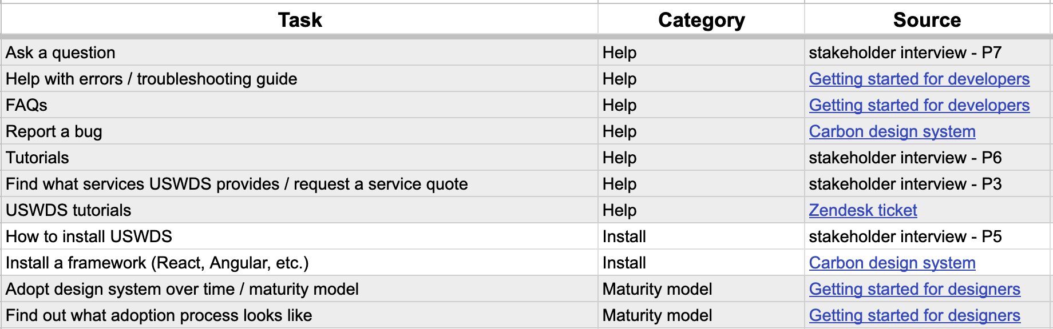
Sample of our spreadsheet

Slide 24
Consolidate tasks and ensure the same “level” of information architecture

Slide 25
Trimming down to a short list should be a collaborative process

Slide 26
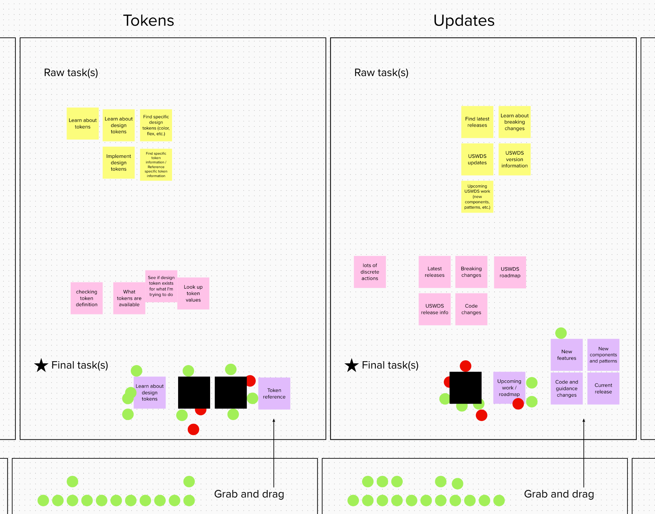
Collaborative trimming and consolidation

Slide 27
Task wording
Avoid verbs. Keep tasks short and scannable.

Slide 28
Role
Experience using USWDS
Proficiency
Usage frequency
The 63 tasks
We built a simple Touchpoints survey

Slide 29
Below is a list of tasks you could do on a design system website. Choose up to five of the tasks that are most important to you.
Please trust your first instincts and do not spend more than a few minutes on this exercise.
Instructions

Slide 30
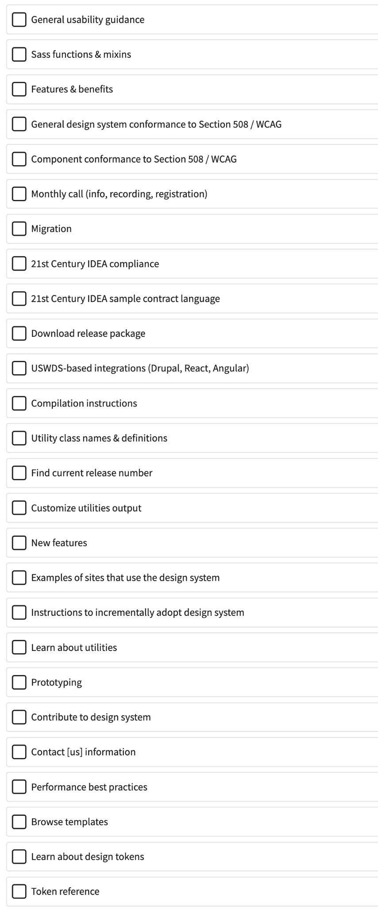
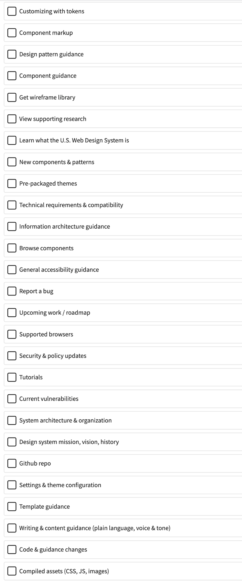
The tasks

Slide 31
Users will scan and choose the most important tasks on instinct.

Slide 32
Create a communications plan.

Slide 33
Pilot the survey before launch.

Slide 34
PRA

Slide 35
Actually, fast-track PRA approval is really quick!

Slide 36
A lot of qualitative UX research qualifies for the fast-track process

Slide 37
More PRA resources

Slide 38
PRA approval took a few days

Slide 39
The survey was open for
three weeks

Slide 40
Findings

Slide 41

Valid responses
This was a great response and more than enough to feel confident in our results

Slide 42
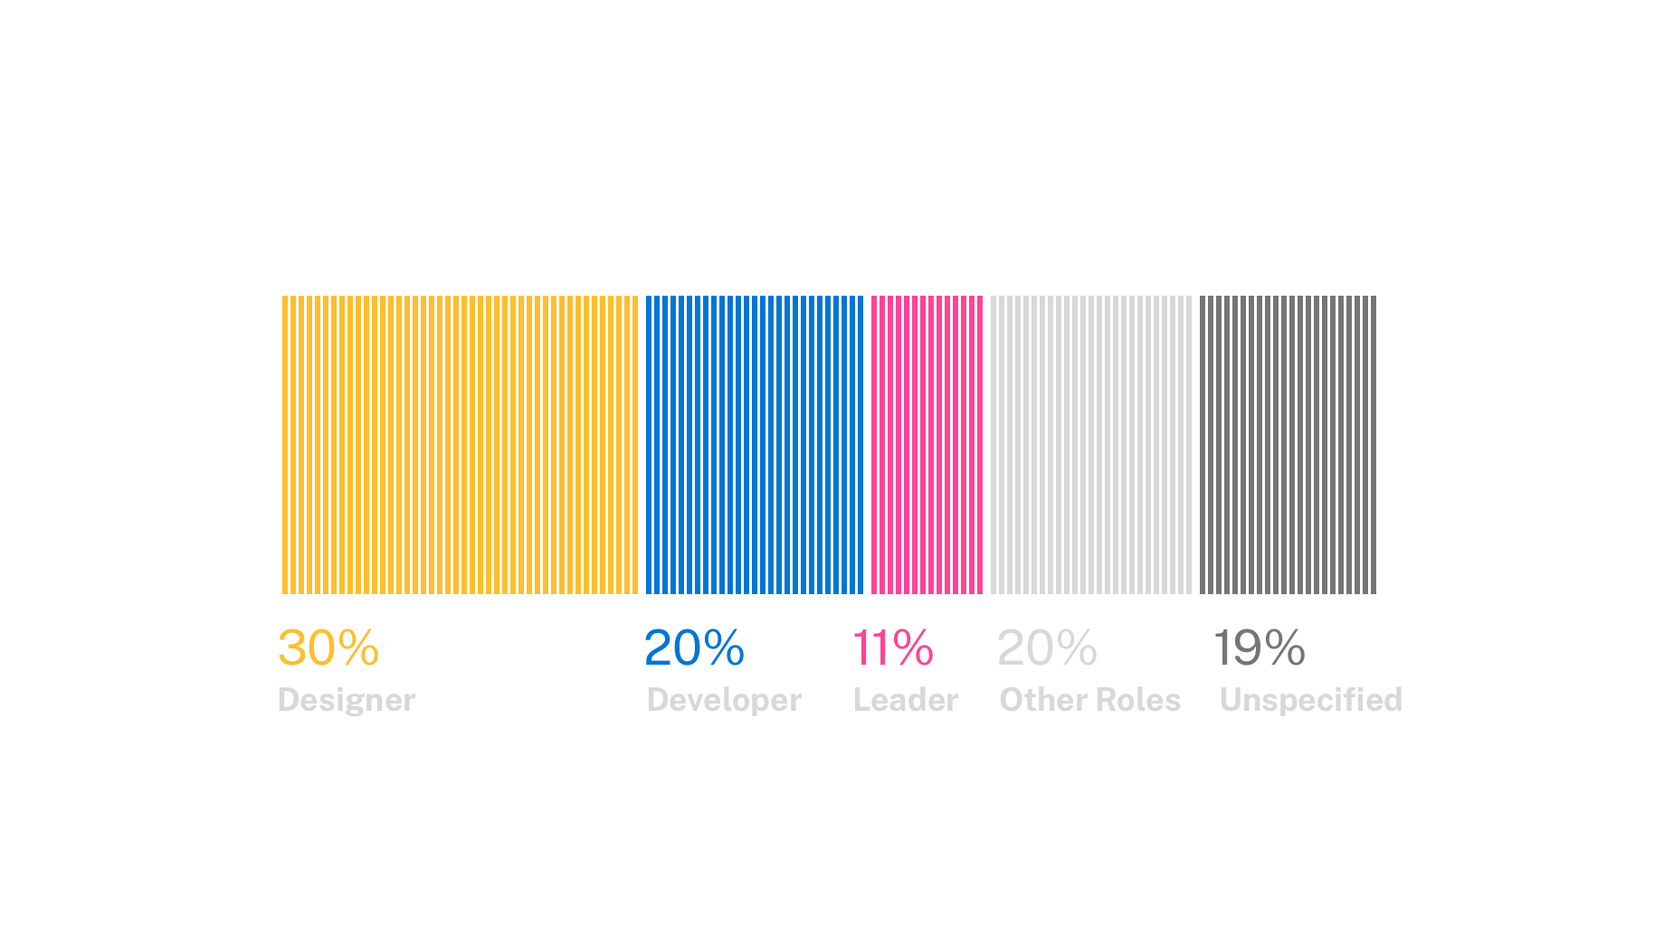
Roles
50% of respondents were either a designer or a developer

Slide 43
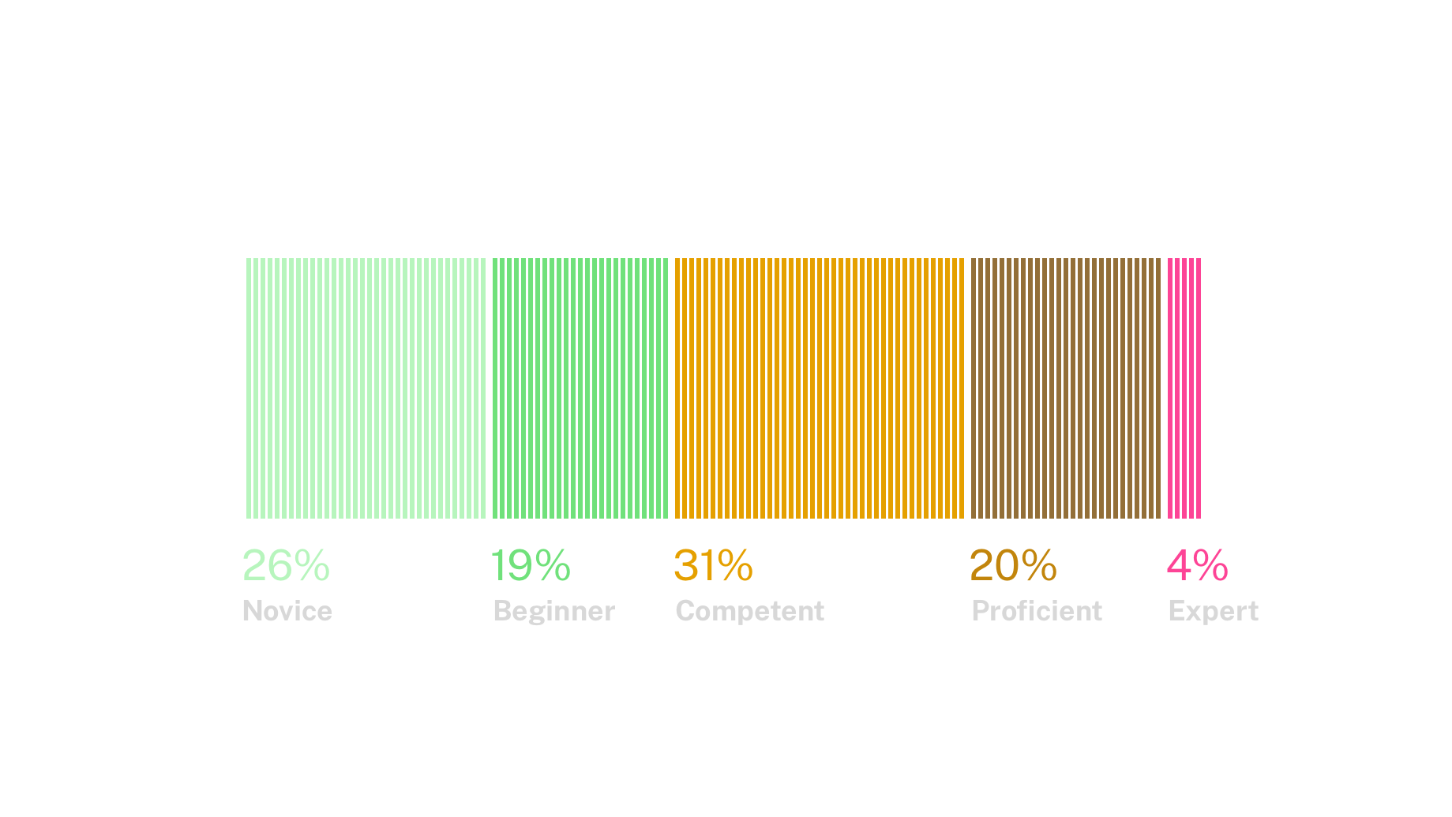
Familiarity with the design system
Nearly 50% of respondents consider themselves novice or beginner user of the design system

Slide 44
Overall Top Tasks

Slide 45
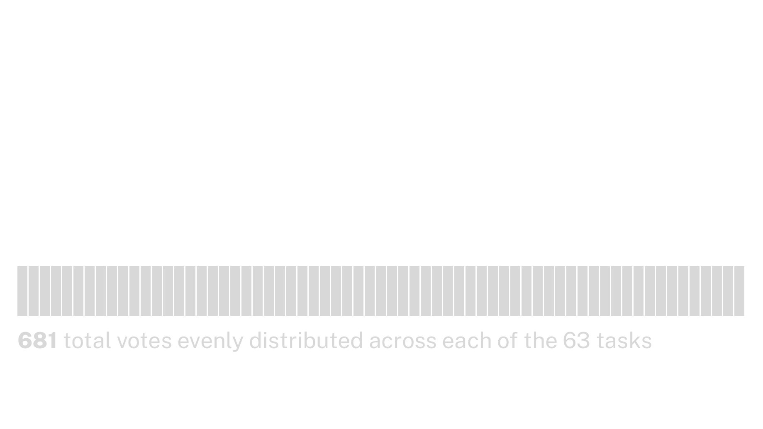
Total votes
If all the votes were evenly distributed, the graph would look like a flat bar…

Slide 46
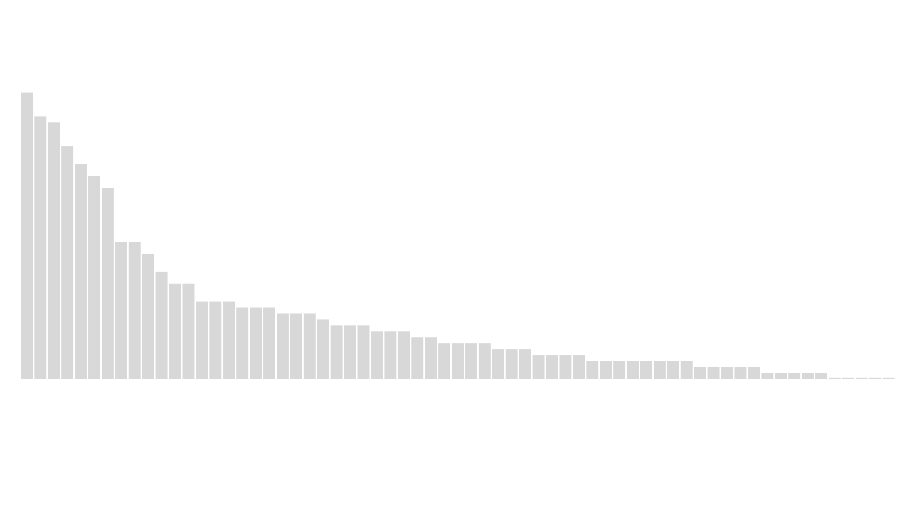
Actual distribution
The actual distribution of votes was closer to traditional power-law distribution

Slide 47
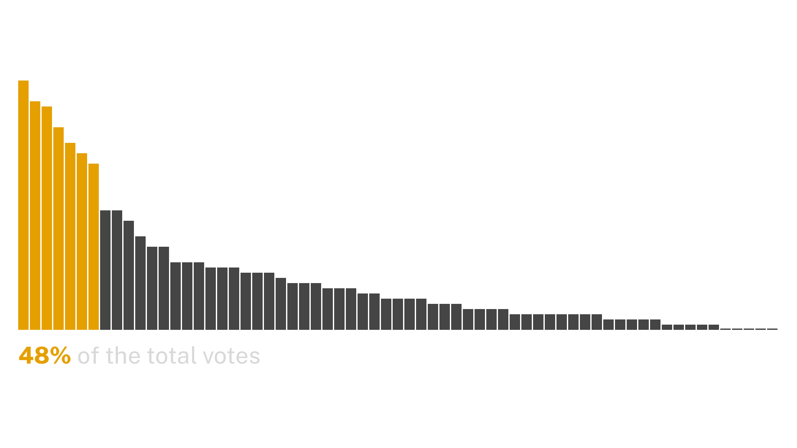
Top Tasks vs. all the rest
Our seven identified Top Tasks collectively received almost half the total votes

Slide 48
Overall USWDS Top Tasks
General usability guidance
Browse components
Component conformance to Section 508 / WCAG
General design system conformance to Section 508 / WCAG
Design pattern guidance
Component guidance
Design kits

Slide 49
Important to all three roles
Design pattern guidance
Browse components
Component conformance to Section 508 / WCAG

Slide 50
How did Top Tasks differ?
Designers: Design kits
Developers: Sass functions & mixins, USWDS-based integrations, Utility class names & definitions, GitHub repo
Leaders: Examples of sites that use the design system

Slide 51
Experience and proficiency didn’t meaningfully affect task selection.

Slide 52
Next stop: Baselines

Slide 53
Key takeaways

Slide 54
Accessibility
We have an opportunity to better communicate how the design system and its components conform to Section 508 / WCAG

Slide 55
Browsing components
Our research shows that some users struggle to navigate component pages.

Slide 56
General usability guidance
There is demand to provide general usability guidance and best practices in one place.

Slide 57
Patterns
New design patterns and guidance should be a continued focus

Slide 58
Implementations and examples
How might we better showcase design system implementations and examples?

Slide 59
Next steps

Slide 60
Site content audit

Slide 61
Designing solutions to test and communicate Section 508 conformance of components

Slide 62
Usability testing of top tasks

Slide 63
Sign up to be a tester if you’re interested. :)
(52 people have signed up so far!)

Slide 64
Study limitations and lessons learned

Slide 65
Consider a survey tool that can randomize

Slide 66
Plan for more time

Slide 67
Provide users a way to give open comments on the survey

Slide 68
The Top Tasks process really worked for us.

Slide 69
Give it a shot.

Slide 70
For more information, we recommend:
A Deep Dive into Top Tasks with Gerry McGovern (Digital.gov)
Using Top Tasks to be Top-Notch (Digital.gov)
Search for “top tasks research”

Slide 71
Q&A

Slide 72
Next month
May: Real-world accessibility
#uswds-public
github.com/uswds
designsystem.digital.gov

