Slide 1
Plain Language: Accessibility Environmental Justice for All Points of View & Points to Do Angie Luigina Fuoco, BSChE, MPH Doctor of Public Health candidate at Samford University Disclaimer: Information, resources, and non-EPA links provided in this presentation represent views of this speaker and not those of the U.S. Environmental Protection Agency. No agency endorsement is given or implied to any part of this presentation.
1

Slide 2
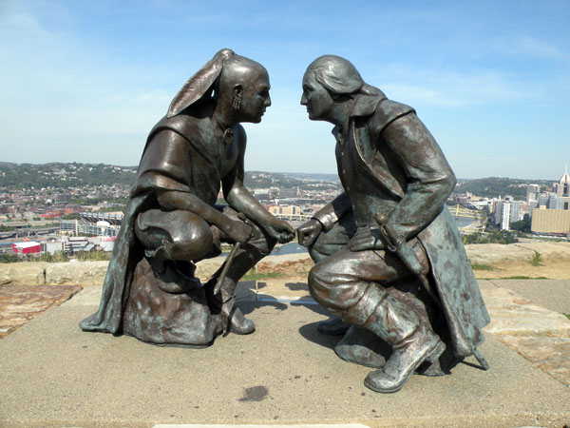

Acknowledge Injustice and Ability Privilege
The land on which I stand in Pittsburgh, Pennsylvania, was once possessed by the Seneca and other tribes. Today, I honor Seneca Chief, Guyasuta. Note his equality with George Washington in this bronze sculpture, Points of View which sits atop Mount Washington, one block from my home. The chief lost his land, or I may be standing on Mt. Guyasuta. I honor Guyasuta in his once-position of power and peacemaker and as brave defender of the Seneca.
Points of View Sculpture Photo credit: Leepaxton at en.wikipedia, CC BY-SA 4.0, https://commons.wikimedia.org/w/index.php?curid=16992171
Creative Commons image: pngimg.com
2

Slide 3
What We’ll Talk About Today
Points of View - guiding principles we can keep in mind as we write or speak for the federal government.
Points to Do - little things we can do to make our work and our world just a bit more accessible, kind, and healed from an onslaught of injustices.
3

Slide 4
Reasons for Accessibility & Environmental Justice
Public Law | Public Law | Executive Order | Executive Order | Executive Order | Executive Order
Sept. 26, 1973 | Oct. 13, 2010 | Feb. 11, 1994 | Aug. 11, 2000 | Jan. 20, 2021 | June 25, 2021
Rehabilitation Act Federal agencies must make physical and digital spaces accessible to persons with disabilities (including the public we serve, federal employees and applicants) | Plain Writing Act Federal agencies must promote clear Government communication that the public can understand and use | E.O. 12898 Federal Actions To Address Environmental Justice in Minority Populations and Low-Income Populations Focus EPA & Health Agencies | E.O. 13166 Executive Order 13166, Improving Access to Services for Persons with Limited English Proficiency | E.O. 13990 Executive Order on Protecting Public Health and the Environment and Restoring Science to Tackle the Climate Crisis Focus: EPA & Health Agencies | E.O. 14035 Executive Order on Diversity, Equity, Inclusion, and Accessibility in the Federal Workforce (applies to federal employees and applicants)
4

Slide 5
The Best Reasons are Human Ones
Many environmental indicators disproportionately affect Native, low-income communities, and communities of color.
Blood lead levels in children
More of these communities live near hazardous waste sites
Climate change indicators measure higher
People with disabilities… how many of us are there?
1 in 4 , using six questions CDC
1 in 5 - mental illness (SAMHSA)
Mental illnesses increasing due to Covid-19
Covid-19 recognized as a possible disability
5

Slide 6
Accessibility
Dictionary.com …easy to approach, reach, enter, speak with, use or understand
E.O. 14035 …design of… information and communication technology, programs, and services so that all people, including people with disabilities, can fully and independently use them. …ensuring that people with disabilities can independently access every outward-facing and internal activity or electronic space, and the pursuit of best practices universal design.
UK Gov Blog: Accessibility means people can do what they need to do in a similar amount of time and effort as someone that does not have a disability. It means that people are empowered, can be independent, and will not be frustrated by something that is poorly designed or implemented.
Environmental Justice (EJ)
EPA’s definition is the fair treatment and meaningful involvement of all people regardless of race, color, national origin, or income with respect to the development, implementation and enforcement of environmental laws, regulations and policies.
6

Slide 7
Point of View 1 - Power
Serve public with all their beliefs about our power.
Power of government perceived by public is usually “too high.”
Antidote to power imbalance => cultural humility in our writing, speaking, and interactions
Cultural humility is the “ability to maintain an interpersonal stance that is other-oriented in relation to aspects of cultural identity that are most important to the [person]. (Hook, J., 2013)
Part of cultural humility is to redress power imbalances that shouldn’t exist but do. (Tervalon, M. and Murray-Garcia, J., 1998)
7

Slide 8
Point of View 2 - Perception
Serve all the public at all levels of emotion.
Change the perception. Be empathetic to the public’s emotions.
Emotional climate:
Every community these days - risks, fear, conflict…
Consider what’s important to that community (values)
Consider what’s happening in the community
Prepare for the emotions of a wider audience
(…for what we say to live on and live anywhere)
8

Slide 9
Point of View 3 - Prepare the Paths
…for all levels of ability to receive and understand.
Set up files accessibly (use built-in templates)
Use Readability Checker often (built into Word)
Prepare for translations as you write (digital.gov/EPA resources)
Prepare for as many formats as possible
Learn and do all you can to serve the 100% (DEIA)
Digital.gov Communities of Practice and Listservs
Plain Language, IT Accessibility & 508, Multilingual
LEP.gov (limited English proficiency)
Interagency Accessibility Forum (each October)
World Institute on Disability (CEO, Marci Roth, formerly of FEMA)
Forum on Workplace Inclusion (private, non-Gov-affiliated)
9

Slide 10


Points to Do (EJ or other Kind Practices)
Acknowledge Land, Community, Racial Injustices
Acknowledge Situation (we’re in a world full of crises!)
CDC Crisis & Emergency Risk Communication (CERC)
ATSDR Community Stress Resource Center (resilience building)
Increase respect with order and prominence
Use the current language of your audience
Use ADA-recommended “people first” language
Avoid “trigger” words and topics
10

Slide 11
Points to Do (Accessibility)
Why? (CDC Vaccine Information Statements)
Plan and advertise all access pathways same
Online accessibility (video and audio)
Captions (accurate, correct placement, not too fast - play back)
Audio description - close your eyes, write what you see in script
Turn hard concepts into Questions and Answers
Write for all abilities using ADA Guidance
ALF rules on sentences and abbreviations
Use helpful styles and terms as you can
“Transcript” (as a play) when possible
11

Slide 12
References and Resources
Americans with Disabilities Act Network Guidelines for Writing About People with Disabilities https://adata.org/factsheet/ADANN-writing
Dictionary.com https://www.dictionary.com/browse/accessibility
Digital.gov. 6 Ways Translation Glossaries Help Agencies Succeed In Sharing Information.
EPA Environmental Justice: https://www.epa.gov/environmentaljustice
Glosario ambiental bilingüe | US EPA
Hook, J., Davis, D., Owen, J. Worthington, Jr., E. L., Utsey, S. O., Cultural Humility: Measuring Openness to Culturally Diverse Clients (May 2013) Journal of Counseling Psychology 60(3) DOI:10.1037/a0032595.
Native Governance Center (land acknowledgement) https://nativegov.org/a-guide-to-indigenous-land-acknowledgment/
Tervalon, M. and Murray-Garcia, J. (May 1998). Cultural humility versus cultural competence: A critical distinction in definition Journal of Health Care for the Poor and Underserved; 9, 2; Research Library. pg. 117.
U.K. Blog https://accessibility.blog.gov.uk/2016/05/16/what-we-mean-when-we-talk-about-accessibility-2/
12

Slide 13

Thoughts?
13

