Slide 1

Plastic Free Environment
COMMUNITY SERVICE PROJECT
NARASARAOPET
B.Tech Final Presentation | Department of CSE (DS)
[Add: full college name | academic year]
Building a cleaner and healthier environment by reducing plastic pollution
Notes:
Welcome the panel. Introduce the project: Community Service Project on a Plastic Free Environment, by the CSE (DS) team from Narasaraopet. Key message: a cleaner, healthier environment by reducing plastic pollution.

Slide 2


Guidance & Submission
OUR TEAM
Submitted By
Under Guidance
1
B. Bhavya Sai Sri
1
Mr. P. Srinivasarao
24471A4402
2
M. Aparna
2
Mr. P. Solman
24471A4425
3
N. Esther Rani
3
Mr. N. Siva Rama Krishna
24471A4435
4
T. Anitha
4
Mr. B. Veera Brahmam
24471A4461
Under the guidance of Department CSE (DS)
Notes:
Introduce the four team members and the four faculty guides. Roll numbers and names are as in the original submission.

Slide 3

Table of Contents
ROADMAP
1
Introduction & Concept
2
Problem & Objectives
Slides 4–5
Slides 6–7
3
Effects of Plastic Pollution
4
Study Area & Methodology
Slide 8
Slides 9–10
5
Activities & Survey Analysis
6
Solutions & Implementation
Slides 11–12
Slide 13
7
Results & Community Feedback
8
Conclusion & Gallery
Slides 14–15
Slides 16–17
Notes:
Story flow: Introduction, Problem, Evidence, Objectives, Investigation, Activities, Solutions, Results, Conclusion.

Slide 4




Introduction
GETTING STARTED
A plastic-free environment minimizes or eliminates single-use plastics such as bags, bottles and packaging.
Swap plastic for
Glass
It replaces plastic with sustainable alternatives: glass, metal, paper, bamboo or compostable materials.
Metal
Paper
Bamboo
It protects ecosystems, reduces greenhouse gas emissions and conserves non-renewable resources.
Compostable materials
Notes:
Define a plastic-free environment and the alternatives to plastic. Keep it short; the next slide defines the problem itself.

Slide 5

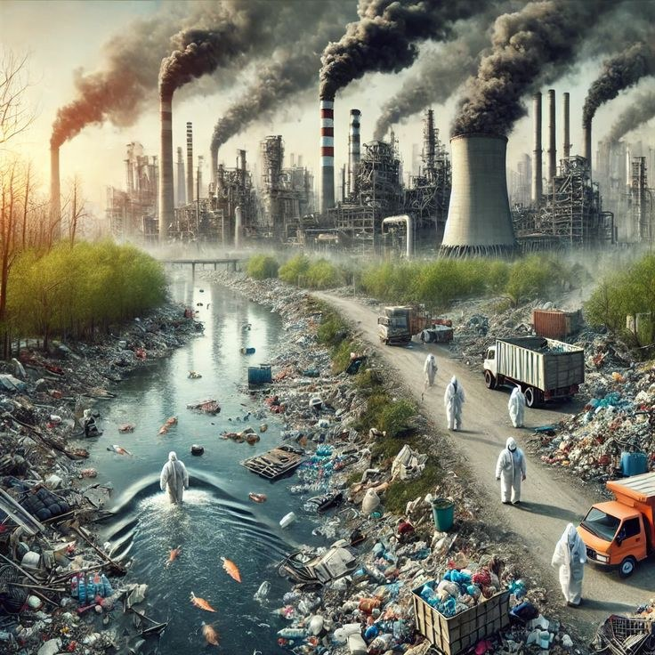
What is Plastic Pollution?
DEFINITION
Plastic pollution is the build-up of plastic waste in the environment: bags, bottles, packaging and microplastics that persist for centuries because they resist decomposition.
Made mainly from petroleum-based compounds, plastics now spread through land and water, threatening wildlife, human health and ecosystems.
Long-lasting
Petroleum-based
Microplastics
Notes:
Plastic does not decompose easily, so waste accumulates. Microplastics are tiny fragments that enter water, soil and food chains.

Slide 6




Problem Statement
CHALLENGE
Rising Plastic Use
Land & Water Contamination
Single-use plastics, improper disposal and low recycling rates let waste pile up faster than it is managed.
Plastic waste contaminates soil and water bodies, harming wildlife and fragile ecosystems.
Health & Climate Risks
Awareness Gap
Microplastics affect human health, while plastic production and disposal add to climate change.
Despite campaigns, plastic use keeps rising, so sustainable habits are urgently needed.
PROBLEM STATEMENT
Excessive single-use plastic and improper disposal pollute land and water and harm health. Our project investigates this problem in the community and promotes plastic-free habits through awareness.
Notes:
These four problem areas drive everything that follows: the objectives, the survey, the activities and the proposed solutions.

Slide 7




Objectives
WHAT WE SET OUT TO DO
01
02
03
04
Understand
Assess
Educate
Promote
Study plastic use and disposal habits in the community.
Measure awareness of plastic pollution through a survey.
Raise awareness of its hazards among students and residents.
Encourage reusable alternatives and proper waste segregation.
Aim: a cleaner and healthier environment by reducing plastic pollution.
Notes:
Each objective maps to a later slide: Understand and Assess to Study Area, Methodology and Survey; Educate to Activities; Promote to Solutions.

Slide 8






Effects of Plastic Pollution
IMPACT
Pollution & Waste
Wildlife & Ecosystems
Climate Change
Human Health
Waste accumulates across land, rivers and oceans.
Animals suffer entanglement and habitat loss.
Plastic production and disposal add greenhouse gases.
Toxic chemical exposure harms people and ecosystems.
Key insight: plastic harms at every stage: production, use and disposal.
Notes:
Evidence slide: explain why the problem matters. Follow the chain from waste to wildlife, climate and human health.

Slide 9

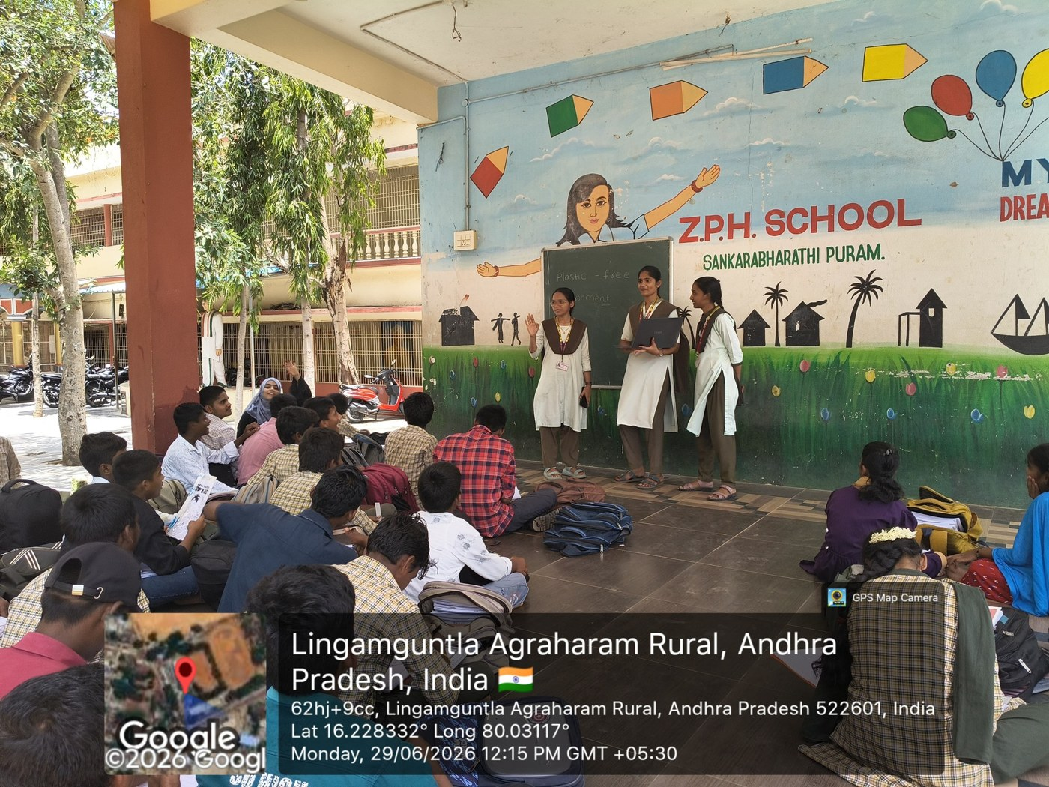




Study Area & Community Profile
WHERE WE WORKED
LOCATION
Lingamguntla Agraharam (Rural), Andhra Pradesh
COMMUNITY SETTING
ZPH School students and staff
FIELD VISIT DATE
29 June 2026
COMMUNITY PROFILE
[Add: population, households, main occupations]
SAMPLE SIZE
Field visit at the study area | 29 June 2026 | PIN 522601
[Add: number of respondents]
Notes:
Location and date are taken from the GPS-stamped project photographs. Add population, household and sample details where indicated.

Slide 10




Methodology
OUR PROCESS
1
2
3
4
5
Identify
Plan
Visit
Engage & Collect
Analyse
Select plastic pollution as the community problem.
Set objectives; prepare the survey and awareness material.
Visit the study area and meet students and staff.
Run the awareness activity and collect responses.
Analyse the data and recommend solutions.
[Add:] survey tool (questionnaire / interview), sample size, sampling method and survey dates.
Notes:
Walk through the five stages. Steps 3 and 4 are supported by the field photographs; confirm and add survey tool details in the placeholder strip.

Slide 11

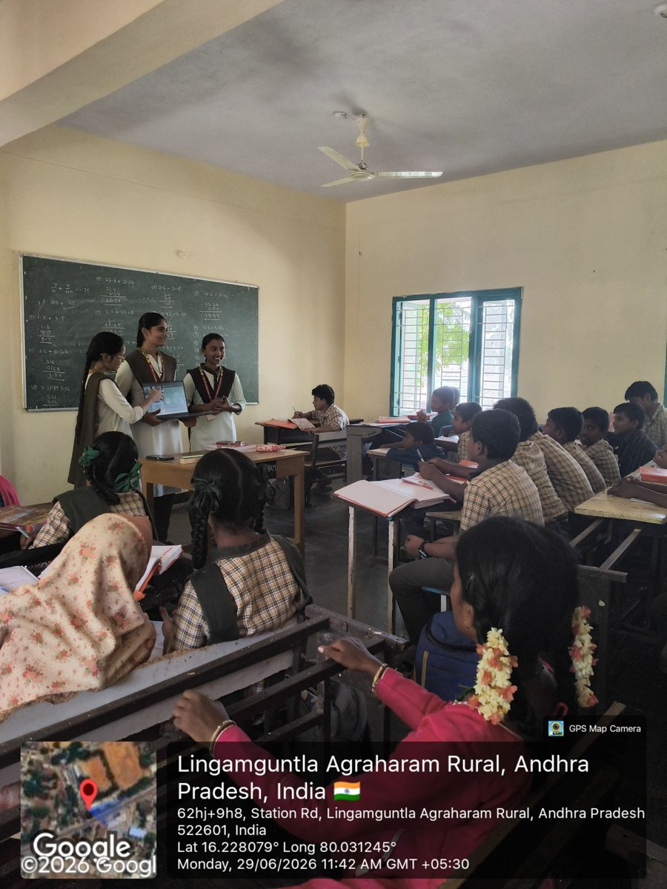
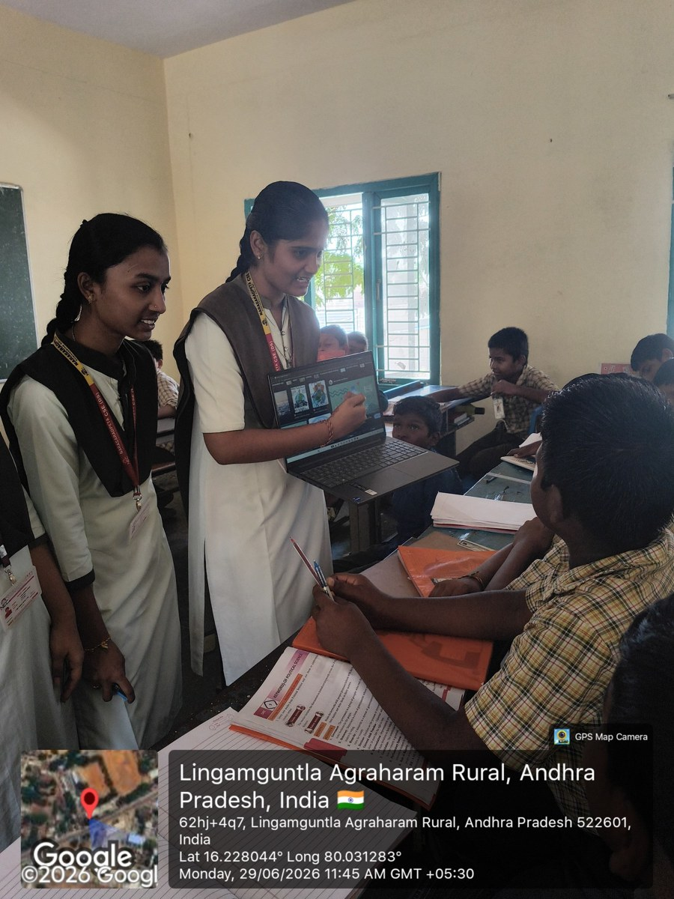


Activities Performed
FIELD WORK
Awareness & educational session
Taught school students about plastic pollution and its effects.
Student interaction
Guided learning and discussion with students in the classroom.
Other activities
[Add if performed: clean-up drive, plastic collection, poster or slogan activity]
Educational activity
Student interaction & learning
Photos GPS-stamped 29 June 2026
Notes:
Only activities supported by the project photographs are shown as performed. Add any other activities in the placeholder card.

Slide 12


Survey & Data Analysis
EVIDENCE
PLACEHOLDER – ADD ACTUAL DATA
[ N ]
Respondents surveyed
[ __ % ]
Key finding 1
[Insert survey chart here]
Use actual survey results, e.g. plastic-use frequency, awareness level, disposal method.
[ __ % ]
Key finding 2
Link to solutions: each finding here should support a solution on slide 13.
Notes:
No survey figures were available in the original file, so none are shown. Replace the placeholder with a native chart built from the real data and fill in the three callouts.

Slide 13

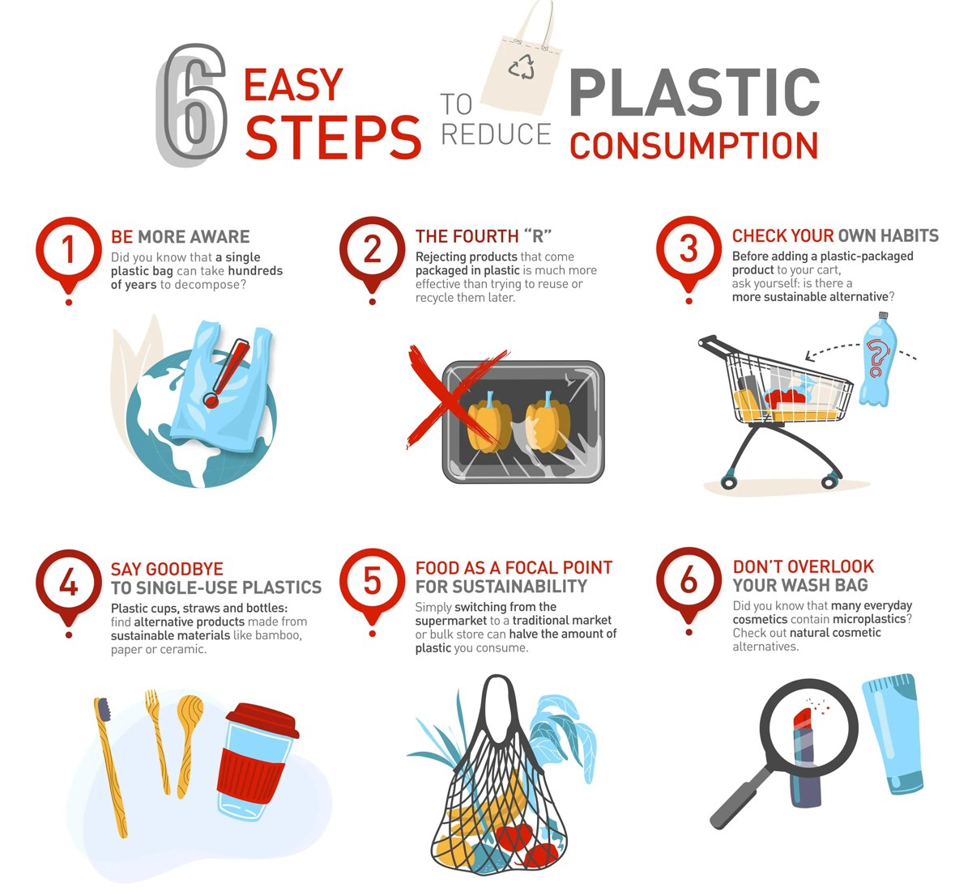

Proposed Solutions & Implementation
OUR APPROACH
PROBLEM
SOLUTION
STATUS
Rising Plastic Use
Cut single-use plastics; promote cloth bags, steel bottles, bamboo items.
Proposed
Land & Water Contamination
Segregate plastic at source; improve recycling.
Proposed
Health & Climate Risks
Involve students and citizens; support local plastic-ban rules.
Proposed
Awareness Gap
Run awareness sessions in schools and communities.
Real-life models: plastic-bag bans in Kannur and Sikkim; the Plastic Free July campaign.
Implemented
Notes:
Each solution answers a problem from slide 6. Only the awareness session is marked Implemented (supported by the school photographs); the rest are proposed. Change a status if more was actually done.

Slide 14




Results & Outcomes
WHAT WE ACHIEVED
Achieved Results
Expected Outcomes
Awareness session on plastic pollution held with school students on 29 June 2026
Cleaner surroundings with less plastic waste
Student interaction and learning activity completed
Higher use of eco-friendly alternatives
Team engaged students and staff at Lingamguntla Agraharam
Wildlife and ecosystems protected by better waste management
Healthier, sustainable community for future generations
[Add: students reached | survey responses collected]
Achieved: completed during this project
Expected: anticipated long-term impact, not yet measured
Notes:
Be clear about the difference: achieved results are what the team completed; expected outcomes are the anticipated long-term impact of reducing plastic use.

Slide 15



Before vs After & Community Feedback
CHANGE & VOICES
PLACEHOLDER – ADD ACTUAL DATA
BEFORE
AFTER
Awareness level
[Add survey result]
Awareness level
[Add survey result]
Plastic-use habits
[Add survey result]
Plastic-use habits
[Add survey result]
Disposal practice
[Add survey result]
Disposal practice
[Add survey result]
Community Feedback
“[Add feedback from a student, teacher or resident]”
“[Add feedback from a student, teacher or resident]”
[Name, role]
[Name, role]
Notes:
No before/after photos or feedback were supplied. Fill the placeholders with real survey results and genuine quotes; do not present anything that was not collected.

Slide 16

Conclusion & Learning Outcomes
WRAPPING UP
A plastic-free environment is essential for the health of our planet, wildlife and people. Reducing plastic cuts pollution on land and in water, conserves non-renewable resources, lowers greenhouse gas emissions and limits exposure to toxic chemicals such as BPA and phthalates.
Learning Outcomes
Understood the causes and impact of plastic pollution
Practised community engagement and communication
Learned to plan field work and analyse survey data
Building a cleaner and healthier environment by reducing plastic pollution.
Strengthened teamwork and social responsibility
Learned practical ways to promote plastic-free habits
Notes:
Close the story: problem, investigation, action, results. Edit the learning outcomes to reflect the team's own experience.

Slide 17

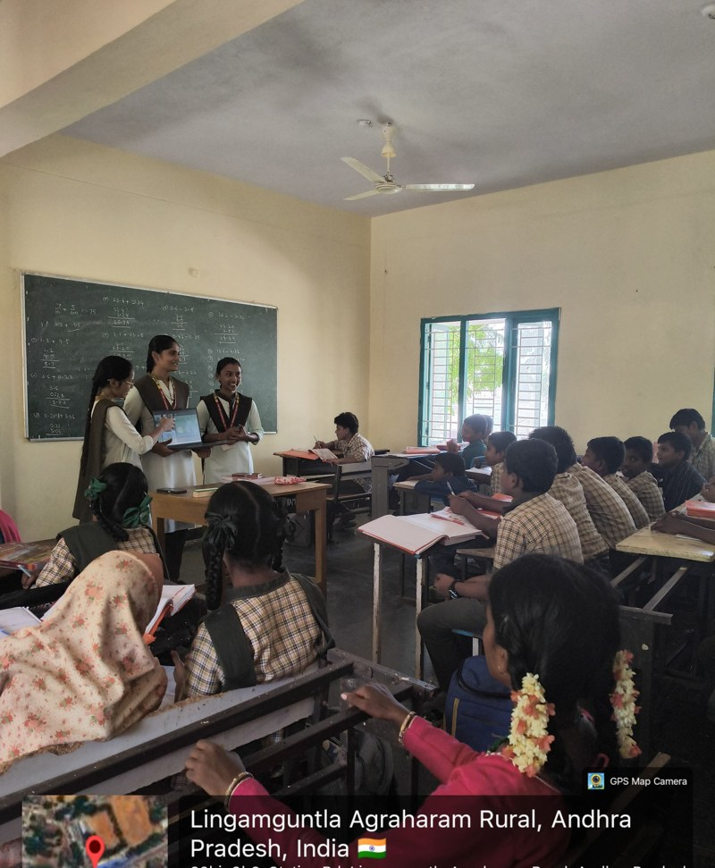
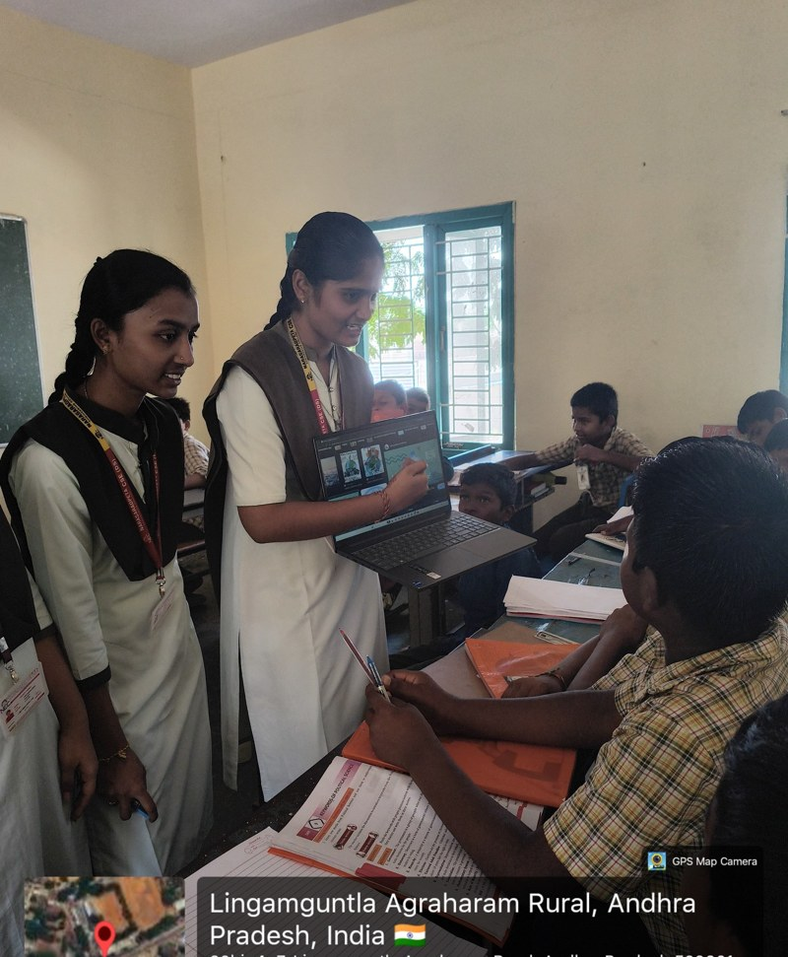
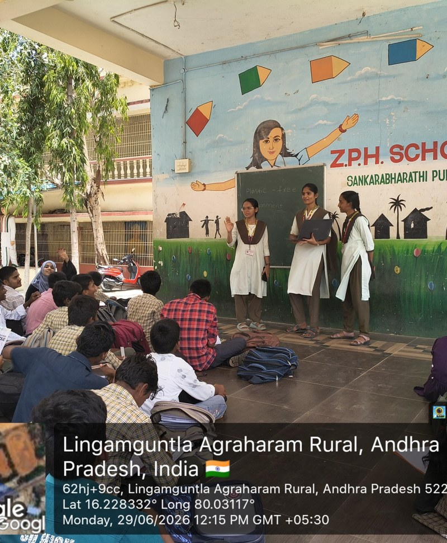
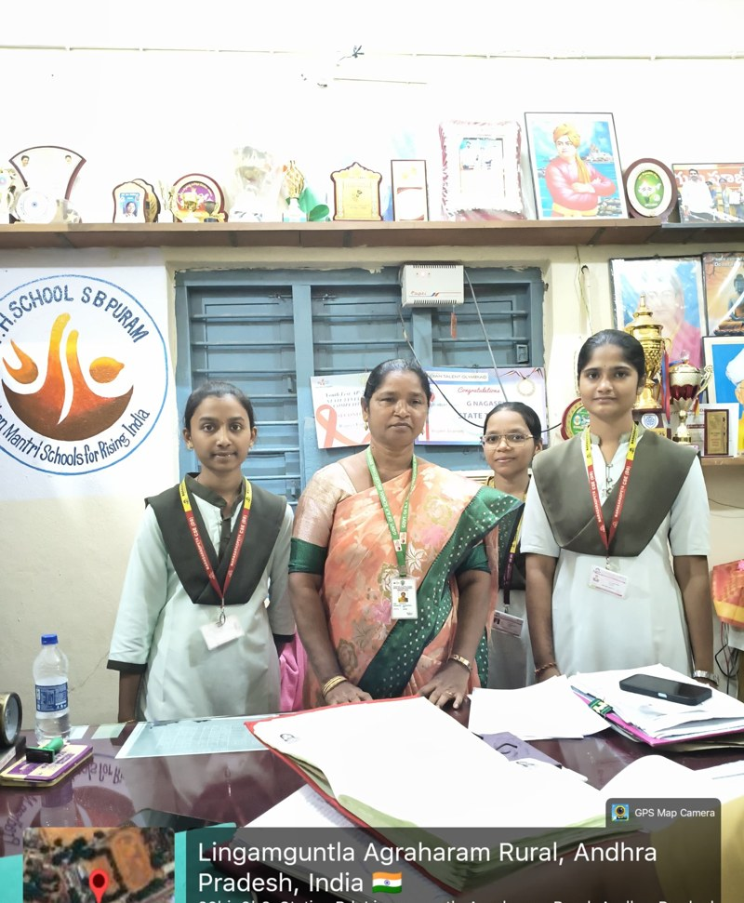
Project Photo Gallery
GALLERY
Educational activity
Student interaction
School group activity
Team at the school
Thank You
Questions & Discussion
Together for a Plastic Free Environment
Notes:
Show the field photographs, thank the panel and invite questions.

