Slide 1


Slide 2
Bankruptcy Prediction
Team Members:
G. Rajesh
N. Shirisha
B. Sathwik Reddy
B. Mahalakshmi
P. Syam Gopal
S. Srinivas Reddy
M. Anitha

Slide 3

Index
You will either learn to manage your money, or the lack of it will manage you.
Dave Ramsey
1.Problem Statement
2.Brief Introduction
3.Exploratory Data Analysis
4.Feature Selection
5.Testing the Models
6. Model Building
7. Model Deployment
8.Challenges

Slide 4

Problem Statement
Predict the bankruptcies of certain companies listed on Taiwan Stock Exchange using data collected from the Taiwan Economic Journal for the years 1999 to 2009.

Slide 5
2. Brief Introduction
Predicting the financial position of companies has become one of the key interests for the creditors, investors and other stockholders alike for investment decisions, risk management, Customer relationships and in case of MNCs, regulatory compliances with respect to the laws and rules of different sovereign nations.
Predictive models can help MNCs, Banks and NBFCs to gauge the performance and stability of a company, to assess creditworthiness and to anticipate potential risks by analysing past data and market trends.

Slide 6
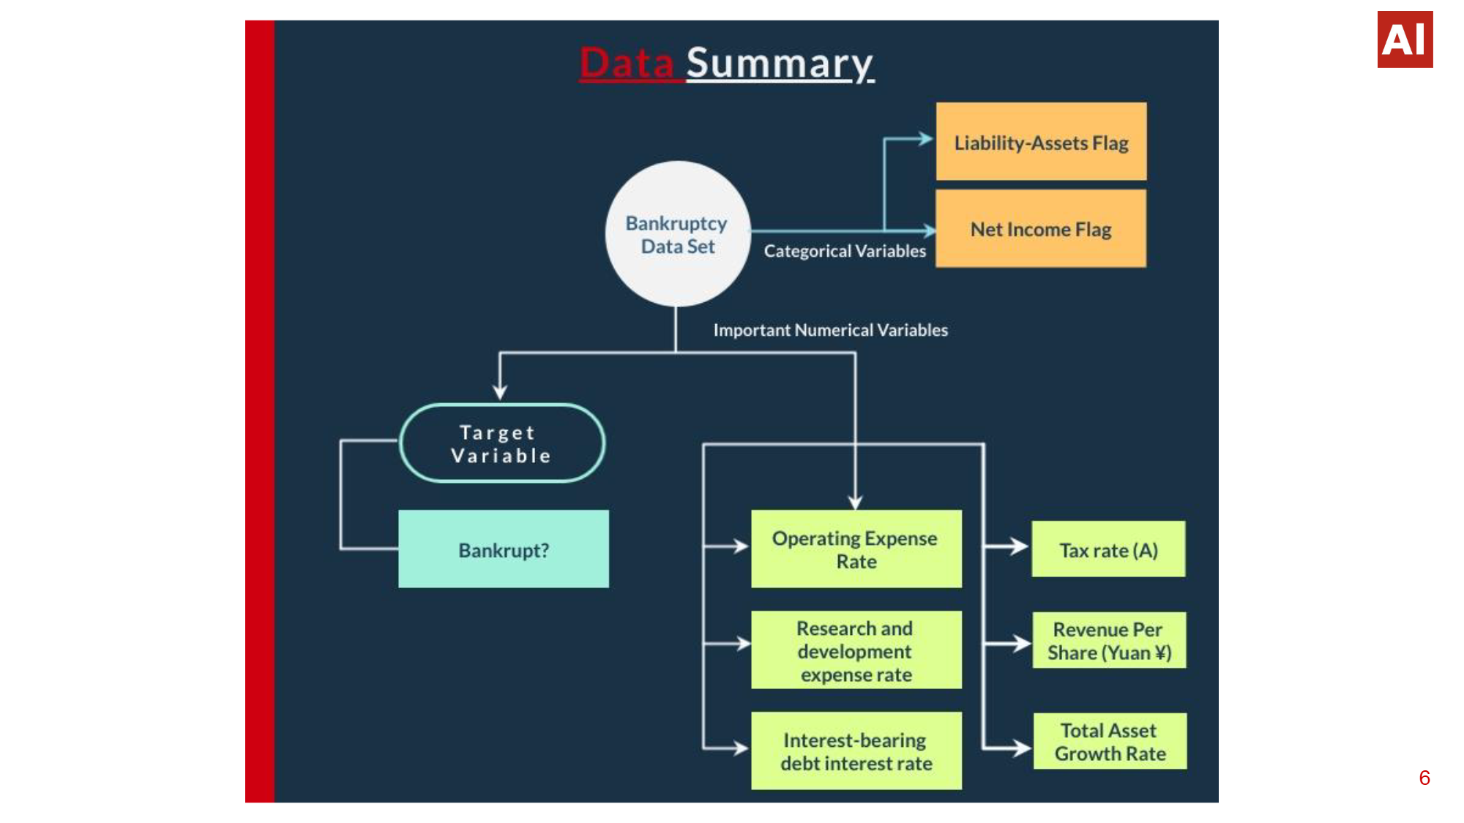
Data Summary

Slide 7
3.Exponential Data Analysis
Renaming Columns: Renaming columns makes the data easier to understand and work with by using descriptive names.
It’s a simple yet powerful step in your data cleaning process.
Dropping Non-Variance: Dropping non-variance columns means removing columns where all values are the same. These columns do not provide useful information for data analysis or modeling.
Removing non-variance columns reduces the dataset size without losing valuable information.

Slide 8
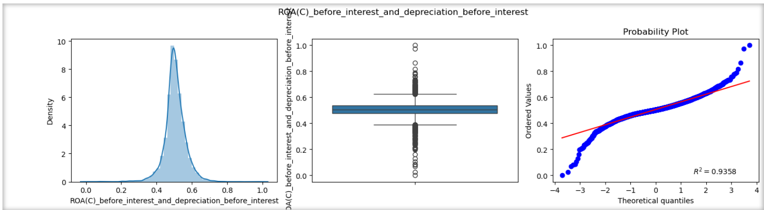
Visualizations of the Bankruptcy Dataset:
Visualizations help in understanding the distribution and relationships within the data.
Subplot Boxplot Probability Plot

Slide 9
Feature Processing in Data Pipelines
Dropping Constant features
Dropping Correlated Features
Dropping Duplicated Features
Remove features with the same value across all samples.
Eliminate features that are highly correlated with each other.
Eliminate features that are highly correlated with each other.
Identify and remove duplicate columns.

Slide 10
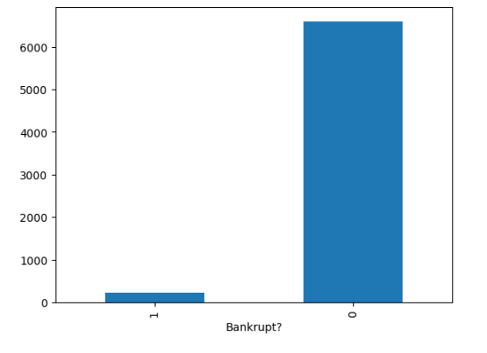
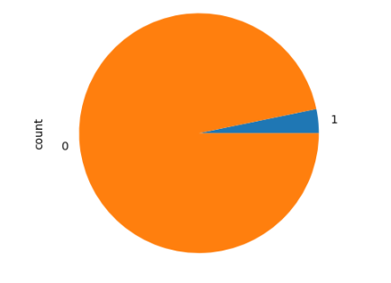
Checking the Imbalance
Bankrupt
0 6599
1 220
Name: count, dtype: int64
● The target variable is highly imbalanced. Less than 3.5% instances for bankrupt companies exist in the data set.

Slide 11
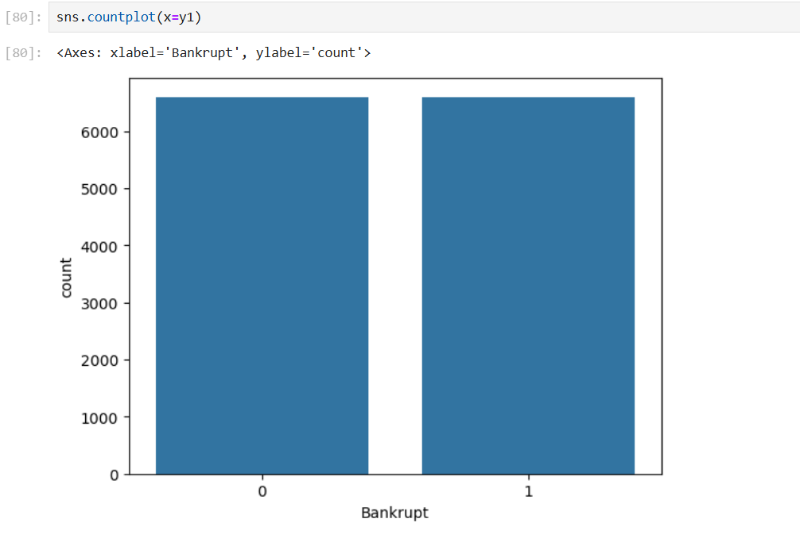

Oversampling Using SMOTE

Slide 12
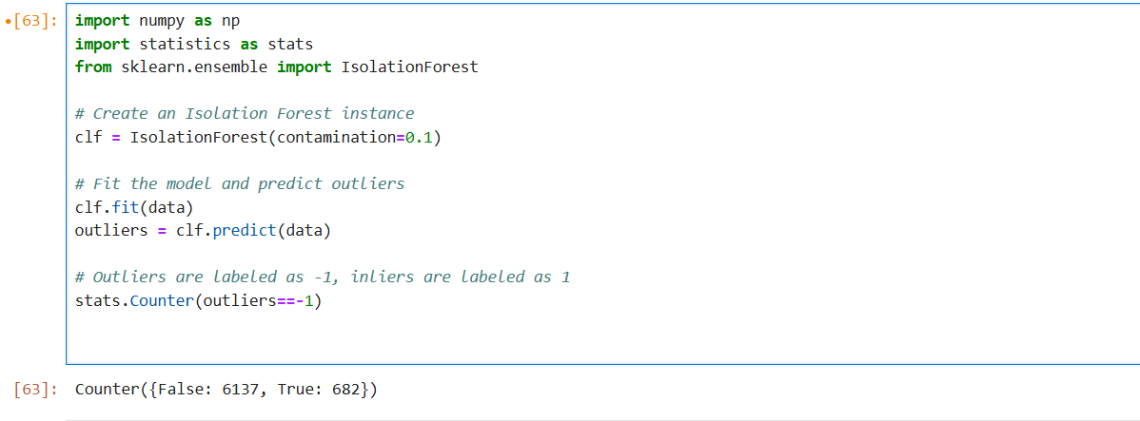
EDA: Using Anomaly Detection Algorithm to further explore the data.
Isolation Forest was used to detect anomalies in the dataset. Since results, were not up to the mark, let us visualize the dataset to investigate the problem.

Slide 13
4.Feature Selection Technique
Introduction to RFE:
Recursive Feature Elimination (RFE) is a feature selection method that recursively removes the least important features and builds the model until the specified number of features is reached.
Why:
RFE is a powerful technique for feature selection that can improve model performance and interpretability by focusing on the most relevant features.
Using RFE, 10columns were selected

Slide 14
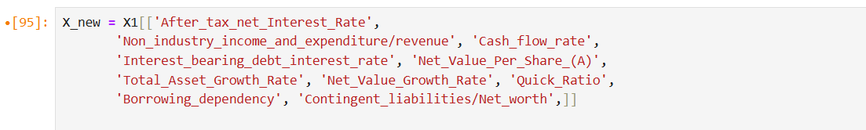

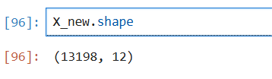
contd…
)
Using RFE Method, 10columns were selected.

Slide 15
5.Model Testing and Evaluation
Training a model in model building is the process of using a set of data to adjust the model's parameters so that it can make accurate predictions on unseen data.
Training a model allows it to learn the relationships between the features and the target variable in the data. Training a model is an iterative process that requires experimentation and tuning.

Slide 16
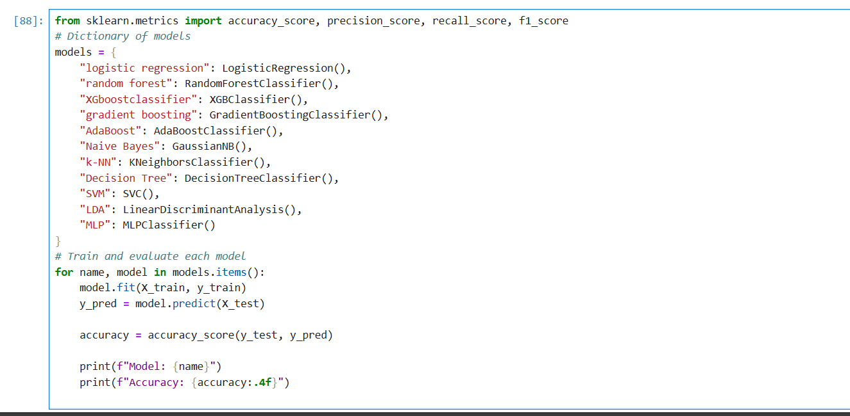
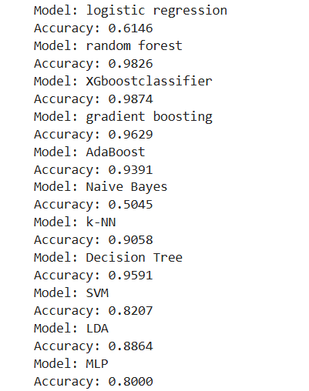

Slide 17
6. Model Building
TRAINING THE MODEL
Training a model in model building is the process of using a set of data to adjust the model's parameters so that it can make accurate predictions on unseen data.
Training a model allows it to learn the relationships between the features and the target variable in the data. Training a model is an iterative process that requires experimentation and tuning.

Slide 18
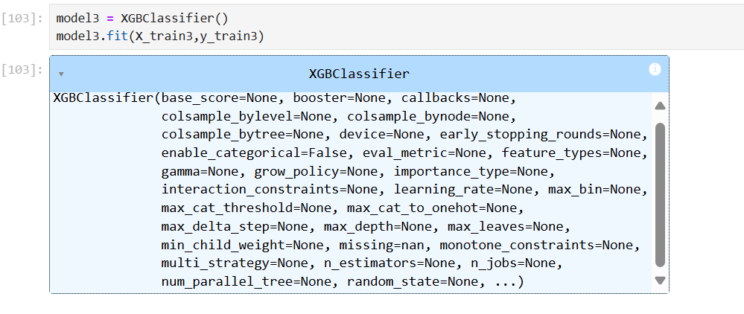
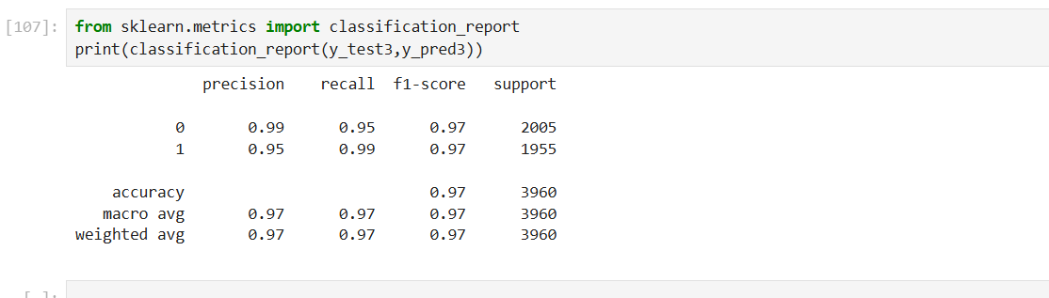
MODEL BUILDING USING XGBoost Classifier Chosen XGboost as it has best accuracy 97%.

Slide 19
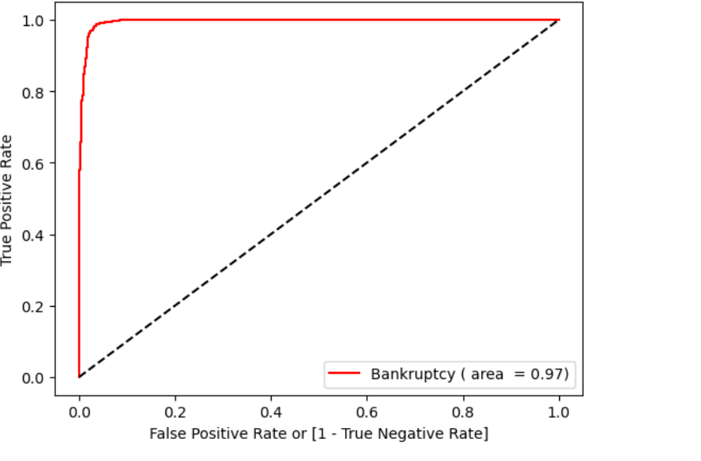
Model Testing…
ROC PLOT
Performance of XGBoost Classifier
Accuracy 97%

Slide 20
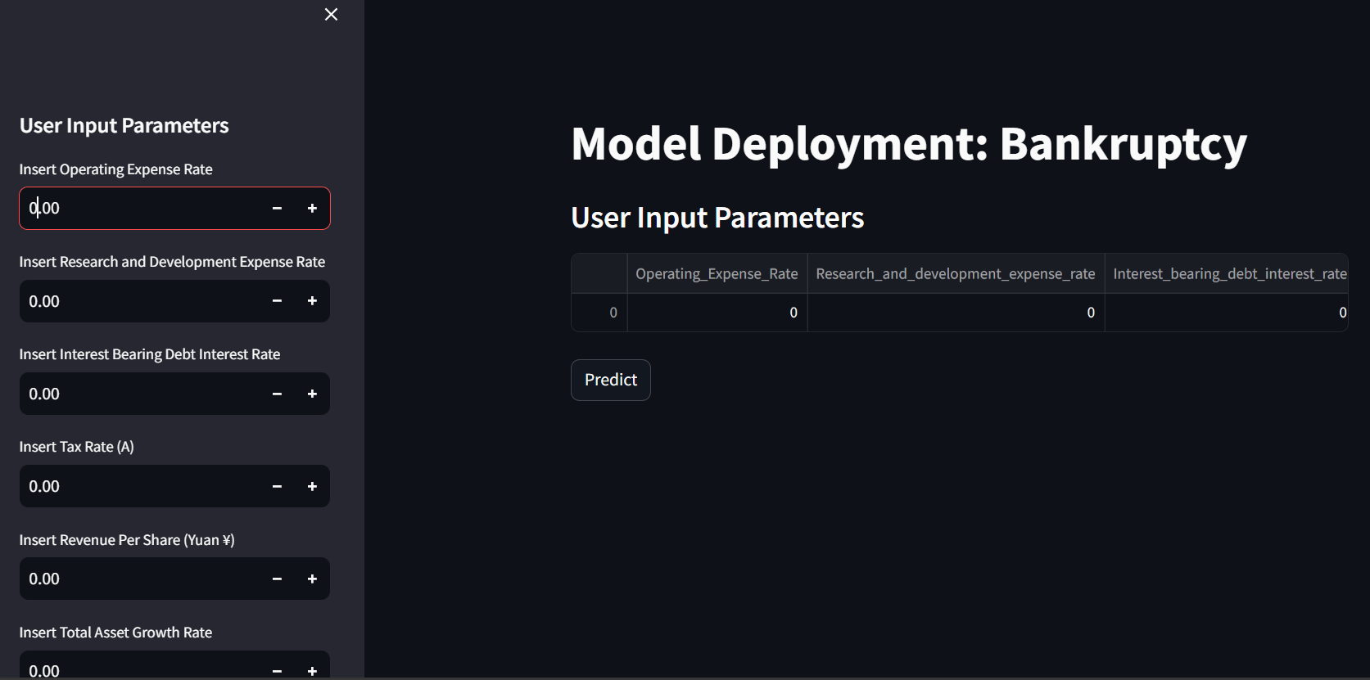
7.Deployment
Deployment is the process of making a software application or machine learning model available for use by users in a real-world environment.

Slide 21
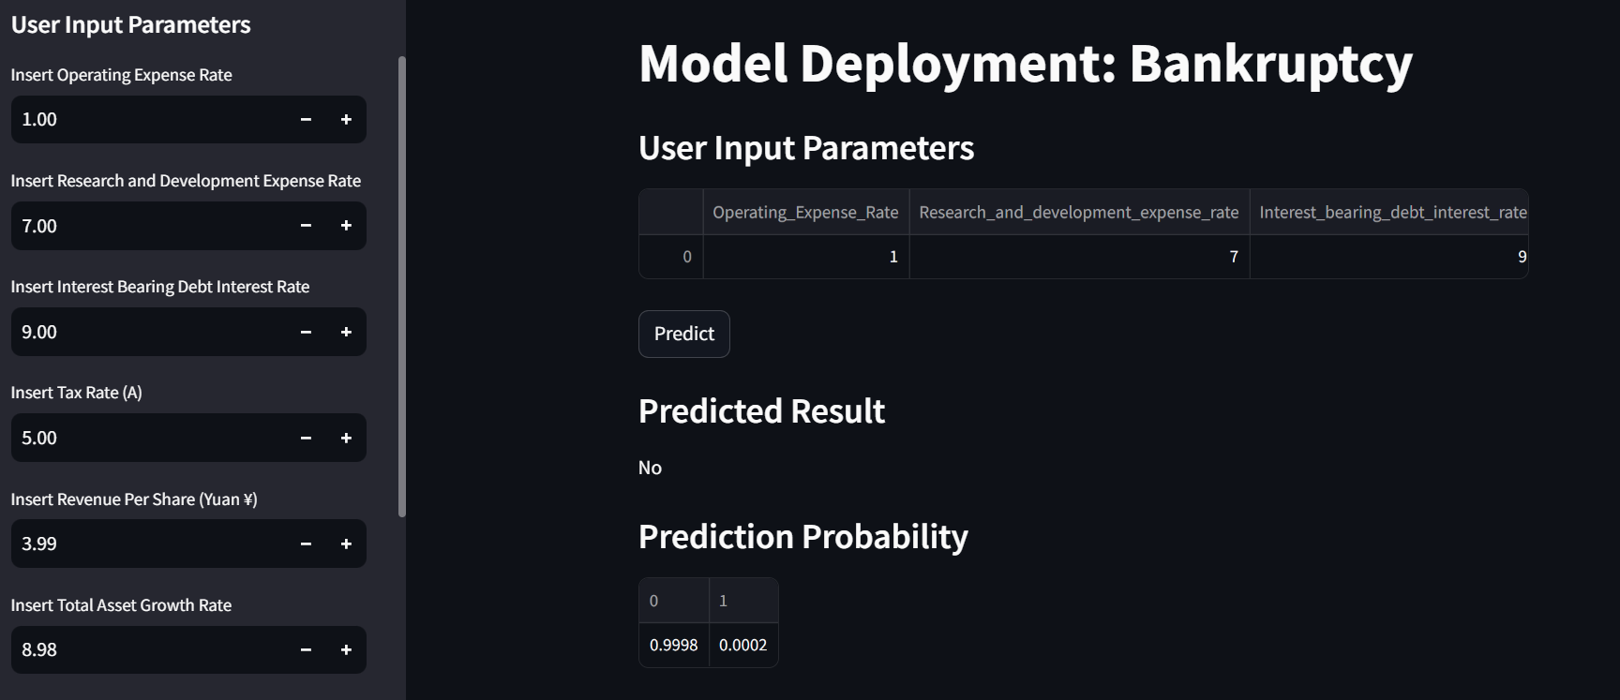

Slide 22
9.Conclusion
Successfully developed a predictive model for bankruptcy using machine learning techniques.
Identified key financial indicators crucial for predicting bankruptcy risk.
Future improvements include refining model accuracy and exploring real-time prediction capabilities.

Slide 23
10.Challenges
Balancing the trade-off between recall and precision was a challenge.
Feature selection and choosing a right technique.
Exploring literature and resources to understand the problem and to find the solution was a little exhaustive.
Deadlines felt a little strained. But it all worked out for the best.

Slide 24



