Slide 1

An Exploratory Data Analysis on the Aspiring
Mind Employment Outcome (AMEO) 2015
study from AMCAT

Slide 2
About me
I am Anitha Raavi, a graduate from Mahindra University in the branch of Computer Science and Engineering(CSE) and a aspiring data analyst. I am versed in the use of Excel, SQL, Python libraries (Pandas, Numpy, Matplotlib, and many others), and Power BI to extract relevant and domain-specific insights from data. Some of my projects include building a machine learning model to identify the fake news and many others.
For this project, this is a concise report capturing my data analysis workflow, insights, and conclusion for the exploratory data analysis of the Aspiring Mind Employment Outcome Study conducted in 2015.
• Have a look at my portfolio below :
Linkedin – www.linkedin.com/in/anitha-raavi
Github - https://github.com/Anitha0123

Slide 3
About AMCAT
AMCAT, known as Aspiring Minds Computer Adaptive Test is an AI-based computer adaptive test which evaluates job applicants on critical areas like communication skills, logical reasoning, quantitative skills, and job-specific domain skills thereby helping recruiters identify the suitability of a candidate for different job roles.

Slide 4
Analysis Workflow
Understanding the data – initial exploratory data analysis
Data cleaning and transformation
Univariate analysis – Visual and non visual analysis
Bivariate analysis
Solutions to hypothesis or questions
Conclusion

Slide 5
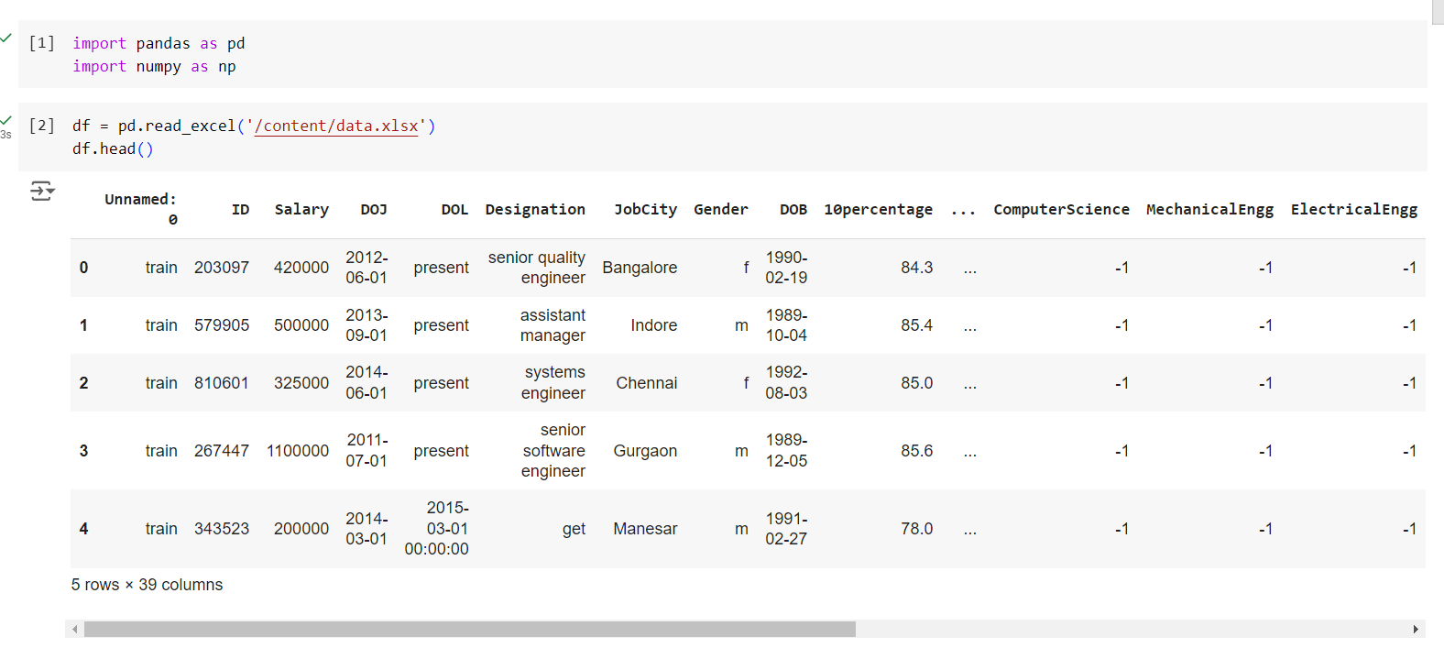
Understanding the Data
This shows a view of the first five elements of the data.
This shows a view of the first five elements of the data.

Slide 6
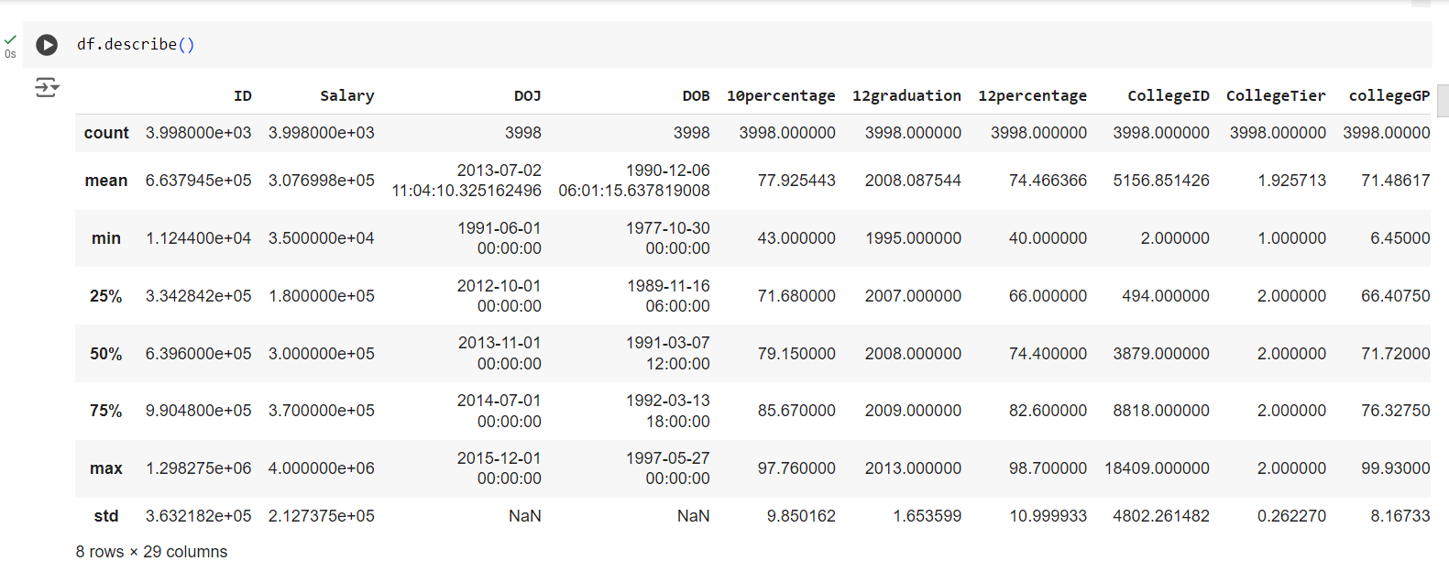
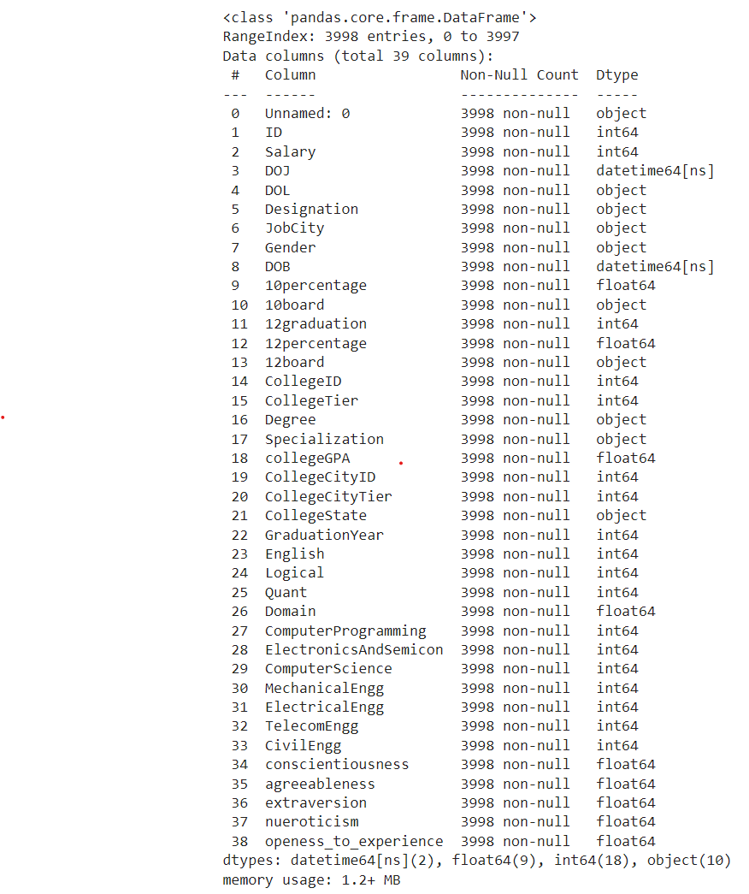
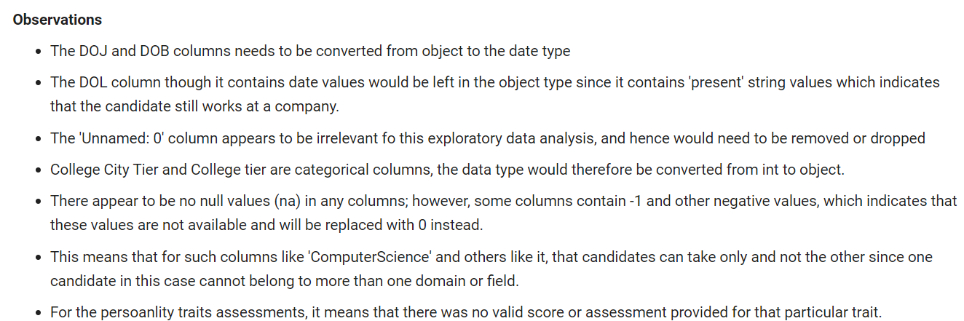
Understanding the data

Slide 7
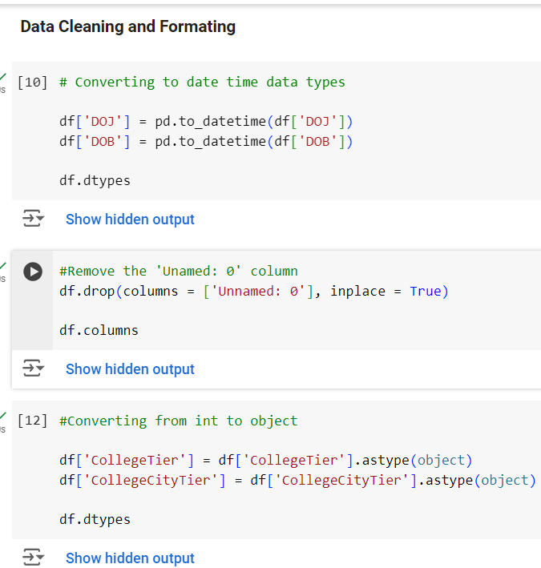
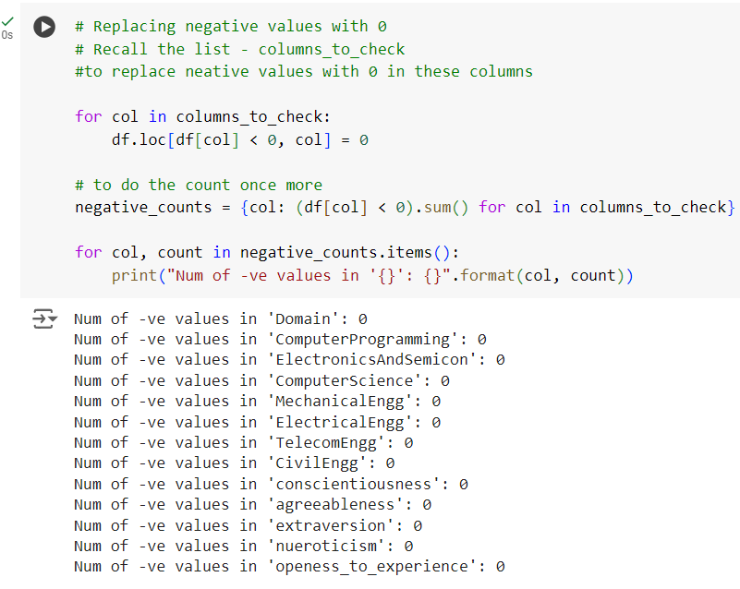
Data Transformation
Data cleaning and transformation steps

Slide 8
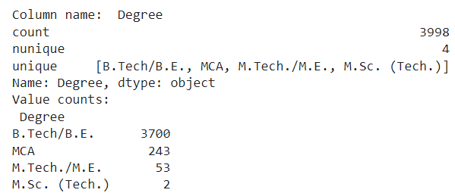
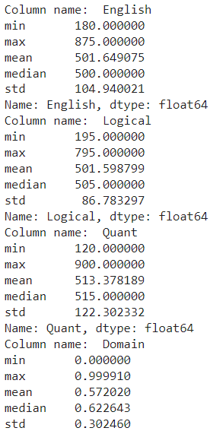
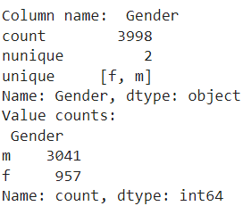
Univariate analysis – Non visual analysis
.
In the study conducted, there were more candidates with a B.Tech/B.E and very few with an M.Sc. Analysis showed that the males were in greater number that year. Also, it shows relevant statistics of the test scores for candidates in the English, Quant and Logical sections.

Slide 9
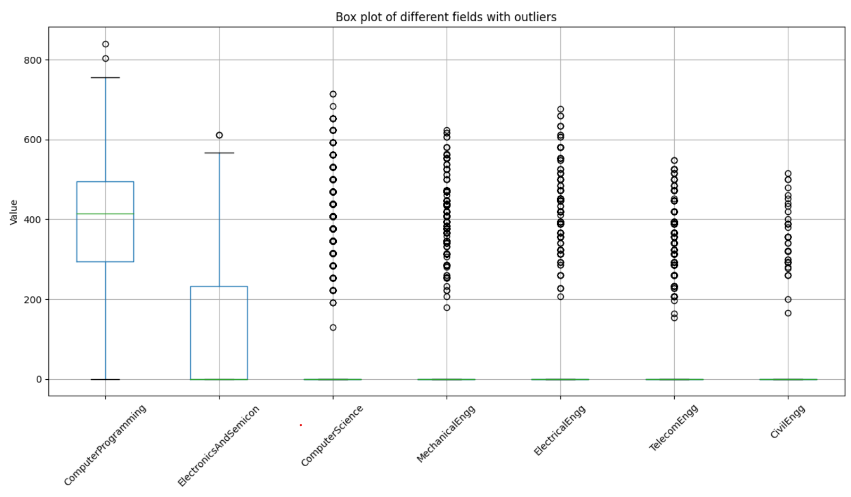
Univariate analysis – Visual analysis
Observations:
Computer programming has the largest spread of scores compared to the others, also boasting of the highest median value.
The fields of Computer Science, Mechanical, Electrical, Telecom and Civil engineering have the least variability and contain considerably large number of outlier cases

Slide 10
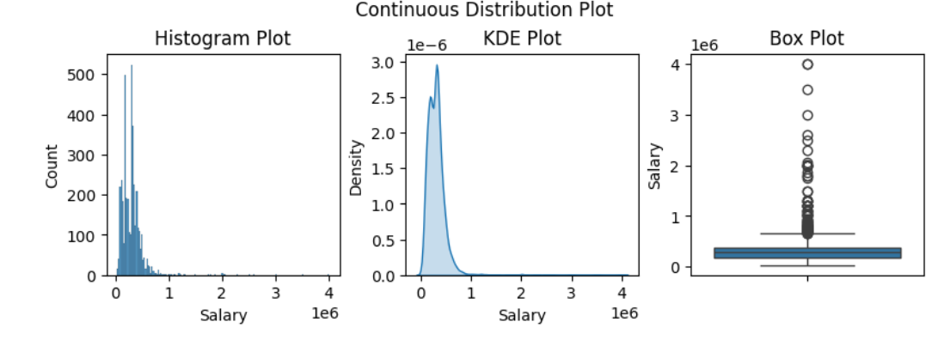
Univariate analysis - Visual
This shows the distribution of salaray amongst the
This shows the distribution of salary amongst the candidates.

Slide 11
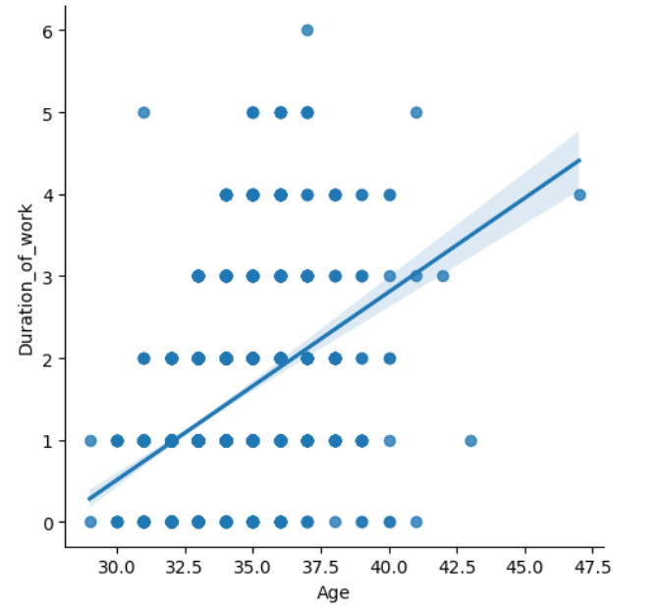
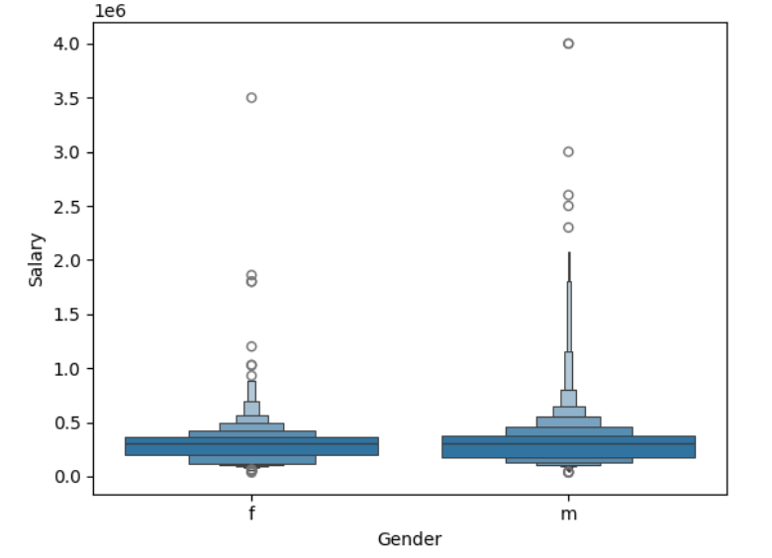
Bivariate Analysis - Visual
Age Vs Experience Gender Vs Salary
From the plots, it is seen that the distribution of salary for males is higher, which also means they earn more. But as we saw in earlier analysis, the number of males to females in this study is unequal. Also, the plot shows a relationship between the age of duration of work for participants.

Slide 12
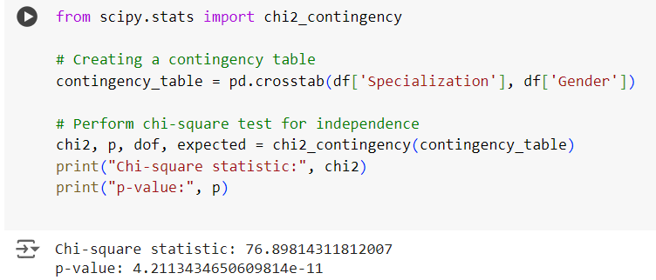
Is there a relationship between gender and specialization?
The analysis reveals a statistically significant association between gender and specialization among the candidates in the dataset. The p-value obtained from the chi-squared test is significantly smaller than the typical significance level of 0.05, providing strong evidence to reject the null hypothesis. This suggests that gender plays a role in the selection of specialization, indicating a potential influence of societal or personal factors on career choices.

Slide 13
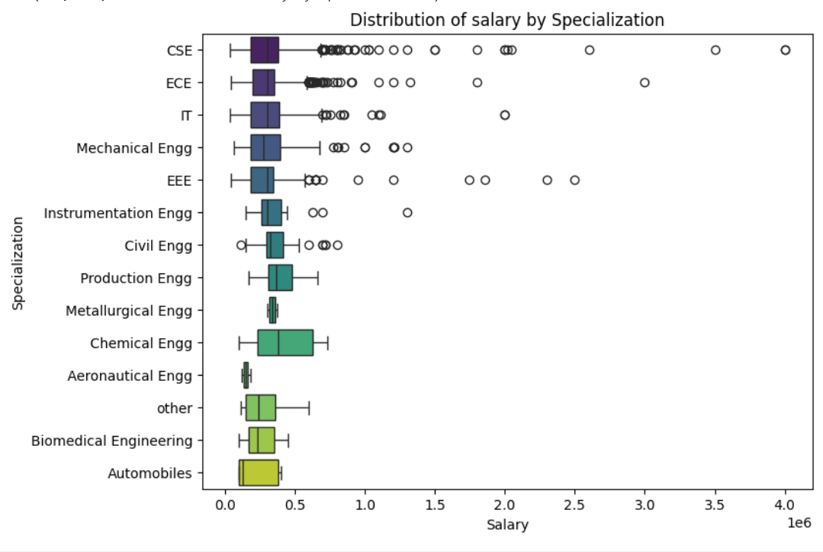
What specialization earns more salary?
Chemical engineering has a wider spread of salary range
Computer Science (CSE) has the most outlier cases - larger salary cases compared to other fields.
Aeronautical engineering and Metallurgical Engineering had the least spread of salary ranges
Production and Chemical Engineers have the highest median salary amongst the different specializations

Slide 14
Conclusions
Following the insights generated from my analysis, I can make the following conclusions:
In the 2015 study, there were more male candidates compared to the female candidates who took part in the tests.
The maximum scores for each AMCAT test section was 900. A perfect score was achieved in the Quant section alone with the highest scores in the English and Logical section being 875 and 795 respectively.
Computer programming has the largest spread of scores compared to the others, also boasting of the highest median value.
From the plots, it is seen that the distribution of salary for males is higher, which also means they earn more. But as we saw in earlier analysis, the number of males to females in this study is unequal. Also, the plot shows a relationship between the age of duration of work for participants.
Production and Chemical Engineers have the highest median salary amongst the different specializations.

Slide 15

THANK YOU

